Slide 1
Testing and Adapting Your Mobile App for Real-World Network Conditions: Flexibly Network Aware Apps
Jennifer Leong
AT&T Developer Program

Slide 2
Flexibly Network Aware Architecture
Why we need it
What it is/How to test
Code implementations
Bandwidth
Latency
Roaming
Summary

Slide 3
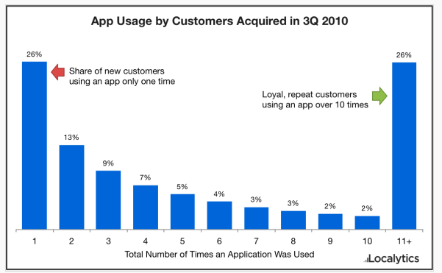
Mobile Apps That Work
http://techcrunch.com/2011/03/15/mobile-app-users-are-both-fickle-and-loyal-study/

Slide 4
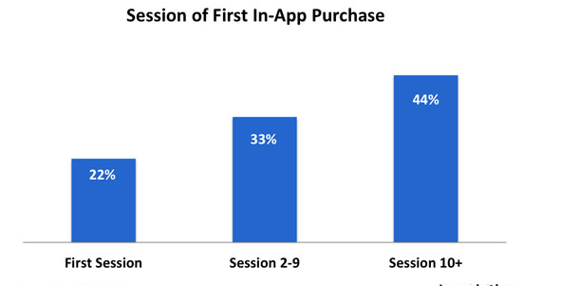
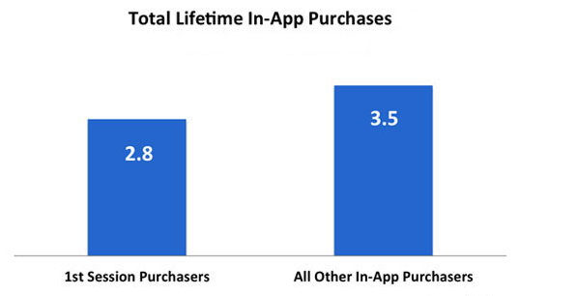
Engaged Customers
More likely to buy!
Buy MORE!
http://www.localytics.com/blog/2012/loyal-users-generate-25-more-in-app-purchases/

Slide 5
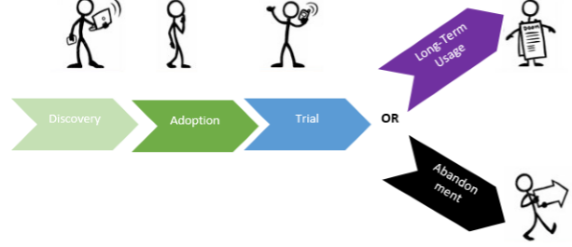
How to Get Customers Engaged?
48% abandon if dissatisfied with the performance of a mobile app
http://www.tatvic.com/blog/churn-analysis-for-mobile-app/
http://offers2.compuware.com/APM_13_WP_Mobile_App_Survey_Report_Registration.html

Slide 6
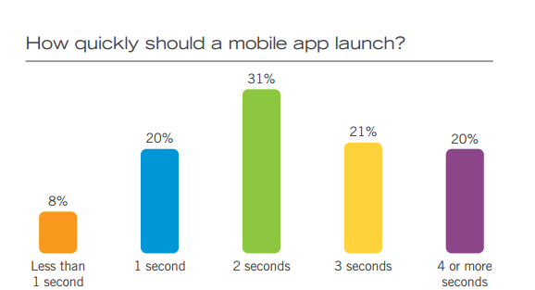
Expectations: Loading
http://offers2.compuware.com/APM_13_WP_Mobile_App_Survey_Report_Registration.html

Slide 7
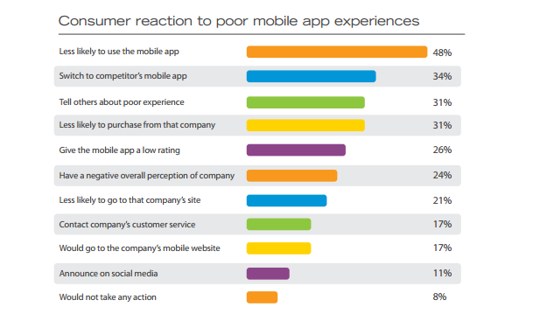
http://offers2.compuware.com/APM_13_WP_Mobile_App_Survey_Report_Registration.html

Slide 8
Performance Matters
500ms in delay:
26% frustration increase
8% decrease in engagement
Amazon.com: 100ms delay– 1% drop in revenue
4% of mobile users admit to throwing their phones out of frustration from slow sites!
http://blog.radware.com/applicationdelivery/applicationaccelerationoptimization/2013/12/mobile-web-stress-the-impact-of-network-speed-on-emotional-engagement-and-brand-perception-report/
http://www.flickr.com/photos/9009139@N08/1263954439
http://www.mobilejoomla.com/mobile-joomla-blog/172-responsive-design-vs-server-side-solutions-infographic.html

Slide 9
Mobile App Performance
Prior to Launch
Test, Test, Test
Android Best Practices
http://developer.android.com/guide/practices/index.html
#1 Improve Quality!
AT&T’s Application Resource Optimizer
Developer.att.com/ARO
Free and Open Source
Post Launch
Analytics
Respond quickly to issues

Slide 10
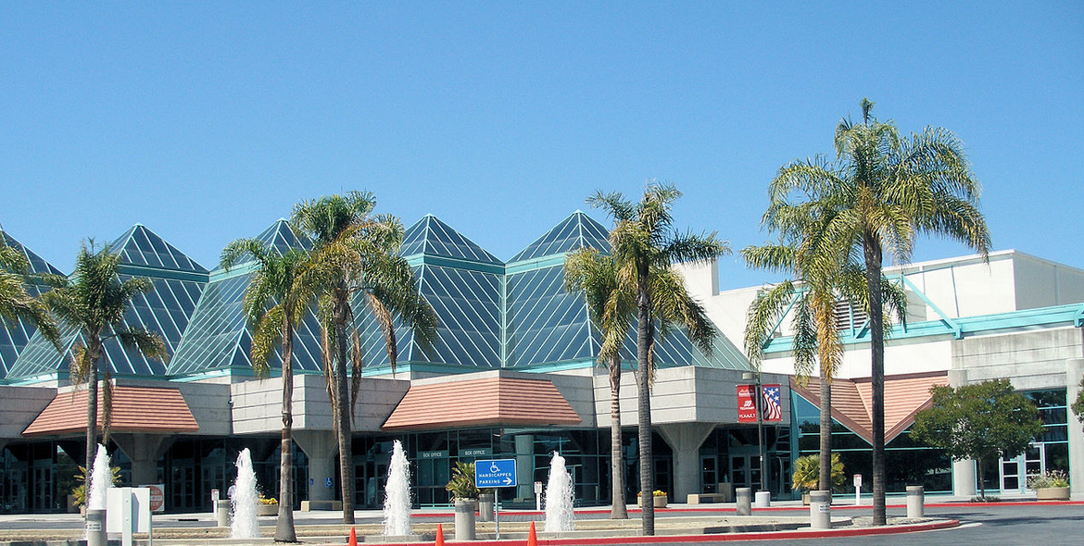
Speed: What You Can’t Control
Location Location Location
http://en.wikipedia.org/wiki/Santa_Clara,_California#mediaviewer/File:Santaclaraconventioncenter.jpg

Slide 11
Network Conditions Vary
2.5G: 3G: 4G:
GPRS EDGE
UMTS HSPA+
LTE
Throughput
100-400 Kbit/S 0.5 – 5Mbit/s 1-50 Mbit/s
Last Mile
Latency:
300-1000ms 100-500 ms <100ms

Slide 12
Network Conditions Vary
Is your app ready to adapt and change based on network conditions?
GPRS EDGE
UMTS HSPA+
LTE
Your App needs to be Flexibly Network Aware
https://www.flickr.com/photos/bladeflyer/2930342826/

Slide 13
International Networks
American developers work in a bubble of the fastest networks & cutting-edge handsets
© 2014 AT&T Intellectual Property. All rights reserved. AT&T and the AT&T logo are trademarks of AT&T Intellectual Property.

Slide 14
Next Billion People Going Online
Few PCs/landline. Mostly mobile.
Slow networks
Old technology
Low bandwidth
High congestion
Small data plans - can get used up quickly
Power issues
Radio hogging = battery drain
HUGE if you can only charge phone 1x a week
© 2014 AT&T Intellectual Property. All rights reserved. AT&T and the AT&T logo are trademarks of AT&T Intellectual Property.
Notes:
Not all slowness problems all the time
Anecdote: ad hoc mobile banking, using minutes as currency

Slide 15
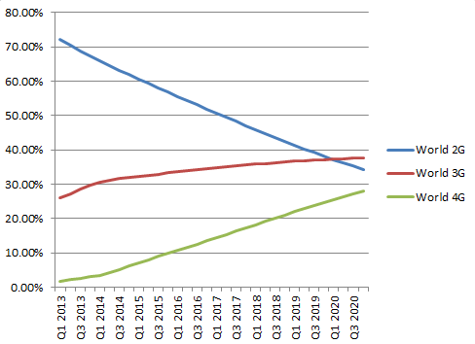
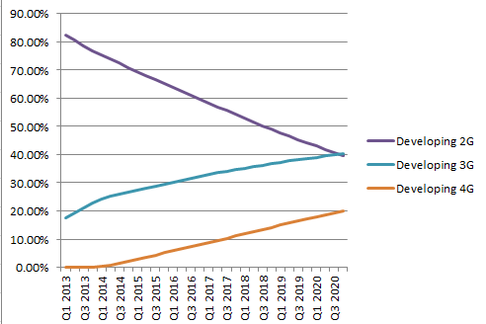
Mobile Throughput: Worldview
2G is dominant, but rapidly decreasing.
3G and 4G still growing
Heavily weighted by the developing world.
GSMAIntelligence 2014

Slide 16
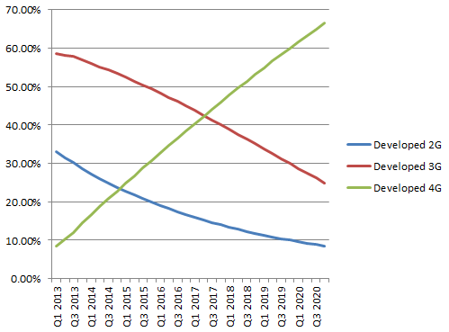
Mobile Throughput: Worldview
In developed world, 2G & 3G are decreasing.
3G dominates, but ~20% of connections are 4G
4G connections to surpass 2G EOY 2014, 3G 2017
~25% of connections are still 2G (>10% through 2019)
GSMAIntelligence 2014

Slide 17
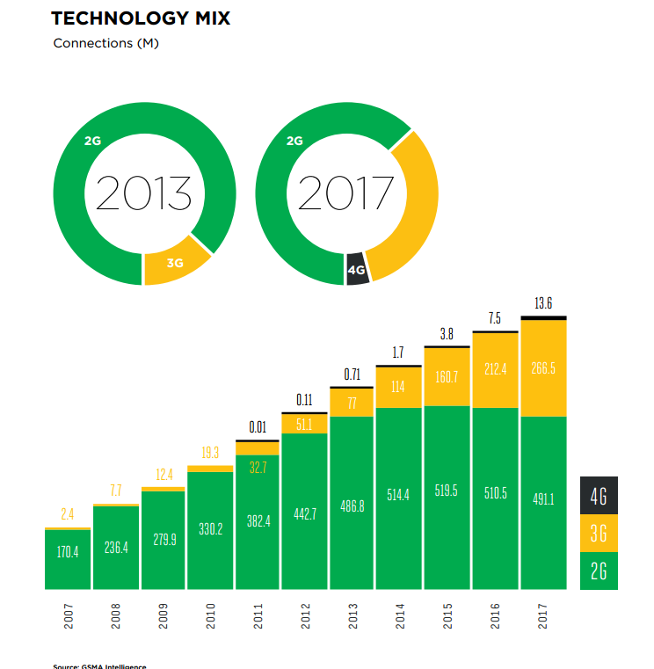
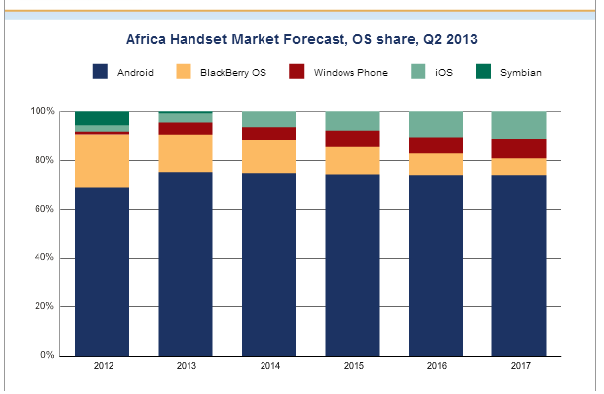
Mobile: Africa
http://itersnews.com/?p=55430
http://www.gsmamobileeconomyafrica.com/
Notes:
Côte d’Ivoire, Egypt, Ghana and Uganda use minutes as currency (http://www.economist.com/news/finance-and-economics/21569744-use-pre-paid-mobile-phone-minutes-currency-airtime-money)

Slide 18
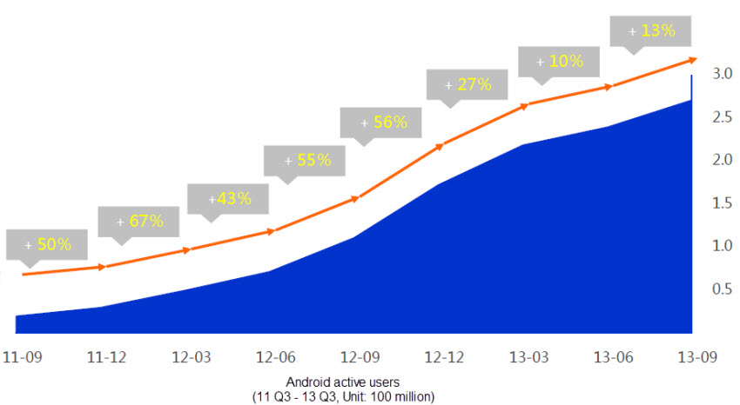
Android Growth in China
Q3 2013: 270M Active Android users in China!
http://www.unwiredview.com/2013/11/27/baidu-says-android-now-has-270-million-daily-active-users-in-china-mobile-internet-statistics-galore/

Slide 19
Network Speeds in China
83M Android users in China rely on 2G networks for data!
270M Active Android users:
44% Wi-Fi (80% of Mobile Internet traffic)
23% use 3G
31% get their data through 2G networks

Slide 20
Android on 2G
E-mail – was slow, but worked
Social Media – Facebook & Twitter problematic, WhatsApp worked well
Google Play: Not accessible - “No connection: Retry” timeouts
Have you tested your application on slow mobile networks?
A Flexibly Network Aware App will run quickly and smoothly, regardless of network condition
http://mobility.ng/using-2g-on-an-android-smartphone/

Slide 21
Should I Bother with 2G Users?
Success in developing world a primary factor

Slide 22
Flexibly Network Aware Architecture
Why we need it
What it is/How to test
Code implementations
Bandwidth
Latency
Roaming
Summary

Slide 23
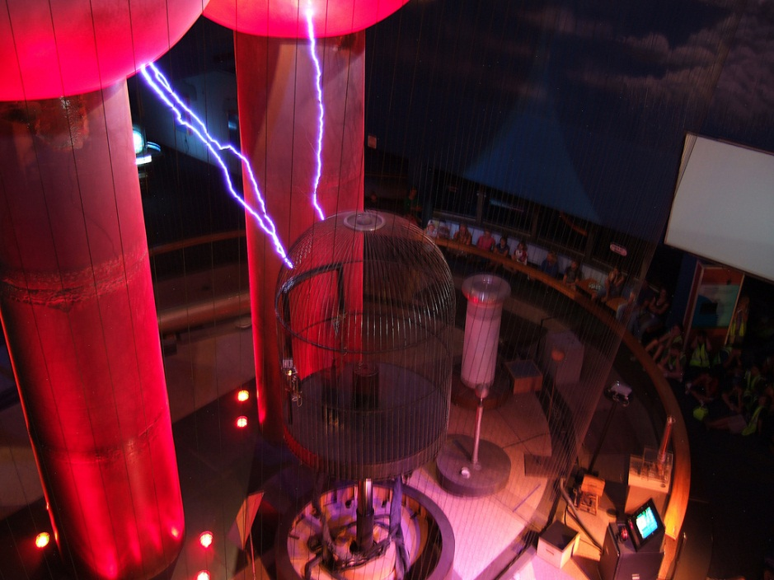
Testing Different Network Conditions
https://flic.kr/p/93r5Jy
https://flic.kr/p/7XeRFK

Slide 24
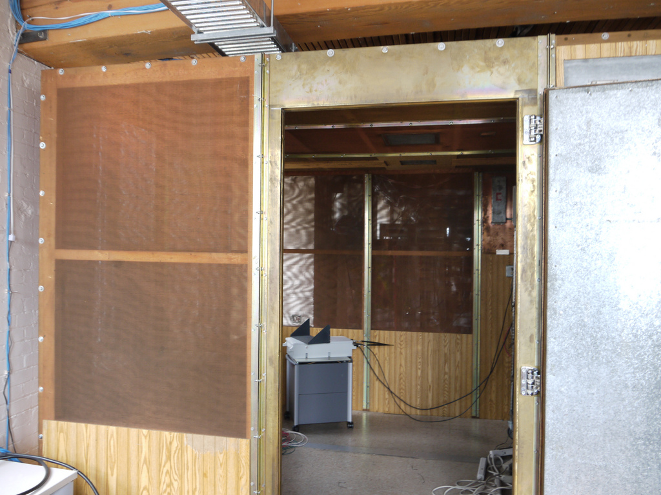
Testing Different Network Conditions
https://flic.kr/p/93r5Jy
https://flic.kr/p/7XeRFK

Slide 25
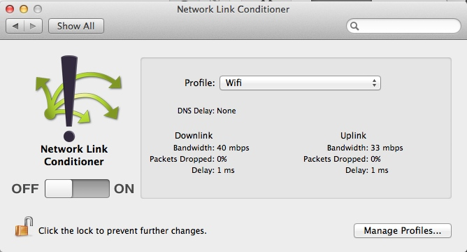
iOS: Network Link Conditioner
developer.apple.com/downloads
Hardware IO Tools for Xcode
Double click on Network Link Conditioner icon to install Preferences pane
© 2014 AT&T Intellectual Property. All rights reserved. AT&T and the AT&T logo are trademarks of AT&T Intellectual Property.

Slide 26
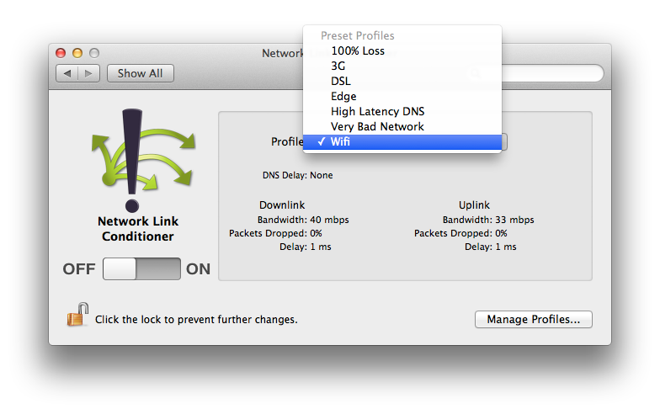
iOS: Network Link Conditioner
© 2014 AT&T Intellectual Property. All rights reserved. AT&T and the AT&T logo are trademarks of AT&T Intellectual Property.

Slide 27
iOS: Speedlimit
Allows limiting by domains
No longer officially supported past Leopard
http://mschrag.github.io (open source)
© 2014 AT&T Intellectual Property. All rights reserved. AT&T and the AT&T logo are trademarks of AT&T Intellectual Property.

Slide 28
iOS: Slowy
Can limit by port
Currently supported
Paid app
http://slowyapp.com
© 2014 AT&T Intellectual Property. All rights reserved. AT&T and the AT&T logo are trademarks of AT&T Intellectual Property.

Slide 29
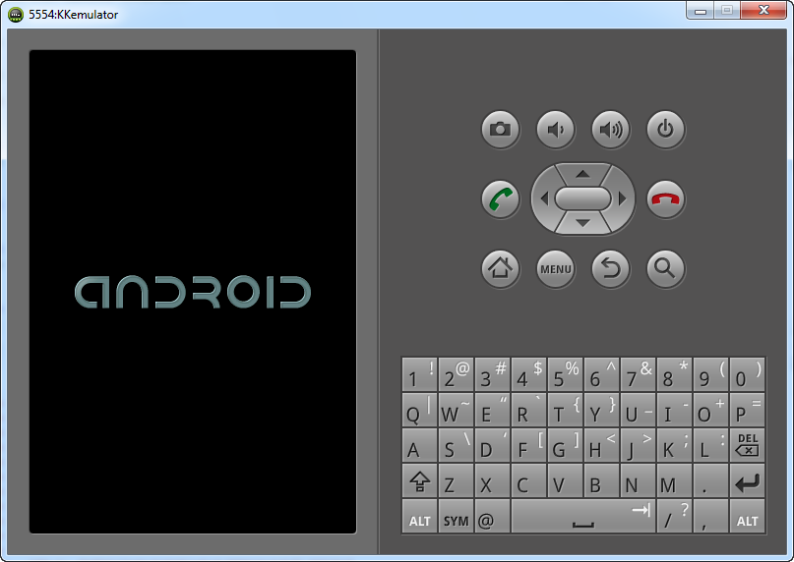
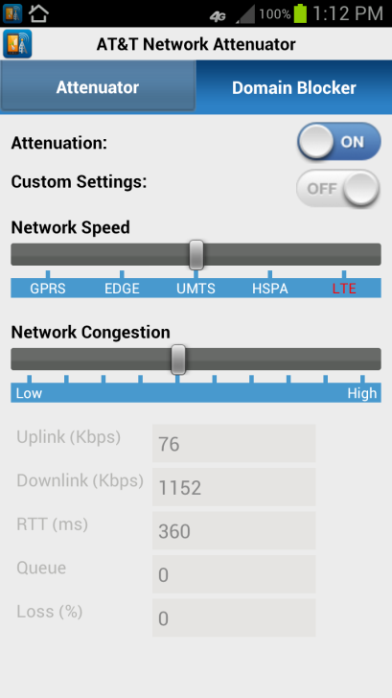
Testing Android
Android Emulator
AT&T Network Attenuator

Slide 30
Android Emulator
Latency and bandwidth changes possible
Value | Speed (up:down, kbps) | Latency (ms)
gprs | 40:118 | 150-550
edge | 80:236 | 80-400
umts | 128:1920 | 35-200
hsdpa | 248:14400
full | (no limit)
none |  | 0
telnet localhost 5554
network speed edge
Network delay edge
You must apply each change independently – each time you want to test.
Changes the Network Indicator in emulator

Slide 31
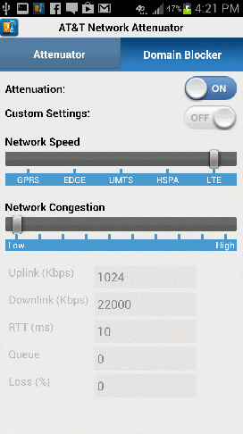
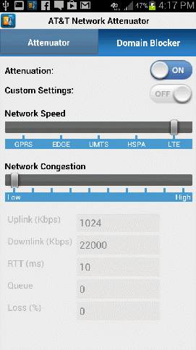
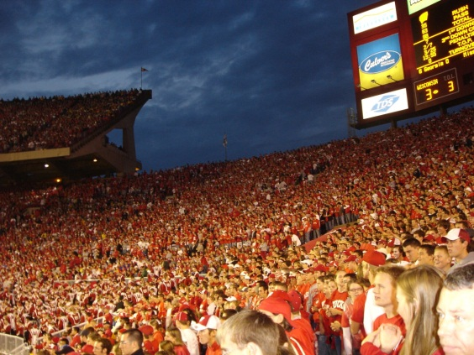
AT&T Network Attenuator
Rooted Samsung S3 with custom kernel & libraries
Similar speeds/latency to emulator
Increasing congestion
Raises latency
Lowers throughput
Free beta!
Developer.att.com/attenuator
OR: @jenleongatt

Slide 32
Support Existing 4G, 3G users, and provide great 2G service
Flexibly Network Aware (FNA)
Development
https://www.flickr.com/photos/helico/404640681

Slide 33
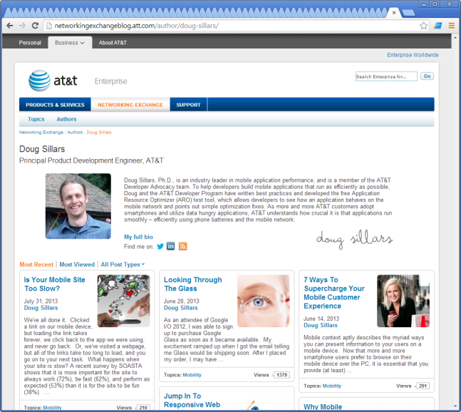
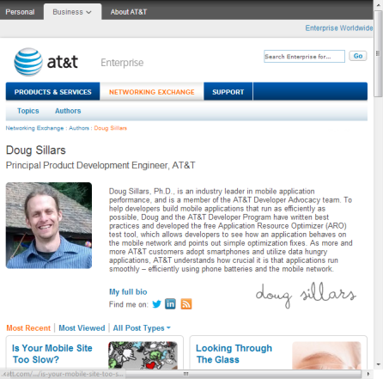
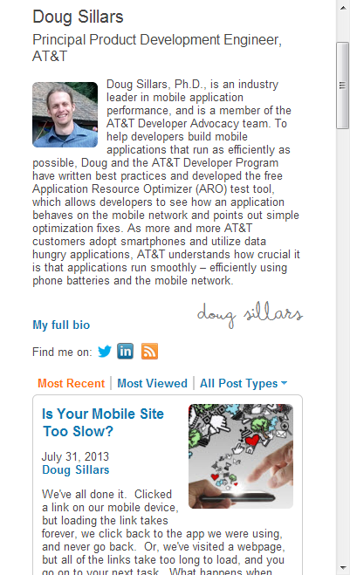
Responsive Web Design
One URL/one codebase
Media Queries allow code to adapt for different screen sizes.
Code tells browser how to build page based on screen width.
UI is improved on all devices
http://alistapart.com/article/responsive-web-design

Slide 34
Flexibly Network Aware App
Application is aware of network conditions and displays/modifies content flexibly
Consider:
Bandwidth
Latency
Roaming
Like RWD, app changes display/request characteristics in a flexible manner

Slide 35
Flexibly Network Aware Architecture
Why we need it
What it is/How to test
Code implementations
Bandwidth
Latency
Roaming
Summary

Slide 36
Bandwidth
Tiers:
Wi-Fi: Fast, reliable, generally unlimited data
3G/4G: (HSPA+, LTE) Generally fast, limited data
3G: UMTS, HSDPA, HSPA: Medium
2-2.5G: GPRS, EDGE: Slow

Slide 37
Network Aware: Bandwidth
TelephonyManager teleMan = (TelephonyManager)getSystemService(Context.TELEPHONY_SERVICE);
int networkType = teleMan.getNetworkType();
switch (networkType)
{case 1: netType = "GPRS"; NetworkSpeed = "slow"; break;
case 2: netType = "EDGE"; NetworkSpeed = "slow";break;
case 3: netType = "UMTS"; NetworkSpeed = "medium";break;
…
case 13: netType = "LTE"; NetworkSpeed = "fast";break;}
Want to test, but don’t want to travel?
add Network Attenuator Library
an = new ARONetworkAttenuator(getApplicationContext());
NetworkConfig nc = an.getNetworkConfig();
int downlinkspeed;
downlinkspeed = nc.getDownlinkSpeed();
https://github.com/dougsillars/FNASampleApps

Slide 38
Network Aware: Bandwidth
switch(NetworkSpeed){
case "fast":
new ImageDownloader().execute(urlbig);
break;
case "medium":
new ImageDownloader().execute(urlmed);
break;
case "slow":
new ImageDownloader().execute(urlsmall);
break;
}
3 Images (all 525x700)
Big: 143 KB
Medium: 41 KB
Small: 27 KB
Jpg quality:
90%
50%
10%
https://github.com/dougsillars/FNASampleApps

Slide 39
Network Aware: Bandwidth
3 Images (all 525x700)
Big: 143 KB
Medium: 41 KB
Small: 27 KB
Jpg quality:
90%
50%
10%

Slide 40
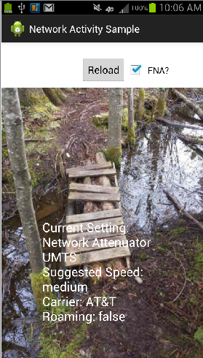
Bandwidth Test Results
Download Image:
Not Network Aware
Flexibly Network Aware
 | LTE (4G) | UMTS (3G) | EDGE (2G)
BIG (143 KB) | 1.938 | 5.243 | 9.405
Medium (41 KB) |  | 2.793
Small (27 KB) |  |  | 3.401
Performance Gain |  | 94% | 177%
500ms in delay:
26% frustration increase
8% decrease in engagement
Code: https://github.com/dougsillars/FNASampleApps

Slide 41
Bandwidth Test Results
 | LTE (4G) | UMTS (3G) | EDGE (2G)
BIG (143 KB) | 1.938 | 5.243 | 9.405
Medium (41 KB) |  | 2.793
Small (27 KB) |  |  | 3.401
Performance Gain |  | 94% | 177%
Changing file size equalizes the UX across network conditions.
Being Flexibly Network Aware significantly improves the end user experience

Slide 42
Bandwidth Test Results
 | LTE (4G) | UMTS (3G) | EDGE (2G)
BIG (143 KB) | 1.938 | 5.243 | 9.405
Medium (41 KB) |  | 2.793
Small (27 KB) |  |  | 3.401
Performance Gain |  | 94% | 177%
Real-time throughput of files:
KB/s (avg) | LTE (4G) | UMTS (3G) | EDGE (2G)
BIG (143 KB) | 73.8 | 27.3 | 15.2
Medium (41 KB) |  | 14.7
Small (27 KB) |  |  | 7.9

Slide 43
Flexibly Network Aware Architecture
Why we need it
What it is/How to test
Code implementations
Bandwidth
Latency
Roaming
Summary

Slide 44
Latency
Round Trip Time (RTT)
Biggest concern is “last mile”
2G: 300ms-1s
3G: 100-500ms
4G: <100ms
Distance to Tower
Congestion
https://www.flickr.com/photos/irisphotos/6668818033/in/photostream/

Slide 45
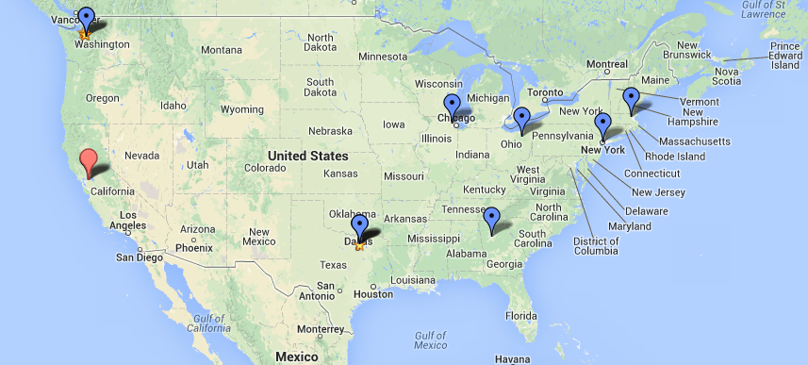
Network Aware: Latency
Get data ‘closer’ to customers
Use a CDN
RTT from Boston to London: 53 ms
Boston to Sydney: 162ms
Get IP lists from carriers to map IP to locations
Request a copy of AT&T’s Public IP Ranges Doc at http://developer.att.com/support

Slide 46
Flexibly Network Aware: Latency
private Bitmap downloadBitmap(String url) {
Long start = System.currentTimeMillis();
final DefaultHttpClient client = new DefaultHttpClient();
final HttpGet getRequest = new HttpGet(url);
try {HttpResponse response = client.execute(getRequest);
//check 200 OK for success
final int statusCode = response.getStatusLine().getStatusCode();
Long gotresponse = System.currentTimeMillis();
…}
final HttpEntity entity = response.getEntity();
if (entity != null) {
InputStream inputStream = null;
try {
inputStream = entity.getContent();
final Bitmap bitmap = BitmapFactory.decodeStream(inputStream);
Long gotimage = System.currentTimeMillis();
responsetime = gotresponse - start;
imagetime = gotimage-start;
return bitmap;
}
responsetime *= 2*RTT
imagetime = time to download file
https://github.com/dougsillars/FNASampleApps

Slide 47
FNA: Latency
 | LTE (4G) | UMTS (3G) | EDGE (2G)
RTT | 159 | 475 | 744
Measured from code. Includes Network and server latency
Lots of flux in RTT measurements. Use a running average.

Slide 48
Latency: Low Congestion
https://flic.kr/p/aaYkDt

Slide 49
Latency: High Congestion
https://flic.kr/p/9w8eWL

Slide 50
FNA: Latency Measurements
 | LTE | EDGE
Uplink | 1024 | 118
Downlink | 22000 | 236
RTT | 10 | 150
Image (KB) | 143 | 27
(ms) | LTE | EDGE
RTT | 81 | 596
Download | 526 | 2613
Place Network Attenuator Network Congestion at 50%.
 | LTE | EDGE
Uplink | 512 | 59
Downlink | 11000 | 118
RTT | 36 | 540
Image (KB) | 143 | 27
(ms) | LTE | EDGE
RTT | 252 | 1697
Download | 2036 | 15194
(ms) | LTE | EDGE
RTT | 311% | 285%
Download | 387% | 581%
Measured from code. Includes Network and server latency
Lots of flux in RTT measurements. Average several before making rash changes.

Slide 51
Latency Sample App
Scroll
if (ImagesBelowtheFold<2){
<get next batch of images>
}

Slide 52
Latency
Normal Latency High Latency
Start prefetching data earlier to eliminate perceived lag time
If (latency = normal){
if (ImagesBelowtheFold<2){
<get next batch of images>
}
}
Else {
//latency is high
if (ImagesBelowtheFold<4){
<get next batch of images>
//consider getting more images too
//also, smaller images?
}
if (ImagesBelowtheFold<2){
<get next batch of images>
}

Slide 53
Latency: High Congestion
https://flic.kr/p/9w8eWL

Slide 54
Flexibly Network Aware Architecture
Why we need it
What it is/How to test
Code implementations
Bandwidth
Latency
Roaming
Summary

Slide 55
Flexibly Network Aware: Roaming
TelephonyManager teleMan = (TelephonyManager)getSystemService(Context.TELEPHONY_SERVICE);
String operatorname =teleMan.getNetworkOperatorName();
boolean roaming = teleMan.isNetworkRoaming();
If customer is roaming:
Offer lighter site. (Compare to “slow” network.)

Slide 56
Flexibly Network Aware Architecture
Why we need it
What it is/How to test
Code implementations
Bandwidth
Latency
Roaming
Summary

Slide 57
Flexibly Network Aware
Mobile apps that respond to Network Conditions:
Bandwidth
Latency
Roaming
Optimize mobile performance automatically
Provide excellent UX no matter the network conditions
Increase the engagement of your customers

Slide 58
Thank You
AT&T Network Attenuator
Free tool with signed SDK agreement
Test various Network Conditions
AT&T ARO
Free Open Source
Test Network Performance
Jennifer.Leong@att.com @jenleongatt

