Slide 2
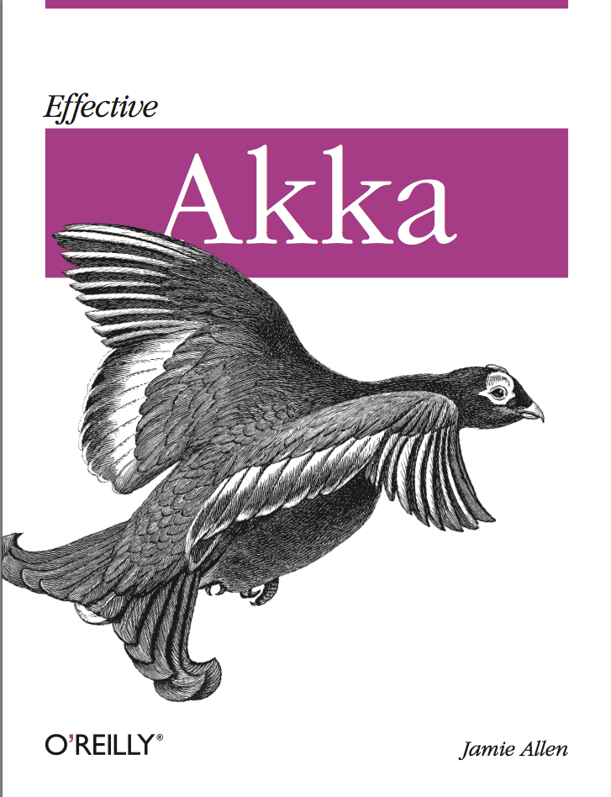
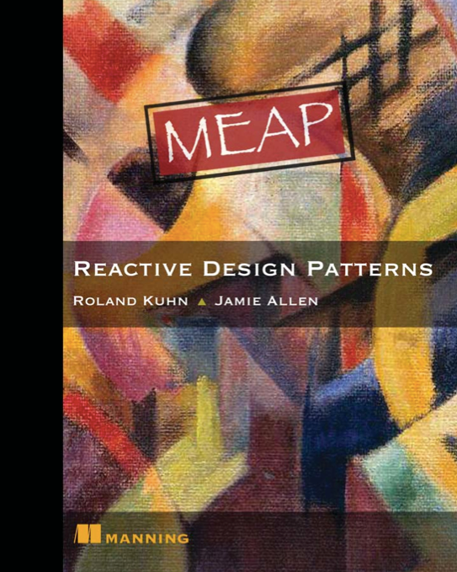
@jamie_allen

Slide 3
This is an era of profound change.

Slide 4
Implications are massive, change is unavoidable
Users
Applications
Businesses
Users are demanding richer and more personalized experiences.
Yet, at the same time, expecting blazing fast load time.
Mobile and HTML5; Data and compute clouds; scaling on demand.
Modern application technologies are fueling the always-on, real-time user expectation.
Businesses are being pushed to react to these changing user expectations…
...and embrace
modern application requirements.
Notes:
New York Times article, for impatient end users, the blink of an eye is just too long.
http://www.nytimes.com/2012/03/01/technology/impatient-web-users-flee-slow-loading-sites.html?pagewanted=all&_r=2&

Slide 5
As a matter of necessity, businesses are going Reactive.

Slide 6
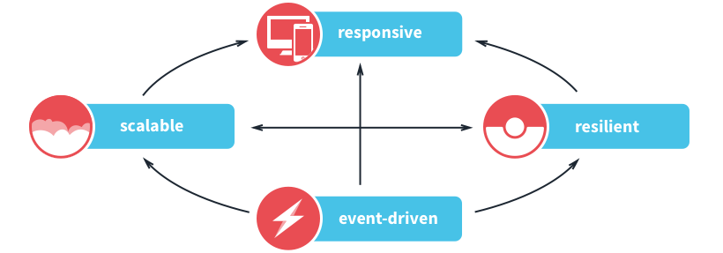
Reactive applications share four traits
Notes:
These new requirements are fueling a new class of Reactive software application that is:
Event-Driven—processing messages in parallel, asynchronously, without blocking.
Scalable—on-demand, across cores, nodes, and clusters; scaling predictably and elastically.
Resilient—recovering and repairing itself automatically for seamless business continuity.
Responsive—rich and engaging, providing instant feedback based on user interactions.
if you look across all the big ecosystem of applications that try to solve this, there's really no platform that implements all of the four traits like Typesae. Most of them have problems with the resilience part. They can't possibly be fully resilient without the developer having to bend over backwards to get it there.
But let’s dive into each trait and take a closer took.

Slide 7
Reactive applications react to changes in the world around them.

Slide 8

Event-Driven
Loosely coupled architecture, easier to extend, maintain, evolve
  Asynchronous and non-blocking
  Concurrent by design, immutable state
  Lower latency and higher throughput
“Clearly, the goal is to do these operations concurrently and
non-blocking, so that entire blocks of seats or sections are not locked.
We’re able to find and allocate seats under load in less than 20ms
without trying very hard to achieve it.”
  Andrew Headrick, Platform Architect, Ticketfly
Notes:
Loosely coupled architecture, easier to extend; maintain; evolve
Under heavy load it leads to lower latency and higher throughput
More efficient resource utilization and management
Asynchronous sending of events and non-blocking execution of events (benefit statement goes here)
Concurrent by design
Immutable state
Fully reactive: Push instead of Pull plus on-demand execution
Less non-determinism

Slide 9
Reactive applications scale up and down to meet demand.

Slide 10

Scalable
Scalability and elasticity to embrace the Cloud
  Leverage all cores via asynchronous programming
  Clustered servers support joining and leaving of nodes
  More cost-efficient utilization of hardware
“Our traffic can increase by as much as 100x for 15 minutes each day.
Until a couple of years ago, noon was a stressful time.
Nowadays, it’s usually a non-event.”
Eric Bowman, VP Architecture, Gilt Groupe
Notes:
Event-driven is the foundation for Scalability
Elasticity – embrace the Cloud
Scale Up or Down dynamically
Topology and scalability is a deployment or runtime decision
More cost-efficient hardware utilization
Less risk; Too little hardware to meet you needs; Too much hardware idling for no good reason
Scale with predictability
Technical Overview
Its loose coupling and level of indirection makes location transparency possible
Not transparent distributed computing – which does not work – but the contrary:
Make the network explicit in the prog model
The network is unreliable
Fully embrace the network

Slide 11
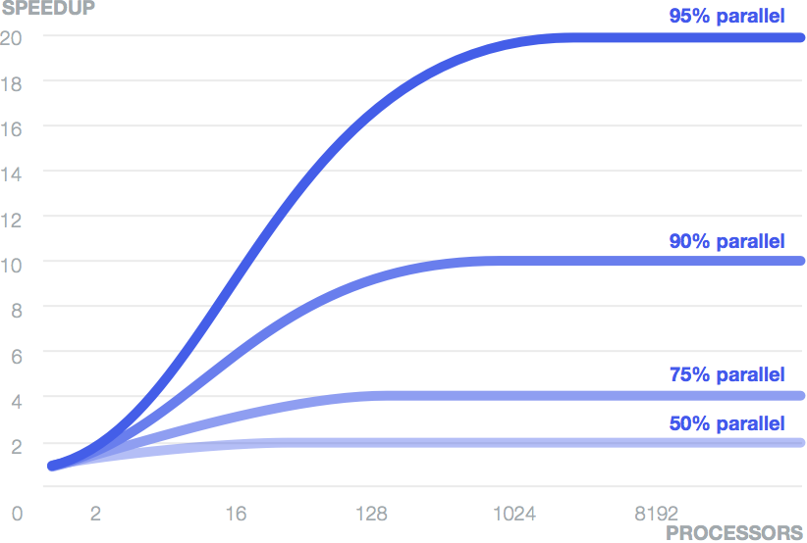
Amdahl's Law

Slide 12
Reactive applications are architected to handle failure at all levels.

Slide 13
Resilient
Failure is embraced as a natural state in the app lifecycle
  Resilience is a first-class construct
  Failure is detected, isolated, and managed
  Applications self heal
“The Typesafe Reactive Platform helps us maintain a very
aggressive development and deployment cycle, all in a fail-forward manner.
It’s now the default choice for developing all new services.”
Peter Hausel, VP Engineering, Gawker Media
Notes:
Resilience is to a large extent ignored by the industry
If not completely ignored then bolted on afterwards
In a Reactive Application resilience is not an afterthought
But part of the design, and a first class construct in the programming model
Failure will happen – even if you like it or not
See it as a natural state in the applications lifecycle
and not only react to it but manage it
Delivers an application that that can self-heal
and Avoid cascading failures

Slide 14
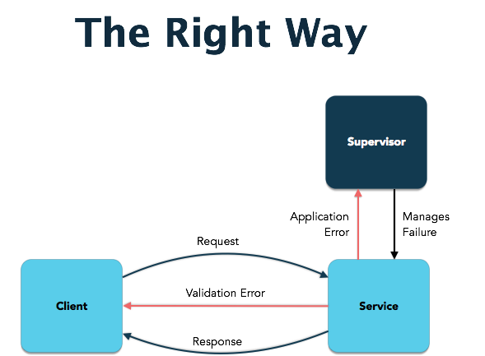

Slide 15
Reactive applications enrich the user experience with low latency response.

Slide 16
Responsive
Real-time, engaging, rich and collaborative
  Create an open and ongoing dialog with users
  More efficient workflow; inspires a feeling of connectedness
  Fully Reactive enabling push instead of pull
“The move to these technologies is already paying off.
Response times are down for processor intensive code–such as image
and PDF generation–by around 75%.”
Brian Pugh, VP of Engineering, Lucid Software
Notes:
Real-time, engaging, rich and collaborative
Businesses can create an open and ongoing dialog with customers by welcoming them through responsive experiences
Makes for more efficient workflow and inspires a feeling of connectedness that equips them to solve problems and accomplish tasks.
Technical Overview
Push instead of Pull; WebSockets, Server-Sent Events
Streaming; Rx/FRP, Iteratees
Reactive JavaScript libraries; Knockout.js, Reactive.js, Meteor

Slide 17
Reference Architecture
Web Tier
Work Tier
Play Server
Akka
Worker
Akka Worker
Play Server
Akka
Master Router
Akka Worker
Play Server
Akka
Router Standby
Akka Worker
Play Server
Akka Worker
(Distributed Workers in Akka with Java/Scala Activator template)

Slide 18

Cost of Not Being Reactive
Cost to your wallet and the environment
No ability to recover from failure
No ability to be responsive to our users

Slide 19
Functional Programming is Key
We want to be asynchronous and non-blocking
We need to ensure that our data is protected without locks
Functional programming is critical to meeting these needs
  Declarative
  Immutable
  Referentially transparent
  Pure functions that only have inputs and outputs

Slide 20

Tools of the Trade

Slide 21
Tools of the Trade: Event Loops
Leverage green threads to provide asynchronous semantics
The core concept of Node.js and Vert.x
Powerful abstraction for performance and potentially scalability
Limited with respect to resilience

Slide 22

Node.js Example

Slide 23
Tools of the Trade: CSP
Communicating Sequential Processes
Decouples the sender and receiver by leveraging a "channel"
The underlying principle behind Go's Goroutines and Clojure's core.async
Theoretically able to statically verify a deadlock will occur at compilation time, though no popular implementation does currently does this
No inherent ability to send messages in a distributed environment
No supervision for fault tolerance

Slide 24
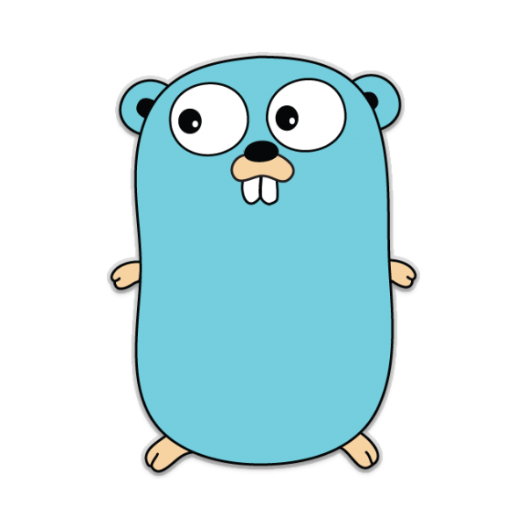
Go Example

Slide 25
Futures
Allow you to define behavior that will be executed on another thread at some time
Responses can be handled with callbacks or higher-order functions (map, flatMap), and can be composed
Not supervised, but do allow explicit fault tolerance via failure callback definition

Slide 26
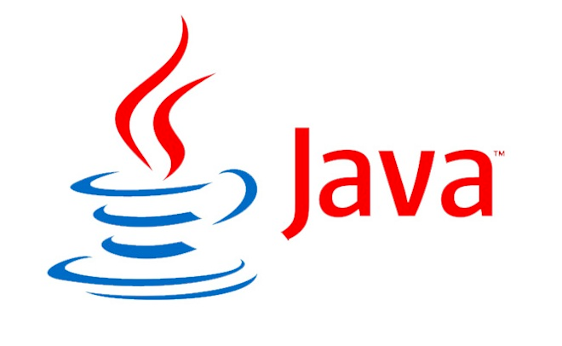
Java8 CompletableFuture Example

Slide 27
Tools of the Trade: CPS and Dataflow
Take asynchronous operations and compose them into steps of execution, like a pipeline
Application logic looks synchronous and clean, compiled into code that executes asynchronously
Maintains order of execution
Do not scale across machines
Can be supervised (Akka Dataflow), but failure handling can depend on tool you choose

Slide 28
Tools of the Trade: Reactive Extensions (RX)
Combine the Iterator and Observer patterns into the Observable
Excellent mechanism for handling streams of data
Fault tolerance depends on implementation
Reactive Streams (http://www.reactive-streams.org/) introduced the requirement for handling backpressure in overwhelmed systems, as well as a test kit to prove compliance.

Slide 29

RxJava Example

Slide 30
Tools of the Trade: Actors
Individual entities that can only communicate by passing messages
Excellent for isolating mutable state and protecting it without locks
Location transparency
Supervision
Well-suited for creating state machines
Several implementations, most popular are Erlang and Akka

Slide 31
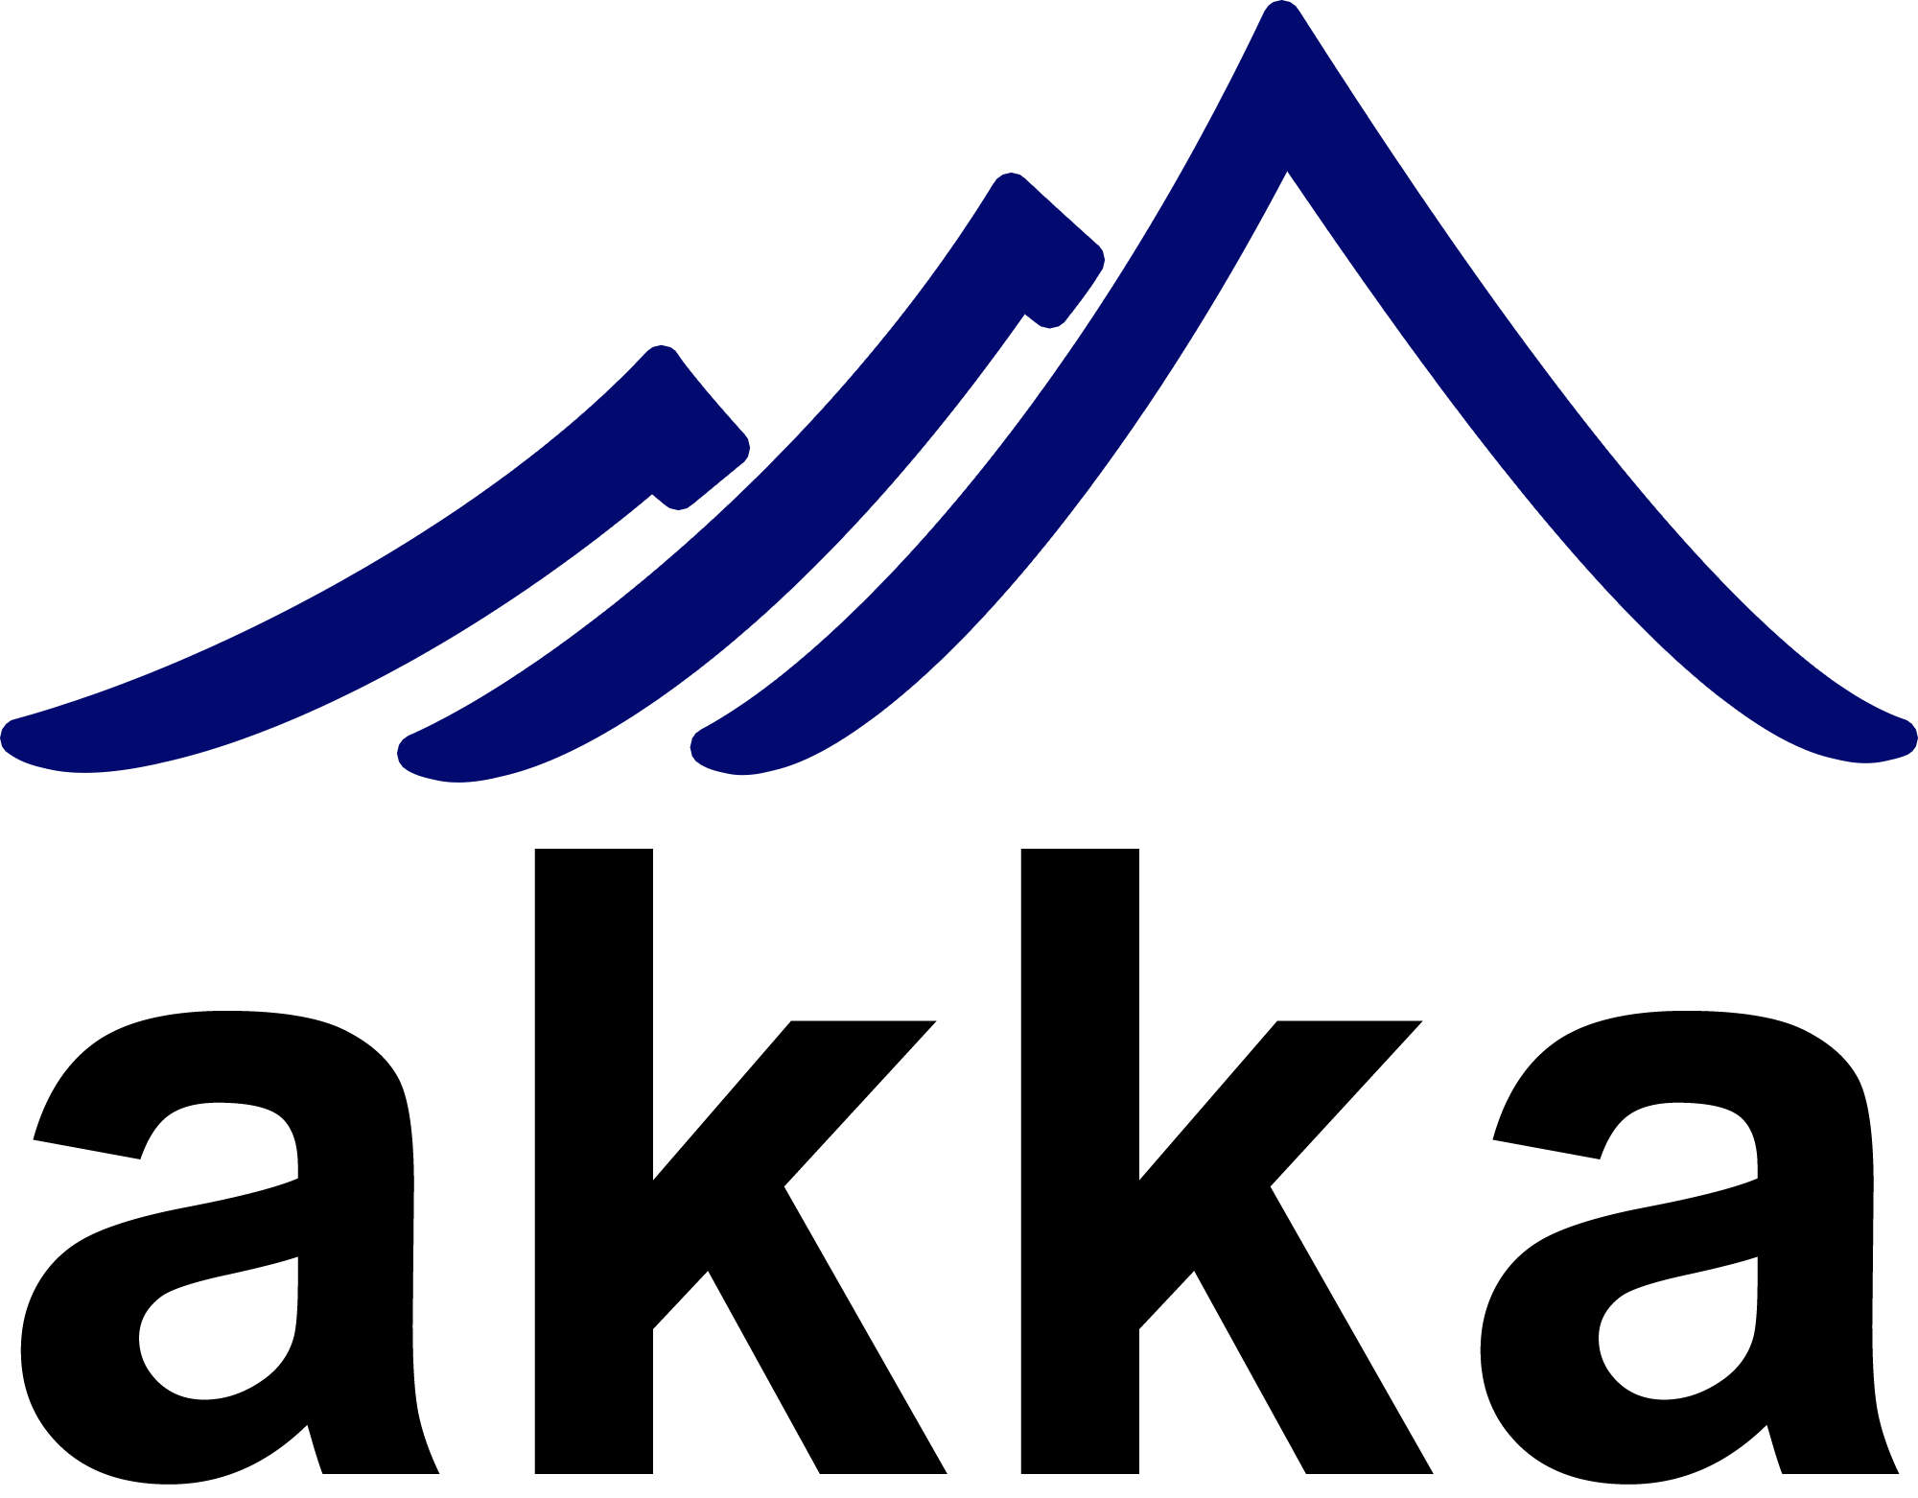
Akka Example

Slide 32
Reactive is being adopted across a wide range of industries.

Slide 33





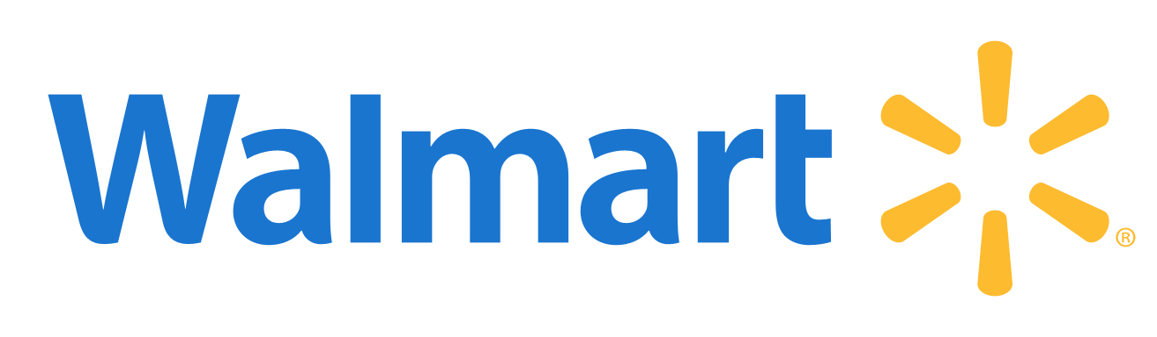
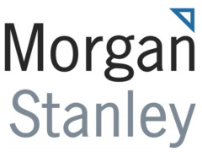









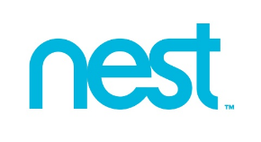

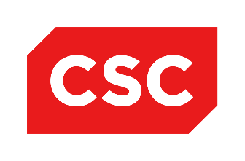









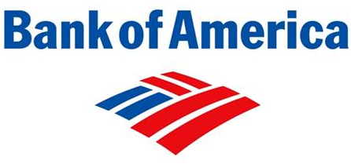




Finance
Internet/Social
Media
Mfg/Hardware
Government
Retail
Notes:
In addition to typical early adopters – like Financial Services – industries that have been slower to embrace new technologies are making the move to Reactive.

Slide 34
Typesafe delivers the world’s leading
Reactive platform on the JVM.

Slide 35
Typesafe is Reactive Throughout Our Platform
JVM Based Developer Tools and Runtime
Activator
  Ensures Adopters are Successful from the Start
  Plugin Architecture enables Third Party Integrations
Play Framework for Web Applications
  Ideal for Responsive Web Apps
  Rest based Services and Web Socket Apps
  Supports Java and Scala
Akka Runtime
  Highly Scalable Runtime for Java and Scala Applications
  Implementation of the Actor Model
  Reactive Streams for integration with Spring/RxJava/Vert.x/etc
Scala Programming Language
  Scalable and Performant
  Functional programming supports reusability
Notes:
Play is event driven from start. When you create your Play actions that should then process the requests, you have the option of creating an async request or an ordinary request. Then it's handed off to an implementation called iteratees. Iteratees is basically just a reactive streams. From Play, it asyncs actions. You go down to Play. Async your reactive streams down to the control layer where you can start to do things. So all of Play is really event driven from top to bottom there.
Then the same as Akka. Akka's actors only communicate by sending messages. You can't communicate with an actor in any other way by sending a message. You can't send a message in any other way than sending it in asynchronous and non-blocking fashion. If you're using Akka, then there's no way out basically. You're reactive even if you want it or not. So that's event driven.

Slide 36
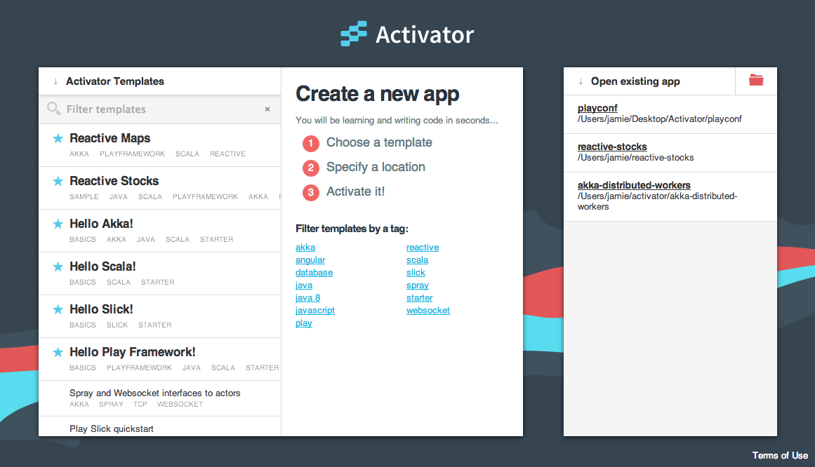
How do I get started?

