Slide 2
Understanding Mass and Agility
OSCON 2014, Portland
23/07/2014
Tim Bell
@noggin143
tim.bell@cern.ch

Slide 3
About Tim
Runs IT Infrastructure group at CERN
Member of OpenStack management board and user committee
Previously worked at
  Deutsche Bank running European Private Banking Infrastructure
  IBM as a consultant and kernel developer

Slide 4
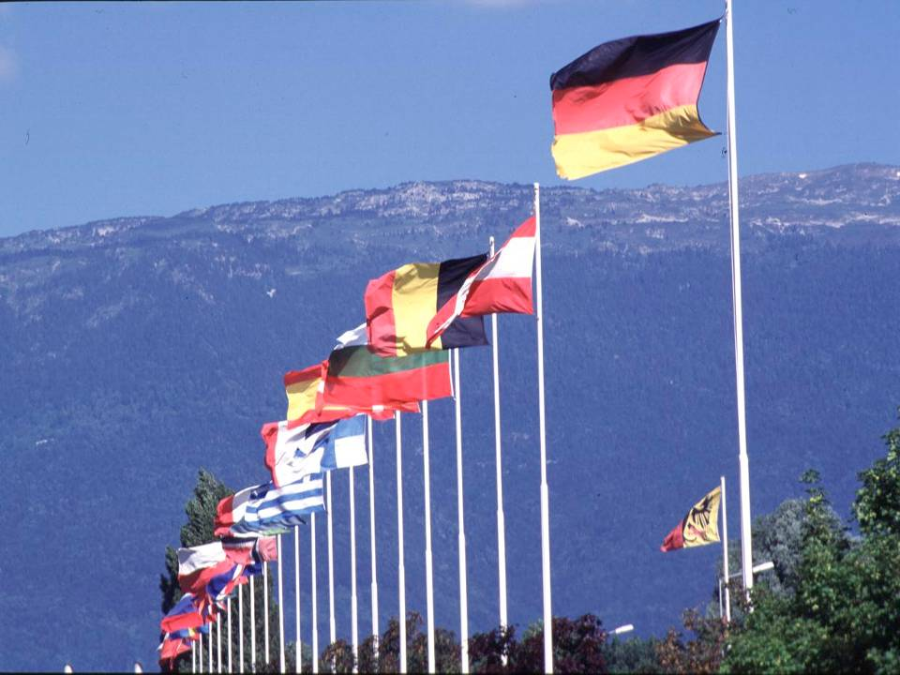
CERN was founded 1954: 12 European States
“Science for Peace”
Today: 21 Member States
~ 2,300 staff
~ 1,000 other paid personnel
> 11,000 users
Budget (2013) ~1,000 MCHF
Member States: Austria, Belgium, Bulgaria, the Czech Republic, Denmark, Finland, France, Germany, Greece, Hungary, Israel, Italy, the Netherlands, Norway, Poland, Portugal, Slovakia, Spain, Sweden, Switzerland and
the United Kingdom
Candidate for Accession: Romania
Associate Members in Pre-Stage to Membership: Serbia
Applicant States for Membership or Associate Membership:
Brazil, Cyprus (awaiting ratification), Pakistan, Russia, Slovenia, Turkey, Ukraine
Observers to Council: India, Japan, Russia, Turkey, United States of America; European Commission and UNESCO

Slide 5
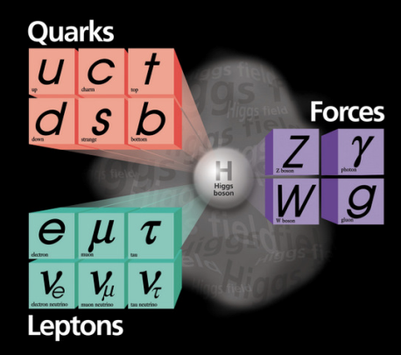
What are the Origins of Mass ?

Slide 6
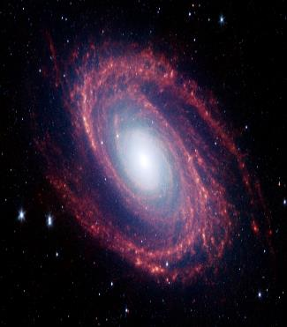
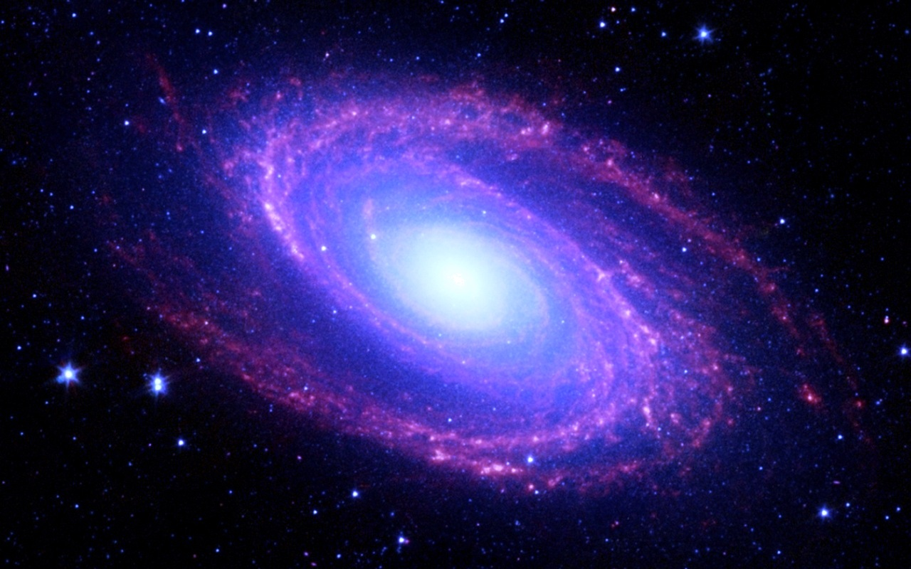
Matter/Anti Matter Symmetric?

Slide 7
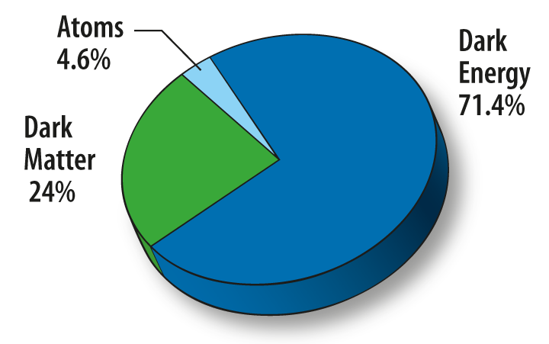
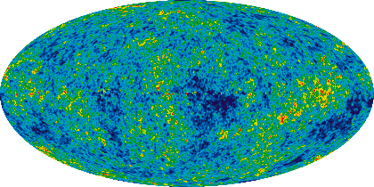
Where is 95% of the Universe?

Slide 8


Slide 9
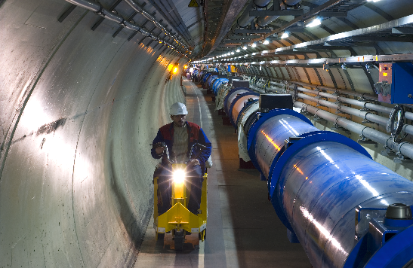
Notes:
Over 1,600 magnets lowered down shafts and cooled to -271 C to become superconducting. Two beam pipes, vacuum 10 times less than the moon

Slide 10
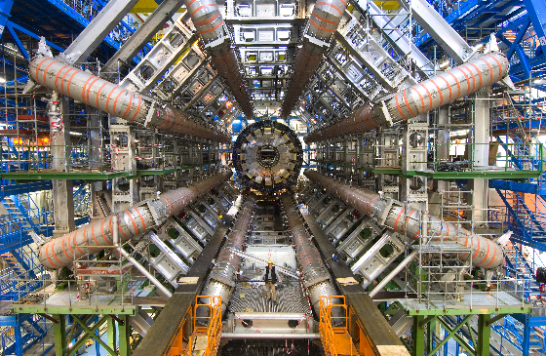

Slide 11
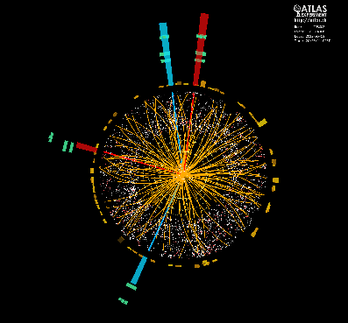
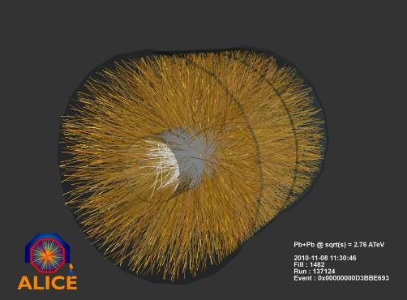
Collisions

Slide 12

A Big Data Challenge
In 2014,
~ 100PB archive with additional 35PB/year
~ 11,000 servers
~ 75,000 disk drives
~ 45,000 tapes
Data should be kept for at least 20 years
In 2015, we start the accelerator again
Upgrade to double the energy of the beams
Expect a significant increase in data rate
Notes:
These collisions produce data, lots of it. Over 100PB currently 45,000 tapes… data rates of up to 35 PB/year currently and expected to significantly increase in the next run in 2015. The data must be kept at least 20 years so we’re expecting exabytes….

Slide 13
LHC data growth
Plan to record 400PB/year by 2023
Compute needs expected to be around 50x current levels if budget available
PB
per
year
2010 2015 2018 2023

Slide 14
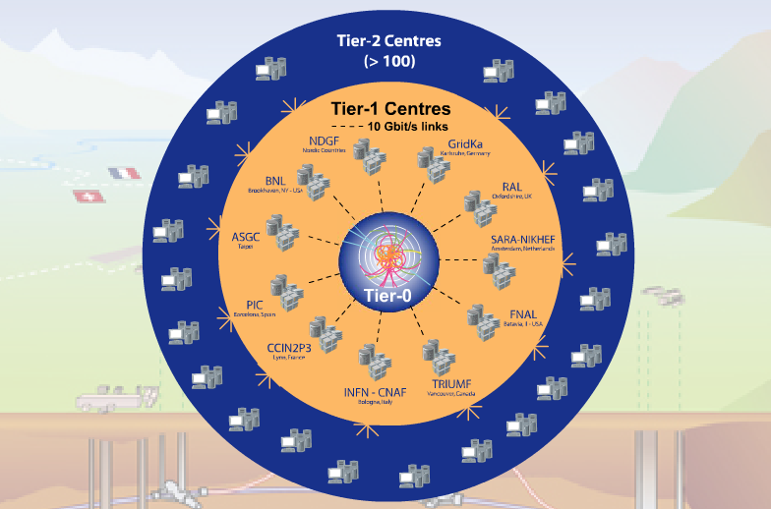
Tier-0 (CERN):
  Data recording
  Initial data reconstruction
  Data distribution
Tier-1 (11 centres):
Permanent storage
Re-processing
Analysis
Tier-2 (~200 centres):
Simulation
End-user analysis
Data is recorded at CERN and Tier-1s and analysed in the Worldwide LHC Computing Grid
In a normal day, the grid provides 100,000 CPU days executing over 2 million jobs
Notes:
The Worldwide LHC Computing grid is used to record and analyse this data. The grid currently runs over 2 million jobs/day, less than 10% of the work is done at CERN. There is an agreed set of protocols for running jobs, data distribution and accounting between all the sites which co-operate in order to support the physicists across the globe.

Slide 15
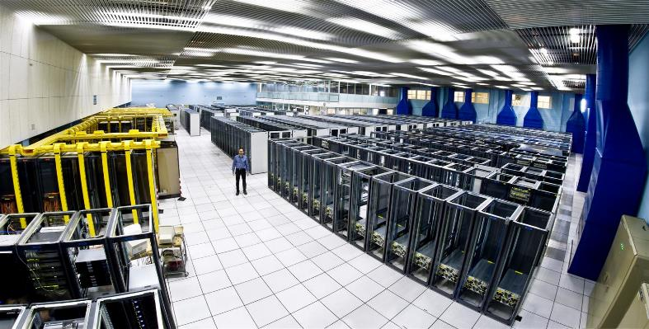
The CERN Meyrin Data Centre
Notes:
Recording and analysing the data takes a lot of computing power.
The CERN computer centre was built in the 1970s for mainframes and crays. Now running at 3.5MW of power, it houses 11,000 servers but is at the limit of cooling and electrical power. It is also a tourist attraction with over 80,000 visitors last year!
As you can see, racks are only partially empty in view of the limits on cooling.

Slide 16
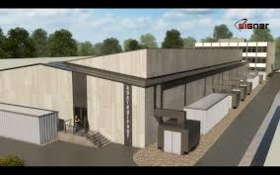
New Data Centre in Budapest
Notes:
We asked our 20 member states to make us an offer for server hosting using public procurement. 27 proposals and Wigner centre in Budapest, Hungary was chosen. This allows us to envisage sufficient computing and online storage for the run from 2015.

Slide 17
Good News, Bad News
Additional data centre in Budapest now online
Increasing use of facilities as data rates increase
But…
Staff numbers are fixed, no more people
Materials budget decreasing, no more money
Legacy tools are high maintenance and brittle
User expectations are for fast self-service

Slide 18
Public Procurement Cycle
Step | Time (Days) | Elapsed (Days)
User expresses requirement |  | 0
Market Survey prepared | 15 | 15
Market Survey for possible vendors | 30 | 45
Specifications prepared | 15 | 60
Vendor responses | 30 | 90
Test systems evaluated | 30 | 120
Offers adjudicated | 10 | 130
Finance committee | 30 | 160
Hardware delivered | 90 | 250
Burn in and acceptance | 30 days typical with 380 worst case | 280
Total |  | 280+ Days

Slide 19
Approach
There is no Moore’s Law for people
  Automation needs APIs, not documented procedures
Focus on high people effort activities
  Are those requirements really justified ?
  Accumulating technical debt stifles agility
Find open source communities and contribute
  Understand ethos and architecture
  Stay mainstream

Slide 20

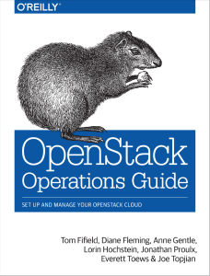
O’Reilly Consideration

Slide 21
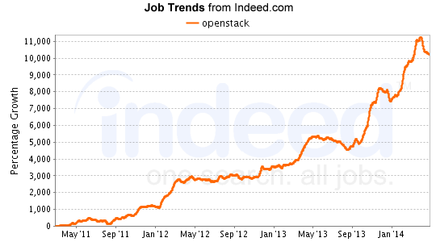
Indeed.Com Consideration

Slide 22
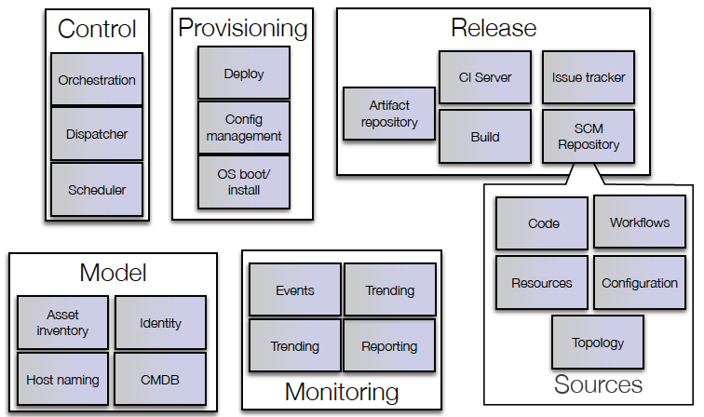
mcollective, yum
Bamboo
Puppet
AIMS/PXE
Foreman
JIRA
OpenStack
Nova
git
Koji, Mock
Yum repo
Pulp
Active Directory /
LDAP
Hardware database
Lemon /
Hadoop /
LogStash /
Kibana
Puppet-DB
Notes:
We adopted a Google toolchain approach. The majority of home written software was replaced by open source projects. Commercial tools which were already working well such as JIRA and Active Directory were maintained. The approach was to select a tool, prototype, fail early and then refine requirements (following the we are not special approach)
Key technologies were Puppet for configuration management and OpenStack for the private cloud.

Slide 23
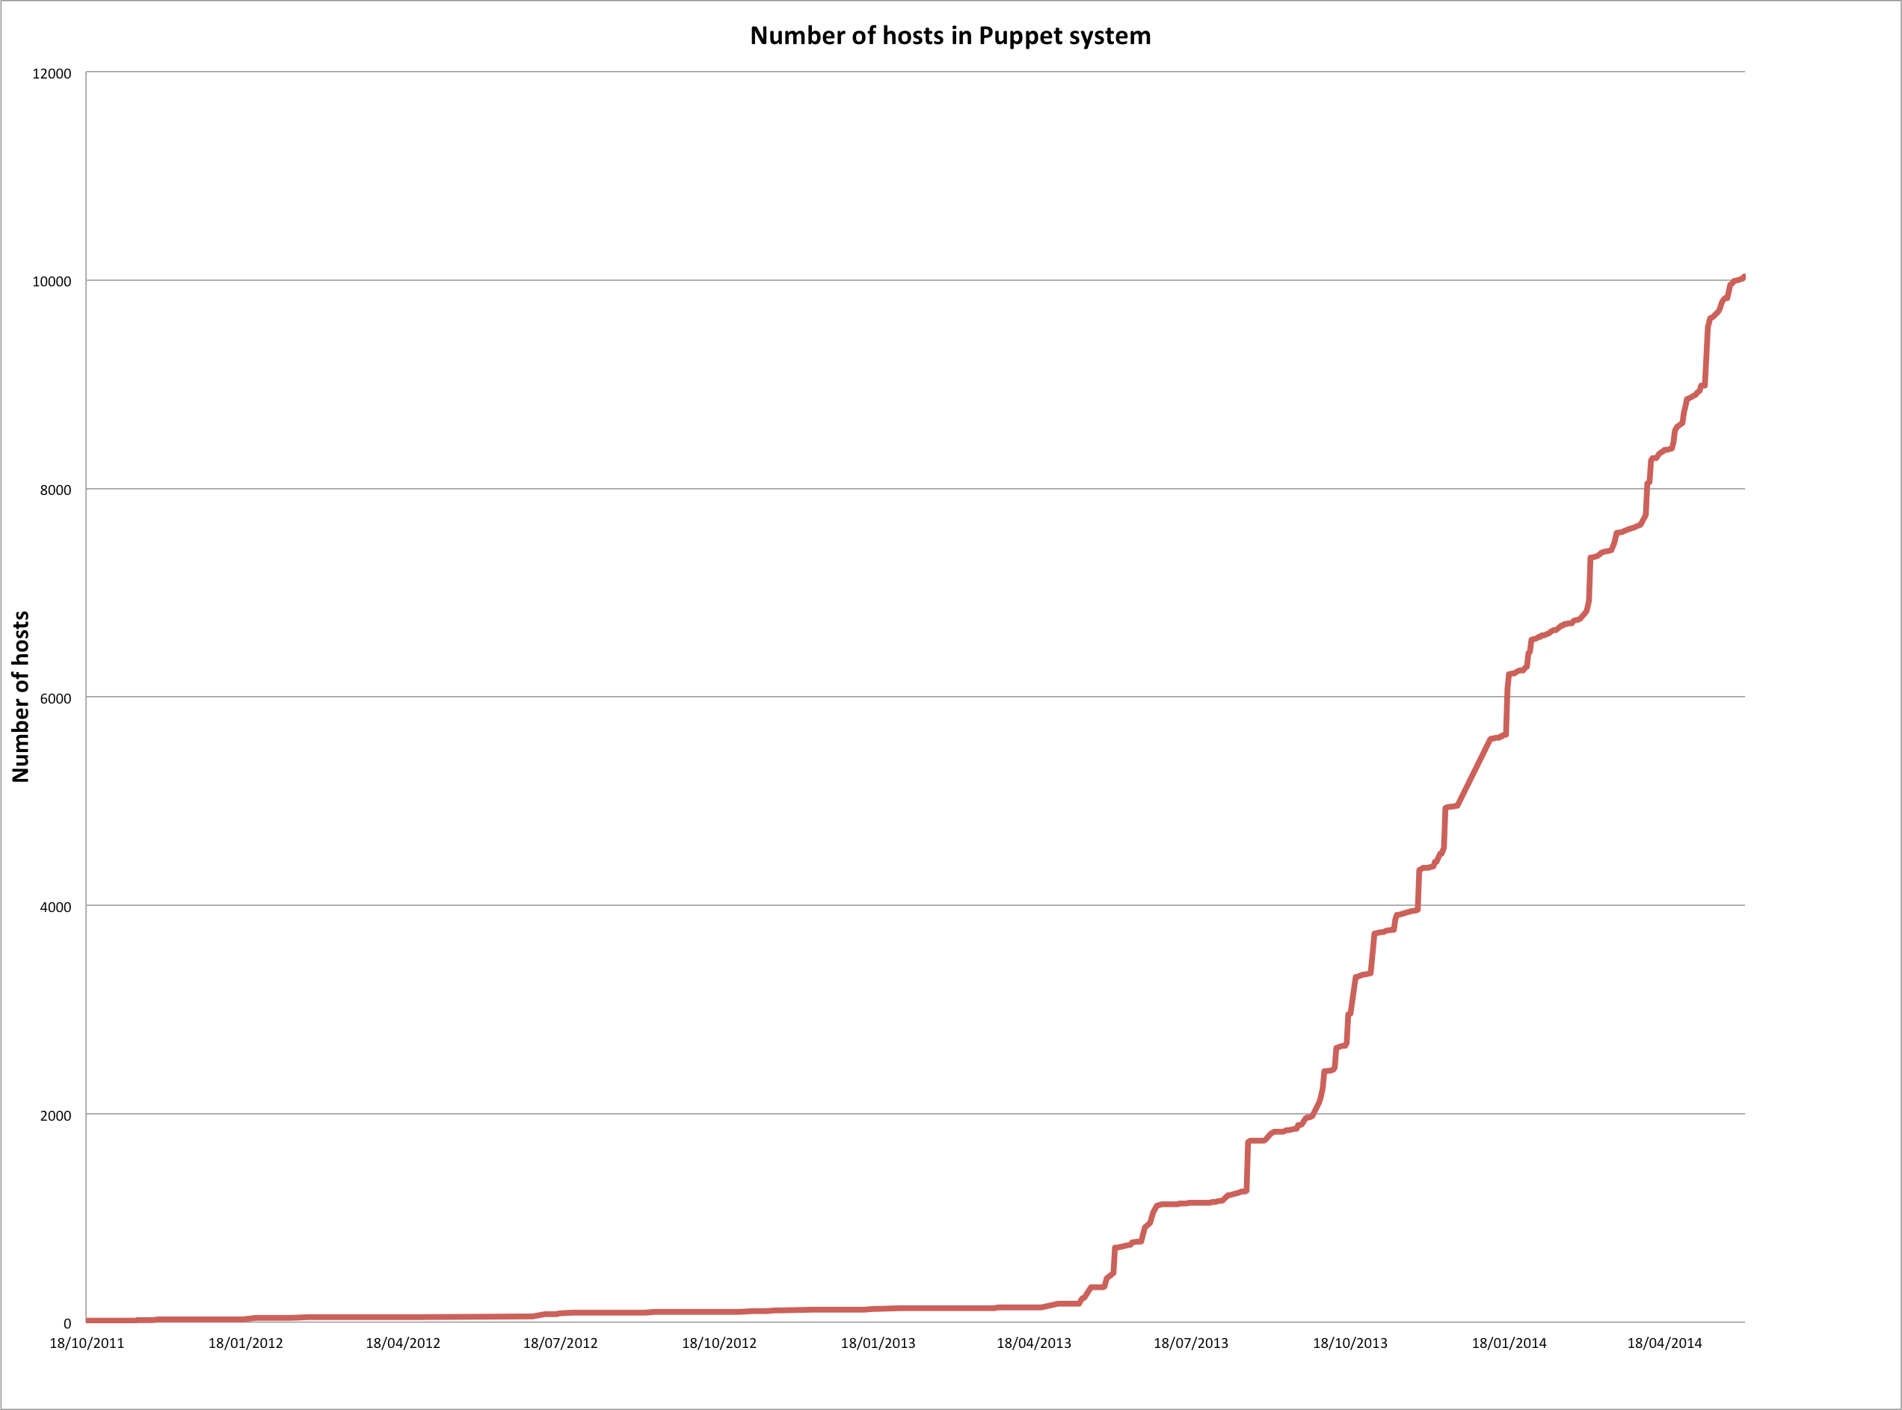
Puppet Configuration
Over 10,000 hosts in Puppet
160 different hostgroups
Tool chain using
  PuppetDB
  Foreman
  Git
Scaling issues resolved with the communities

Slide 24

Monitoring - Flume, Elastic Search, Kibana
elasticsearch
Flume
gateway
Kibana
HDFS
OpenStack infrastructure

Slide 25


Block Storage
Ceph & NetApp
CERN Accounting
CERN Network Database
Ceilometer
Cinder
Account mgmt system
Network
Compute
Keystone
Scheduler
Microsoft Active Directory
Nova
Horizon
Glance
CERN DB on Demand
Notes:
Account Management Automation
CERN legacy network database
No Neutron yet

Slide 26


Scaling Architecture Overview
Child Cell
Geneva, Switzerland
controllers
compute-nodes
Load Balancer
Geneva, Switzerland
Top Cell - controllers
Geneva, Switzerland
Child Cell
Budapest, Hungary
controllers
compute-nodes
Notes:
HA Proxy load balancers to ensure high availability
Redundant controllers for compute nodes
Cells used by the largest sites such as Rackspace and NeCTAR – more than 1000 hypervisors is the recommended configuration

Slide 27
Status
Multi-data centre cloud in production since July 2013 (Geneva and Budapest) with nearly 1,000 users
Currently running OpenStack Havana
  KVM and Hyper-V deployed
  All configured automatically with Puppet
  ~70,000 cores on ~3,000 servers
  3PB Ceph pool available for volumes, images and other physics storage
Notes:
Already 3 independent clouds – federation is now being studied
Rackspace inside CERN openlab
Helix Nebula as discussed later

Slide 28
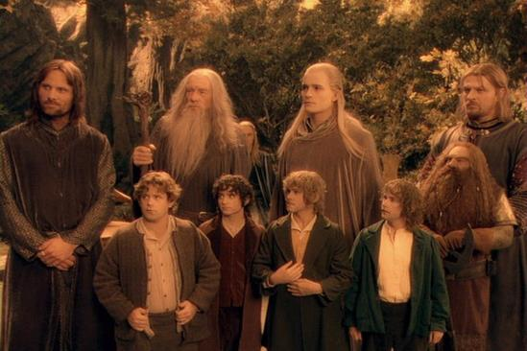
The Agile Experience
Notes:
So, we assembled a team made up of experienced service managers and new students. By freezing developments on legacy projects, we were able to make resources available but only as long as we could rapidly implement new functions. Many of the staff had to do their ‘day’ jobs as well as work on the new implementations. Several effects
- Newcomers often had experience of the tools from university
People learnt very rapidly by following mailing lists, going to conferences and interacting with the community. Contributions such as contributing to the governance, use cases and testing in addition to standard development contributions.
Short term staff saw major improvements in their post-CERN job prospects as they left with very relevant skills

Slide 29


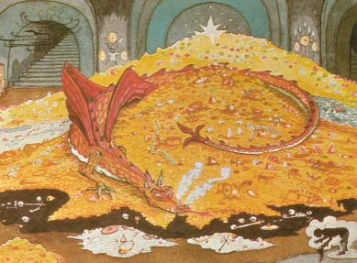

Cultural Barriers
Notes:
The agile approach is a major cultural change which is an ongoing process. To illustrate this, there are some characteristics which I show extreme examples of to watch out from Tolkein…. Luckily, we never had characters like this at CERN:
Don’t be hasty, let’s go slowly… transformations such as this cannot be done in a reasonable time by incremental change
Move away from silos… top to bottom from application to hardware managed by a single team to a layered model with shared budget and resources.
Knowledge management responsibilities change. The guru who wrote the tool and trains others on how to use it is replaced by the outside community in which people participate. Everything can appear to be research if you start with a blank piece of paper.
The server or application manager of ‘precious’ applications that need special handling and care has to be understood… some cases are inevitable but many reflect non-technical aspects of the application or server management and may justify changes of process

Slide 30
Agility and Elasticity Limits
Communities help to set good behaviour
Internal demonstrations build momentum
Finding the right speed is key
Keeping up with releases takes focus
Coping with legacy requires compromise
Travel budget needs significant increase!

Slide 31
Next Steps: Scale with Physics
Scaling to >100,000 cores by 2015
  Around 100 hypervisors per week with fixed staff
Deploying and configuring latest releases
  Need to stay close … but not too close
Legacy systems retirement
  Server consolidation
  Home grown configuration and monitoring
Analytics of processor, disk and network
  Focus on efficiency

Slide 32




Next Steps: Federated Clouds
Many Others on Their Way
Public Cloud such as Rackspace
NecTAR
Australia
Brookhaven National Labs
IN2P3
Lyon
CERN Private Cloud
70K cores
ATLAS Trigger
28K cores
CMS Trigger
12K cores
Notes:
The trigger farms are those servers nearest the accelerator which are not needed while the accelerator is shut down till 2015
Public clouds are interesting for burst load (such as coming up to a conference) or when price drops such as spot market
Private clouds allow universities and other research labs to collaborate in processing the LHC data

Slide 33
Summary
Open source tools have successfully replaced CERN’s legacy fabric management system
Scaling to 100,000s of cores with OpenStack and Puppet is in sight
Cultural change to an Agile approach has required time and patience but is paying off
Community collaboration needed to reach 400PB/year

Slide 34
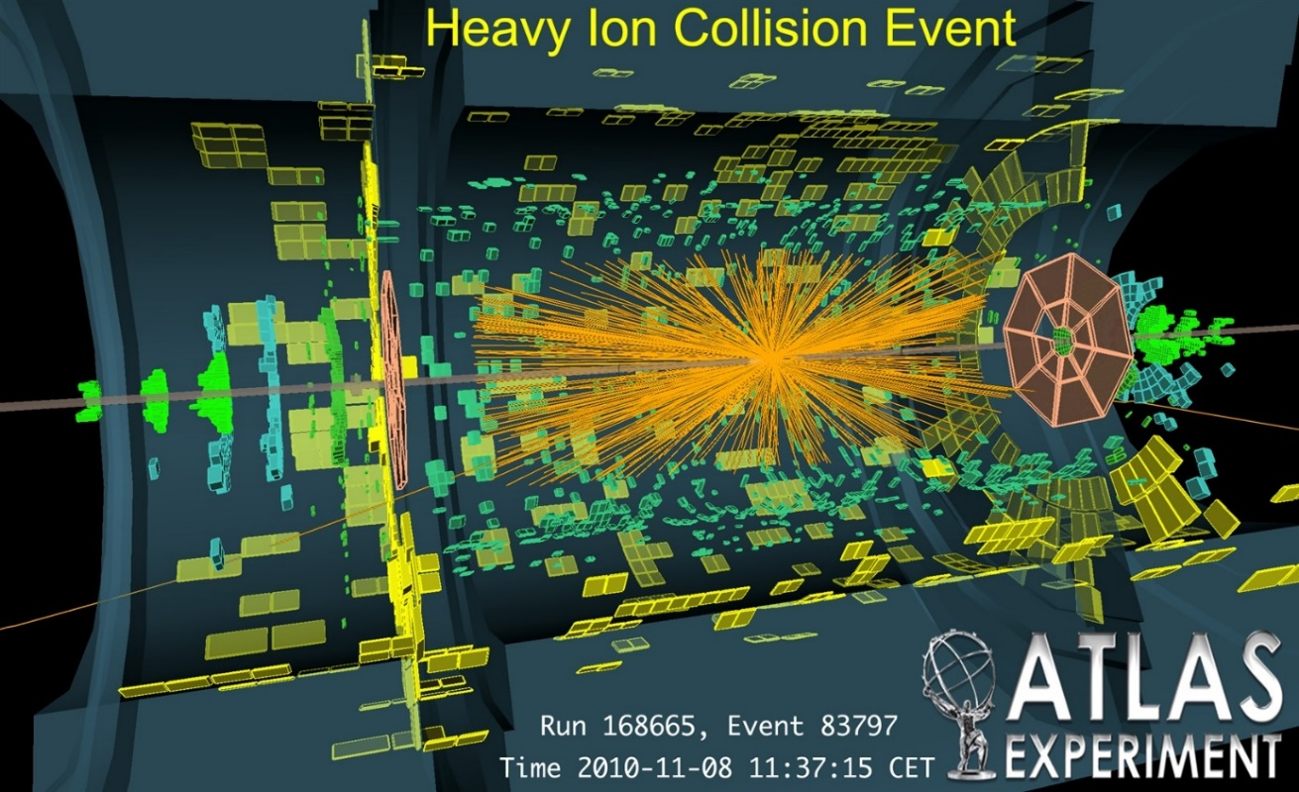
Questions ?
Details at http://openstack-in-production.blogspot.fr
Previous presentations at http://information-technology.web.cern.ch/book/cern-private-cloud-user-guide/openstack-information
CERN code is at http://github.com/cernops

Slide 35
Backup Slides

Slide 36
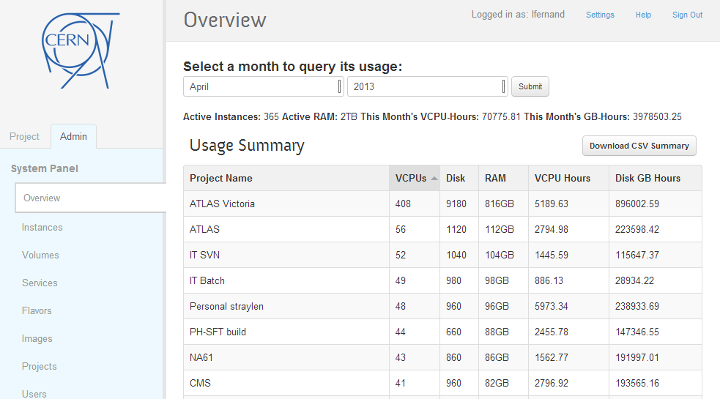

Slide 37
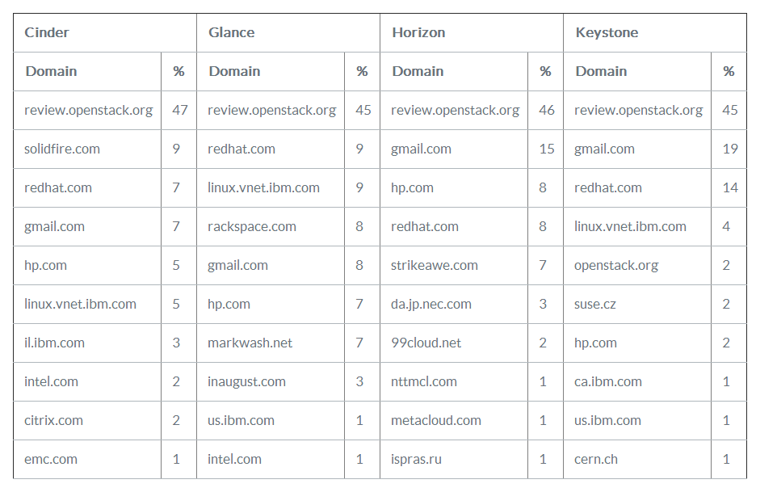
http://www.eucalyptus.com/blog/2013/04/02/cy13-q1-community-analysis-%E2%80%94-openstack-vs-opennebula-vs-eucalyptus-vs-cloudstack

Slide 38
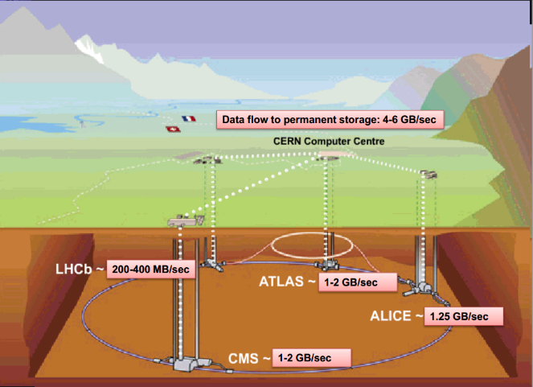

Slide 39
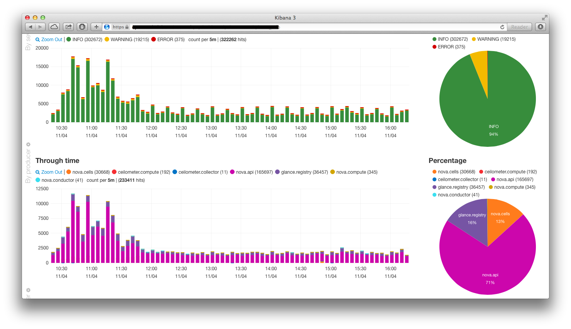
Monitoring - Kibana

Slide 40
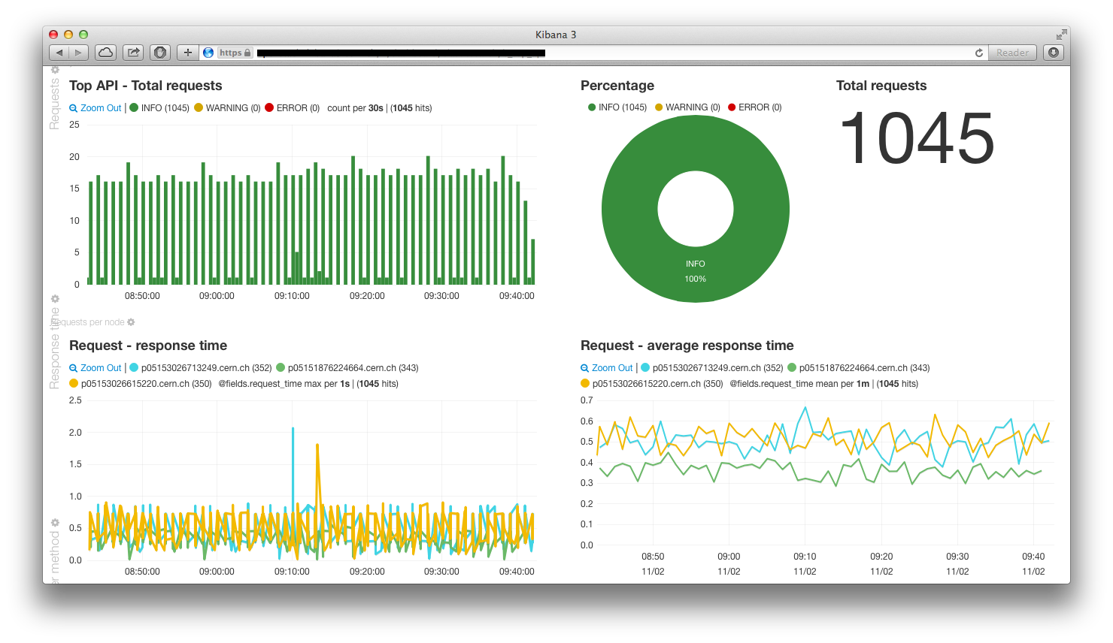
Monitoring - Kibana

Slide 41
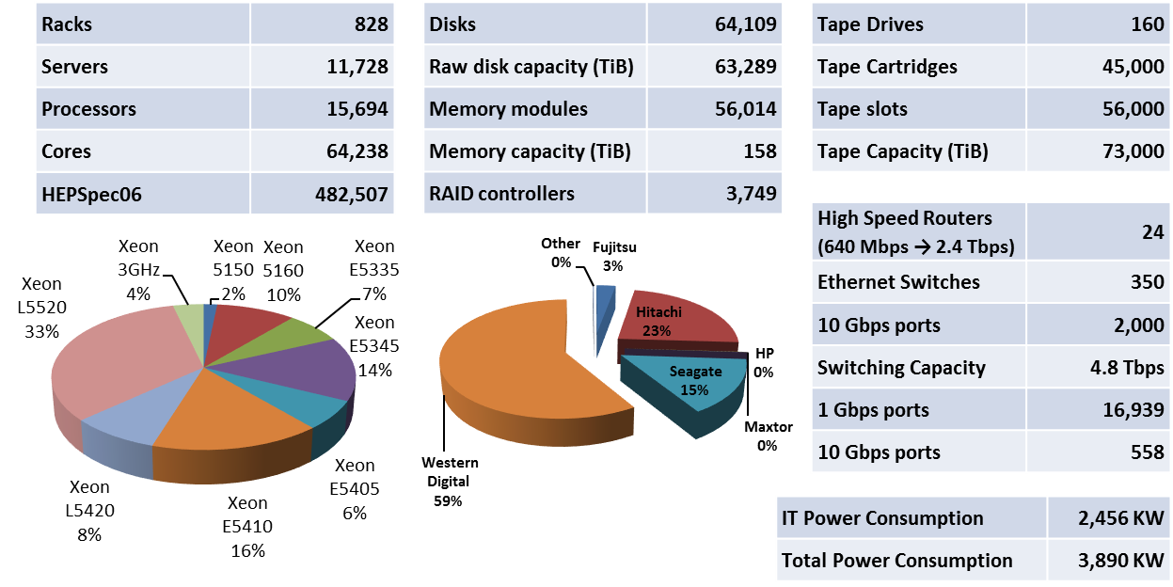

Slide 42
Architecture Components
Top Cell
Children Cells
Controller
Controller
Compute node
rabbitmq
- Nova api
- Nova consoleauth
- Nova novncproxy
- Nova cells
rabbitmq
- Nova api
- Nova conductor
- Nova scheduler
- Nova network
- Nova cells
- Nova compute
- HDFS
- Ceilometer agent-compute
- Elastic Search
- Flume
- Kibana
- Glance api
- Glance registry
- Glance api
- Ceilometer api
- Stacktach
- Ceilometer agent-central
- Ceilometer collector
- Cinder api
- Cinder volume
- Cinder scheduler
- Ceph
- Keystone
- Keystone
- Flume
- MySQL
- Horizon
- MongoDB
- Flume
Notes:
Child cells have their own keystone in view of load from ceilometer
Requires care to set up and test

Slide 43
Upgrade Strategy
Surely “OpenStack can’t be upgraded”
  Our Essex, Folsom and Grizzly clouds were ‘tear-down’ migrations
    Puppet managed VMs are typical Cattle cases – re-create
    User VMs snapshot, download image and upload to new instance
    One month window to migrate
Users of production services expect more
  Physicists accept not creating/changing VMs for a short period
  Running VMs must not be affected

Slide 44
Phased Migration
Migrated by Component
  Choose an approach (online with load balancer, offline)
  Spin up ‘teststack’ instance with production software
  Clone production databases to test environment
  Run through upgrade process
  Validate existing functions, Puppet configuration and monitoring
Order by complexity and need
  Ceilometer, Glance, Keystone
  Cinder, Client CLIs, Horizon
  Nova

Slide 45
Upgrade Experience
No significant outage of the cloud
  During upgrade window, creation not possible
  Small incidents (see blog for details)
  Puppet can be enthusiastic! - we told it to be ☺
Community response has been great
  Bugs fixed and points are in Juno design summit
  Rolling upgrades in Icehouse will make it easier

Slide 46
Duplication and Divergence
Storage
Compute
Windows
Storage
Compute
Web
Platform as a Service
Windows
Database
Custom
Infrastructure as a Service
Hardware Facilities
Hardware Facilities
Network
Network
Service Silos
Functional Layers

Slide 47


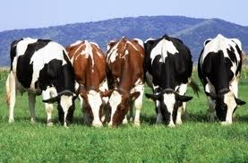
Service Models
Pets are given names like pussinboots.cern.ch
They are unique, lovingly hand raised and cared for
When they get ill, you nurse them back to health
Cattle are given numbers like vm0042.cern.ch
They are almost identical to other cattle
When they get ill, you get another one

Slide 48
