Slide 1
Make Your Data Talk Analytic Techniques for Identifying Hidden Performance Issues
Steve Fox: Foglight Product Manager
Rob Dickinson: Dir. Software Development

Slide 2
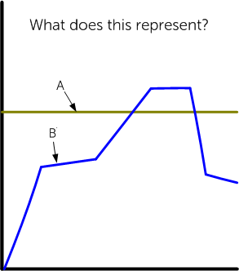
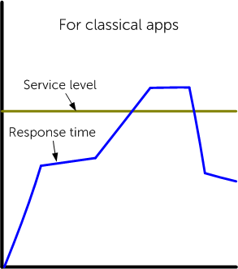
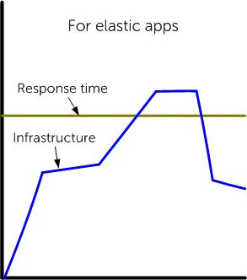
Contextual relevance of performance
Application Performance Monitoring
Notes:
Let’s start thinking about performance with this little Rorschach test. What does A represent in this chart? If you said “service level”, you are correct. If you said “response time”, you are also correct. The type of infrastructure used by your app will determine the context of your application performance. For traditional apps, we’re trying to improve service level compliance. For elastic apps, the ideal response time is flat and boring, but we’re minimizing operating costs.
NOTE – this is the only place where we tie in Enstratius

Slide 3
Experiment

Slide 4
Experiment: Group A

Slide 5
Experiment

Slide 6
Experiment: Group B

Slide 7
Experiment

Slide 8
Experiment: What do you see?
Notes:
Young woman?
Old woman?
Wearing a necklace?
Large nose?
Looking to her right?
Looking straight ahead?

Slide 9
Experiment: Why such different answers?
Notes:
Young woman?
Old woman?
Wearing a necklace?
Large nose?
Looking to her right?
Looking straight ahead?
Published from Harvard.

Slide 10
Experiment #2

Slide 11
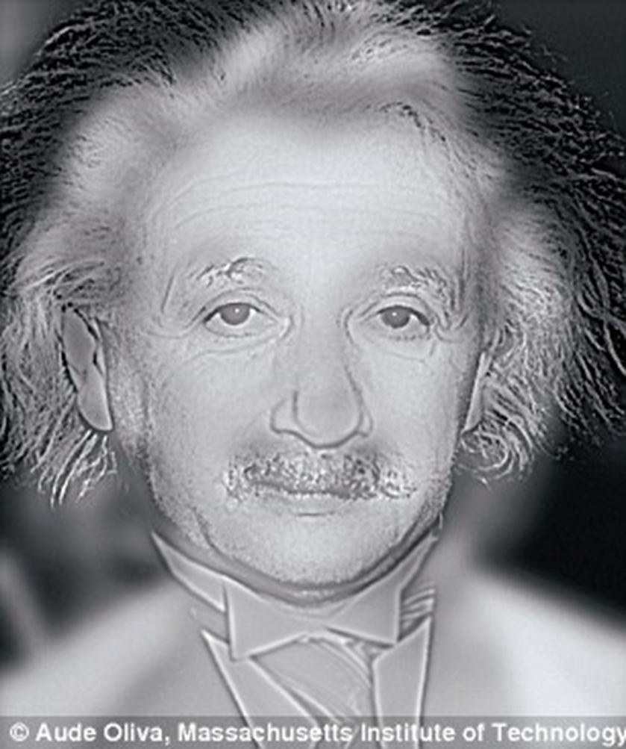
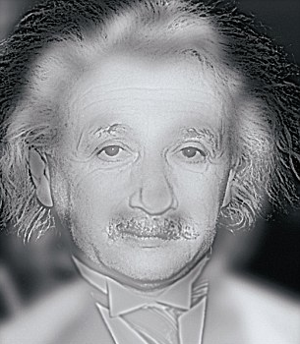
Experiment #2
Velocity Santa Clara is cool!

Slide 12
Experiment #2

Slide 13
Lesson: We are not always as objective as we think
Hypotheses
Collect Data
Conclusions
Analyze
Scientific Method

Slide 14
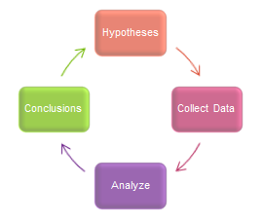
See in Diagnosing Performance Problems
A few dozen users called complaining
From 15 to 60 seconds
No, scattered about the country
Yes, average response time is 1.2 seconds
Who is having Issue?
How bad is it?
Are all the users from a particular location?
Are other users using the app ok?
Notes:
Even elastic scaling will not help you here.

Slide 15
Division of Labor
Hypotheses
Collect Data
Conclusions
Analyze

Slide 16
Division of Labor
Hypotheses
Collect Data
Conclusions
Analyze
What if?

Slide 17
Division of Labor
Hypotheses
Collect Data
Conclusions
Analyze
What if?

Slide 18
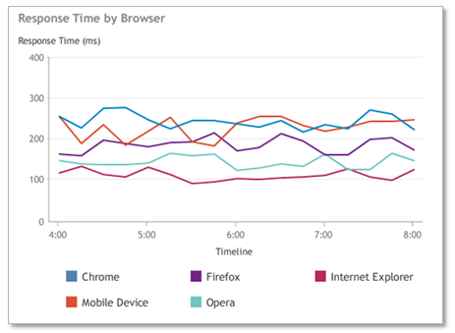
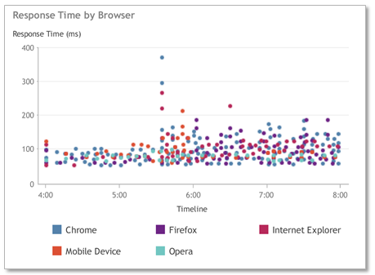
Challenge #1: Problems Hide in Aggregations
Averages misleading
Majority of users fine, but problem still exists
Often outliers give more clues than averages or aggregates
Solution
Capture and store discrete transactional data

Slide 19
Challenge #2: Complexity and Volume of Data
Saving everything creates lots of “big data”
Entire data set too large to look for patterns manually
Solution: Only look at problem transactions
Look for patterns and commonalities in the problem transactions

Slide 20
Real World Example
VP reports many user complaints. Scanning problem transaction data shows every one originates from an IE 9 browser
Solved! A browser version issue!
Or is it?
Turns out IE 9 is a corporate enforced standard and this application is only accessed by employees
Did the scientific method fail us?
Where did we go wrong?
Software

Slide 21
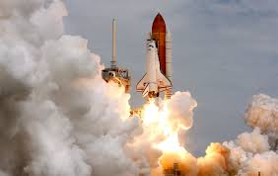
What went wrong?
Our test of “IE 9 is the determining factor of the problem” was flawed
We made assumptions about distribution of traffic that were incorrect
Easy to do, especially under crisis-mode pressure
Even easier to do if only looking at the problem data
Happens in other operations disciplines too

Slide 22
Interpreting Causality from Data Analysis
Causality and Correlation are related but different things
Have to be very careful about hidden reasons behind otherwise interesting patterns
In the heat of crisis, easy to fall into trap of “Believing what feels to be true”

Slide 23
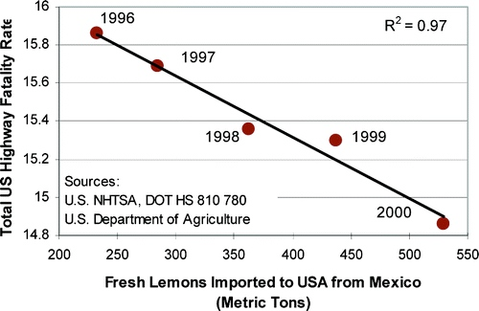
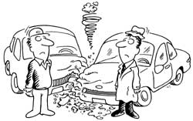
Mexican Lemons Prevent Highway Death

Slide 24
Heart Disease
Studies showed women on hormone replacement therapy (HRT) have lower than average incidence of heart disease.
Randomized control trials showed HRT actually slightly increased incidence of heart disease
Analysis showed women on HRT are more likely to be from higher social-economic group with better than average diet, exercise, and medical care
Termed “Lurking variable”: a hidden 3rd variable that causes the correlation
Software

Slide 25
So back to our performance problem
What if it had been a public facing site with normal browser distribution?
Much more compelling correlation
We discovered a more accurate indicator of likely performance issues was to analyze ratios in the problem set and compare to ratios in the total set of traffic
We call it: Differential Analytics

Slide 26
Differential Analytics Definition
$$R_{D}=\% of poor performing requests that this dimensional value$$
$$R_{T}=\% of requests that had this dimensional value$$
$${\text{Performance} \text{Differential} : P}_{D}=R_{D}−R_{T}$$
The higher the performance differential the more statistically likely having this value in this dimension is strongly correlated to the problem

Slide 27
Differential Analytics: IE 9 Internal Example
$$R_{D}=100\% of poor performing requests had IE 9 as browser$$
$$R_{T}=100\% of requests that had IE 9 as browser$$
$${\text{Performance} \text{Differential} \text{for} \text{IE}\text{ 9 }: P}_{D}=100 −100$$
$$P_{D}=0$$
No correlation at all.

Slide 28
Differential Analytics: IE 9 External Example
$$R_{D}=100\% of poor performing requests had IE 9 as browser$$
$$R_{T}=6\% of requests that had IE 9 as browser$$
$${\text{Performance} \text{Differential} \text{for} \text{IE}\text{ 9 }: P}_{D}=100 −6$$
$$P_{D}=94$$
Highly correlated.

Slide 29
Differential Analytics: IE 9 External Realistic Example
$$R_{D}=22\% of poor performing requests had IE 9 as browser$$
$$R_{T}=6\% of requests that had IE 9 as browser$$
$${\text{Performance} \text{Differential} \text{for} \text{IE}\text{ 9 }: P}_{D}=22 −6$$
$$P_{D}=18$$
Suspicious, but there are likely other factors or multiple problems active at the same time

Slide 30
Powerful technique to apply manually
Automation takes the power to a new level
What if we calculated automatically for:
Device types, OS
Locations, ISP’s
For individual URL’s
What if we included back end dimensions?
Method calls, SQL Queries
What if we did the same set of dimensions for errors too?
Software

Slide 31
Differential Analytics
In a matter of seconds we evaluate 1000’s of possible correlations
For both performance issues and errors
Rank and display top correlations
Automates and streamlines the hypothesis phase of troubleshooting
Guessing / Disproving 1000’s of possibilities at a time
Software

Slide 32
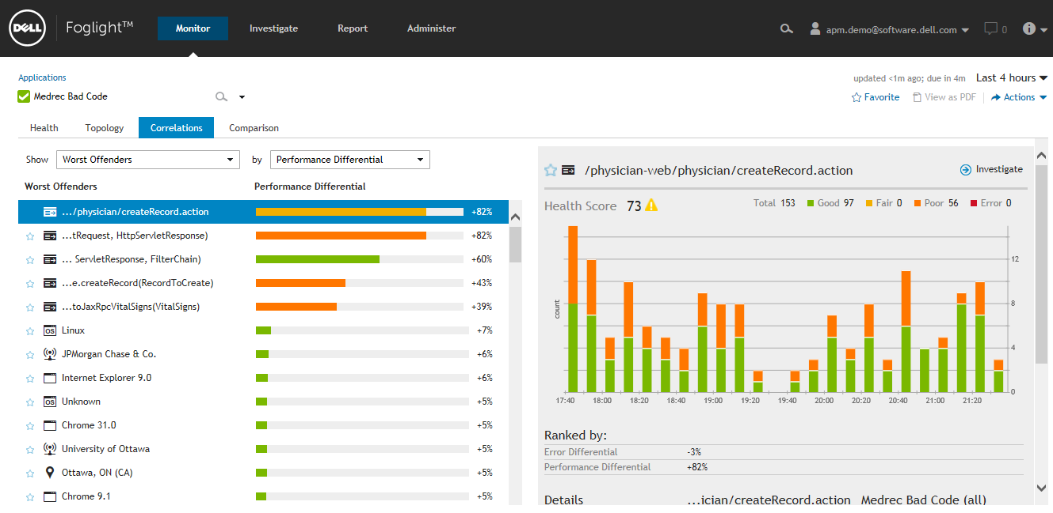
Demo

Slide 33
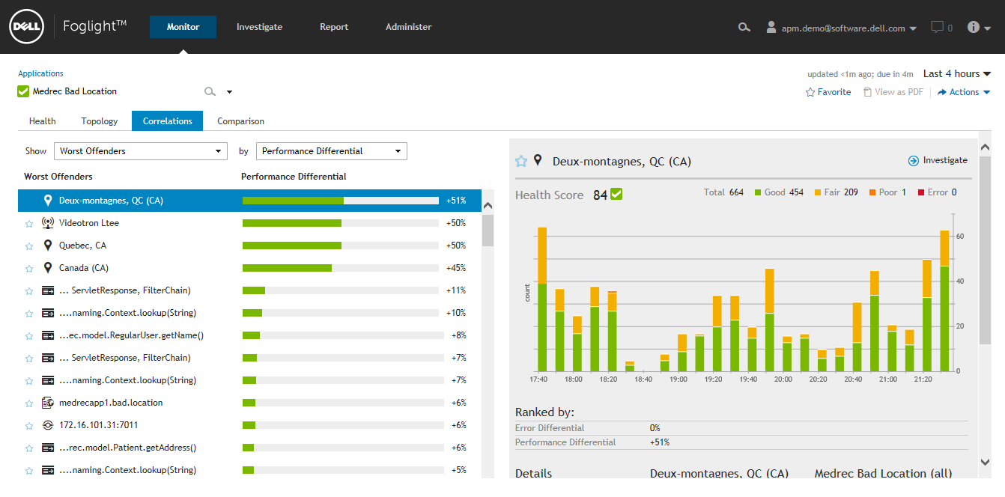
Demo

Slide 34
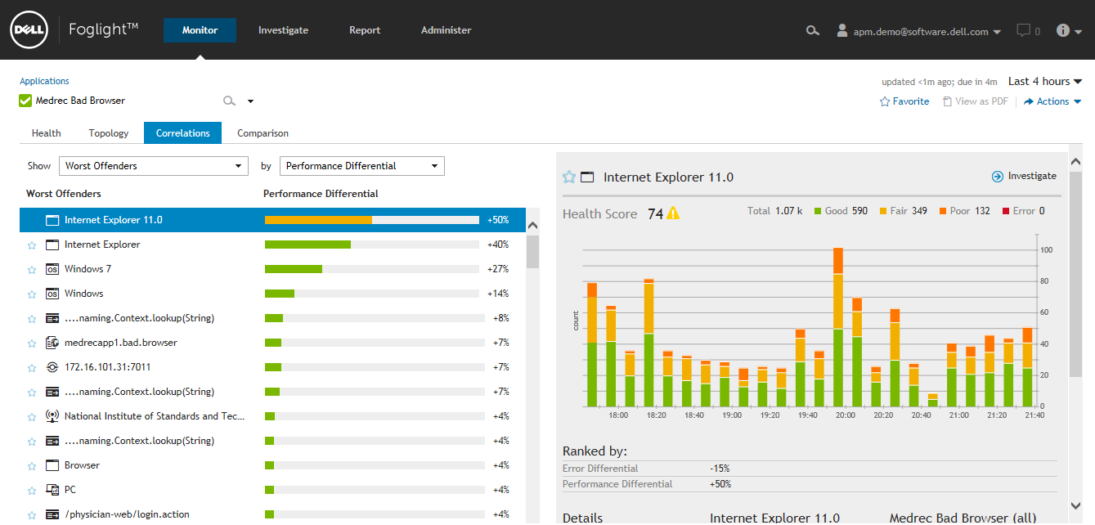

Slide 35
Technology to Support Differential Analytics
Only works if you have “Good” transactions to compare against
Equivalent of “randomized control study” in medicine
Heavy big data processing requirements, difficult to do
Simplification option of only storing problem transactions falls short
No “good” transactions to compare dimensional data on
Analysis cannot reach “randomized control study” quality
If only storing aggregates, you are losing valuable outlier data

Slide 36
Differential Analytics
Hypotheses
Collect Data
Conclusions
Analyze

Slide 37
Investigative Analytics
Differential Analytics answers a specific question:
What are the most correlated characteristics of my problem requests?
What about other questions we might be interested in?
Which requests are consuming the most database resources?
How much time is consumed in front-end vs. back end?
Which app tier method is called the most frequently?
from a mobile device?
In the US?
By which browser type?

Slide 38
Investigative Analytics:
Differential Analytics across multiple dimensions
Many analytics questions span multiple dimensions
Traditional presentation styles limited to 2 or 3 dimensions

Slide 39
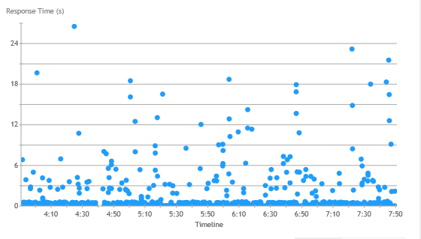
Investigative Analytics: Scatterplot
2 Dimensions: Response Time vs Time

Slide 40
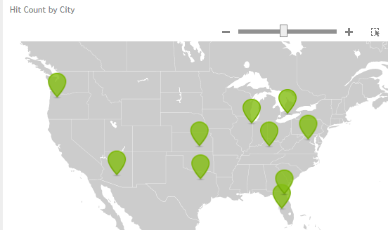
Investigative Analytics: Geographic Map
2 Dimensions: Hit Count by City

Slide 41
Investigative Analytics: Scatterplot
How add more dimensions?

Slide 42
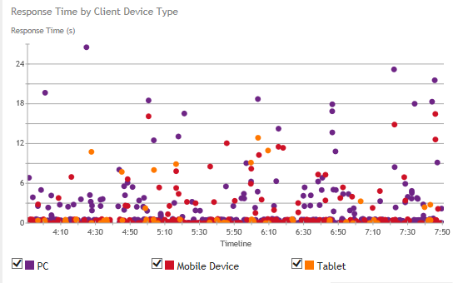
Investigative Analytics: Scatterplot + Color
3 Dimensions: Time, Response Time, Device Type

Slide 43
Investigative Analytics: Visual Filter Chain
How traditionally handle?
Screen to screen navigation of 2 dimensional views
Or many independent 2 dimensional views in portal style
Visual Filter Chain
Chain together 2 dimensional visualizations on one screen
Each one can provide dynamic selection
The resulting data set is fed to downstream visualizations
No limit to the number of dimensions represented

Slide 44
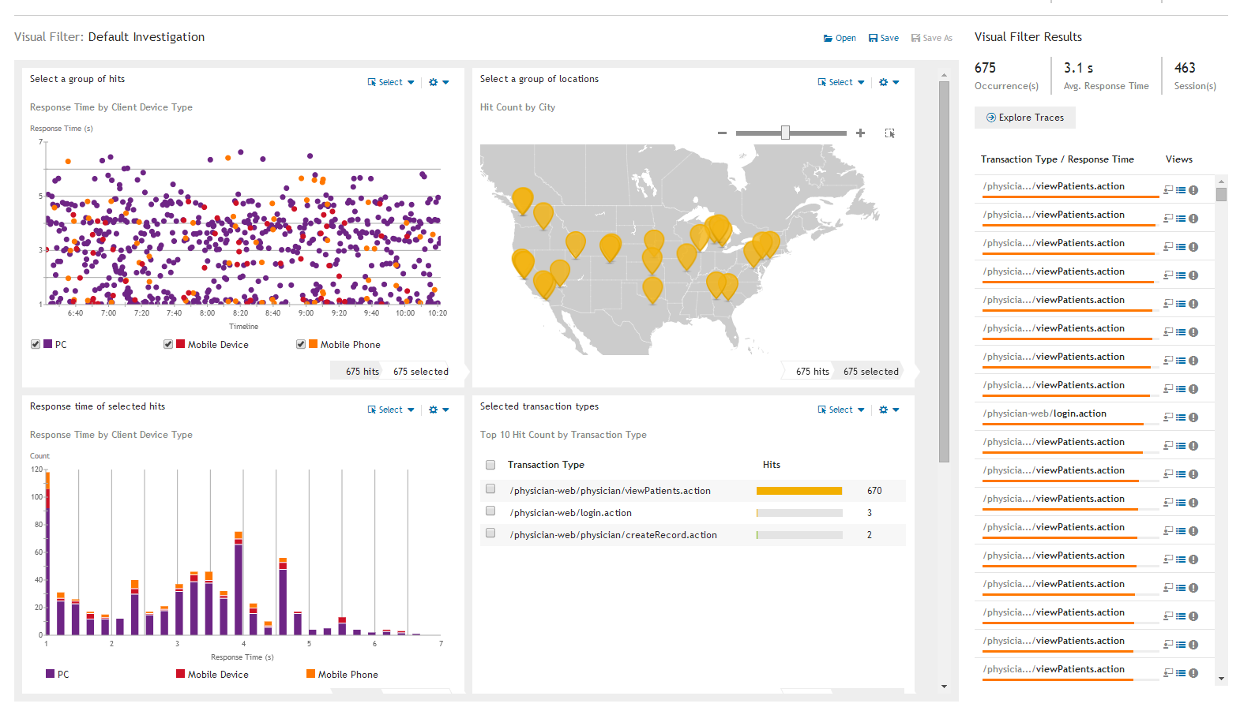
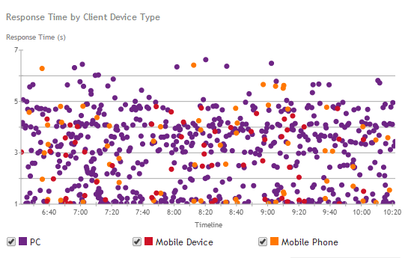
Investigative Analytics: Multiple Dimension Analytics

Slide 45
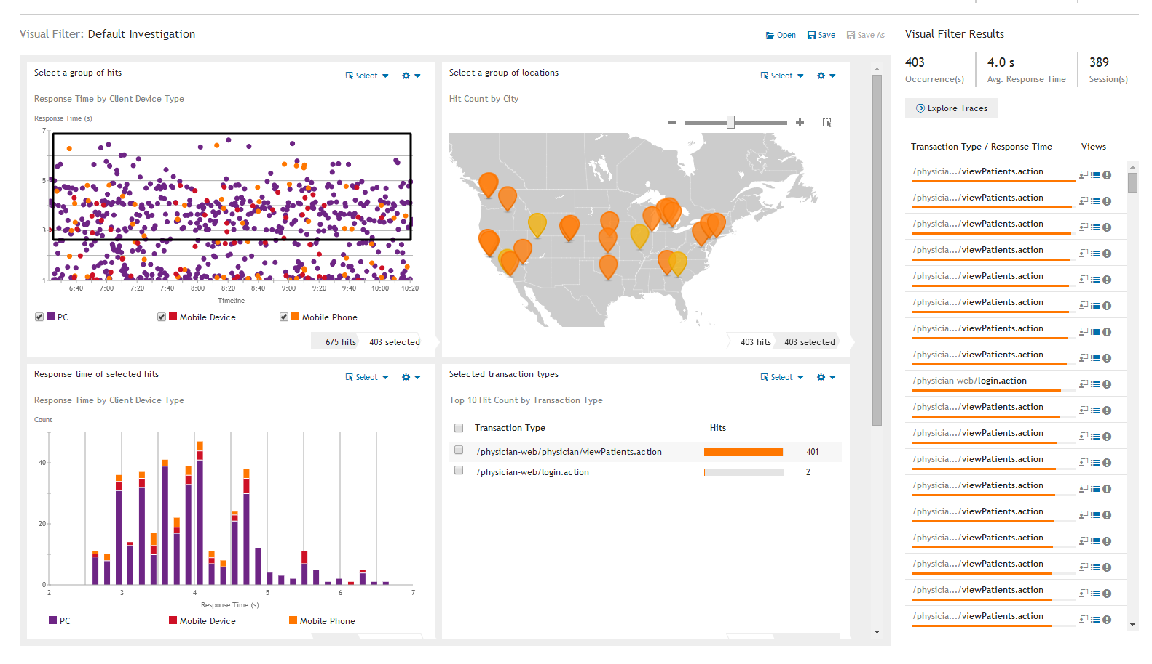

Slide 46
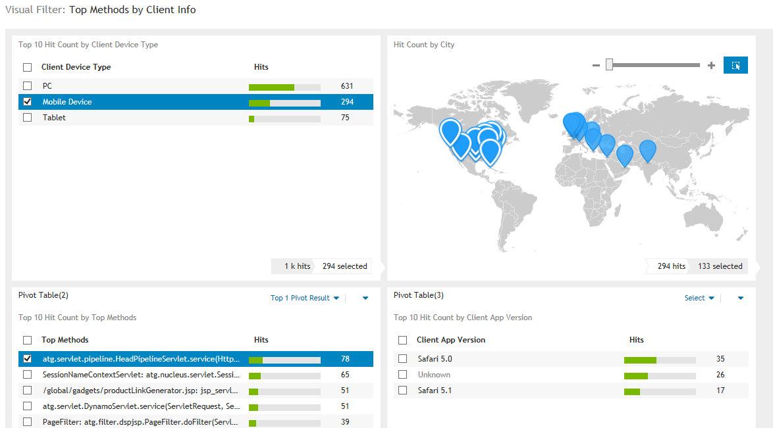
Investigative Analytics: Example Analysis

Slide 47
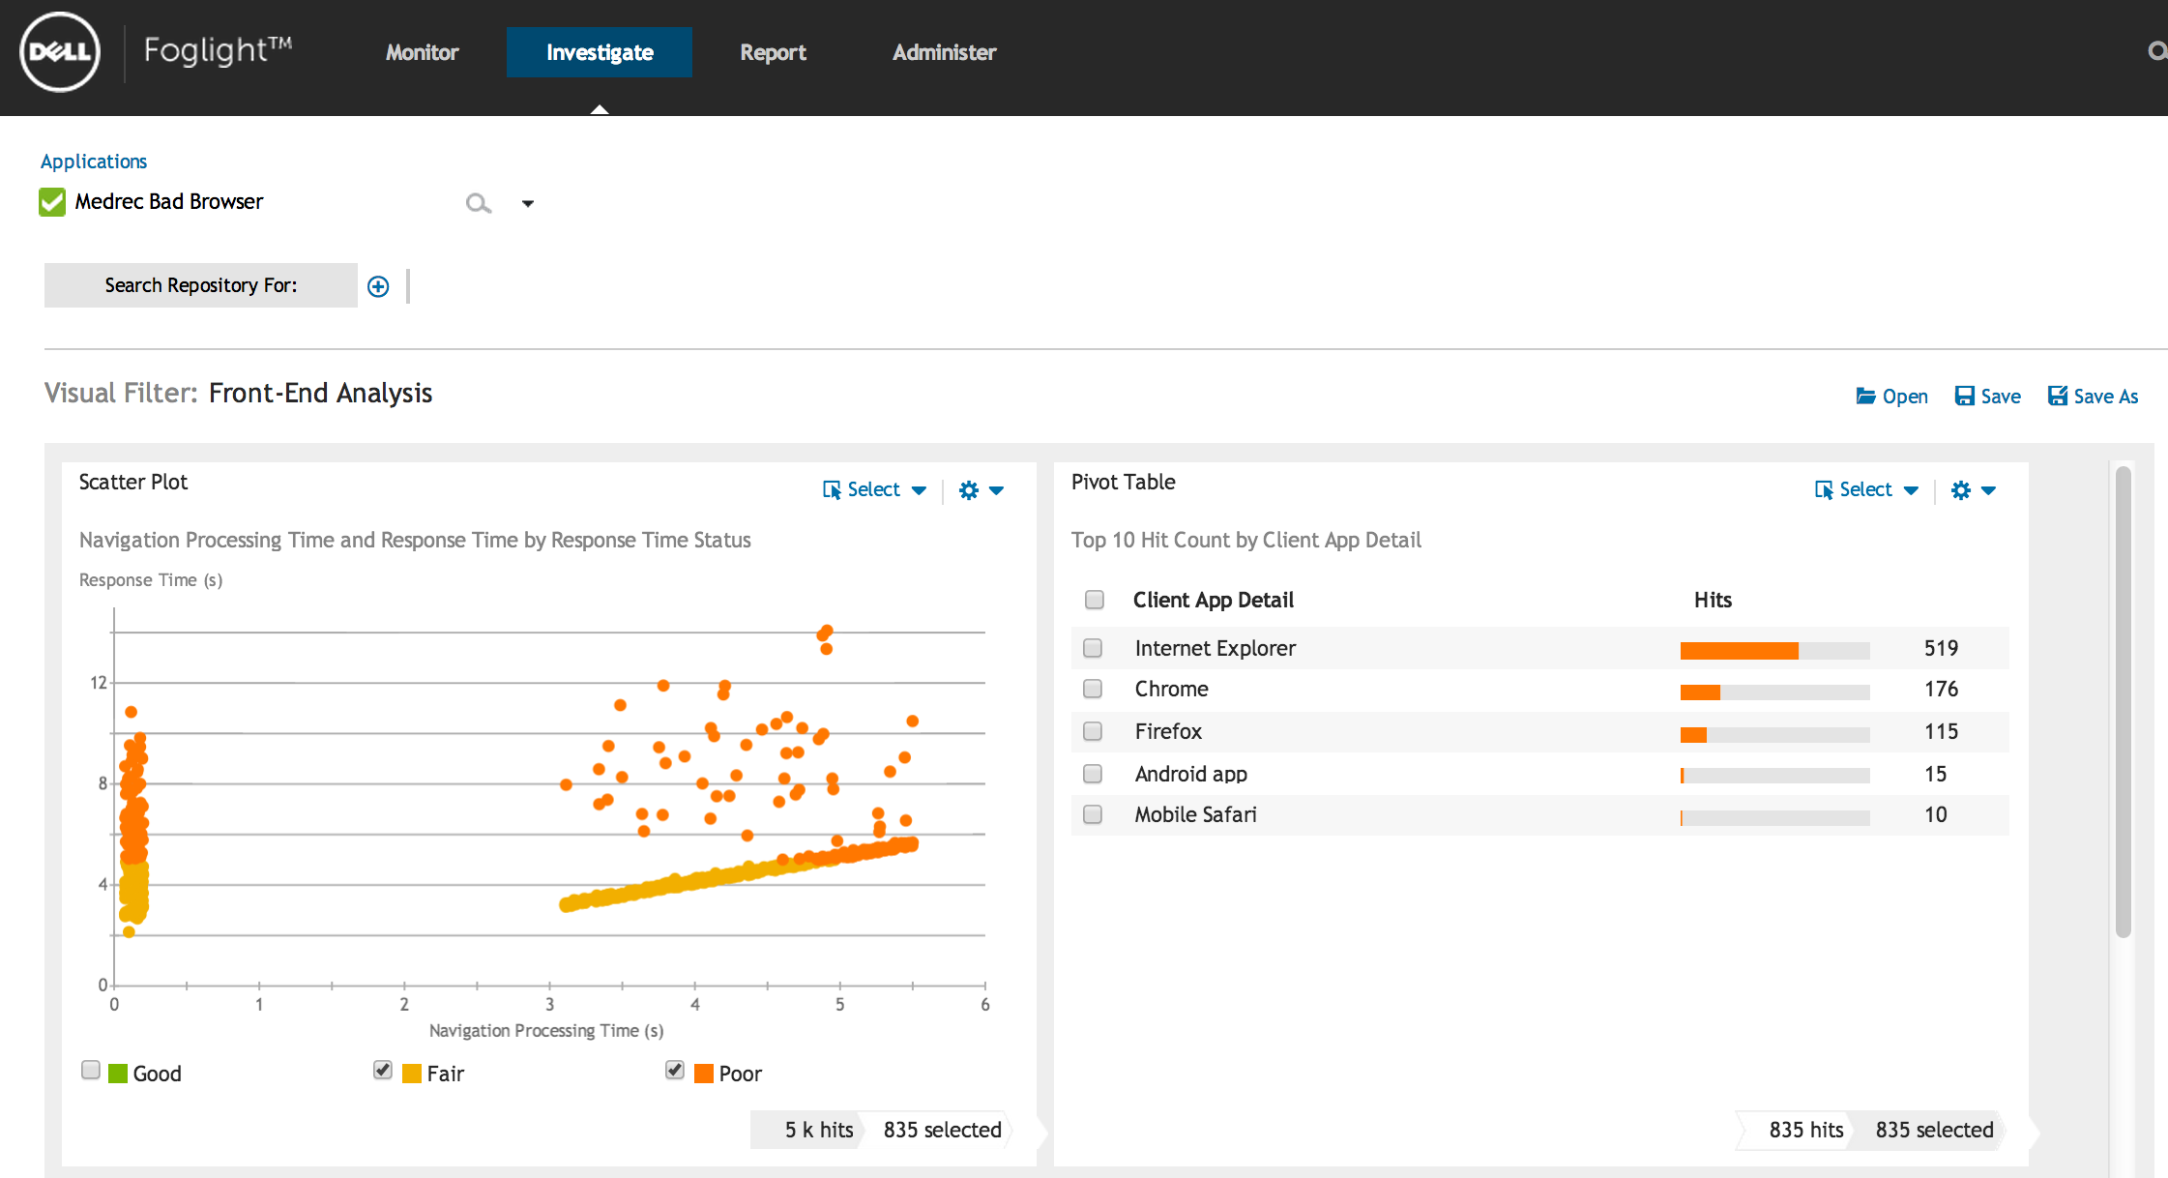

Slide 48
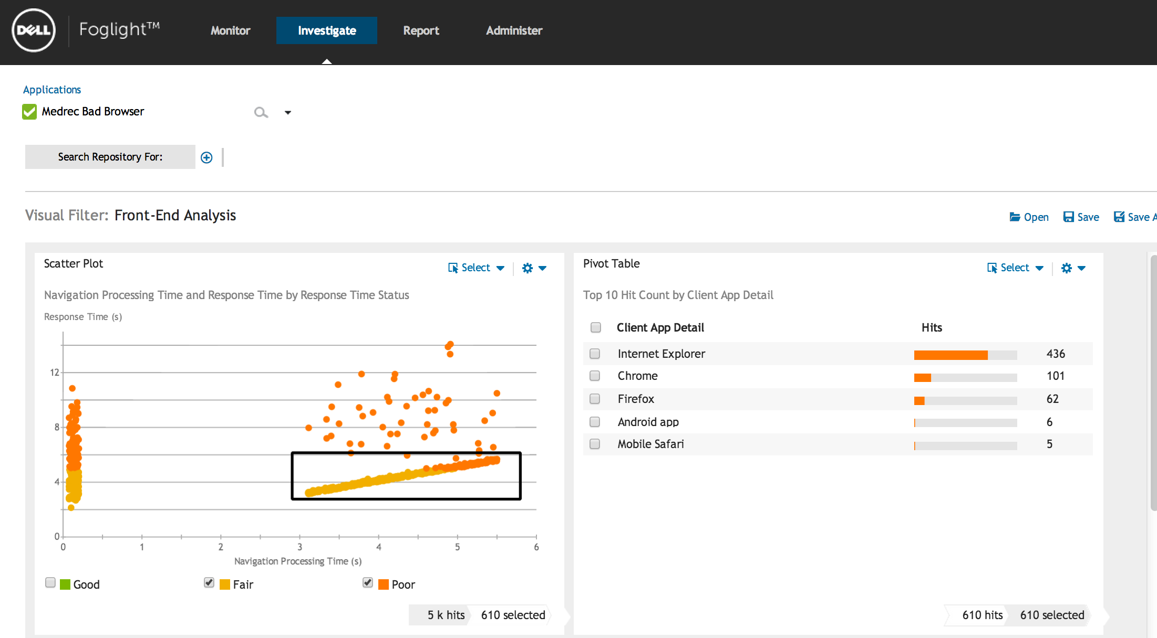

Slide 49
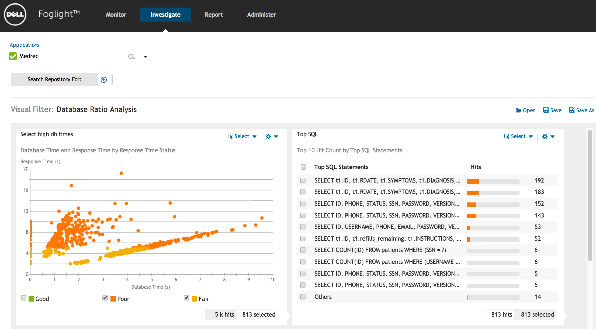

Slide 50
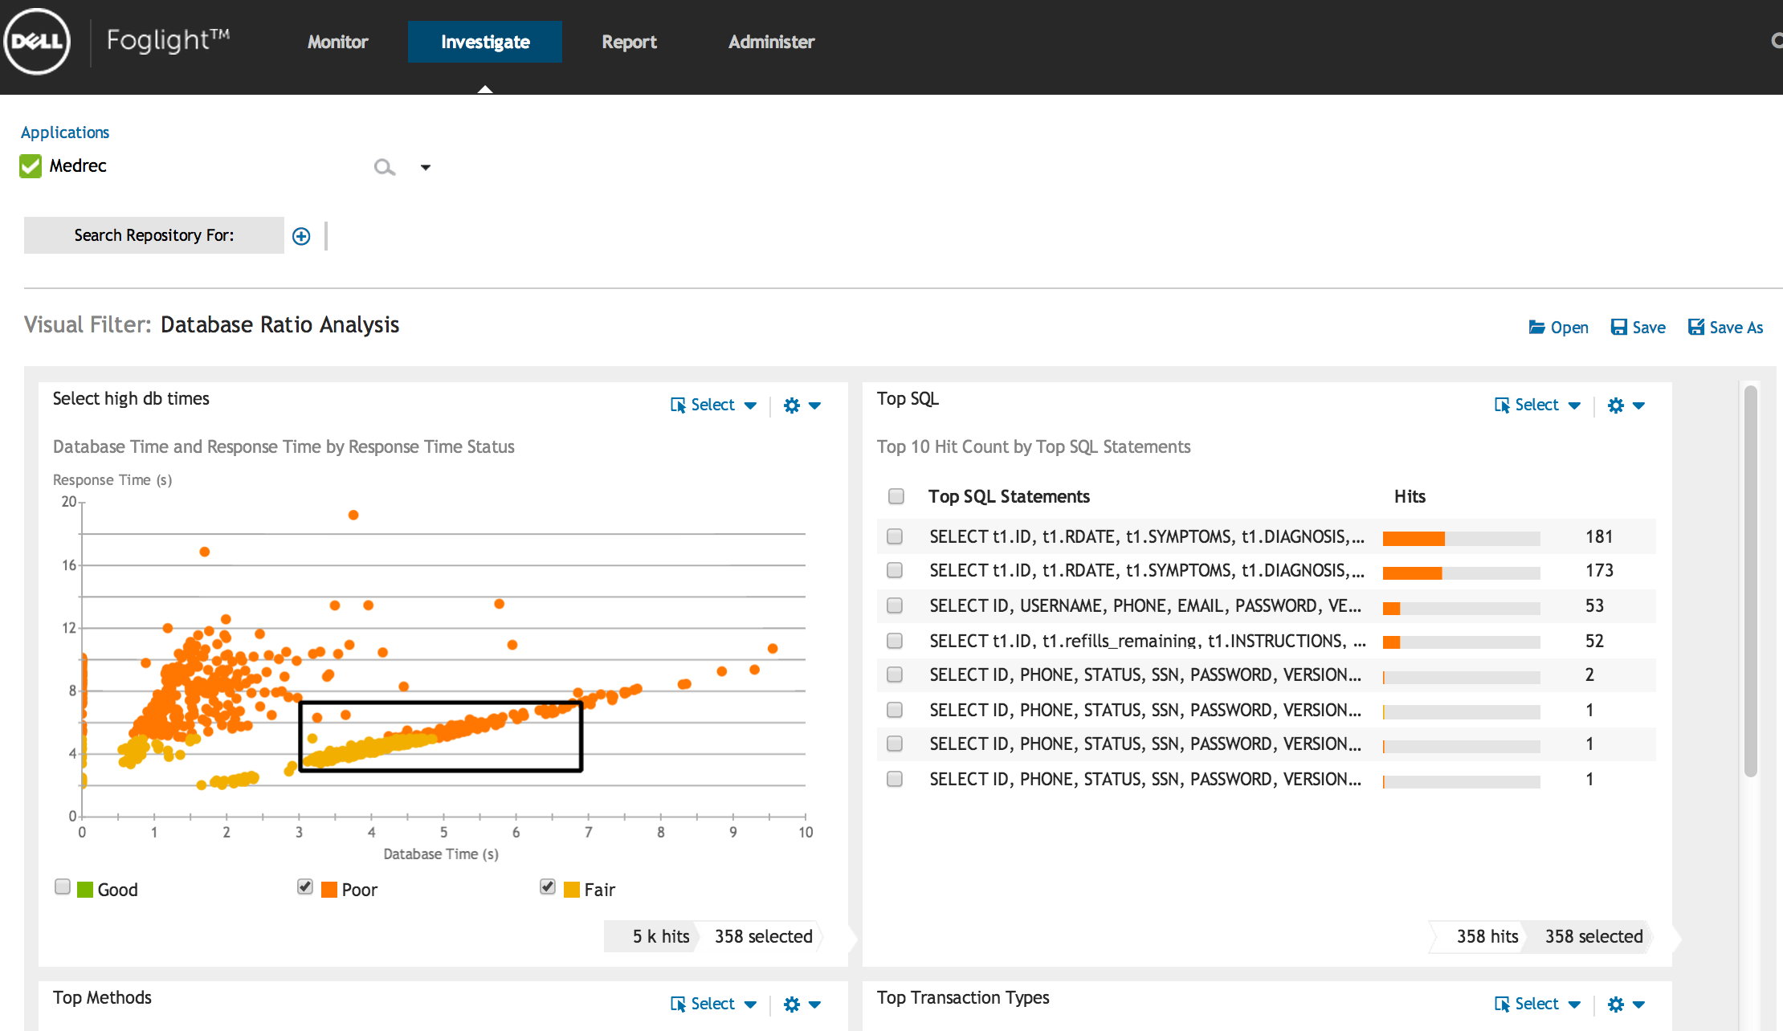

Slide 51
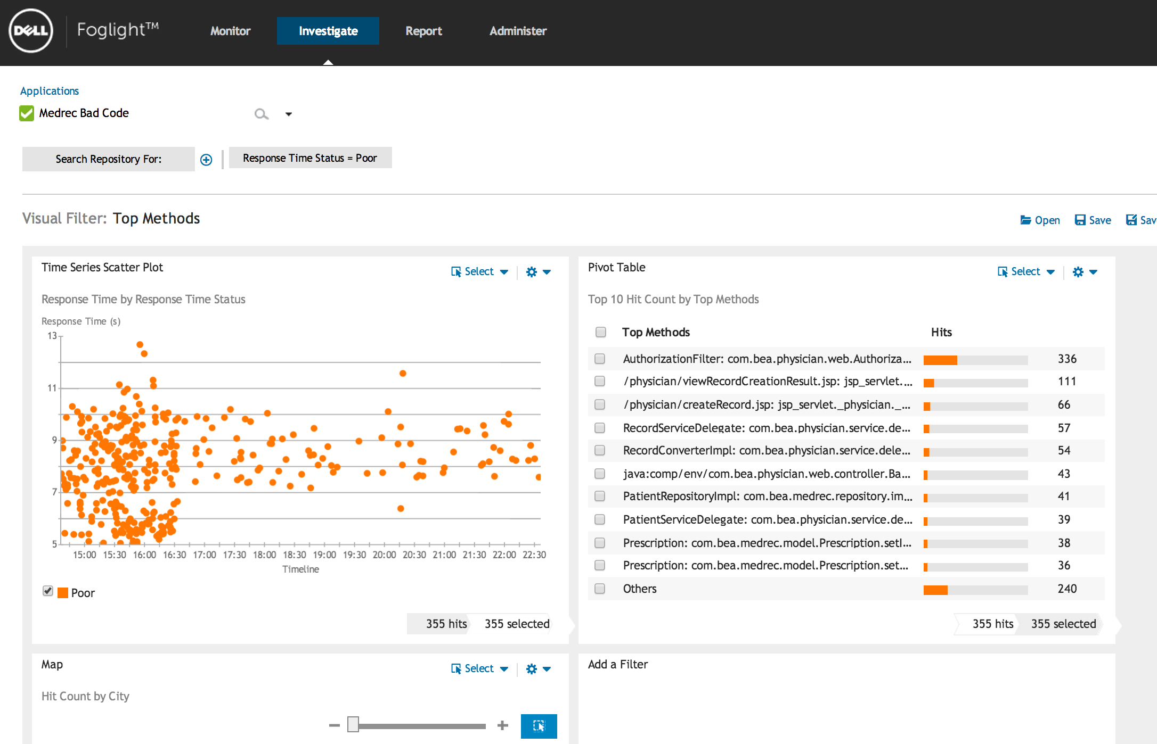

Slide 52
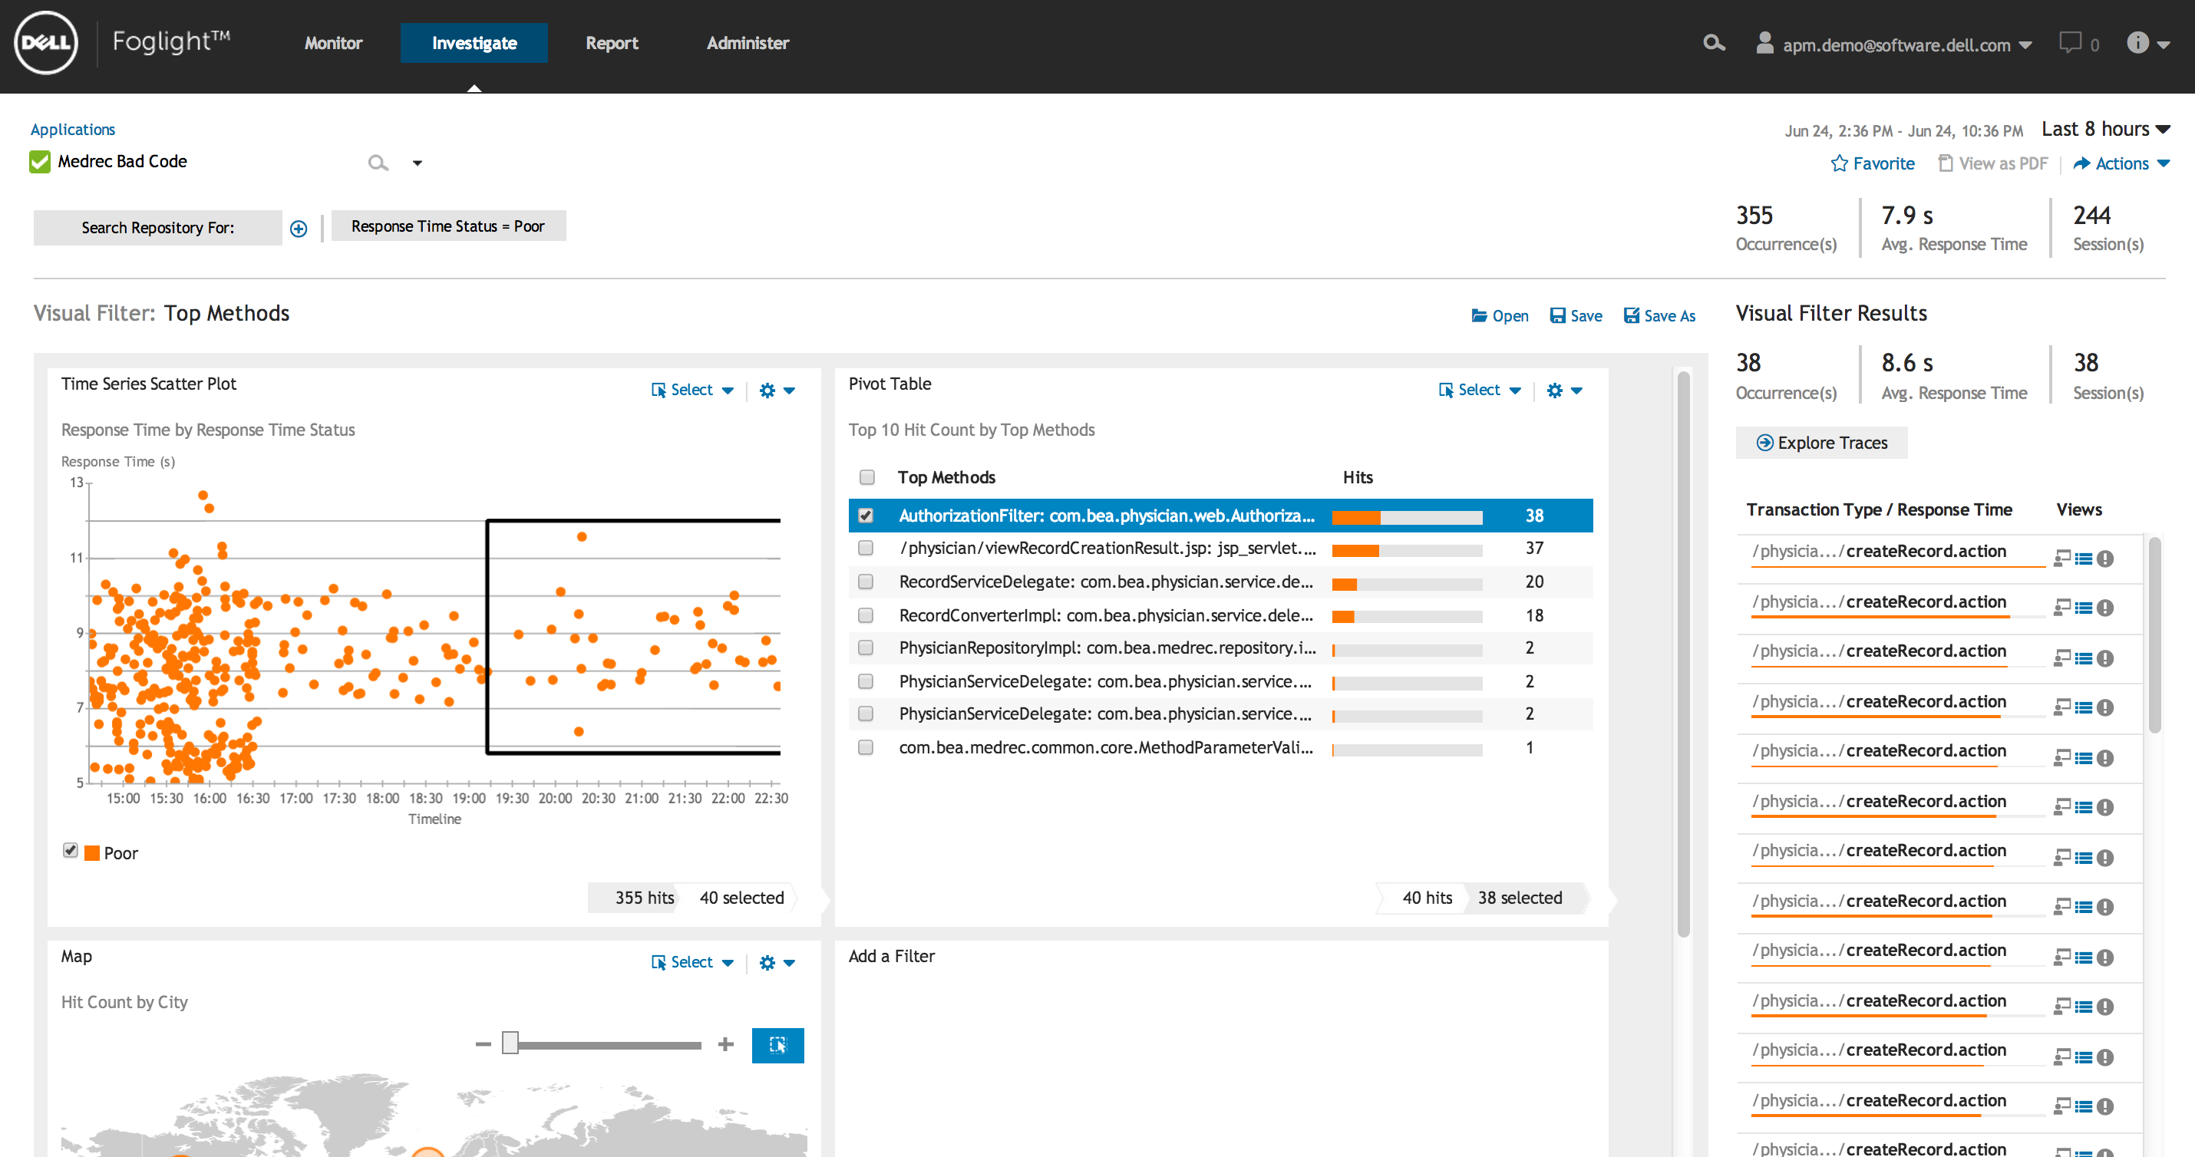

Slide 53
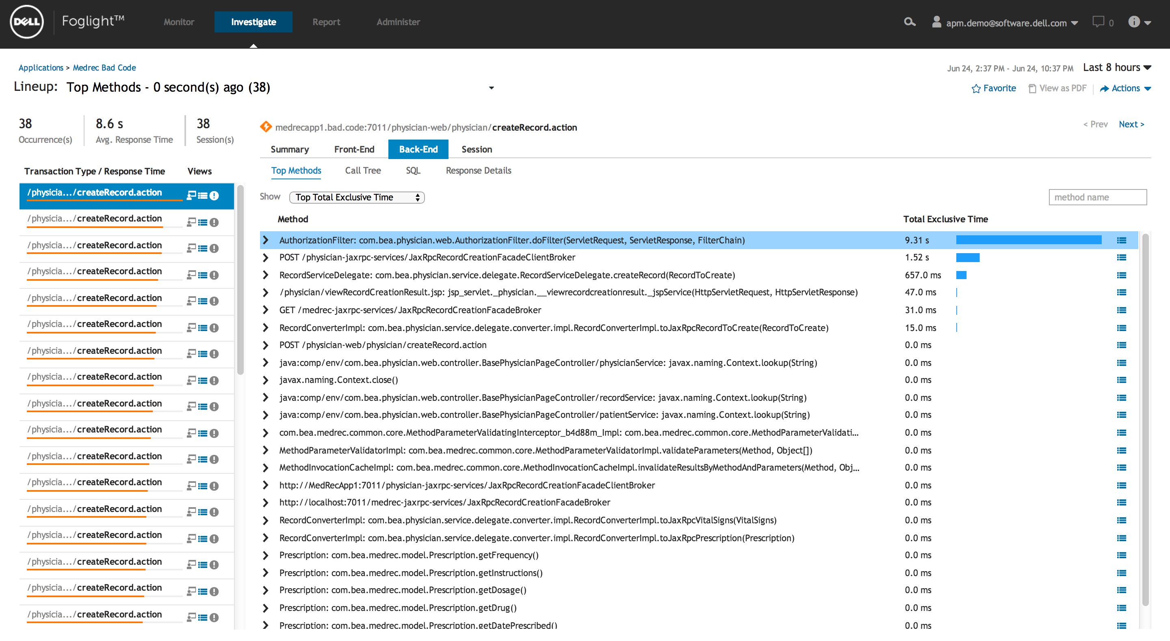

Slide 54
Ad Hoc Analytics to Investigate Anything
Hypotheses
Collect Data
Conclusions
Analyze

Slide 55
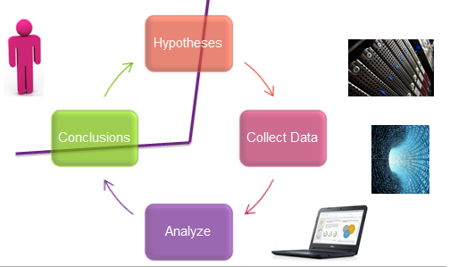
Q&A
Steve Fox
steve.fox@software.dell.com
@MrSteveFox
Rob Dickinson
rob.dickinson@software.dell.com
Come by booth!
Sign up for Beta! www.foglight.com

