Slide 1
User Innovation on the Internet of Things on Wheels
K. Venkatesh Prasad
Senior Technical Leader, Open Innovation
Ford Motor Company
Solid Conference
May 22, 2014 Fort Mason Center
San Francisco CA 2014

Slide 2
Outline
A Maker’s Story – The Haptic Shift Knob
User Innovation:
The Role of User Innovators (Makes)
Reducing Barriers to Innovation
The Internet of Things on Wheels
OpenXC
Why bother?
More Maker Stories ..
Q&A
http://corporate.ford.com/news-center/press-releases-detail/pr-potential-for-opensource-car-38325

Slide 3
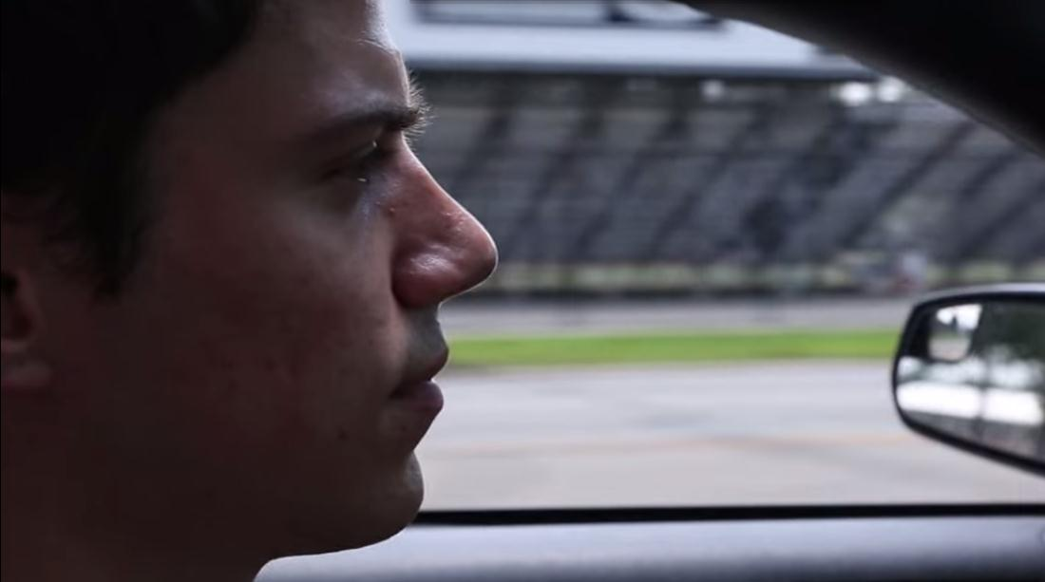
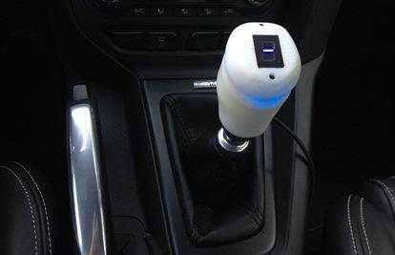
A Maker’s Story: Zac Nelson & The Haptic Shift Knob
http://corporate.ford.com/news-center/press-releases-detail/pr-potential-for-opensource-car-38325

Slide 4
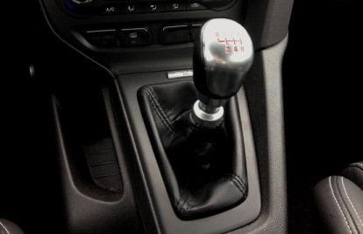
A Maker’s Story: Zac Nelson & The Haptic Shift Knob
openxcplatform.com/projects/shift-knob.html
http://corporate.ford.com/news-center/press-releases-detail/pr-potential-for-opensource-car-38325

Slide 5
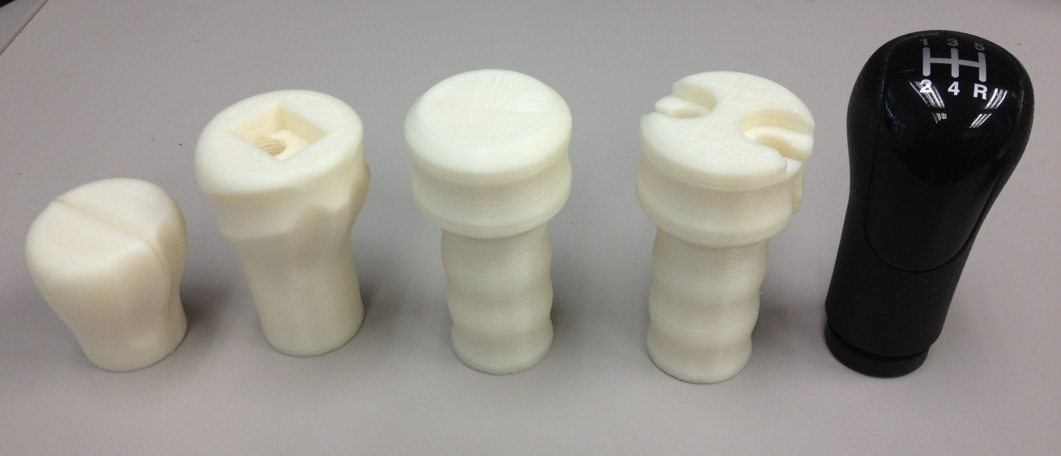
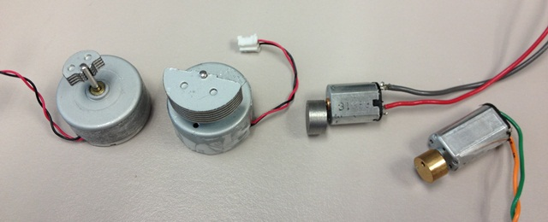
Making the Mechanical Parts
The Haptic Shift Knob

Slide 6
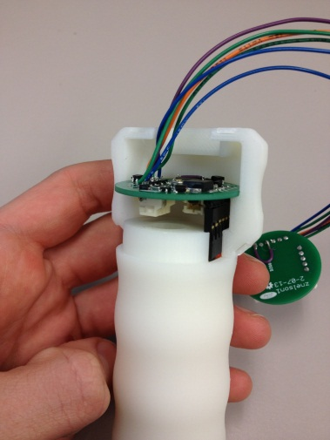
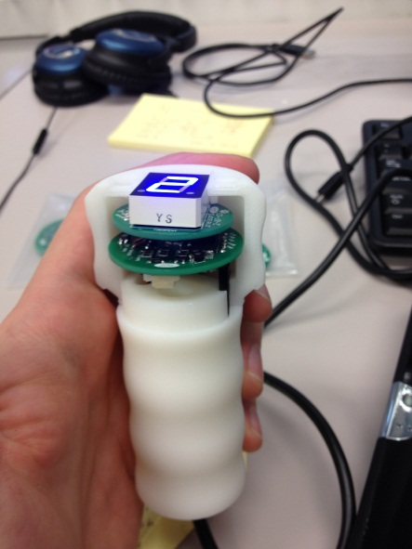
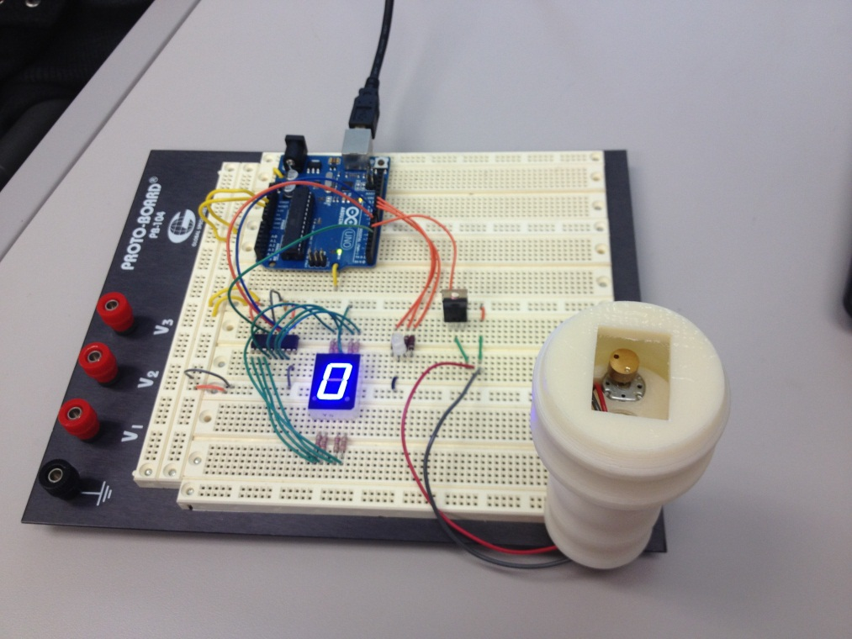
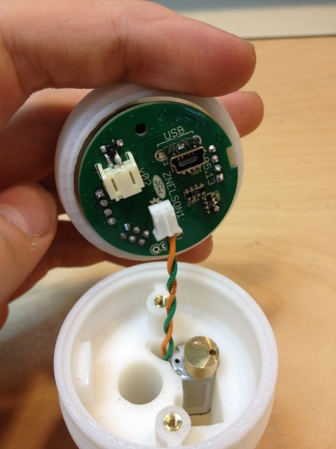
Making the Electronics & the Integration
The Haptic Shift Knob

Slide 7
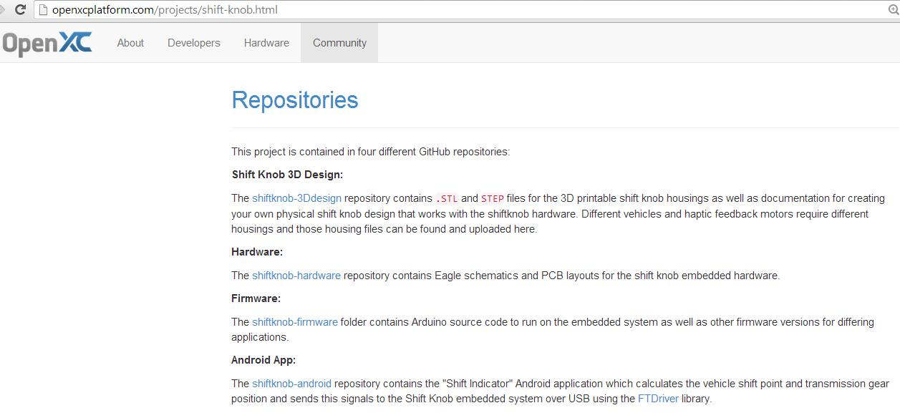
Making It Open
Source: http://openxcplatform.com/projects/shift-knob.html

Slide 8
User Innovation (The Von Hippel Curve)
Source: Professor Eric von Hippel

Slide 9
Users (makers) can Out-Innovate Manufacturers
USER
Non-linear Innovation
MFR
USER
USER
USER
USER
USER
MFR
USER
USER
USER
USER
USER
USER
Source: Professor Eric von Hippel
9
Notes:
9

Slide 10
Reducing barriers to user (maker)-innovation
Open-source:
Hardware and software (e.g., OpenXC)
Affordable Access:
Tools (e.g., TechShop)
Documentation (e.g., via the Creative Commons)
Human wisdom and knowledge
Celebrating Success
Sharing Failure!

Slide 11
The Internet of Things on Wheels

Slide 12
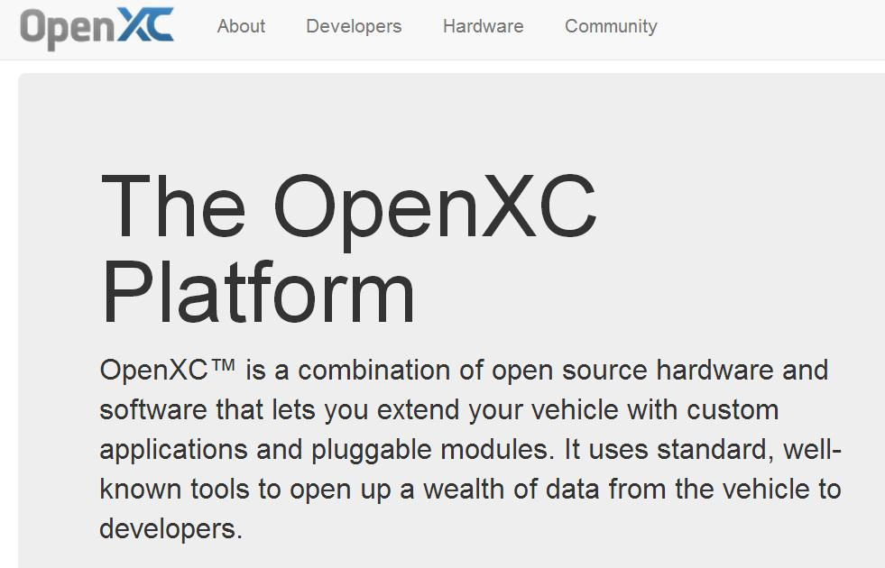
OpenXC: An Open Source Maker Innovation Platform
openxcplatform.com
Notes:
12

Slide 13
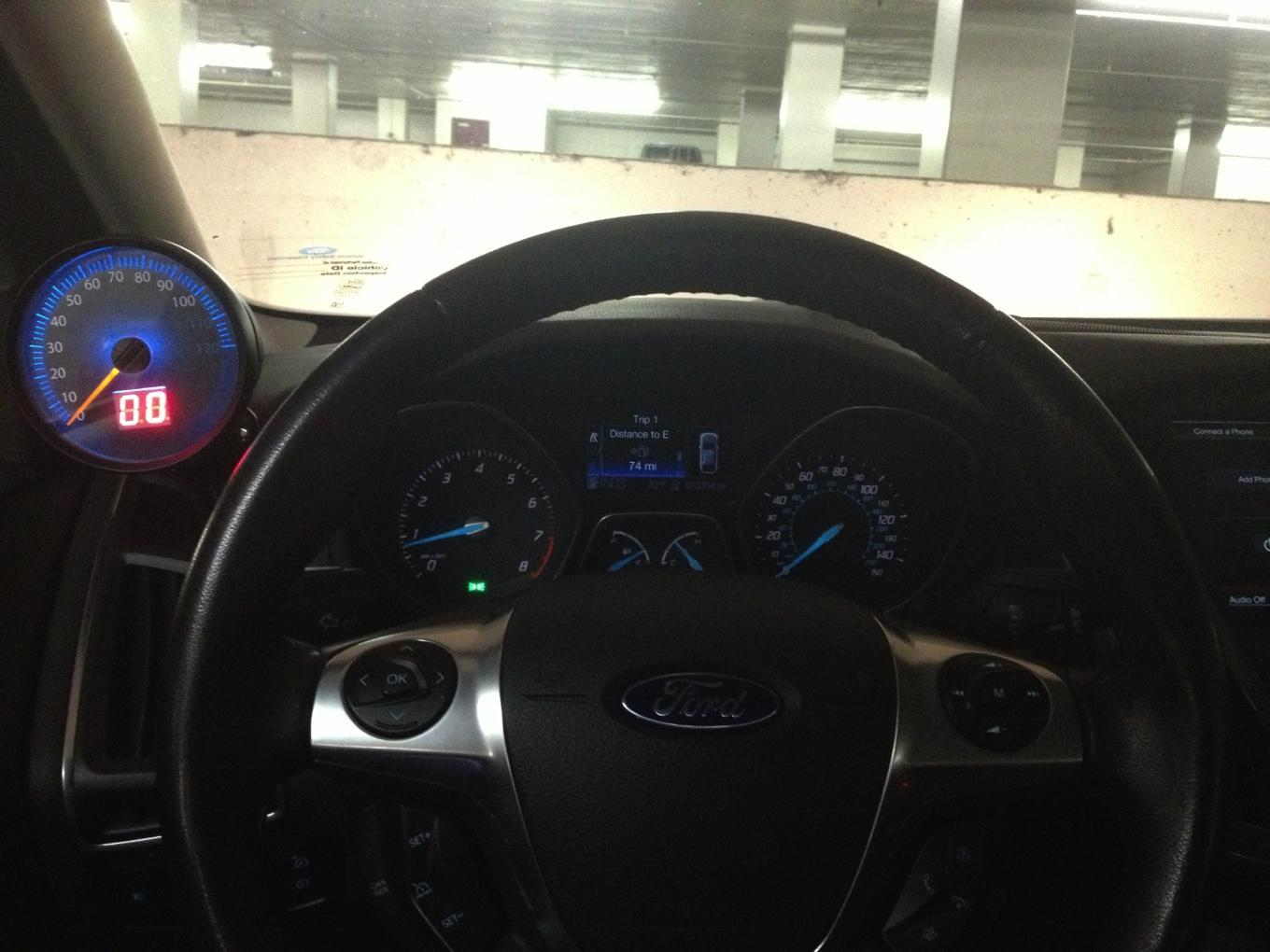
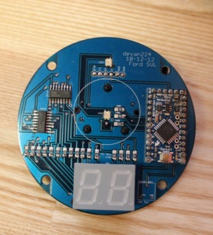
Retro-Gauge
openxcplatform.com/projects/retro-gauge.html

Slide 14
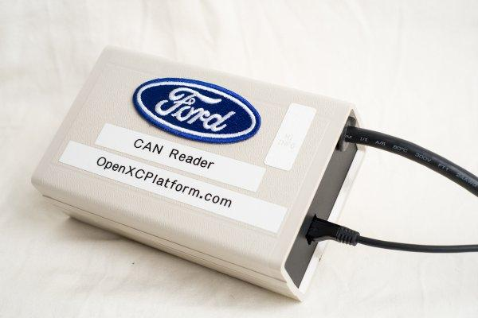
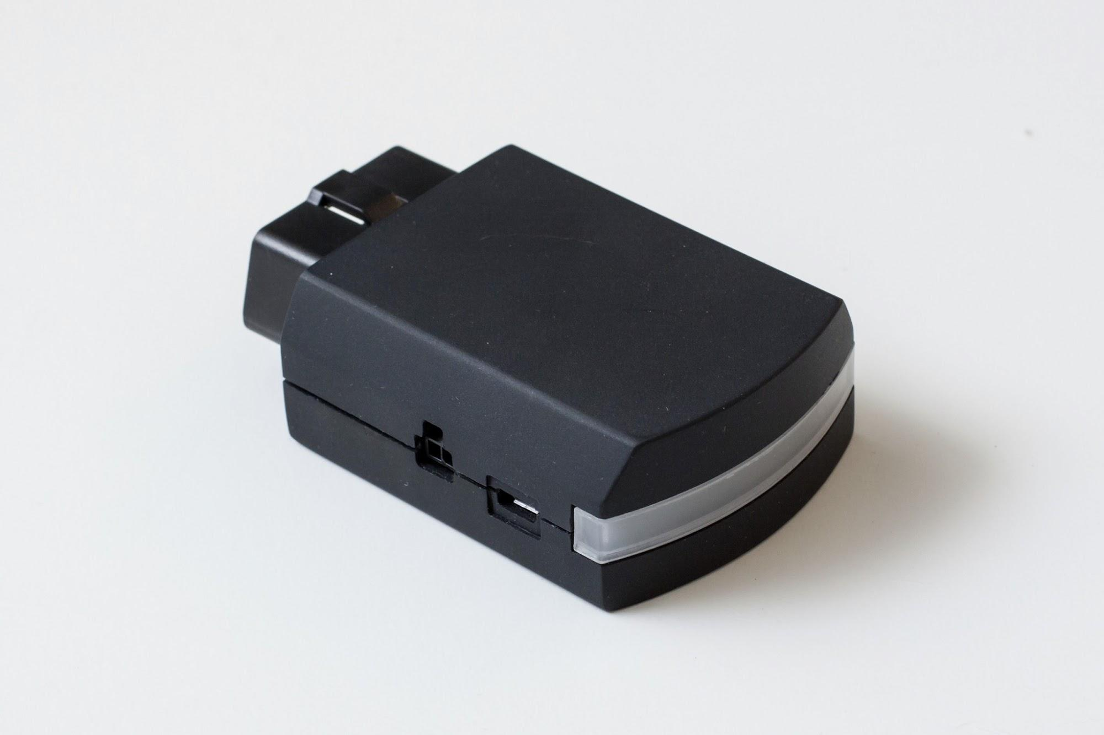
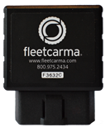
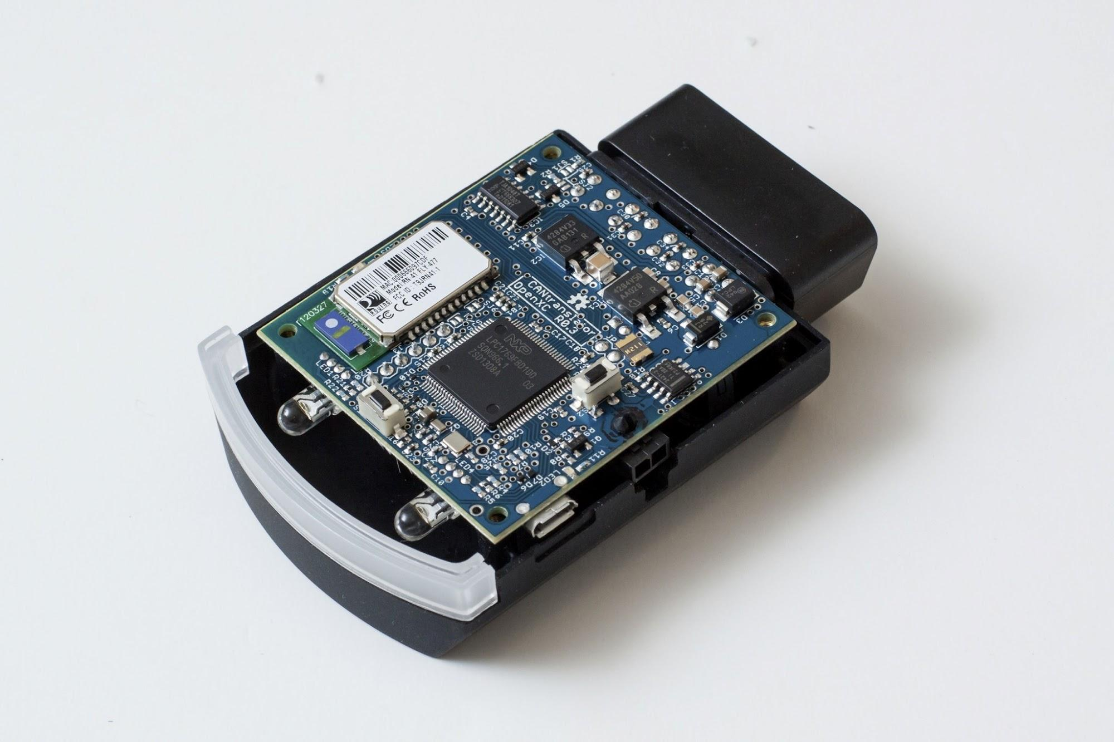
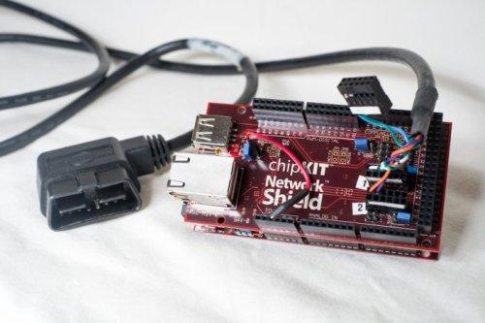
Vehicle Interfaces (VIs)
OpenXC VI – from CrossChasm:
OpenXC VI – streamlined version
OpenXC VI – a DIY version
Off-the-shelf solution, assembly instructions at openxcplatform.com
Open source, streamlined version in prototype production
Sources: http://openxcplatform.com/ (OpenXC – streamlined and DIY versions) http://www.crosschasm.com/technology/openxc-hardware/ (fleetcarma version)

Slide 15
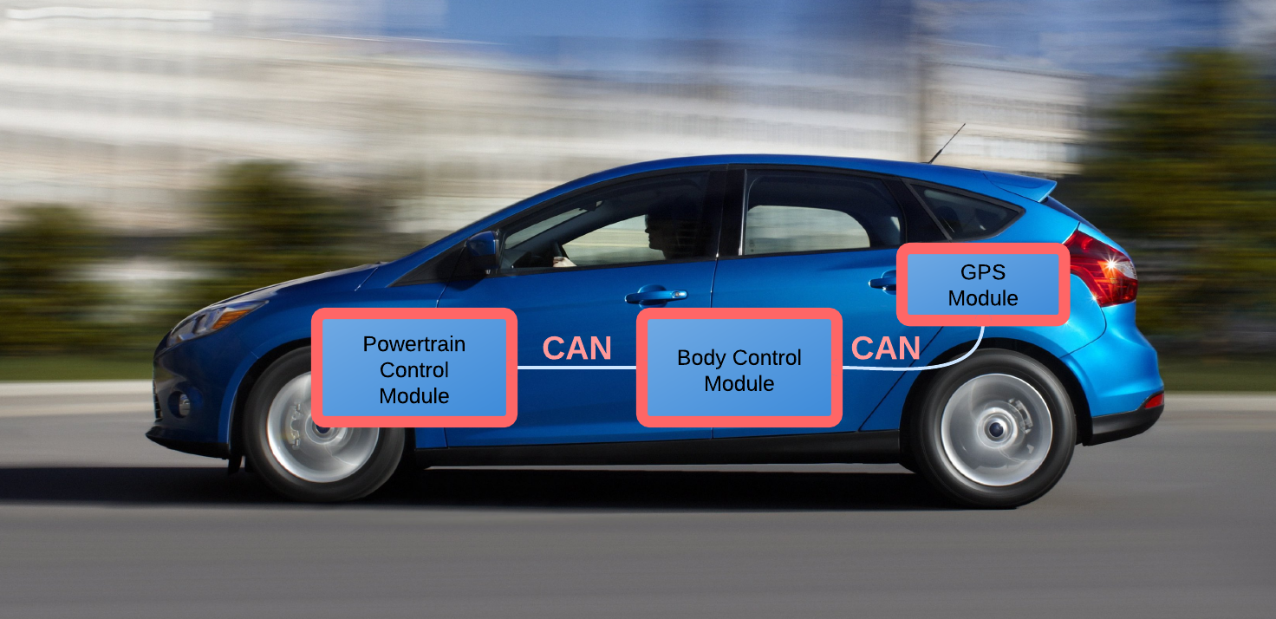
Controller Area Network
openxcplatform.com

Slide 16
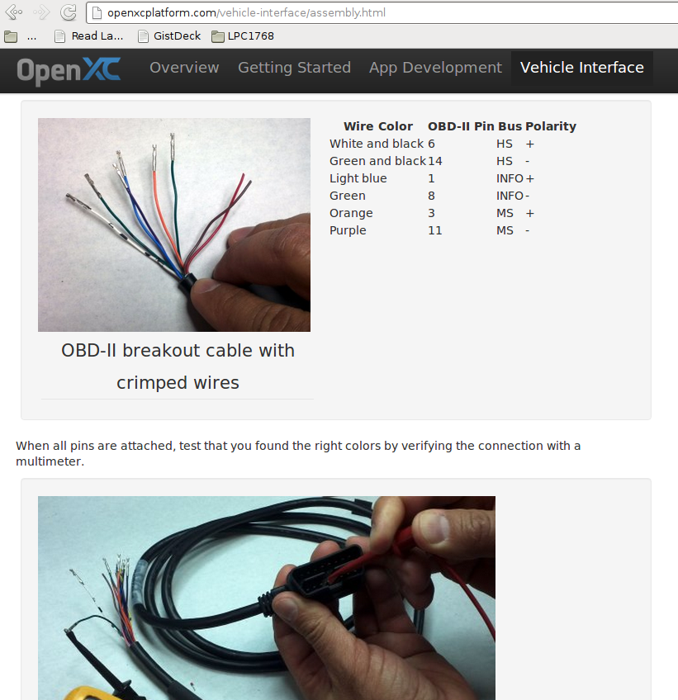
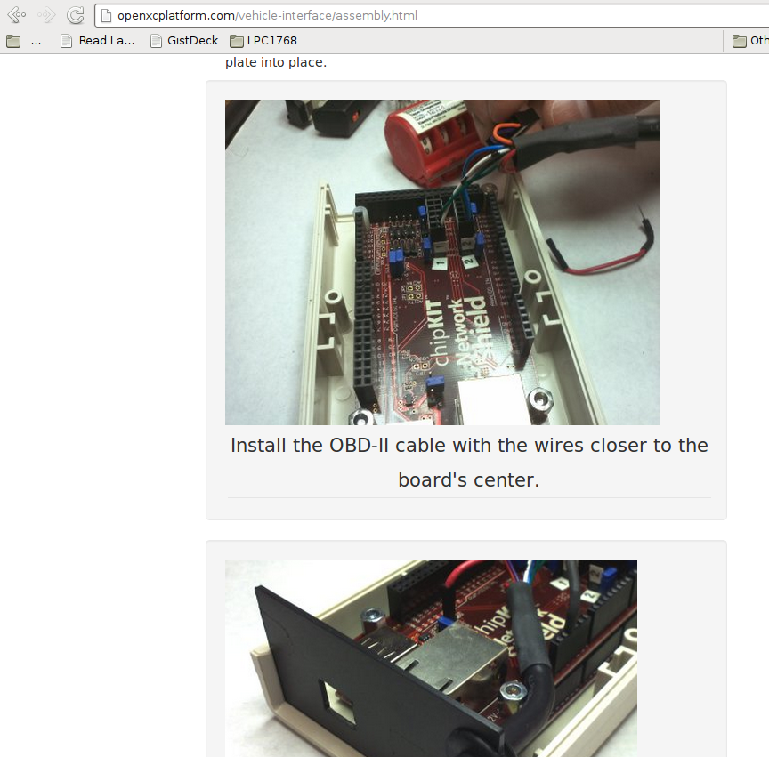
Open Assembly
openxcplatform.com

Slide 17
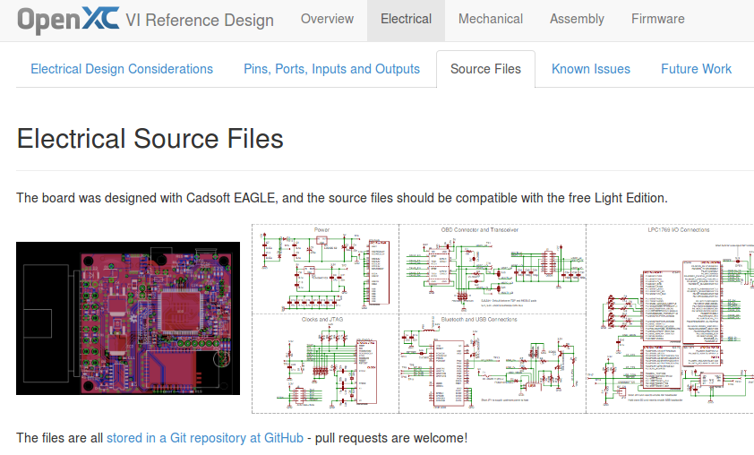
Open Hardware
http://vi.openxcplatform.com

Slide 18
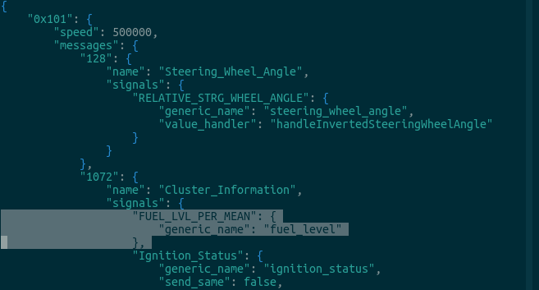
Flexible Software
openxcplatform.com

Slide 19
Developer Requirements
Required:
Laptop
Not Required:
Smartphone
Tablet
Data plan
Ford vehicle
Any vehicle
Vehicle interface
Contract with Ford
openxcplatform.com

Slide 20
Hackathons for Education (for anyone …)
Source: http://www.blrdroid.com/2013/12/02/the-openxc-hackathon/

Slide 21
Hackathons for Vehicles

Slide 22
Innovation Contests … with the Crowds
Three examples:
Apps for Vehicle Challenge (http://appsforvehicles.challengepost.com/ )
Personalized Fuel Efficiency App Challenge (http://ford.challengepost.com/ )
Traffic Tamer Challenge (http://traffic.challengepost.com/ )

Slide 23
Apps for Vehicles (Dec. 2012)
http://appsforvehicles.challengepost.com/

Slide 24
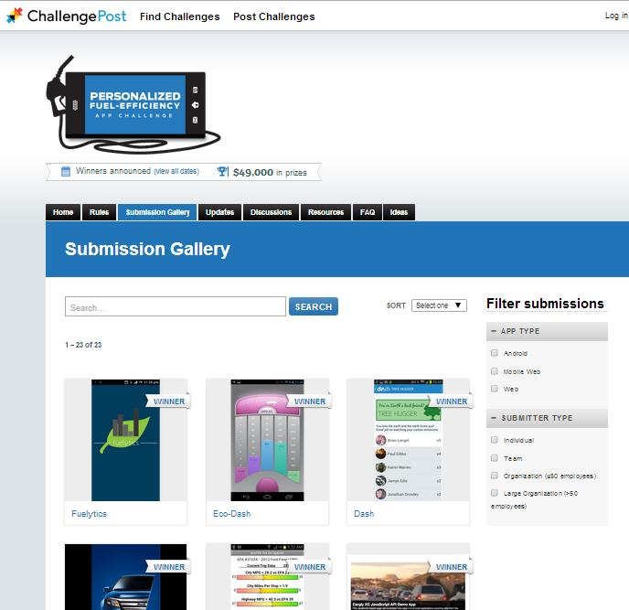
Personalized Fuel Efficiency (April 2013)
http://ford.challengepost.com/

Slide 25
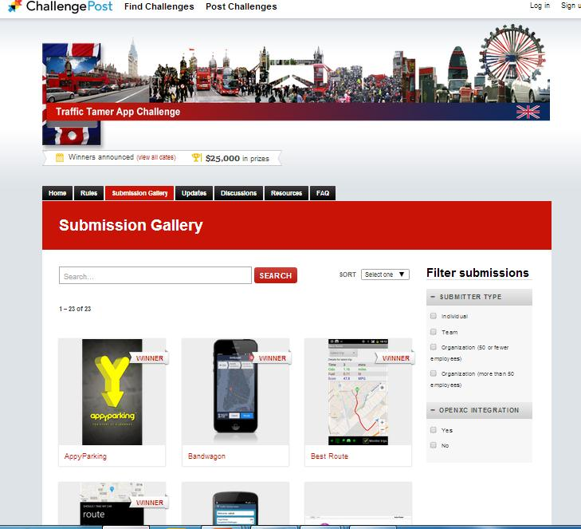
Traffic Tamer Challenge (Oct. 2013)
http://traffic.challengepost.com/

Slide 26
Thank you
Acknowledgments
Sudipto Aich
Bill Coughlin
Jóhannes Kristinsson
Zac Nelson
Jamel Seagraves
Chih-wei Tang
and a number of other colleagues at Ford Motor Company and elsewhere
http://www.youtube.com/watch?v=TS0MQ5Hj91w
Q&A

