Slide 1
Leveraging Logic as a Leader
Patty McCord
Cultivate 2013

Slide 2
How I got here

Slide 3
I did not write the
Netflix Culture Deck

Slide 4
It’s not what you aspire to do It’s what you actually do

Slide 5
Today’s Lessons
Start with: Fundamentals
Teams: Visualizing Greatness
My Secret: Pattern Recognition

Slide 6
I Engineers

Slide 7
Clean, straightforward, logical
Good
Right
True
Zero
Black
Bad
Wrong
False
One
White

Slide 9
Fundamentals
Company First
Judgment trumps everything
You can just tell the truth

Slide 10
Teams: Visualizing Greatness
In 6 months
if everything was amazing
and you had the perfect team in place…
What would be occurring then that’s not occurring now?

Slide 11
What would you measure?
Metrics
Deliverables
Reporting
Cross functional alignment
Timeline, deadlines, due dates

Slide 12
What would it look like?
Winning debates?
Winning tests?
Customer feedback?
Data and analysis?
Influence?

Slide 13
What would people need to know how to do to pull that off?

Slide 14
What skills and experience would it take to know how to do that?

Slide 15
Then, and only then, Who do you got?

Slide 16
Because
To build the right team - you must know what you are going to build
If you start with who you have, you may be limited in what you can do
You now can tell the truth

Slide 17
…and furthermore
People can decide if they are motivated by the work
They know what they can do
They can own their careers
They can opt in or out

Slide 18
Imagine a world
No Performance Improvement Plans
Where interviewing isn’t a sin
You can be honest
People can do their best work

Slide 19
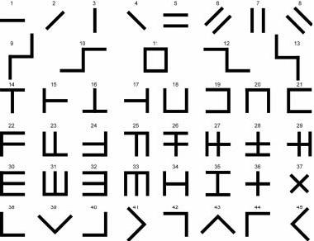
Pattern Recognition

Slide 20
I leaned this from them

Slide 21
Learn to Observe
To change
To challenge
To the unknown
To each other
To unexpected interruption
To learning

