Slide 1
Introducing Hunk ™ Splunk Analytics for Hadoop Brett Sheppard Director, Big Data Product Marketing data@splunk.com
Notes:
Hunk: Splunk® Analytics for Hadoop is a full-featured, integrated analytics platform to enable everyone in your organization to interactively explore, analyze and visualize data in Hadoop.
Building on Splunk’s years of experience with big data analytics technology deployed at over 6,000 customers, Hunk drives dramatic improvements in the speed and simplicity of getting answers from big data in Hadoop without dependence on expensive and scarce personnel skills or inflexible, fixed schemas.
Hunk empowers everyone to quickly and easily derive actionable insights from raw, unstructured and polystructured data in Hadoop. Hunk works with what you have today from Apache Hadoop or your choice of Hadoop distribution including Cloudera, Hortonworks, IBM, MapR and Pivotal.
List pricing for a one-year term license begins at US$2,500 per Hadoop node with a minimum of 10 nodes.

Slide 2
Safe Harbor Statement
During the course of this presentation, we may make forward looking statements regarding future events or the expected performance of the company. We caution you that such statements reflect our current expectations and estimates based on factors currently known to us and that actual events or results could differ materially. For important factors that may cause actual results to differ from those contained in our forward-looking statements, please review our filings with the SEC. The forward-looking statements made in this presentation are being made as of the time and date of its live presentation. If reviewed after its live presentation, this presentation may not contain current or accurate information. We do not assume any obligation to update any forward looking statements we may make. In addition, any information about our roadmap outlines our general product direction and is subject to change at any time without notice. It is for informational purposes only and shall not be incorporated into any contract or other commitment. Splunk undertakes no obligation either to develop the features or functionality described or to include any such feature or functionality in a future release.
Notes:
Splunk safe harbor statement.

Slide 3
The Accelerating Pace of Data
Volume | Velocity | Variety | Variability
Machine data is the fastest growing, most complex, most valuable area of big data
GPS,
RFID,
Hypervisor,
Web Servers,
Email, Messaging,
Clickstreams, Mobile,
Telephony, IVR, Databases,
Sensors, Telematics, Storage,
Servers, Security Devices, Desktops
Notes:
Data is growing and embodies new characteristics not found in traditional structured data: Volume, Velocity, Variety, Variability.
Machine data is one of the fastest, growing, most complex and most valuable segments of big data.
All the webservers, applications, network devices – all of the technology infrastructure running an enterprise or organization – generates massive streams of data, in an array of unpredictable formats that are difficult to process and analyze by traditional methods or in a timely manner.
Why is this “machine data” valuable? Because it contains a trace - a categorical record - of user behavior, cyber-security risks, application behavior, service levels, fraudulent activity and customer experience.

Slide 4
Make machine data accessible, usable and valuable to everyone.
Notes:
Splunk software is the platform for machine data. At Splunk, our mission is to make machine data accessible, usable and valuable to everyone. And this overarching mission is what drives our company and product priorities.

Slide 5
Splunk Company Overview
Company (NASDAQ: SPLK)
Business Model / Products
Customers 6000+
2004
60+
of the Fortune 100
founded
On-premise
2006
first software release
In the cloud
Largest license:
100
Terabytes/day
HQ
San Francisco
SaaS
Notes:
Splunk has more than 850 employees worldwide, with headquarters in San Francisco and 14 offices around the world.
Since first shipping its software in 2006, Splunk now has over 6,000 customers in 90+ countries. These organizations are using Splunk software to improve service levels, reduce operations costs, mitigate security risks, enable compliance, enhance DevOps collaboration and create new product and service offerings.
Please always refer to latest company data found here: http://www.splunk.com/company.

Slide 6
Delivers Value Across IT and the Business
App Dev and
App Mgmt.
IT
Operations
Security and Compliance
Digital Intelligence
Business Analytics
Industrial Data and Internet of Things
Developer Platform (REST API, SDKs)
Small Data. Big Data. Huge Data.
6
Notes:
Customers start by using Splunk Enterprise to address one specific solution area. Then they leverage it and their machine data to solve other pressing problems over time.
Consequently, Splunk Enterprise has many critical uses across IT and the business:
Application Management: provide end-to-end visibility across distributed infrastructures; troubleshoot across application environments; monitor for performance degradation; trace transactions across distributed systems and infrastructure.
IT Operations Management: proactively monitor across IT silos to ensure uptime; rapidly pinpoint and resolve problems; report on SLAs/track SLAs of service providers.
Security and Compliance: provide rapid incident response, real-time correlation and in-depth monitoring across data sources; statistical analysis for advance pattern detection and threat defense.
Web Intelligence and Business Analytics: gain visibility and intelligence on customers, services and transactions; identify trends and patterns in real time; fully understand the impact of new product features on back-end services.
Industrial Data and Internet of Things: understand in real-time with historical context data from the wealth of IP-enabled devices, from environmental and transportation sensors to medical devices and wearable computing.

Slide 7
Getting Value from Data in Hadoop is Challenging
Easy storage but hard analytics: difficult to explore, analyze, visualize
Complex technology: many open source projects
Hard-to-staff skills: must write MapReduce jobs or fixed schemas
Wide Range of Open Source
Projects for Hadoop Analytics
Mahout
Pig
H
i
v
e
Sqoop
YARN
DataFu
Azkaban
Hadoop (MapReduce & HDFS)
Notes:
Working with Hadoop distribution vendors or Apache downloads, customers have sorted out how to set up Hadoop Distributed File System (HDFS) clusters and transfer data into the cluster via Cloudera-developed Flume, Facebook-developed Scribe, Sqoop for data from relational databases, or other data transfer tools. Where customers face significant hurdles is how to explore, analyze and visualize data in Hadoop.
There are well known and significant challenges deploying and getting value out of data in Hadoop:
20X amount of services relative to software – according to Gartner
Getting any kind of analytics out of the data requires rare, specialized skillsets
And “Hadoop” currently consists of 13+ projects that need integration
So how do you get value out of data that – as some of our customers put it – is TO BIG TO MOVE or “TBTM”?
Example Open Source Projects:
Mahout: Library of machine learning algorithms for Hadoop
Sqoop: Data transport engine for integrating Hadoop with relational databases
YARN: The next generation of MapReduce framework
Pig: High-level data flow language for processing data stored in Hadoop
DataFu: Library of User Defined Functions (UDFs) for Apache Pig
Hive: Metadata repository with SQL-like interface and ODBC/JDBC drivers for connecting BI applications to Hadoop
Azkaban: Job scheduler used at LinkedIn

Slide 8
What Does Gartner Say?
Peak of inflated expectations
“
My most advanced Hadoop clients are also getting disillusioned … The only consistent success, reported by my clients, is with Splunk.
“
VISIBILITY
Many Hadoop customers
Svetlana Sicular, Gartner Research Director, January 22, 2013
Plateau of productivity
Slope of enlightenment
Technology Trigger
trough of disillusionment
TIME
8
Notes:
In her blog, Gartner Analyst Svetlana Sicular wrote an article entitled ‘Big Data is Falling into the Trough of Disillusionment’ . She stated and I quote “the only consistent success, reported by my clients, is with log analysis using Splunk. Why? Because Splunk is a nice tool.”
http://blogs.gartner.com/svetlana-sicular/big-data-is-falling-into-the-trough-of-disillusionment/

Slide 9
We Began to Address This Challenge
Real-time Collection and Analysis
Dashboards, Reports, Access Controls
Splunk Hadoop Connect
>
>
Bi-directional data transfer
>
>
>
>
Splunk App for Hadoop Ops
Troubleshoot and monitor
Notes:
Platforms need to provide interoperability. And for Hadoop users, we are providing just that. We began to address this challenge and, we released Splunk Hadoop Connect in October 2012. This enables bi-directional integration - users can browse and move data into Splunk Enterprise and act on it.
Splunk Hadoop Connect enables Hadoop users to leverage Splunk Enterprise to reliably collect massive volumes of machine data. Analyze data in real-time, create visualizations, custom dashboards and protect data with secure role-based access. Then reliably deliver data to Hadoop for ongoing batch analytics. You can also index data stored in Hadoop because once in Splunk Enterprise, your data’s available for rapid visualization, reporting, analysis and sharing.
The Splunk App for HadoopOps extends what Splunk Enterprise already does well - troubleshoot and monitor your Hadoop infrastructure. And because it's Splunk it doesn't stop with the Hadoop components, it includes everything. End-to-end. So you get a more complete view of your environment.
But our customers also want to be able to leverage the full capability of Splunk natively on data in Hadoop. They want to interact with their data faster and more securely than they can today. In June 2013 we announced the beta of Hunk: Splunk Analytics for Hadoop along with strategic alliances with Cloudera, Hortonworks and MapR reinforcing our distribution agnostic strategy. Over 100 companies have participated in the Hunk beta program, with representation from North America, Europe, Asia and Australia, running on every major distribution of Hadoop. Beta customers told us that they went from installation to analytics in an hour or less, a much better experience than hiring programmers to define fixed schemas or write MapReduce jobs. We released Hunk for general availability in October 2013, including the addition of certified distribution support for IBM and Pivotal.

Slide 10
Introducing Hunk™
Splunk Analytics for Hadoop
New product from Splunk delivers interactive data exploration, analysis and visualizations for Hadoop
Notes:
One consequence of data heterogeneity is that there is no single data store that is ideal for every type of data at every stage of the data lifecycle from real-time streams to hot storage for immediate business needs to cold storage for data archival. The breadth of use cases that we see in the big data marketplace offers opportunities to expand and diversify our products to better serve our customers.
Splunk Enterprise delivers real-time and historical analytics of the huge transaction volumes of machine data required for high-speed operations.
Hunk offers ad hoc exploration, analysis and visualization of historical data at rest in Hadoop.
Hunk is priced and packaged separately from Splunk Enterprise. A Splunk Enterprise license is not required to run Hunk. Customers who buy both products can search across both native and virtual indexes in the same search.

Slide 11
Integrated Analytics Platform for Hadoop Data
Full-featured, Integrated Product
Explore
Analyze
Visualize
Dashboards
Share
Insights for Everyone
Works with What You Have Today
Hadoop (MapReduce & HDFS)
Notes:
Hunk offers Full-featured Analytics in an Integrated Platform
Explore, analyze and visualize data, create dashboards and share reports from one integrated platform.
Hunk enables everyone in your organization to unlock the business value of data locked in Hadoop
Hunk integrates the processes of data exploration, analysis and visualization into a single, fluid user experience designed to drive rapid insights from your big data in Hadoop. Enable powerful analytics for everyone with Splunk’s Data Models and the Pivot interface, first released in Splunk Enterprise 6.
And Hunk works with what you have today
Hunk works on Apache Hadoop and most major distributions, including those from Cloudera, Hortonworks, IBM, MapR and Pivotal, with support for both first-generation MapReduce and YARN (Yet Another Resource Negotiator, the technical acronym for 2nd generation MapReduce). Preview results and interactively search across one or more Hadoop clusters, including from different distribution vendors. Use the ODBC driver (beta) to feed data from Hunk to third-party data visualization tools or business intelligence software.

Slide 12
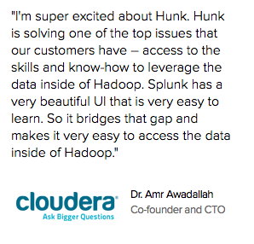
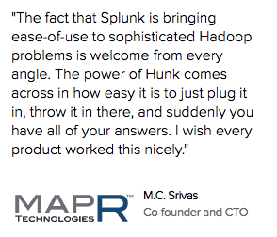
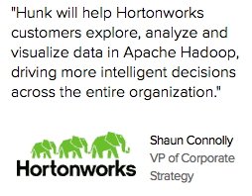
Validation from Partners
“I'm super excited about Hunk. Hunk is solving one of the top issues that our customers have – access to the skills and know-how to leverage the data inside of Hadoop. Splunk has a very beautiful UI that is very easy to learn. So it bridges that gap and makes it very easy to access the data inside of Hadoop."
"The fact that Splunk is bringing ease-of-use to sophisticated Hadoop problems is welcome from every angle. The power of Hunk comes across in how easy it is to just plug it in, throw it in there, and suddenly you have all of your answers. I wish every product worked this nicely.”
"Hunk will help Hortonworks customers explore, analyze and visualize data in Apache Hadoop, driving more intelligent decisions across the entire organization."

Slide 13
Explore, Analyze and Visualize Data On-the-fly
Virtual Index
Schema-on-the-fly
Flexibility and
Fast Time to Value
Enables seamless use of the Splunk technology stack on data wherever it rests
Handles MapReduce
Structure applied at search time
No brittle schema
Automatically find patterns and trends
Interactive search
Preview results while MapReduce jobs run
Drag-and-drop analytics
Notes:
Virtual Index
A virtual index allows a Hunk search to access data in external systems and push computation to those systems. This patent-pending capability brings Splunk’s data processing technology to where your data lives. A virtual index behaves as an addressable data container that can be referenced at search time. With Hunk, you can create multiple virtual indexes that extend across one or more Hadoop clusters. Splunk Virtual Index™ technology decouples the storage tier from the data access and analytics tiers, enabling Hunk to transparently route requests to different data stores. Virtual Indexes enable the use of the Splunk technology stack on data in Hadoop. This stack includes Data Model, Pivot, dashboarding, role-based access controls, the developer platform and Splunk’s powerful Search Processing Language (SPL™), the industry-leading method for interactive data exploration across large, diverse data sets.
Hunk handles the MapReduce jobs so you and your colleagues don’t have to manually script MapReduce jobs, unless you want to for very advanced custom data science use cases. Virtual indexes contain pointers to the data, such as assigning all files in a directory as an index, so you can prune partitions for faster search performance. Expect to see us continue to invest heavily in this enabling technology by bringing other data stores to market, like Apache Cassandra, HBase, and MongoDB, as extensions to the Hunk platform. Because we're not building a native index, Hunk isn't intended for rare-term search or operational troubleshooting use cases that depend on ingesting streaming data in real time. With Hunk, we're really targeting analyzing large-scale data sets.
Schema-on-the-Fly
Search is the starting point for ad-hoc exploratory analytics of raw data in Hadoop. Every search in Splunk's products, Hunk or Splunk Enterprise, comes with its own unique schema. This means you don't know need to know anything about the data in advance to bring back raw, unstructured and polystructured data, structure it, and do analytics on it. We've taken this approach to the farthest extent possible in Hunk, where even event breaking and timestamp extraction are now done at search time. This means we can simply point Hunk at a directory in the Hadoop Distributed File System (HDFS), and off you go, start doing analytics immediately. Hunk automatically identifies fields of interest and adds structure at search time, such as keywords, potentially interesting fields, patterns over time, top values and more.
Flexibility and Fast Time to Value
Empower business and IT teams to analyze raw data in Hadoop. When you start a query in Hunk, it streams back interim results immediately while the MapReduce job continues to run in the background. This delivers a faster, more interactive experience because you can search interactively by pausing and refining queries without having to wait for full MapReduce jobs to complete. Data Models describe relationships in the underlying raw data, making it more meaningful and usable. Quickly generate charts, visuals and dashboards using the Pivot interface, without the need to learn search language commands. Drill down from anywhere in a chart to the underlying raw events or to another dashboard, form, view or external website. Save reports, integrate them into dashboards and view them all from your desktop or mobile device.

Slide 14
Derive Actionable Insights from Raw Data
1
Point Hunk at Hadoop Cluster
2
Immediately start exploring, analyzing and visualizing raw data in Hadoop
Explore
Analyze
Visualize
Dashboards
Share
Hadoop Storage
Notes:
Because it leverages our experience across thousands of organizations, we’ve naturally made Hunk easy to deploy.
Simply point it at your Hadoop cluster and start searching and analyzing data immediately.

Slide 15
Challenges With Alternative Approaches
“Do it yourself” Hadoop / Pig
Hive or SQL on Hadoop
Extract to in-memory store
OPTION 1
OPTION 2
OPTION 3
Problems
Problems
Problems
Need to know MapReduce
Wait for slow jobs to finish
No interactive exploration
Pre-defined fixed schema
Need knowledge of data
Miss data that “doesn’t fit”
Data too big to move
Limited drill down to raw data
Another data mart
Notes:
With Hunk, drive deep analysis, detect patterns and find anomalies across terabytes or petabytes of raw data without the specialized training or fixed schemas required by alternate approaches using Apache Hive or SQL on Hadoop.
Most companies working with Hadoop began with Option 1 – manual MapReduce jobs – and have been experimenting with a combination of the 2nd and 3rd options, for Apache Hive and so-called SQL on Hadoop or extracts out of Hadoop into separate in-memory stores.
Alternative approaches that use Hive or SQL on Hadoop are complex and require fixed schemas. You either create multiple tables for each data type, which is a significant amount of work, or you hand build a very sparse table with all the fields that might be applicable. Within each data source, there may be dozens or hundreds of different formats.
Extracts to an in-memory store require you to decide in advance which data sub-sets you need. This is impractical for exploratory analytics of massive data sets that may span hundreds of terabytes or more.

Slide 16
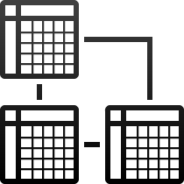
Powerful Analytics Anyone Can Use – Now on Hadoop
Interactive Search
Preview results and interactively search across one or more Hadoop clusters
Data Model
Provides more meaningful representation of underlying raw machine data
Enables non-technical users to build complex reports without learning the search language
Pivot
16
Notes:
Splunk software delivers powerful analytics anyone can use, now not just for data in Splunk Enterprise but also data sitting in Hadoop.
Interactive Search – preview results and interactively search across one or more Hadoop clusters
Data Model – defines meaningful relationships in underlying machine data and making the data more useful to broader base of non-technical users
Pivot – opens up the power of Splunk search to non-technical users with an easy-to-use drag and drop interface to explore, manipulate and visualize data

Slide 17
Empowering Business and IT Stakeholders
Interactive Search
Data Model
Development Environment
Pivot
Enterprise Architect
Business Analyst
Developer
Adapt your architecture for big data
Hadoop shared-service departments offer self-service analytics
Free data scientists for custom analytics, not be data butlers
Save time by just pointing at Hadoop
Avoid fixed-schemas and low-level tooling
Answer questions iteratively without waiting for MapReduce jobs to finish
Build scalable big data apps on top of data in Hadoop
Use the development languages and tools you know and like
Notes:
Business users and developers want more than just long-term data storage; they want to easily access and analyze the data stored in Hadoop. Meanwhile, IT and regulatory departments want role and group based security for data stored in Hadoop.
Enterprise architect:
Coexist Hadoop more seamlessly in your enterprise architecture; adapt your architecture for big data; and enforce granular security controls by role and group.
Business analyst:
Save time by just pointing at the Hadoop cluster; avoid low-level tooling; preview results & answer questions iteratively without waiting for Map/Reduce jobs to finish
Developer:
Build scalable enterprise apps based on data in Hadoop using the languages, frameworks and tools you already know

Slide 18
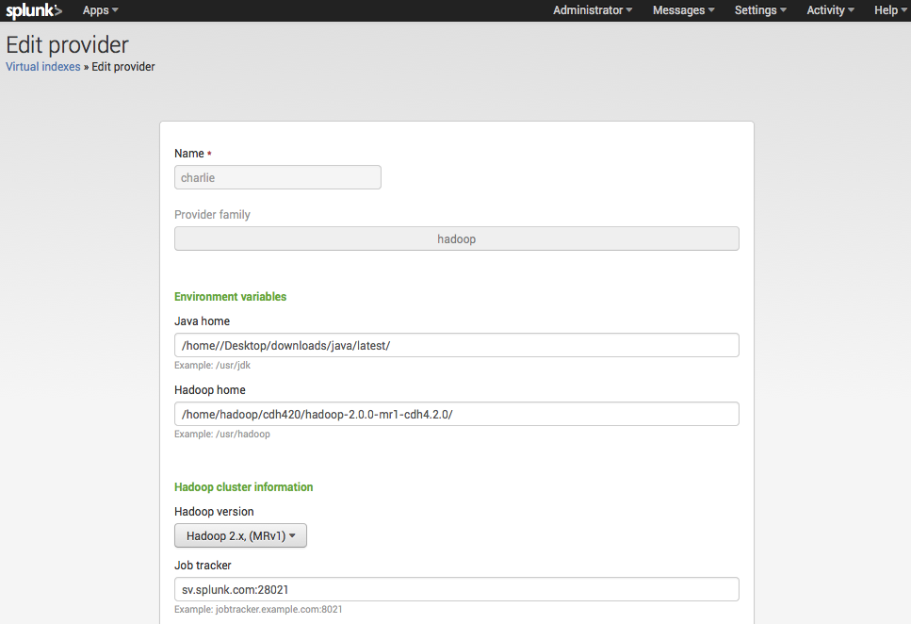
Fast Deployment and Configuration
Just point at Hadoop
Connect to one or multiple Hadoop clusters
Certified integration with all major Hadoop distributions
Choose 1st-gen MapReduce or YARN
Create Virtual Indexes across one or more clusters
From download to searching data in < 60 minutes
YARN certified
Notes:
Just point at Hadoop and start exploring data in Hadoop, in minutes not months. Hunk is certified with the leading Hadoop distributions including Cloudera, Hortonworks, IBM, MapR and Pivotal. Hunk supports both 1st-generation MapReduce and YARN (Yet Another Resource Negotiator) 2nd-generation MapReduce.

Slide 19
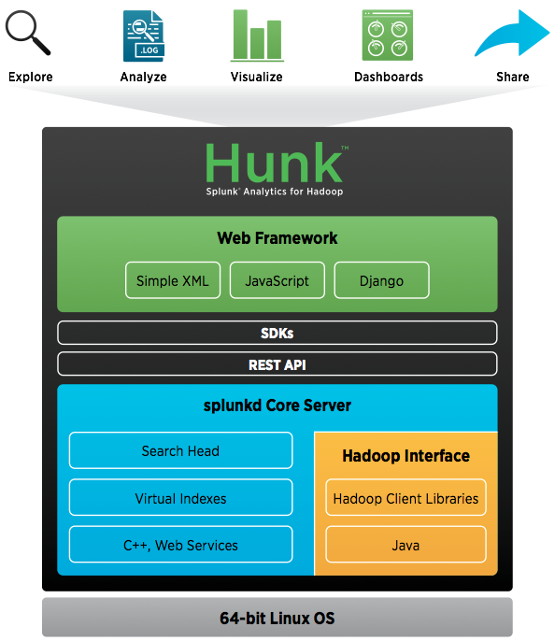
Connect Hunk to HDFS and MapReduce
Connect to Apache HDFS and MapReduce or your choice of Hadoop distribution
Hadoop Cluster 1
Notes:
Connect Hunk to your Hadoop cluster as an external results provider. The external results provider is a search-time helper process responsible for:
accessing the external system (Hadoop);
translating or interpreting the search request; and
pushing as much of the computation as possible to the external system.
Connect to the Hadoop Distributed File System (HDFS) and MapReduce from Apache downloads or from your choice of Hadoop distribution, including the option for Cloudera, Hortonworks, MapR or Pivotal. Hunk only requires basic Hadoop: HDFS and MapReduce.
You can continue to use additional projects and subprojects with your Hadoop cluster but what’s required by Hunk is just MapReduce and HDFS (or MapR’s proprietary variant of HDFS).

Slide 20
Hunk Scales With Your Hadoop Deployments
Connect Hunk to multiple Hadoop clusters
Hadoop Cluster 1
Hadoop Cluster 2
Hadoop Cluster 3
Notes:
Connect Hunk to multiple Hadoop clusters.

Slide 21
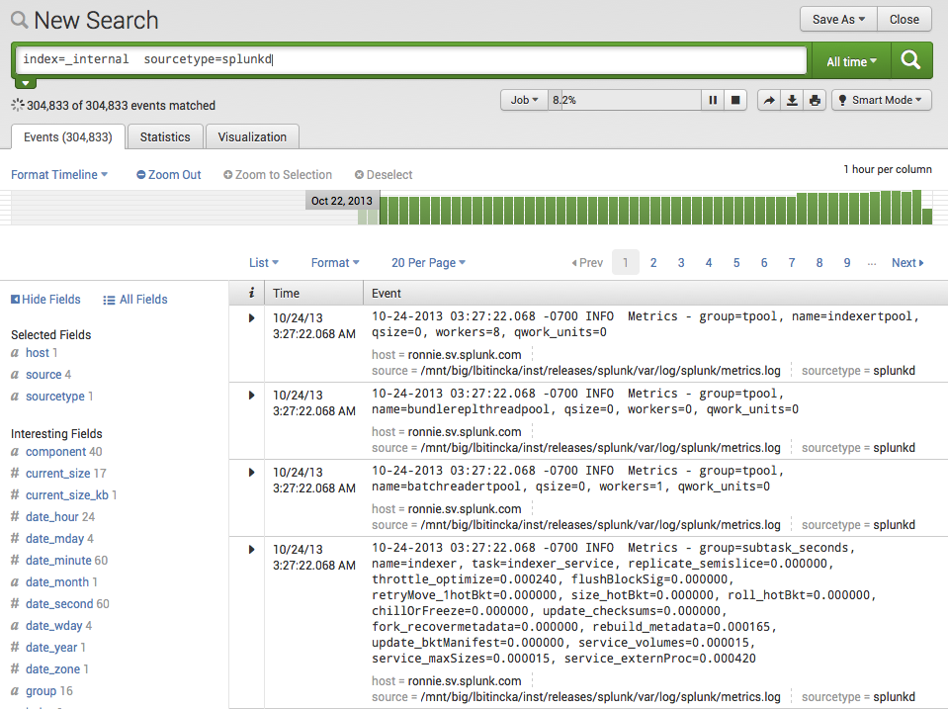
Search and Explore from One Place
Rapidly interact with data
Pause or stop MapReduce jobs
Powerful Search Processing Language (SPL™)
Ad-hoc exploratory analytics across massive datasets
Preview results
No fixed schemas
No requirement to “understand” data upfront
Search interface
Preview results
Drill down to raw data
Notes:
Search is flexible, intuitive and delivers immediate results. There’s no requirement to “understand” the data upfront.
Most data management projects are designed to answer a pre-set list of questions, fitting into brittle schema and ‘rigid’ data model. Hunk doesn’t have these limitations because the schema is applied at the time of search—so users can immediately ask new questions while they search. Hunk’s interactive analytics interface dramatically improves the user’s experience and the speed with which tasks can be accomplished.
Hunk supports five different types of correlation (time, transactions, sub-searches, lookups, joins) and over 100 statistical commands. You can also conduct deep analysis and pattern detection for spotting anomalies or new opportunities in your data.

Slide 22
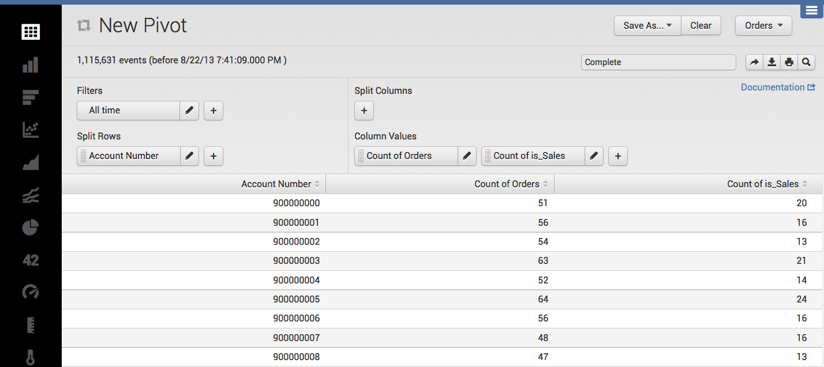
Powerful, Easy-to-use Analytics
Pivot
All chart types available in the chart toolbox
Drag-and-drop interface enables anyone to analyze raw, unstructured data
Build complex queries and reports without learning search language
Click to visualize any chart type; reports dynamically update when fields change
Save report to share
Time window
Select fields from data model
Notes:
Splunk software enables organizations to gain new insights from this data and a key focus for Splunk 6 is to empower a broader base of users in the organization with this insight – users that extend beyond core IT users.
The new Pivot interface enables non-technical and technical users alike to quickly generate sophisticated charts, visualizations and dashboards using simple drag and drop and without learning the Search Processing Language (SPL). Users can access different chart types from the Splunk toolbox to easily visualize their data different ways.
The Pivot interface opens up the power of operational intelligence to a broader base of non-technical users. It enables them to rapidly and interactively manipulate, analyze and visualize data, without requiring them to understand the format and semantics of the underlying raw machine data.
Queries using the Pivot interface are powered by underlying data models, which are usually designed and implemented by users who understand the format and semantics of their indexed data, and who are familiar with the Splunk Search Processing Language (SPL). Data models are covered in the next slide.
Unlike traditional BI visualization tools focused on structured data analytics, the Pivot interface enables both non-technical and technical users to easily explore, manipulate and visualize machine data. It complements existing BI technologies by providing relevant business insights from a rapidly exploding new class of data. Data from Splunk software can also be leveraged directly using the Splunk API and SDKs and integrated into existing business analytics tools.

Slide 23
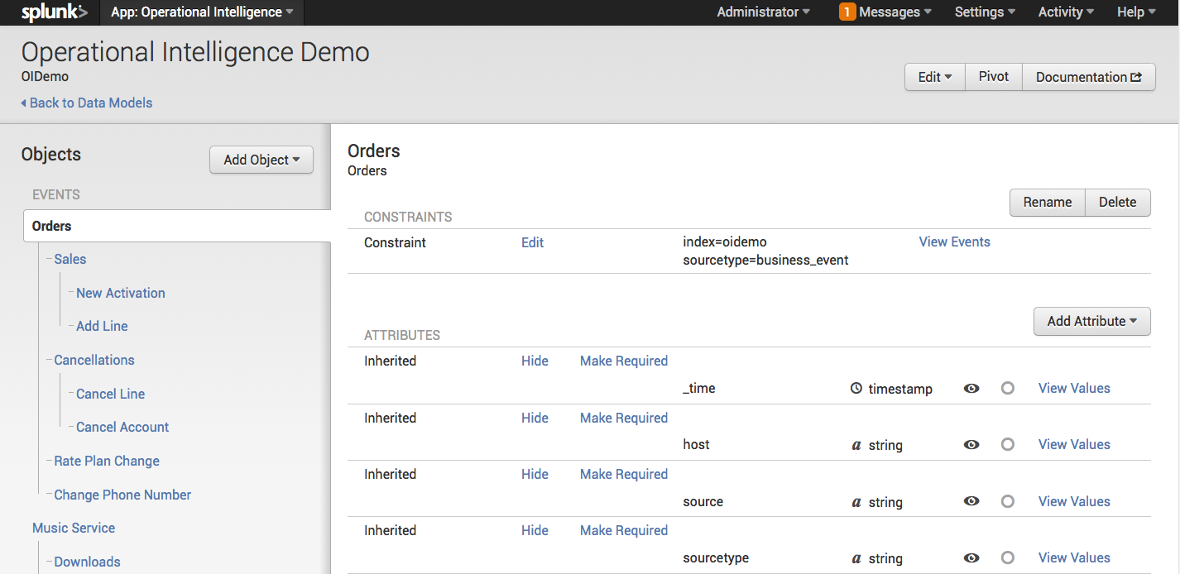
Define Relationships in Big Data
Data Model
Describes how underlying machine data is represented and accessed
Defines meaningful relationships in the data
Enables single authoritative view of underlying raw data
Hierarchical object view of underlying data
Add constraints to filter out events
Notes:
Data models power the new Pivot interface by defining an abstract model of the underlying machine data and meaningful relationships in that data.
Data Models are created using the Data Model Builder and are usually designed and implemented by users who understand the format and semantics of their indexed data, and who are familiar with the Splunk Search Processing Language (SPL).
Once defined, data models are used and accessed via the Pivot interface to rapidly create visualizations and dashboards without needing to understand the underlying raw data. Data models can also be accelerated by leveraging the Analytics Store – an optimized store for analytical operations covered on the next slide.
Unlike data models in the traditional structured world, Splunk software Data Models focus on machine data and data mashups between machine data and structured data. Splunk software is founded on the ability to flexibly search and analyze highly diverse machine data employing late-binding or search-time techniques for schematization (“schema-on-the-fly”). And Data Models are no exception. They define relationships in the underlying data, while leaving the raw machine data intact, and map these relationships at search time. They are therefore highly flexible and designed to enable users to rapidly iterate.

Slide 24
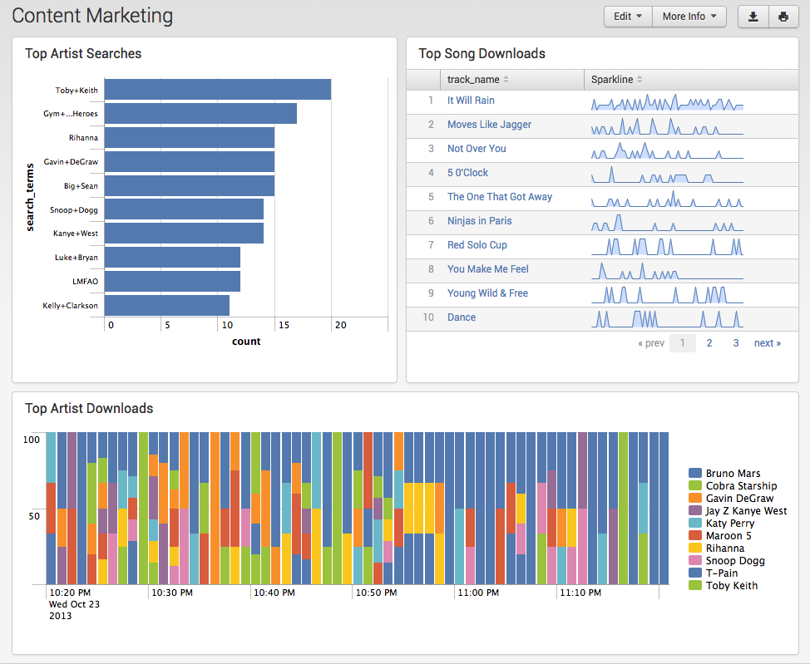
Visualize and Share Data with Role-based Security
Build and personalize
Rapidly build advanced graphs and charts on-the-fly
Combine charts, views and external data in dashboards and reports
View and edit on any desktop or mobile device
Drill down to raw data
Protect data with role-based access controls
Notes:
Generate reports on the fly from hard- to-understand data. Create powerful, information-rich reports to do analysis, without an advanced knowledge of search commands. Schedule delivery of any report via PDF and share it with management, business users or other stakeholders. Combine multiple charts, views, reports and external data
View and edit on any desktop, tablet and mobile device. Personalize and share via PDF.
All while ensuring secure access with role-based access controls. While Hunk does not solve all security issues with Hadoop – you’ll want to use Kerberos for security, and lock down use of Oozie super-users and audit taking data in and out of HDFS through the HDFS API – Hunk gives you a big boost for security. When you assign Hunk as an authorized user with HDFS and Kerberos, you can then assign role-based access controls for business and IT departments and individual users who access the Hadoop data via Hunk.

Slide 25
Build Big Data Apps on Top of Hadoop
Pick your favorite tools
Build Big Data Apps
Extend and Integrate Hunk
Use a standards-based web framework and REST API
Customize dashboards and UIs with Simple XML, JavaScript or Django
Choose among SDKs for Java, JavaScript, Python, Ruby, C# and PHP
Simple XML
SDKs
Data Models
Web
Framework
Search Extensibility
JavaScript
Java
JavaScript
Python
Ruby
C#
PHP
Django
REST API
Hadoop
(MapReduce & HDFS)
Notes:
Build big data apps on top of data in Hadoop using the languages and frameworks that developers already know and like. Hunk includes a standards-based web framework, documented REST API and software development kits for C#, Java, JavaScript, Python, PHP and Ruby. The web framework makes building apps on top of the Hadoop Distributed File System (HDFS) look and feel like building any modern web application. Developers can build big data apps with custom dashboards, flexible UI components and custom data visualizations using common development languages such as Simple XML, JavaScript and Django.

Slide 26
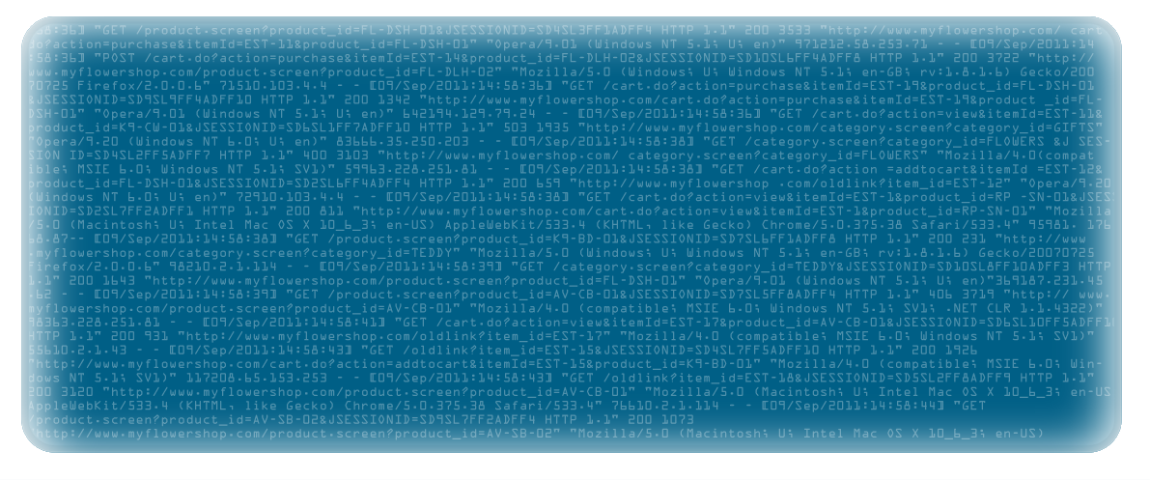
Drive Value Across the Enterprise
Unlock the value of big data in Hadoop to address business challenges
Multi-Channel Retail Management
Financial Risk Management
Synthesize Data from all Customer Touch Points – 360° View
Notes:
As more customers deploy Hunk, we expect to see a wide range of business use cases. These are among the most common use cases among the more than 100 organizations that participated in the Hunk beta program.
Multi-channel retail management
Portfolio analysis across data silos
See from the big picture down to individual components and SKUs
Schema on the fly search of massive data to match patterns of every attribute
Financial risk management
Analyze raw data from diverse sources
Search real time native indexes in Splunk Enterprise + Hunk historical Hadoop data
Drill down to raw data; no sampling
Synthesize data from all customer touch points – near-complete 360° view
Correlate web, mobile, social, wearable
Dump data from data silos into Hadoop
No need to understand data upfront
Additional use cases:
Comprehensive security analytics for modern threats
Hadoop for high volume, low value data
Packet flows, NetFlow, building access
Analyze historical data older than 90 days
Splunk offers flexible choices. Consider using the single-data-source custom SKU for “high volume, but low value” data that’s not already in Hadoop. For data in Hadoop consider Hunk as an alternative to frozen storage to enable interactive search.

Slide 27
Multi-Channel Retailer Otto Group
Sales operations can see the big picture and drill down to individual SKUs
Corporate strategists can access market conditions for 400 stores in 20 countries
Analysts can more quickly explore data and create visualizations for in-store inventory
Notes:
Marcus Buda, senior data architect at multi-channel retailer Otto Group, with 400 stores and more than 53,000 employees in 20 countries, said that “The combination of Splunk software with the processing power of MapReduce and Hadoop generates a transparent and sustainable competitive advantage for your company within minutes.”
Their goal: To draw the right conclusions in a constantly changing business environment, deduce strategies and define new performance targets – and of course reach them.
Using Hunk with a shared service Hadoop cluster, Otto Group sees use cases for a variety of roles and departments.
Using Hunk with a shared service Hadoop cluster, Otto Group sees use cases for a variety of roles and departments. Hunk gives business analytics teams using Hadoop in their stack an enormous possibility to improve overall efficiency for everyone – the analysts can more quickly explore data and create visualizations, the operations teams can better monitor data security and developers can better ensure data quality. If you are working in an agile collaborative way, there are tremendous synergies in monitoring your data processing pipelines for Hadoop and at the same time using your knowledge about that data to develop business analytics dashboards with Hunk.

Slide 28
Petabytes of seemingly “random numbers” in Hadoop
More, higher-complexity risk calculations
Analysis showed the level of core Tier 1 capital ratio that the bank needs to hold against its balance sheet given their current risk profile
RISK MANAGEMENT AT MAJOR GLOBAL BANK
Notes:
A major global bank told Splunk that their Hadoop clusters stored “petabytes of random numbers”. After a lot of digging to get to the real value of these random numbers. “It helps undertake more and higher complexity risk calculations that shows the level of core tier 1 capital ratio that the bank needs to hold against the balance sheet given our current risk profile.” This is one of the core strategic objectives of the bank - something that everyone right up to the CEO cares about.

Slide 29
MORE COMPLETE CUSTOMER VIEW FOR FASHION RETAILER
Analyze this massive, diverse data sets in Hadoop
Obtain a near 360 degree view of customers
Raw data in Hadoop: Apache web logs, ecommerce site activity, Akamai image hosting logs, Squid proxy logs
Notes:
"We see a lot of value in the ability for our company to understand complex data stored in Hadoop,” the sales operations engineer told Splunk. "Hunk will enable us to analyze massive, diverse data sets in Hadoop to obtain a near 360 degree view of our customers. We envision everyone in our company will be able to use Hunk some day to quickly analyze Apache web logs, user activity on our e-commerce site, Akamai image hosting logs and Squid proxy logs."

Slide 30
Demo

Slide 31
Hunk™: Splunk Analytics for Hadoop
FAST TO DEPLOY AND DRIVE VALUE
FULL-FEATURED ANALYTICS
Simply point Hunk at your Hadoop cluster and start exploring data immediately
Explore, analyze and visualize data in Hadoop from one integrated platform
INTERACTIVE SEARCH
RICH DEVELOPER ENVIRONMENT
Interact with data, change perspectives and preview results as MapReduce jobs run
Build big data apps on data in Hadoop using standard web languages and frameworks
Notes:
Fast to Deploy and Drive Value
With Hunk you can get analytics from Hadoop faster and easier than probably you thought possible. Hunk integrates the processes of data exploration, analysis and visualization into a single, fluid user experience designed to drive rapid insights from your big data in Hadoop. Simply point Hunk at your Hadoop cluster and start exploring data immediately. Hunk works with what you have today. Hunk works on Apache Hadoop and most major distributions, including those from Cloudera, Hortonworks, IBM, MapR and Pivotal, with support for both first-generation MapReduce and YARN. Preview results and interactively search across one or more Hadoop clusters, including from different distribution vendors. Use the ODBC driver (beta) to feed data from Hunk to third-party data visualization tools or business intelligence software.
Full-featured Analytics
Explore, analyze and visualize data, create dashboards and share reports from one integrated platform. Hunk features schema-on-the-fly technology that delivers the flexibility that business and IT stakeholders need in working with unstructured data in Hadoop. Interact with data, change perspectives on-the-fly and preview results as MapReduce jobs are running.
Interactive Search
Search is the starting point for ad-hoc exploratory analytics of raw data in Hadoop. Schema-on-the-fly technology means that you don't need to know anything about the data in advance. You can store the data in whatever format it may come. Hunk automatically identifies fields of interest and adds structure at search time, such as keywords, potentially interesting fields, patterns over time, top values and more. With Hunk, even event breaking and timestamp extraction are done at search time, taking schema on-the-fly to the furthest extent possible. When you start a query in Hunk, it streams back interim results immediately while the MapReduce job continues to run in the background. This delivers a faster, more interactive experience because you can search interactively by pausing and refining queries without having to wait for full MapReduce jobs to complete.
Rich Developer Environment
The web framework makes building apps on top of the Hadoop Distributed File System (HDFS) look and feel like building any modern web application. The framework enables developers to integrate data and functionality from Hunk into enterprise big data applications using a standards-based web framework, documented REST API and software development kits (SDKs) for C#, Java, JavaScript, PHP, Python and Ruby. Developers can build Hunk apps with custom dashboards, flexible UI components and custom data visualizations using common development languages such as Simple XML, JavaScript and Django.

Slide 32
Thank You www.splunk.com/hunk
Notes:
For more information about Hunk including the product video and data sheet, visit splunk.com backslash hunk (splunk.com/hunk).
Happy splunking.

