Slide 1
Ensuring 100% DATABASE uptime FOR REAL-time BIG DATA
Dr. V. SriNIVASAN
Founder, VP Engineering & OPERATIONS
Strata Hadoop Conference
OCTOBER 29, 2013

Slide 2






Database Landscape
Real-time Transactions
Response time: < 10 ms
1-20 TB
Balanced Reads/Writes
24x7x365 Availability
Response time: Seconds
Gigabytes of data
Balanced Reads/Writes
REAL-TIME BIG DATA
TRANSACTIONS (OLTP)
ANALYTICS (OLAP)
BIG DATA ANALYTICS
Response time: Seconds
Terabytes of data
Read Intensive
Response time: Hours, Weeks
TB to PB
Read Intensive
STRUCTURED DATA
UNSTRUCTURED DATA
© 2013 Aerospike. All rights reserved Pg. 2

Slide 3

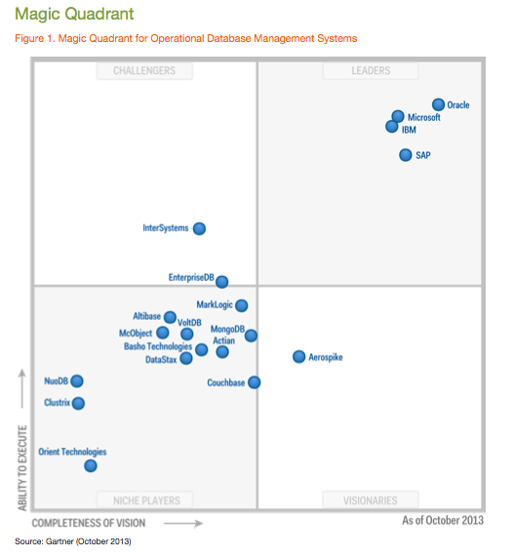

Aerospike recognized as the only company in the
Visionaries Quadrant in Gartner's Magic Quadrant for Operational Database Management Systems
Gartner, Magic Quadrant for Operational Database Management Systems Donald Fienberg et al.October 23, 2013
This graphic was published by Gartner, Inc. as part of a larger research document and should be evaluated in the context of the entire document. The Gartner document is available at www.aerospike.com .
Gartner does not endorse any vendor, product or service depicted in its research publications, and does not advise technology users to select only those vendors with the highest ratings. Gartner research publications consist of the opinions of Gartner's research organization and should not be construed as statements of fact. Gartner disclaims all warranties, expressed or implied, with respect to this research, including any warranties of merchantability or fitness for a particular purpose.
© 2013 Aerospike. All rights reserved Pg. 3

Slide 4




























INTERNET ENTERPRISES
INTELLIGENT & INSTANT INTERNET-SCALE INTERACTIONS
MOBILE
WEB ADVERTISING
MARKETING
SEARCH, VIDEO, SOCIAL, GAMING
RETAIL
© 2013 Aerospike. All rights reserved Pg. 4

Slide 5


Requirements for Internet Enterprises
  Know who the Interaction is with
    Monitor 200+ Million US Consumers,
    5+ Billion mobile devices and sensors
  Determine intent based on
  current context
    Page views, search terms, game state, last purchase, friends list, ads served, location
  Respond now, use big data for
  more accurate decisions
    Display the most relevant Ad
    Recommend the best product
    Deliver the richest gaming experience
    Eliminate fraud…
  Service can NEVER go down!
© 2013 Aerospike. All rights reserved Pg. 5

Slide 6






Typical Real-Time Database Deployment
RDBMS
Web/App
Servers
Transactions
Write Context
Data Warehouse
Interactions
Database
Write Real-time Context,
Read Recent Context
Segments
Profile Store
Cookies, email, deviceID, IP address, location, segments, clicks, likes, tweets, search terms
Real-time Analytics
Best sellers, top scores, trending tweets
Batch Analytics
Discover patterns, segment data:
location patterns, audience affinity
© 2013 Aerospike. All rights reserved Pg. 6

Slide 7
Key Challenges
Handle extremely high rates of read/write transactions over persistent data
Avoid hot spots to maintain tight latency SLAs
Provide immediate consistency with replication
Ensure long running tasks do not slow down transactions
Scale linearly as data sizes and workloads increase
Add capacity with no service interruption
© 2013 Aerospike. All rights reserved Pg. 7

Slide 8
SYSTEM ARCHITECTURE FOR 100% UPTIME

Slide 9

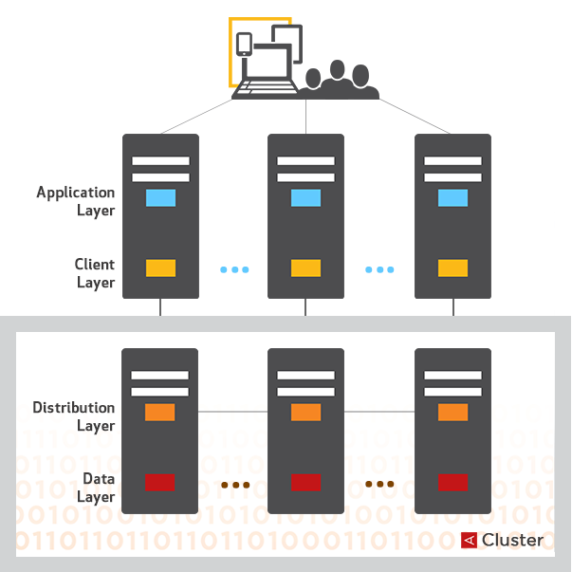
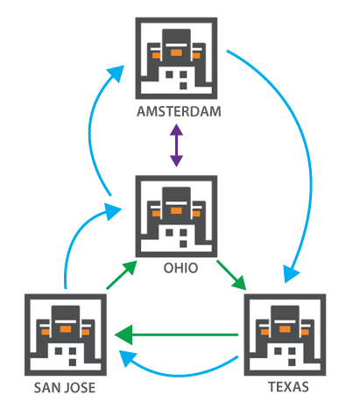
Shared-Nothing System for 100% Data Availability
Every node in a cluster is identical,
handles both transactions and long running tasks
Data is replicated synchronously with immediate consistency within the cluster
Data is replicated asynchronously across data centers
OHIO Data Center
© 2013 Aerospike. All rights reserved Pg. 9

Slide 10
Robust DHT to Eliminate Hot Spots
How Data Is Distributed (Replication Factor 2)
cookie-abcdefg-12345678
Every key is hashed into a
20 byte (fixed length) string
using the RIPEMD160 hash function
This hash + additional data
(fixed 64 bytes)
are stored in RAM in the index
Some bits from this hash value are used to compute the partition id
There are 4096 partitions
Partition id maps to node id
based on cluster membership
182023kh15hh3kahdjsh
Partition ID | Master node | Replica node
… | 1 | 4
1820 | 2 | 3
1821 | 3 | 2
4096 | 4 | 1
© 2013 Aerospike. All rights reserved Pg. 10

Slide 11


Real-Time Prioritization to Meet SLA
master
replica
Writing with Immediate Consistency
Adding a Node
transactions
continue
Write sent to row master
Latch against simultaneous writes
Apply write to master memory and replica memory synchronously
Queue operations to disk
Signal completed transaction (optional storage commit wait)
Master applies conflict resolution policy (rollback/ rollforward)
Cluster discovers new node via gossip protocol
Paxos vote determines new data organization
Partition migrations scheduled
When a partition migration starts, write journal starts on destination
Partition moves atomically
Journal is applied and source data deleted
© 2013 Aerospike. All rights reserved Pg. 11

Slide 12
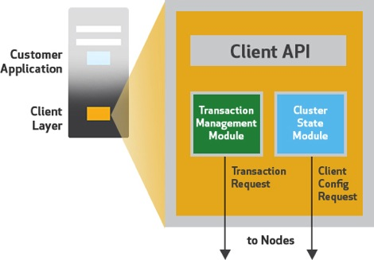

Intelligent Client to Make Apps Simpler
Shield Applications from the Complexity of the Cluster
Implements Aerospike API
  Optimistic row locking
  Optimized binary protocol
Cluster tracking
  Learns about cluster changes, partition map
  Gossip protocol
Transaction semantics
  Global transaction ID
  Retransmit and timeout
Linear scale
  No extra hop
  No load balancers
© 2013 Aerospike. All rights reserved Pg. 12

Slide 13
Flash Optimized High
Performance
Direct device access
Large Block Writes
Indexes in DRAM
Highly Parallelized
Log-structured FS “copy-on-write”
Fast restart with shared memory
Ask me. I’ll look up the answer and then tell it to you.
Ask me and I’ll tell you the answer.
OTHER DATABASE
AEROSPIKE
OS FILE SYSTEM
HYBRID MEMORY SYSTEM™
PAGE CACHE
BLOCK INTERFACE
BLOCK INTERFACE
OPEN NVM
SSD
HDD
SSD
SSD
SSD
OTHER
DATABASE
AEROSPIKE FLASH OPTIMIZED
IN-MEMORY DATABASE

Slide 14

Flash Provides DRAM-like Performance with Much Lower Complexity
Storage type | SSD | DRAM
Storage per server | 2.4 TB (4 x 700 GB) | 180 GB (on 196 GB server)
TPS per server | 500K | 500K
Cost per server | 23000 | 30000
# Servers for 10 TB (2x Replication) | 10 | 110
Server costs | 230,000 | 3,300,000
power/Server (kWatts) | 1.1 | 0.9
Cost kWh ($) | 0.12 | 0.12
Power costs for 2years | 46,253 | 416,275
Maintenance costs for 2 years |  | $$$
Total | $276,253 | $3,716,275
“…data-in-DRAM implementations like SAP HANA.. should be bypassed…
..current leading data-in-flash database for transactional analytic apps is Aerospike.”
- David Floyer, CTO, Wikibon
http://wikibon.org/wiki/vData_in_DRAM_is_a_Flash_in_the_Pan
© 2013 Aerospike. All rights reserved Pg. 14

Slide 15


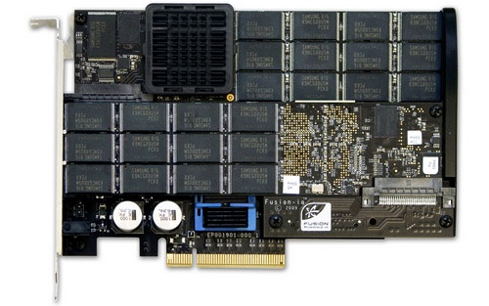
$200+M
+
=
Facebook and Apple bought at least$200+M in FusionIO cards in 2012
  ( 55% of $440M revenue estimate, reported in quarterly FusionIO earnings )
  Everyone wants that “facebook architecture”
© 2013 Aerospike. All rights reserved Pg. 15

Slide 16
HOT ANALYTICS BY ROW

Slide 17

Secondary Indexes in Memory
Fast
  Indexes in DRAM,
  Data on Flash
  No hotspots, Index-Data balanced across the cluster
  Parallel processing across nodes, cores & SSDs
Reliable
  Index and Data co-located
  to manage data migrations and guarantee ACID
  Lock-free MVCC
Client
Secondary Index
Primary Index
DRAM
Record Values
SSD
Server
© 2013 Aerospike. All rights reserved Pg. 17

Slide 18
High selectivity index queries
Client
Query sent to ALL nodes in parallel
“SCATTER”
Secondary Index keys in DRAM
  Map to Primary keys in DRAM
  Co-located with Record on SSD
Records read in parallel from ALL SSDs
Parallel read results aggregated on node
Results from ALL nodes
aggregated client-side
“GATHER”
…
Secondary Keys
Primary Keys
Keys
Keys
DRAM
Records R1, R2
R3, R4
R5, R4
SSD
Server
V1
V2
V3
V4
V5
V6
© 2013 Aerospike. All rights reserved Pg. 18

Slide 19
Indexed Map Reduce
Client
2 Million rows per second
  per 8-core server
  on 1-100TB data
Real-time requests, No ETL!
In parallel
1) Index (WHERE clause)
2) Map
3) Reduce / Finalize
Client gets results, computes
  4) Reduce + Finalize
Secondary Key
Primary Key
DRAM
Record
SSD
Map
Reduce
Server
Aggregate
Client
© 2013 Aerospike. All rights reserved Pg. 19

Slide 20

SQL & NoSQL
Query
Secondary index
  Equality, Range, IN (,,,), Compound
  e.g. WHERE group_id = 1234,
  WHERE last_activity > 1349293398, WHERE branch_id IN (5,6,7,8)
Filters
  SQL: Where clause with non-indexed “AND”s (e.g. “AND gender=‘M’ ”)
  NOSQL: Map step
Aggregation
  SQL: GROUP BY, ORDER BY, LIMIT, OFFSET
  NOSQL: Reduce step
Client
Secondary Key
Primary Key
DRAM
Record
SSD
Filter
Map
Aggregate
Reduce
Server
Aggregate
Aggregate
Client
© 2013 Aerospike. All rights reserved Pg. 20

Slide 21
Row based scheduling
Due to caching and blocks, most system resource consumption is per row
  ( Flash is in-memory )
Rows are fine grained
Scheduler is “local” only
Deadline scheduling
Per-query priority
(per transaction timeout)
Client
Hot analytics
Operational
Secondary Index
Priority Q
Primary Index
Record Values
SSD
Server
© 2013 Aerospike. All rights reserved Pg. 21

Slide 22
LESSONS LEARNED

Slide 23

Native Flash → Performance
Low Latency at High Throughput
© 2013 Aerospike. All rights reserved Pg. 23

Slide 24

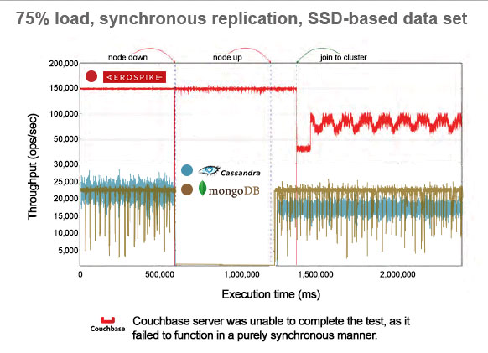
“Only Aerospike was able to function in synchronous mode with a replication factor of two.. it is a significant advantage that Aerospike is able to function reliably on a smaller amount of hardware while still maintaining true consistency.”
© 2013 Aerospike. All rights reserved Pg. 24

Slide 25
Lessons
Keep architecture simple
  No hot spots (e.g., robust DHT)
  Scales up easily (e.g., easy to size)
  Avoids points of failure (e.g., single node type)
Avoid manual operation – automate, automate!
  Self-managed cluster responds to node failures
  Data rebalancing requires no intervention
  Real-time prioritization allows unattended system operation
Keep system asynchronous
  Shared nothing – nodes are autonomous
  Async writes across data centers
  Independent tuning parameters for different classes of tasks
© 2013 Aerospike. All rights reserved Pg. 25

Slide 26
Lessons (cont’d)
Monitor the Health of the System Extensively
  Growth in load sneaks up on you over weeks
  Early detection means better service
  Most failures can be predicted (e.g., capacity, load, …)
Size clusters properly
  Have enough capacity ALWAYS!
  Upgrade SSDs every couple years
  Reduce cluster sizes to make operations simple
Have geographically distributed data centers
  Size the distributed data centers properly
  Use active-active configurations if possible
  Size bandwidth requirements accurately
© 2013 Aerospike. All rights reserved Pg. 26

Slide 27
Lessons (cont’d)
Have plan for unforeseen situations
  Devise scenarios and practice during normal work time
  Ensure you can do rolling upgrades during high load time
  Make sure that your nodes can restart fast (< 1 minute)
Constantly test and monitor app end-to-end
  Application level metrics are more important than DB metrics
  Most issues in a service are due to a combination of application, network, database, storage, etc.
Separate online and offline workloads
  Reserve real-time edge database for transactions and hot analytics queries (where newest data is important)
  Avoid ad-hoc queries on on-line system
  Perform deep analysis in offline system (Hadoop)
Use the Right Data Management System for the job
  Fast NoSQL DB for real-time transactions and hot analytics on rapidly changing data
  Hadoop or other comparable systems for exhaustive analytics on mostly read-only data
© 2013 Aerospike. All rights reserved Pg. 27

Slide 28
Aerospike 3
Build the Modern Real-time Data Platform
  Scaling the Internet of Everything
  Pushing the limits of modern hardware
  No data loss and No downtime
  ASQL & NoSQL
  Powerful Aggregations
  (MapReduce++)
AEROSPIKE REAL-TIME DATA DATA PLATFORM
Publish &
Subscribe
Security
Encryption
Compression
Transactions
Secondary Index Queries
User Defined Functions (UDF)
Distribution - Shared Nothing, ACID, Scale-out, Multiple datacenters
Data Types – Int, Str, Blob, List, Map, Large Stack, Large Set, Large List
Storage– DRAM, SSD, HDD
© 2013 Aerospike. All rights reserved Pg. 28

Slide 29
Aerospike Real-time Big Data Platform
Rapid Development
Complete Customizability
Support for popular languages and tools
  ASQL and Aerospike Client in Java, C#, Ruby, Python..
Complex data types
  Nested documents
  (map, list, string, integer)
  Large (Stack, Set, List) Objects
Queries
  Single record
  Batch multi-record lookups
  Equality and range
  Aggregations and MapReduce
User Defined Functions (UDFs)
  In-DB processing
Aggregation Framework
  UDF Pipeline
  MapReduce ++
Time Series Queries
  Just 2 IOPs for most r/w
  independent of object size
© 2013 Aerospike. All rights reserved Pg. 29

Slide 30
How to get Aerospike?
Free
Community Edition
Enterprise Edition
For developers looking for speed and stability and transparently scale as they grow
No transaction limits
No time limit
No production limit
Data per cluster limit
Community support
For mission critical apps needing to scale right from the start
  Unlimited number of nodes, clusters, data centers
  Cross data center replication
  Premium 24x7 support
  Priced by TBs of unique data (not replicas)
© 2013 Aerospike. All rights reserved Pg. 30

Slide 31
  QUESTIONS?
  info@aerospike.com
  www.aerospike.com
© 2013 Aerospike. All rights reserved Pg. 31

