Slide 1
Generative Malware Outbreak Detection
Tensorflow World 2019
Sean Park
Senior Malware Scientist, Trend Micro
spark@trendmicro.com
Notes:
Large number of malware samples
People think of it as binary classification
Features: statistical features, n-gram
Models: xgboost, random forest, SVM / CNN, RNN, supervised GAN, and what have you

Slide 2
“When you torture the data long enough,
it will confess”
– Ronald, H. Coase
Notes:
Overfitting
Generalisation problem
Malware evolves. The past samples don’t necessarily represent the future samples. This is very different to typical machine learning assumption where both the training and the validation samples have common underlying features.
Feature problem
Statistical – Anderson
N-gram does not provide sufficient semantics
Not semantic enough
Lack of interpretability
No feedback from incorrect detection
Hard to embed failure-control
Turned my attention to the actual instruction sequence, which conveys more semantic features. However, it poses yet another challenge - Metamorphism.

Slide 3
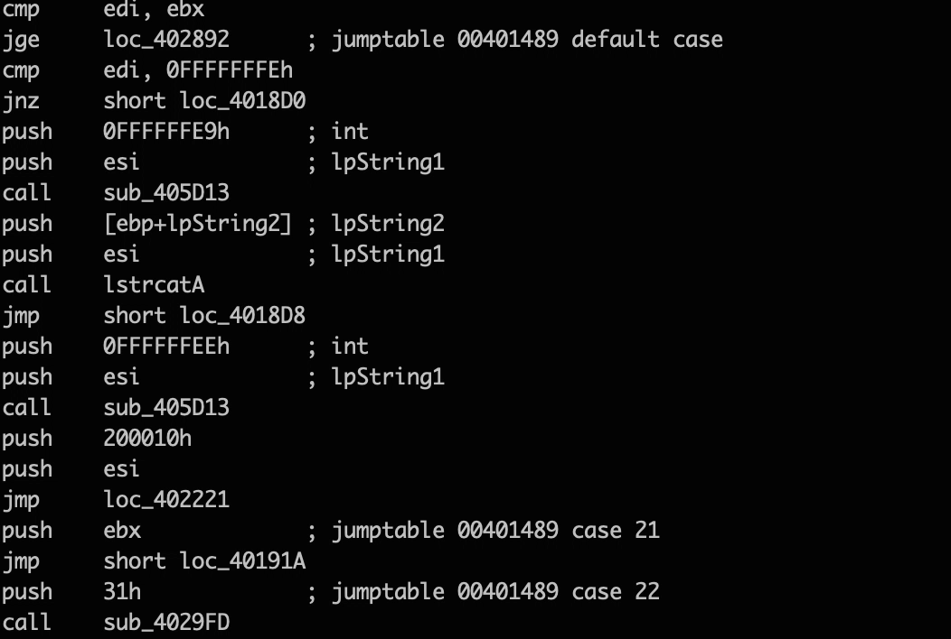
Metamorphism
xor al, al
ret
jmp 0040113Fh
mov [ebx-04h],ebx
lea eax, [ebx-6Ch]
push ebp
pop ecx
mov ebp, esp
ret
sub esp, 0Ch
push 5Ch
push eax
call 004021A4h
call 0041230EFh
mov [ecx-1Ch], ebx
ret 10h
jmp 0040113Fh
mov [edx-04h], ecx
lea eax, [ebp-6Ch]
mov ebp, esp
mov ecx, [ebx-38h]
add ecx, 1Eh
mov ecx, [ebp-38h]
add ecx, 1Eh
call ecx
ret 10h

Slide 4
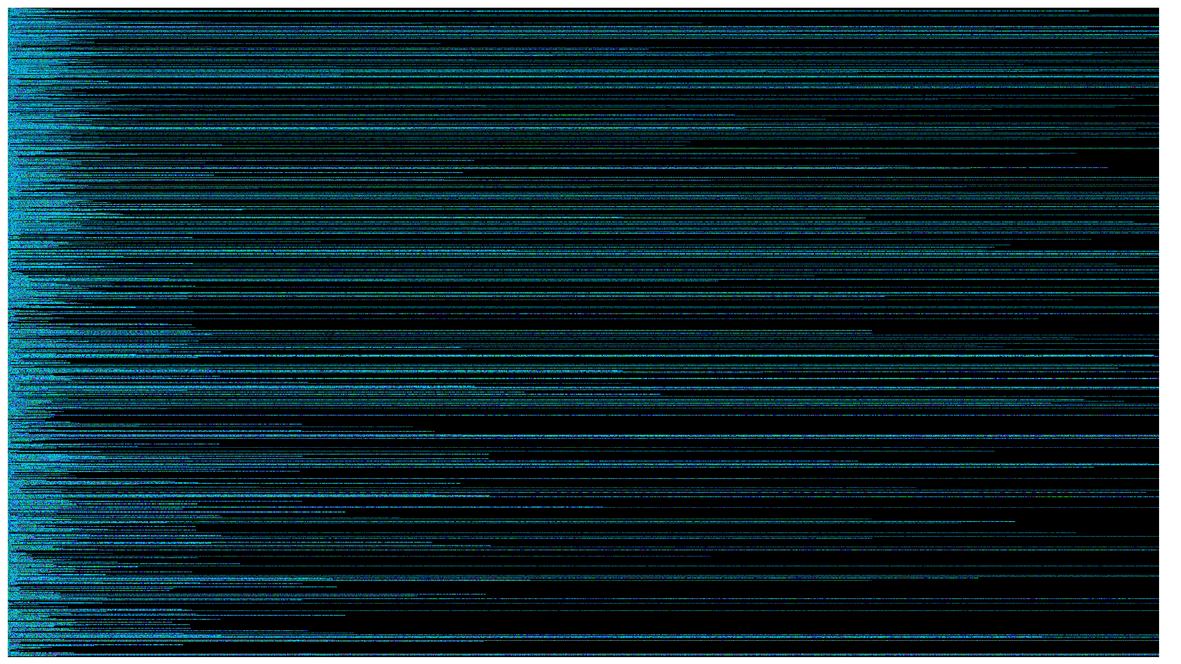
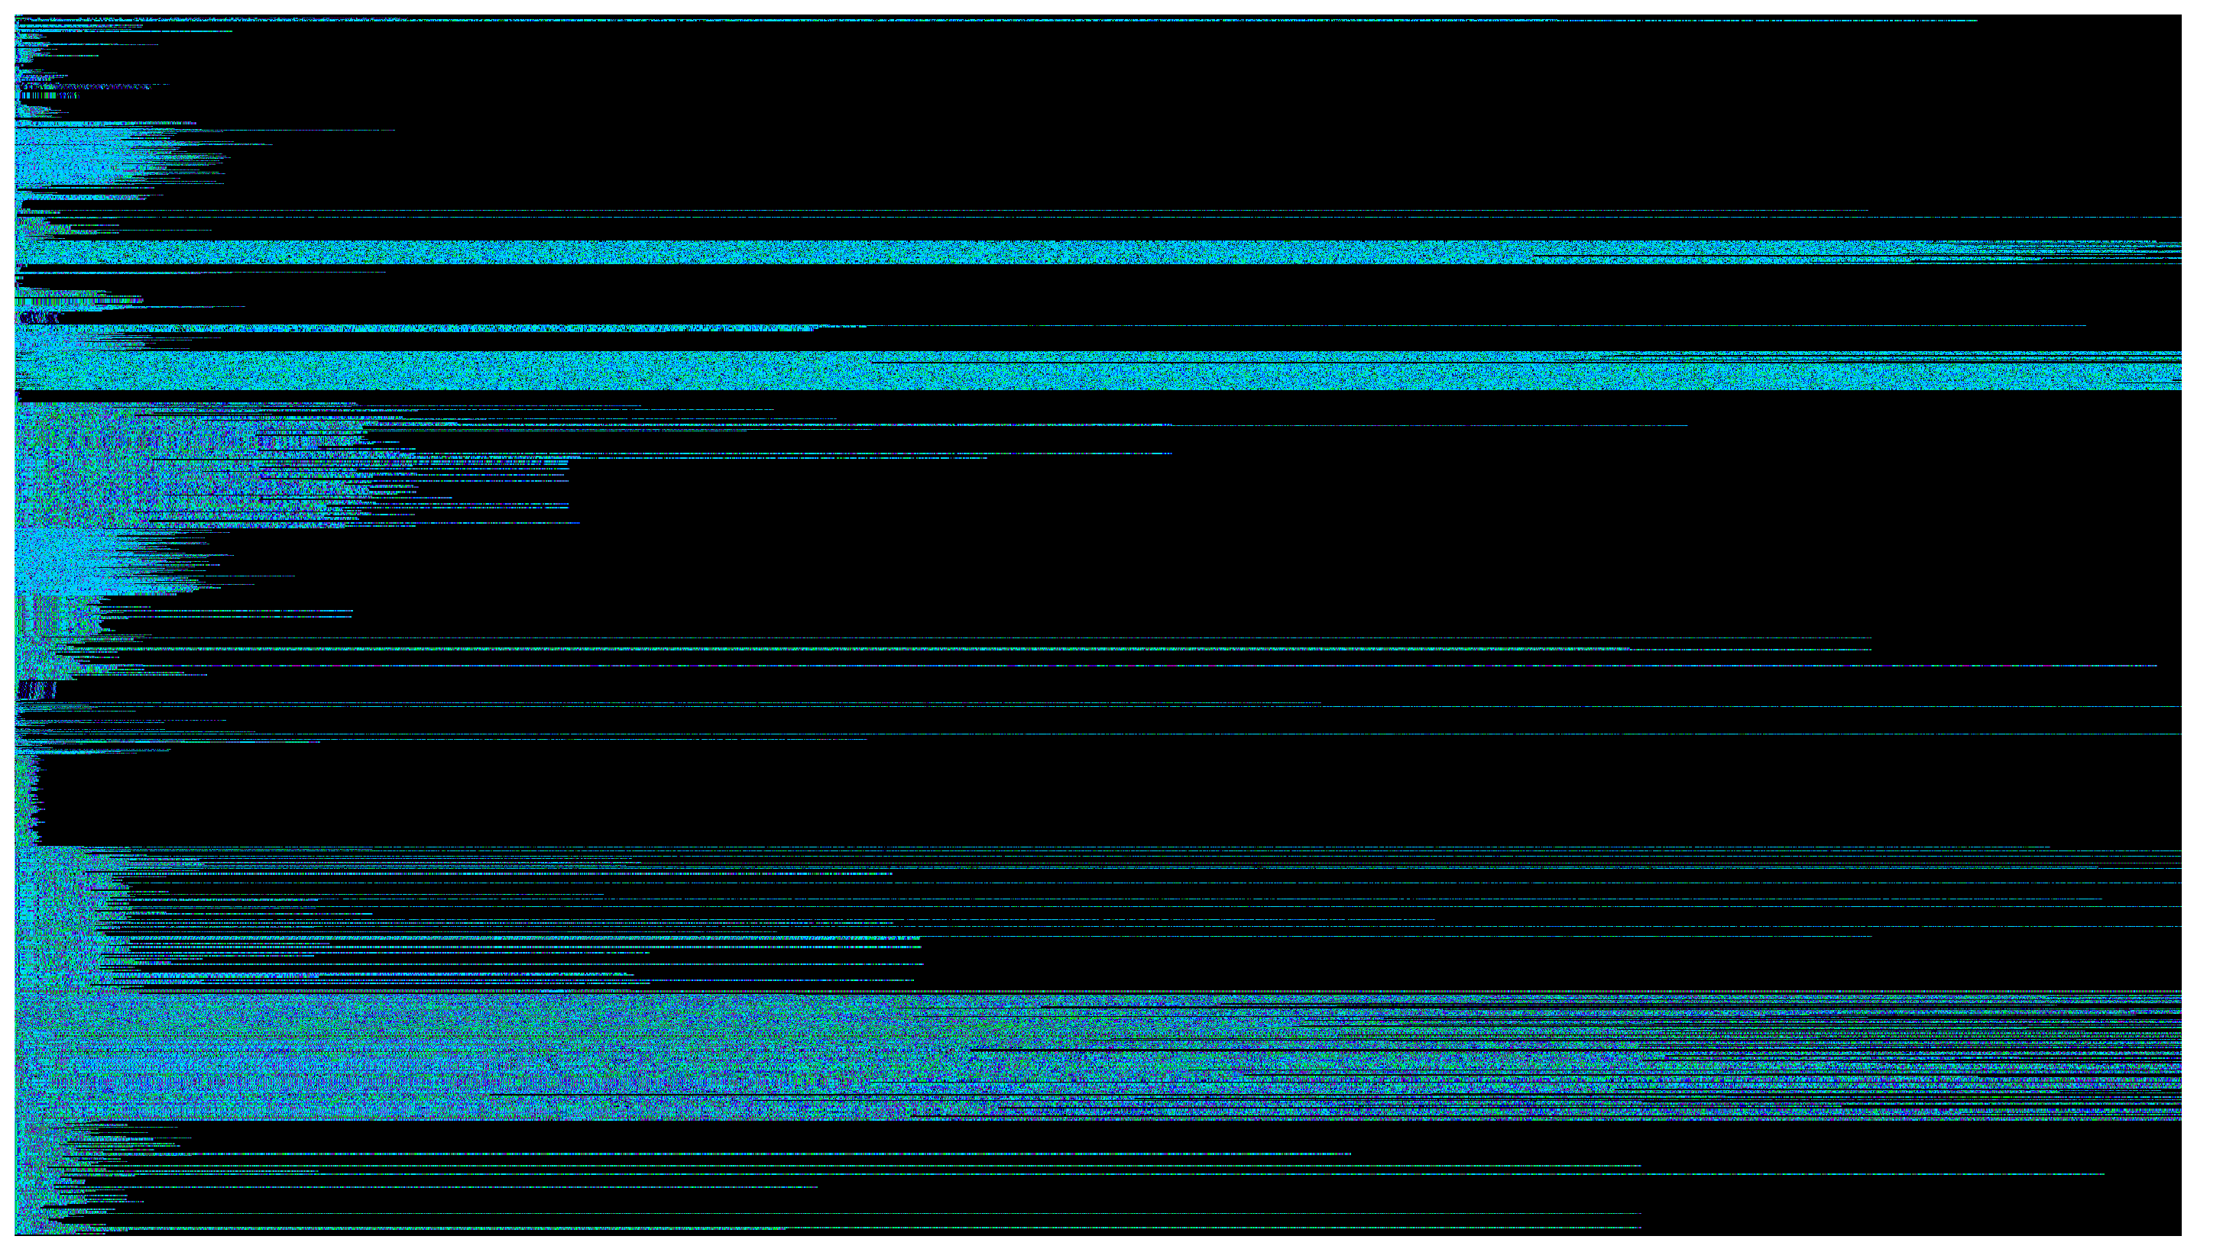
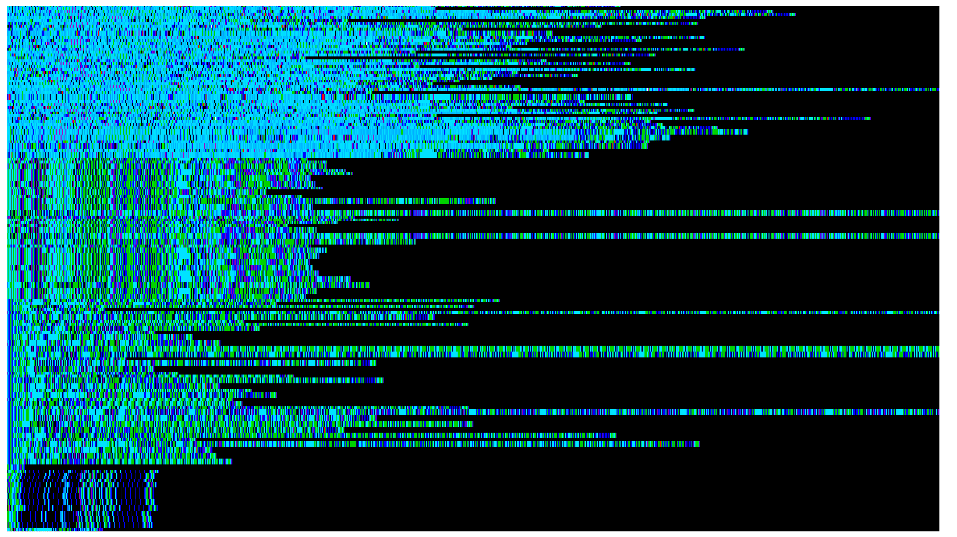
Ransom_CRYPTESLA
TSPY_EMOTET
BKDR_TOFSEE.SMF
Ransom_CERBER
Notes:
Point:
If I can produce a representation for each instruction sequence using unsupervised learning, I can perhaps apply distance metric to find out how similar the samples are.

Slide 5
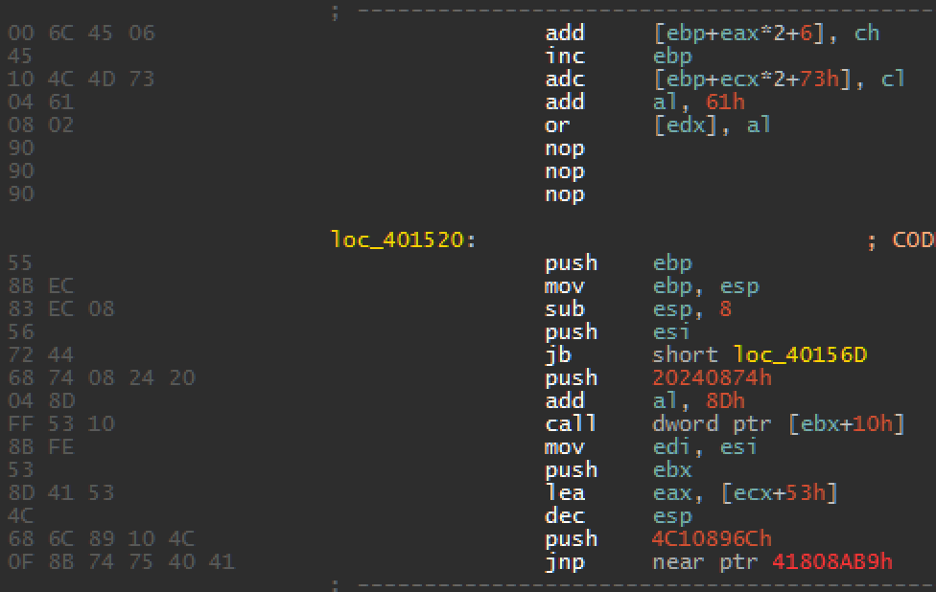
Feature

Slide 6
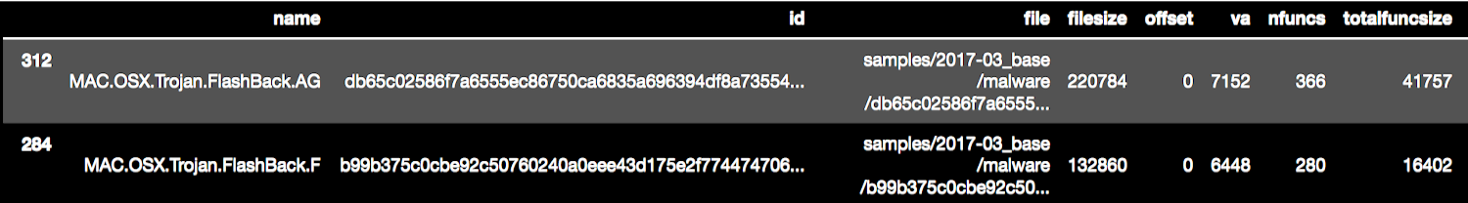
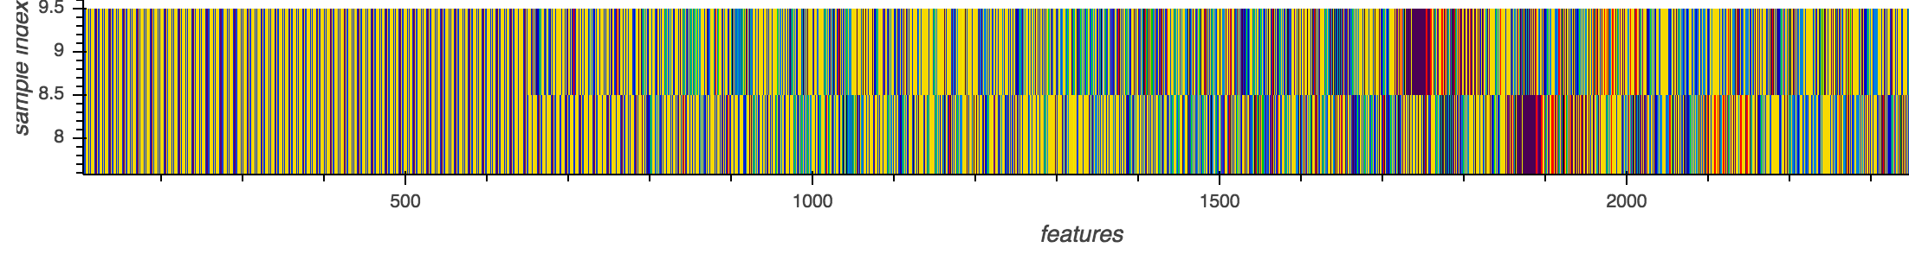
Feature
Notes:
The same metamorphic template used during a campaign
End:
Come up with a representation that is resilient to metamorphism, which involves code shuffling, random instruction injection, etc.
Compute the distance to find the similarity
Unsupervised learning

Slide 7

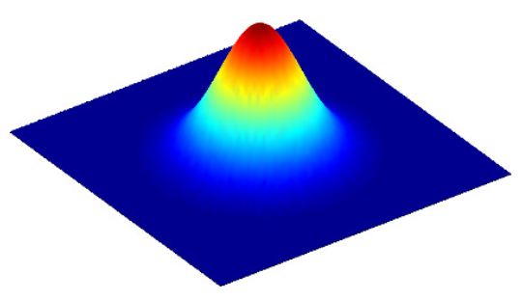

Model Architecture
Discrete Adversarial Autoencoder with Convolution
x
q(z|x)
p(x|z)
p(x)
E8
6A
E8
33
89
…
z ~ q(z)
E8
6A
E8
33
89
…
G(z)
z ~ p(z)
-
x
E8
6A
E8
33
89
…
+
Notes:
The model is jointly trained with stochastic gradient descent by minimising the reconstruction loss and by trying to reach Nash equilibrium through min-max adversarial game
Points:
- We take the latent representation, z, at the bottleneck to compare samples.

Slide 8
Symbol Loss
Embedding (nsymbols,embsize)
Input (?)
L2 normalise
Lookup
Normalised Embedding
Feature (?,embsize)
Encoder
. . .
cosine distance
probability (?,nsymbols)
Decoder
Feature (?, embsize)
softmax crossentropy
L2 normalise
Normalised Reconstruction
Output

Slide 9
Handling Variable Length Inputs
z
Long sample
z
Short sample
Embedding
Convolution
Global Max Pooling

Slide 10
Demo

Slide 11
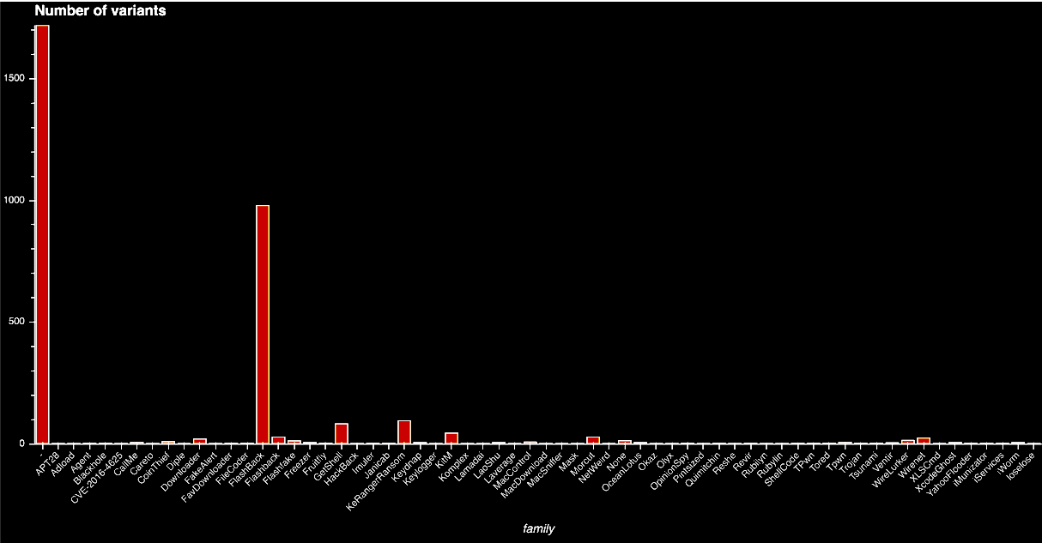
Sample Distribution
11
Notes:
Points
- We need one-shot malware detection

Slide 12
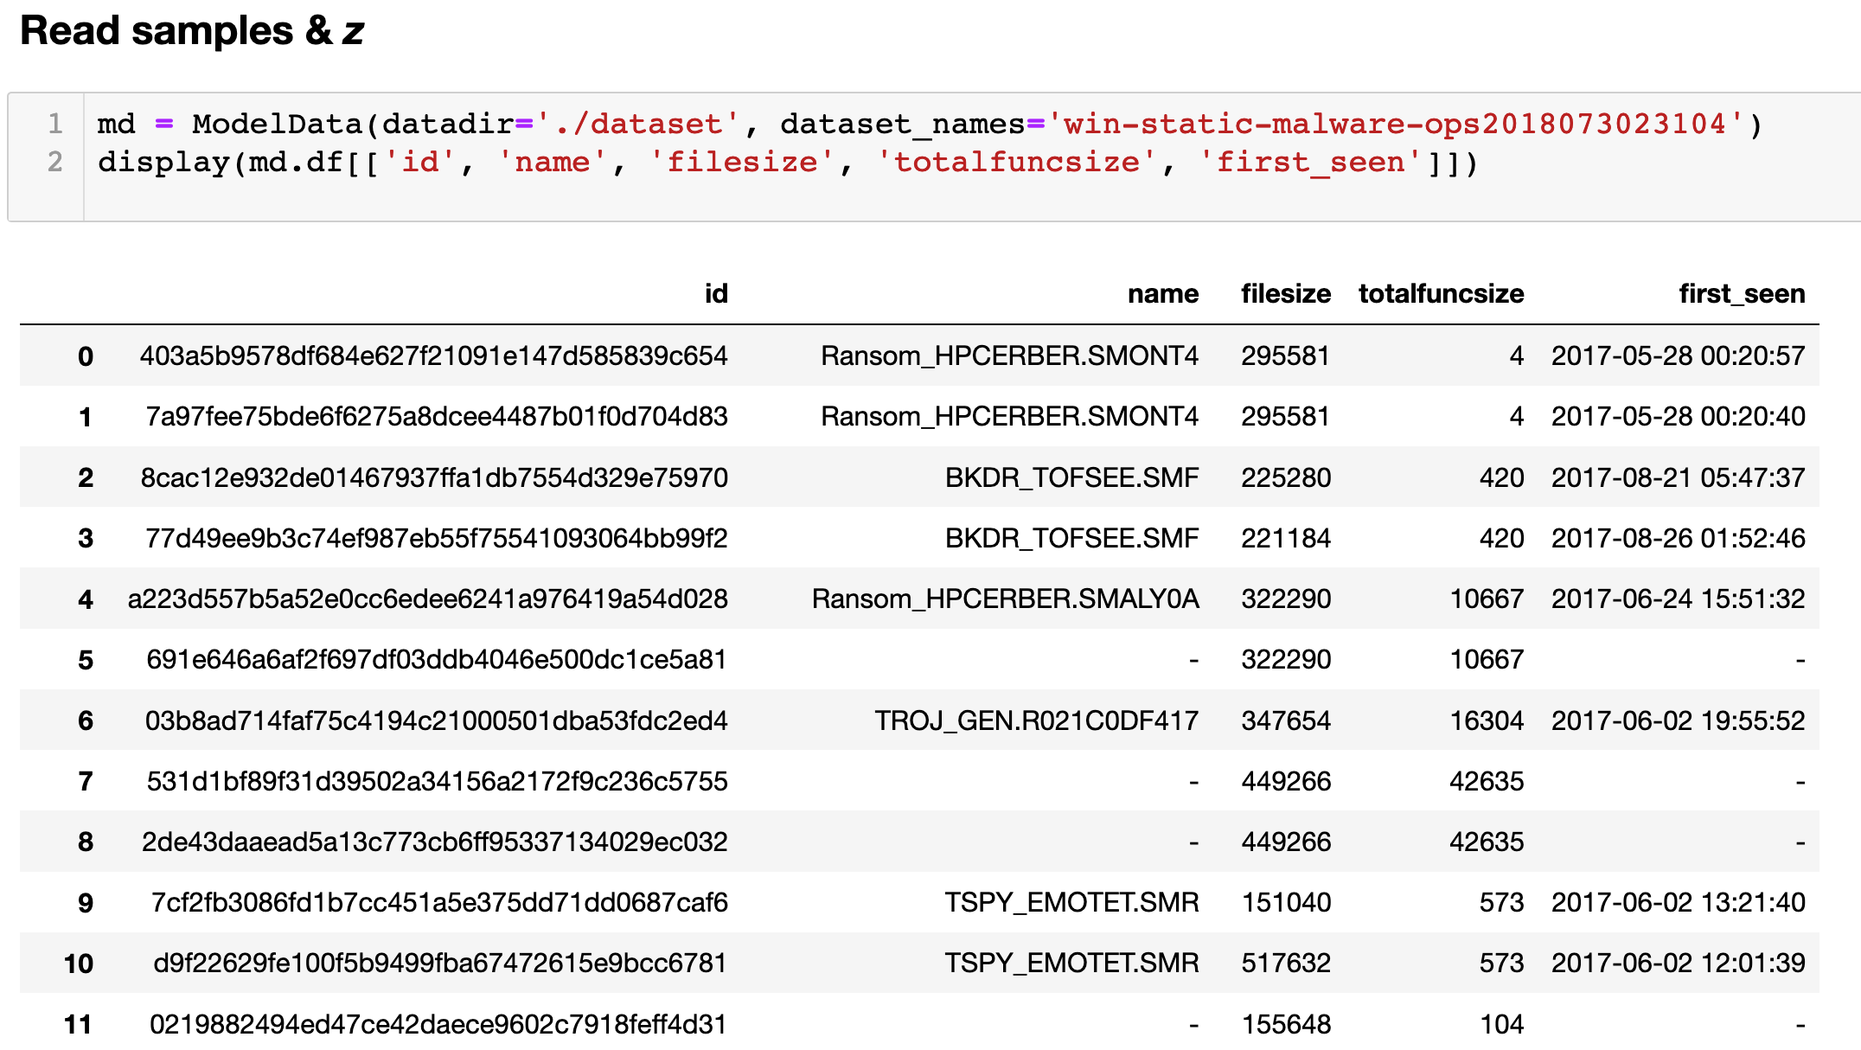

Slide 13
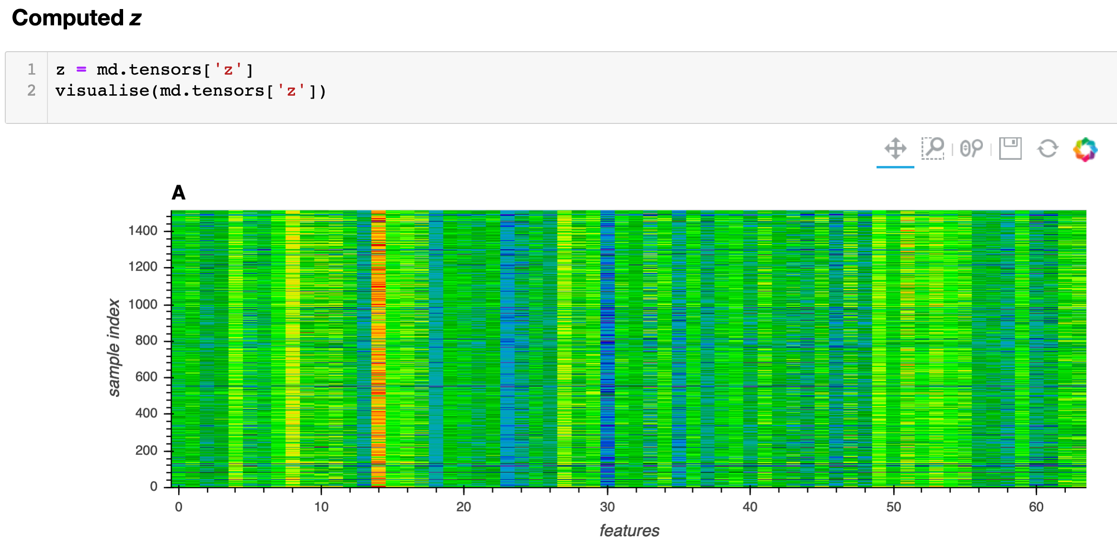

Slide 14
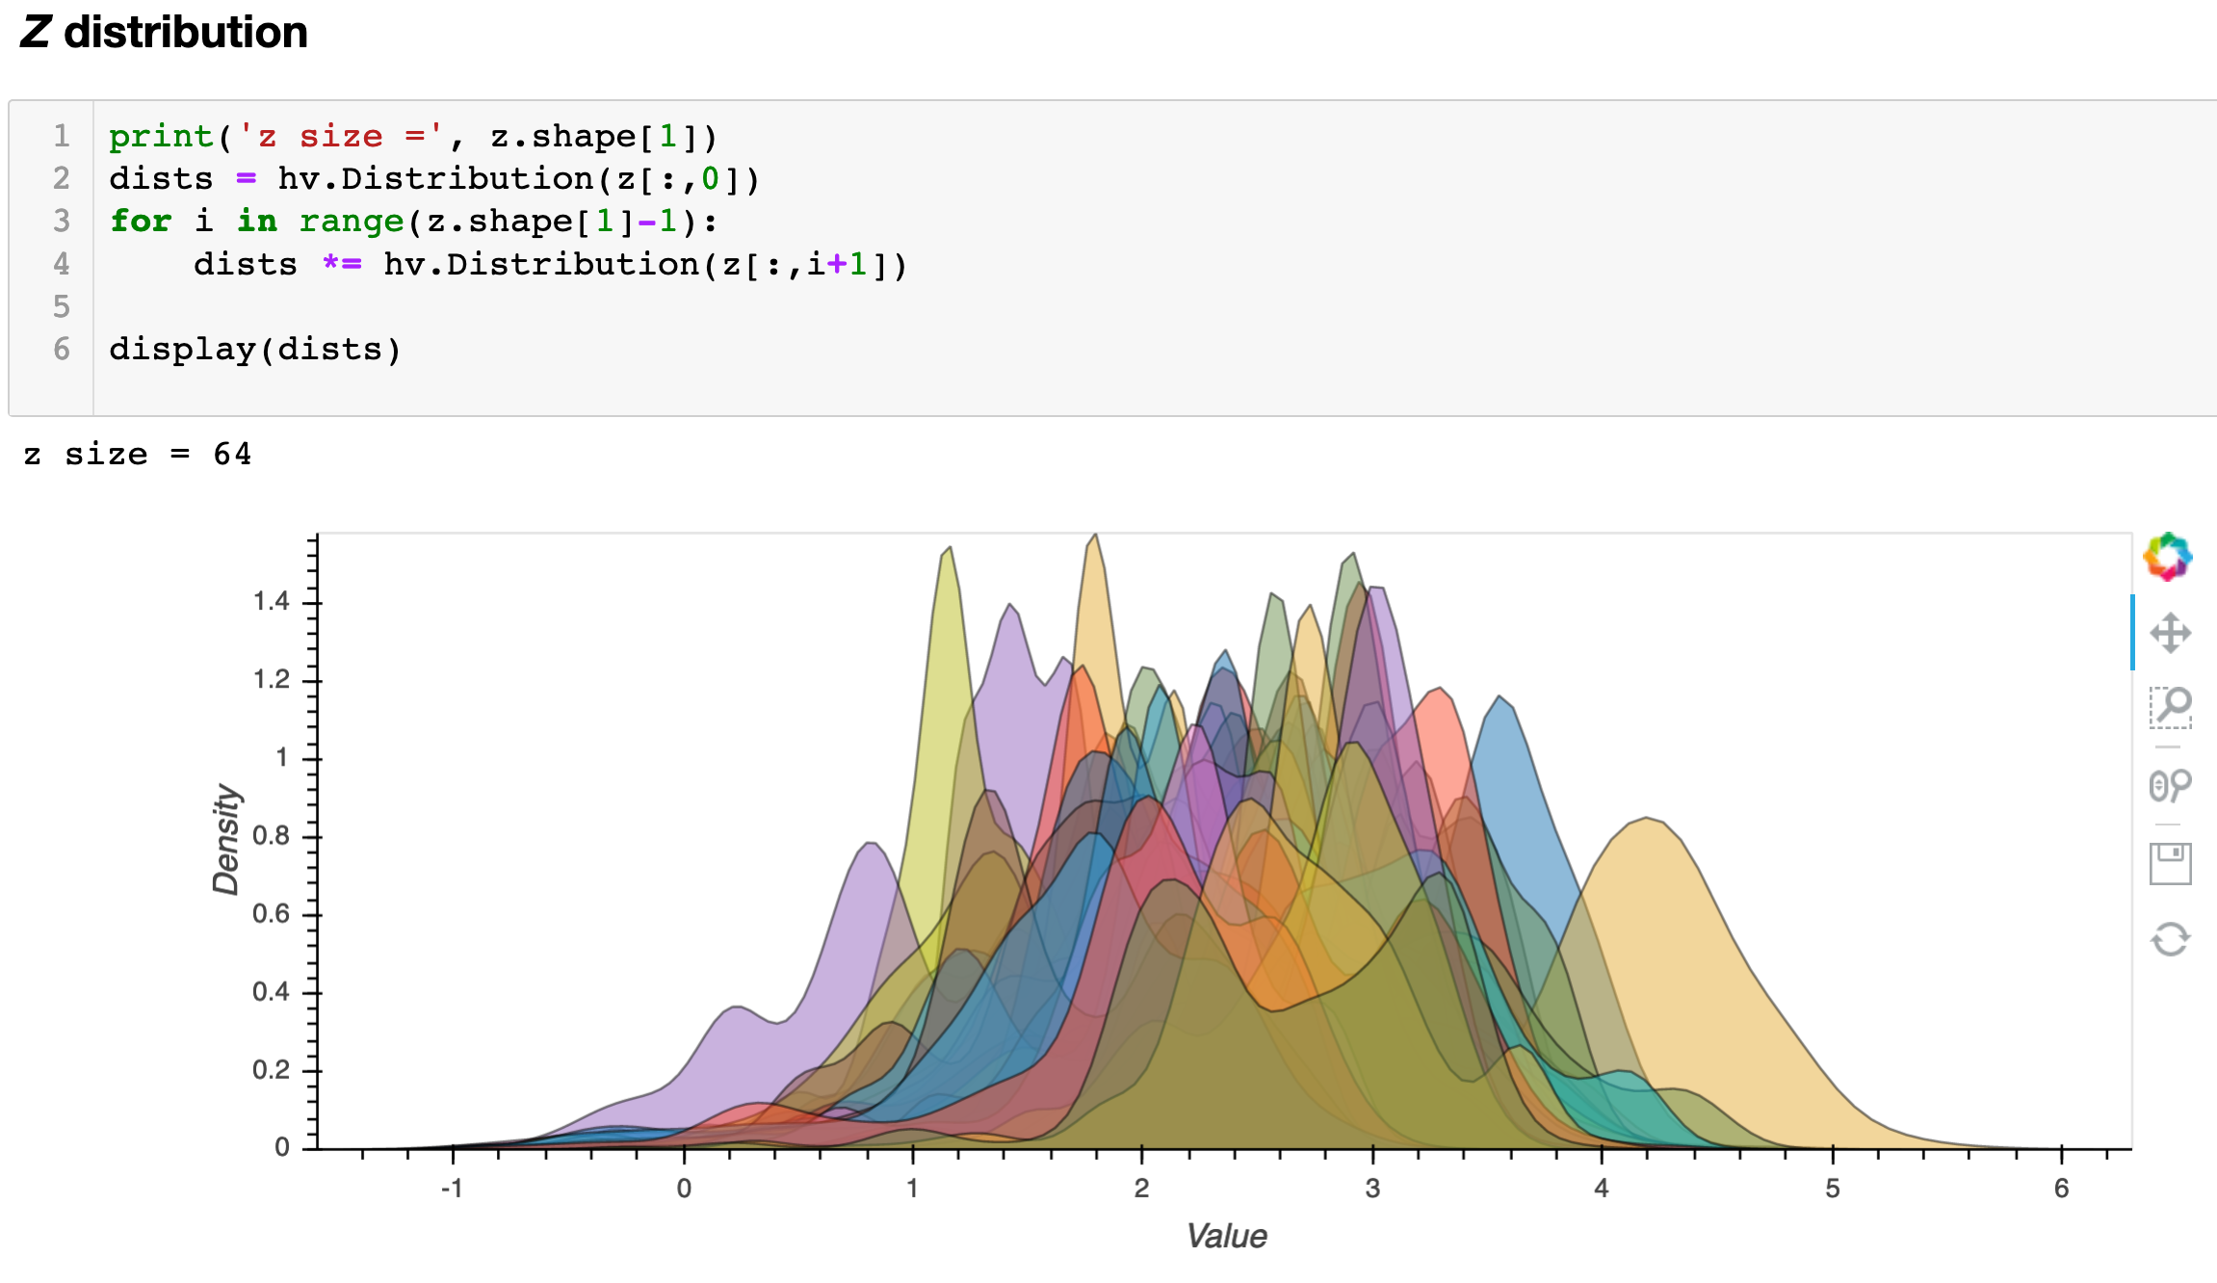

Slide 15
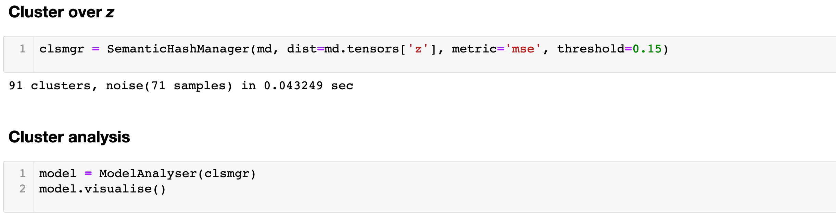

Slide 16
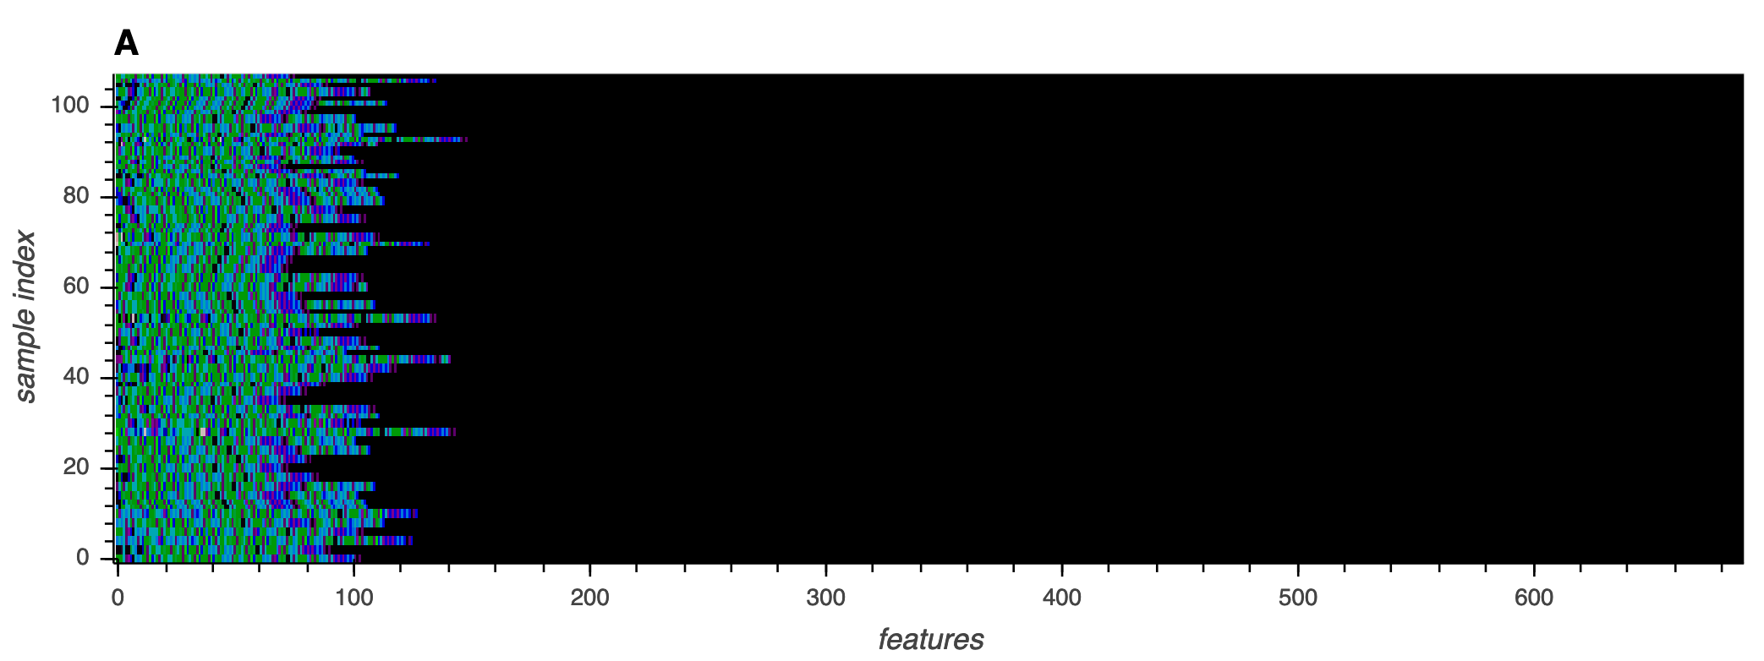
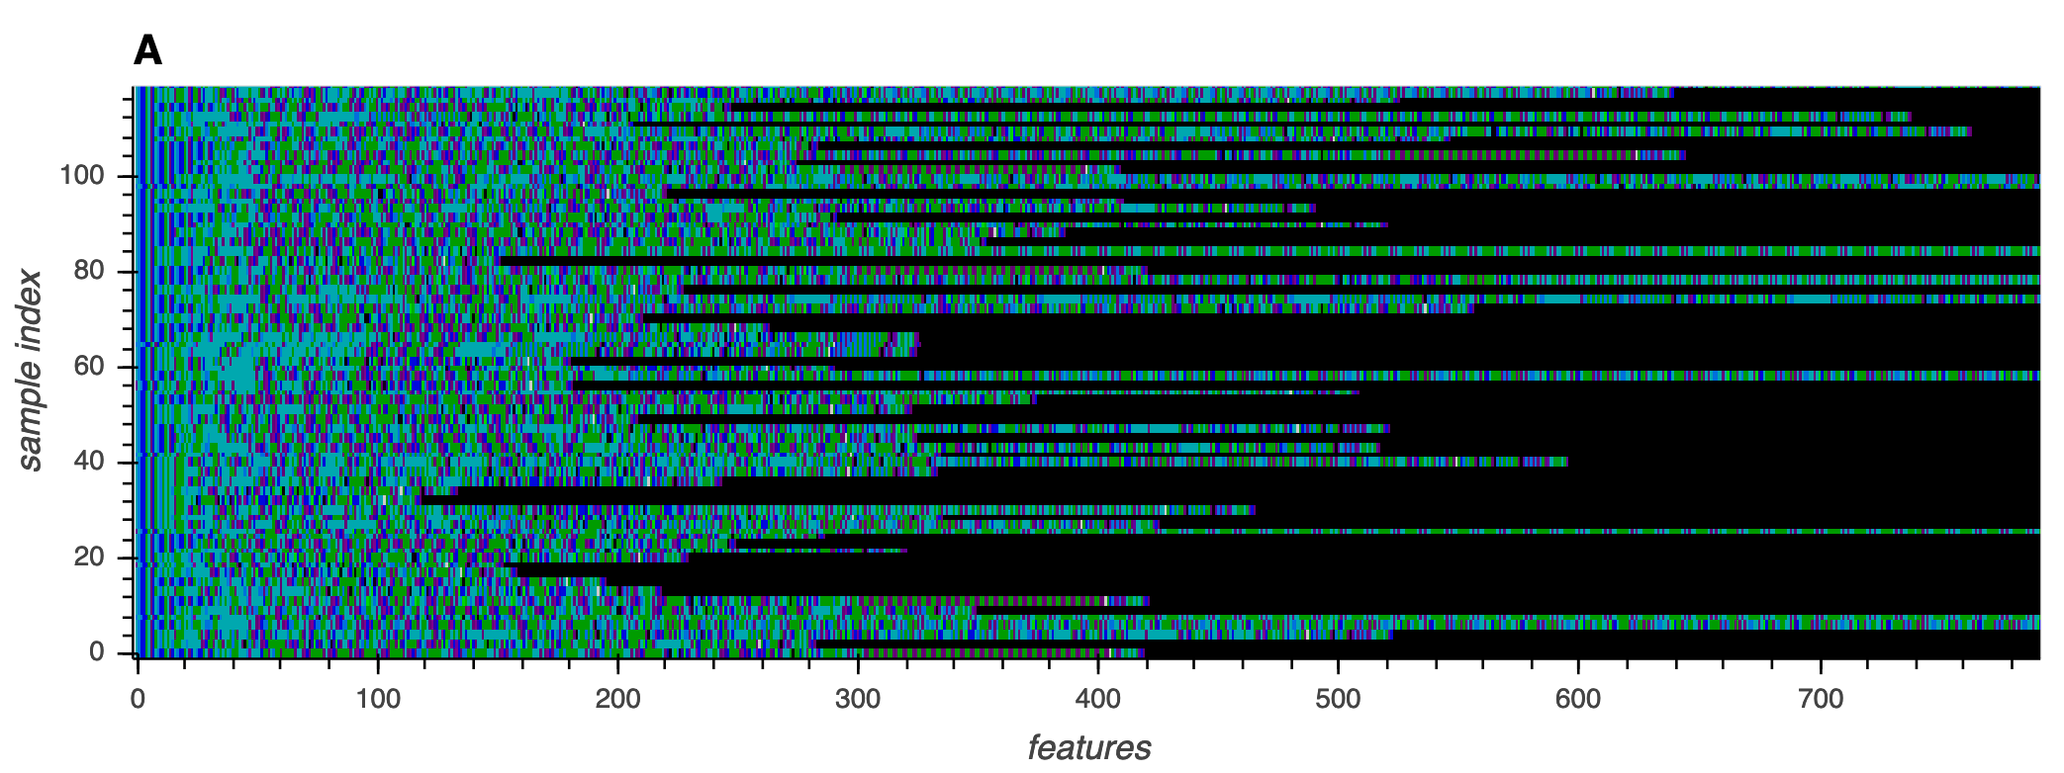
Instructions in the cluster
BKDR_TOFSEE.SMF
Ransom_HPCERBER.SMONT4
Notes:
Ransom_HPCERBER.SMONT4

Slide 17
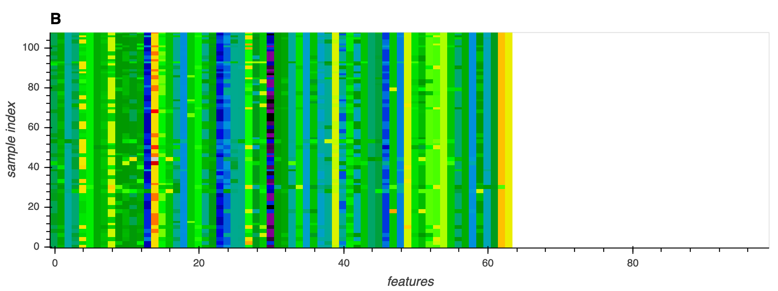
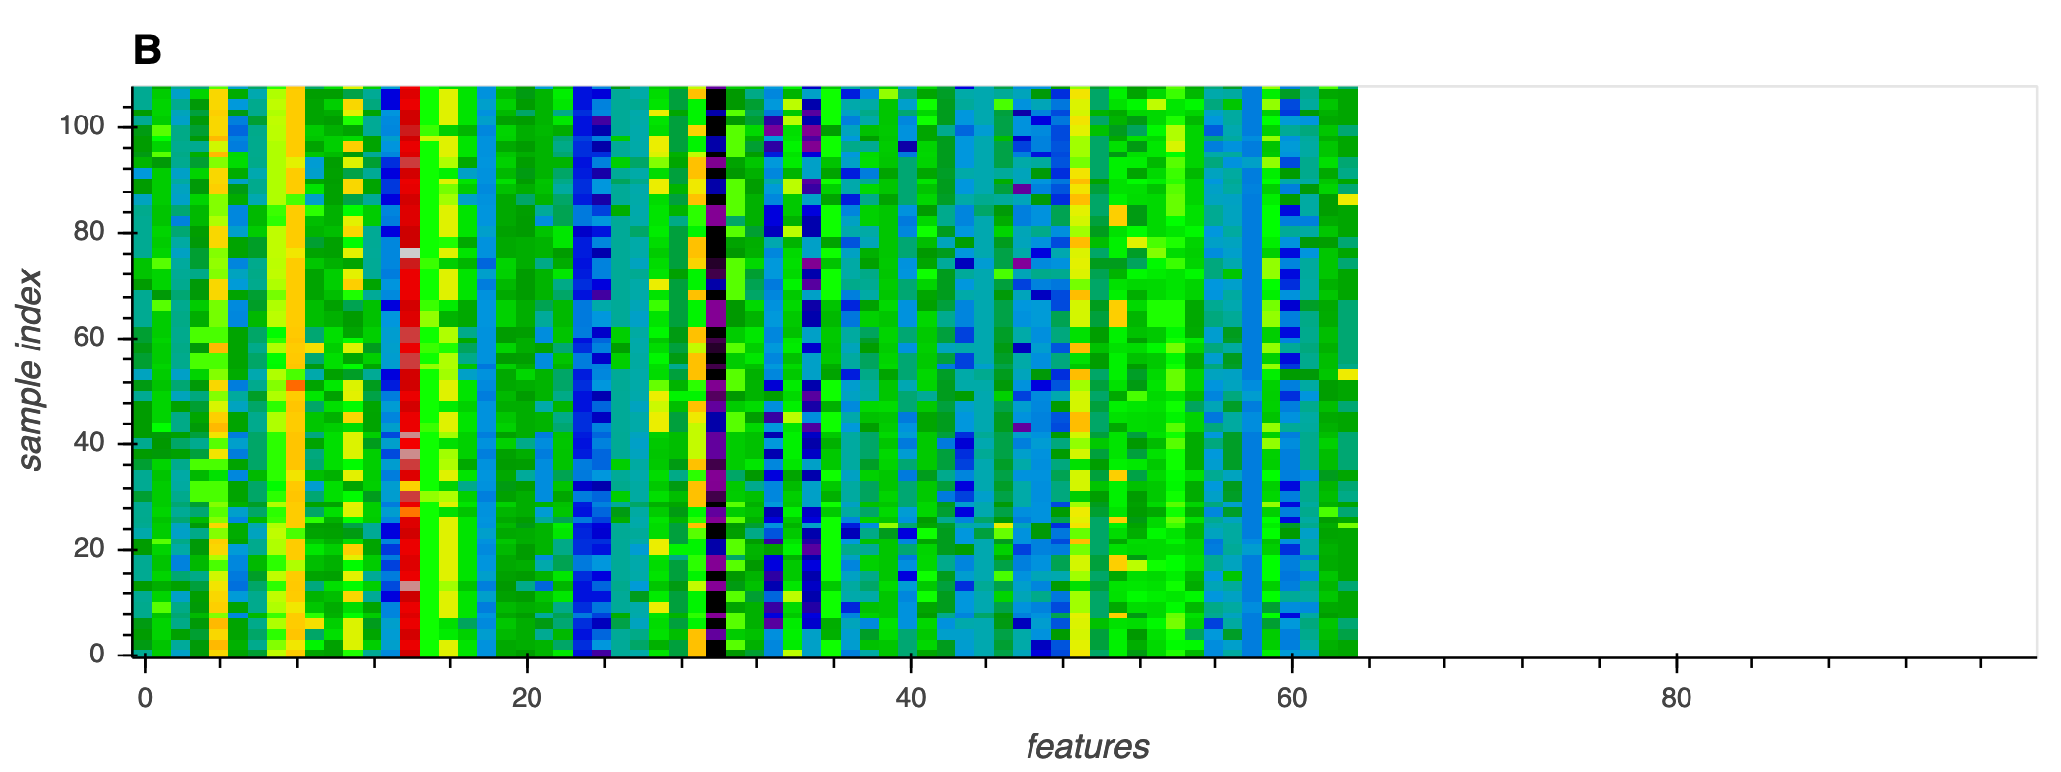
Z in the cluster
BKDR_TOFSEE.SMF
Ransom_HPCERBER.SMONT4

Slide 18
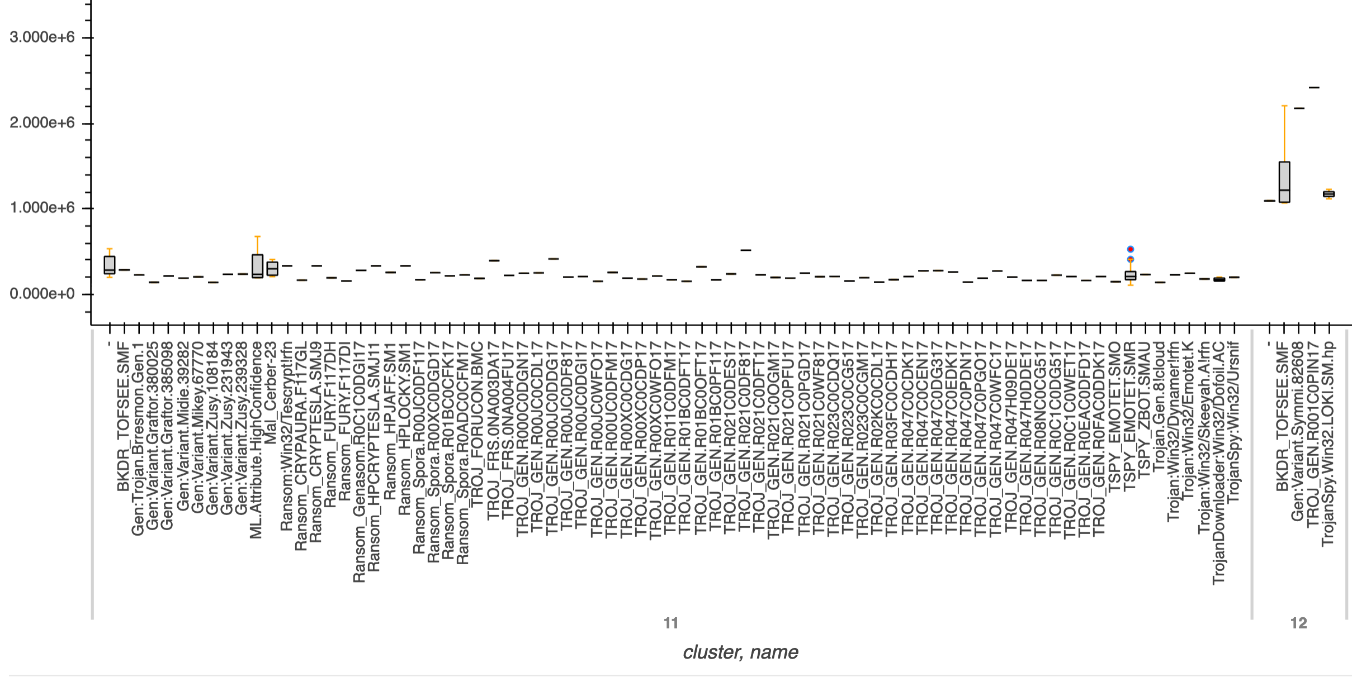
File size in the cluster

Slide 19
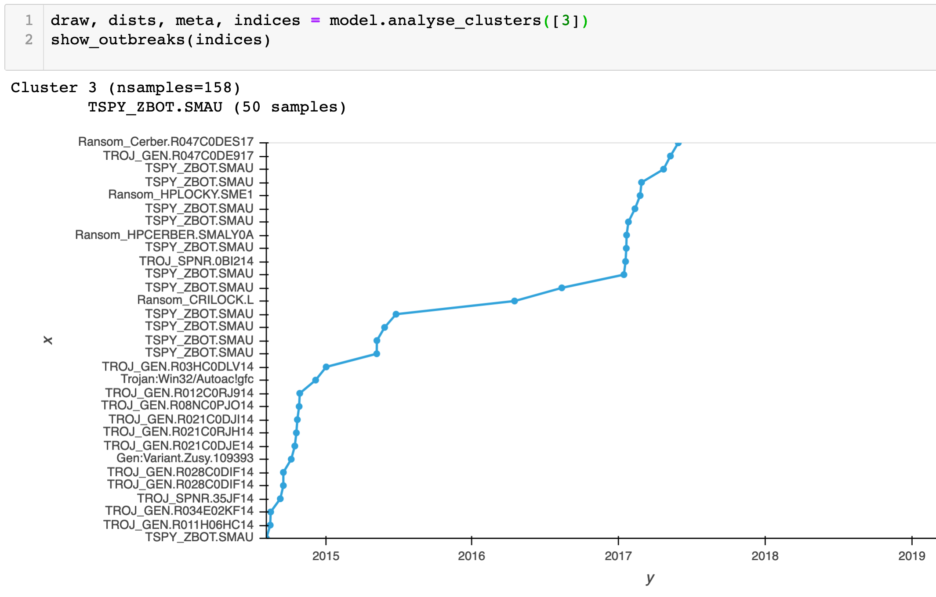

Slide 20
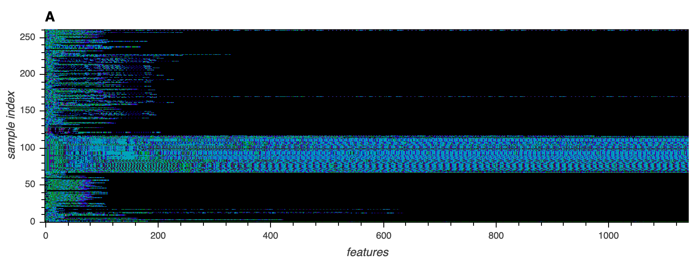
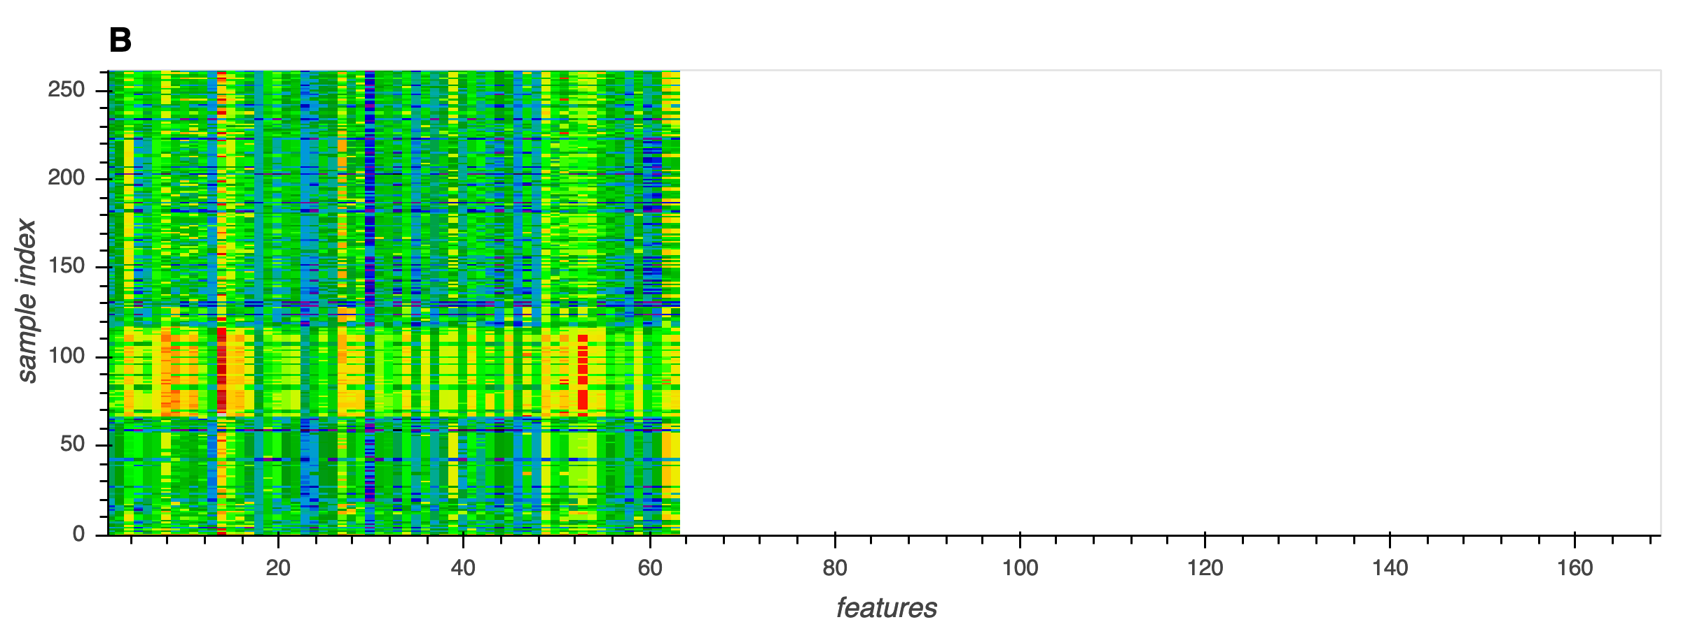
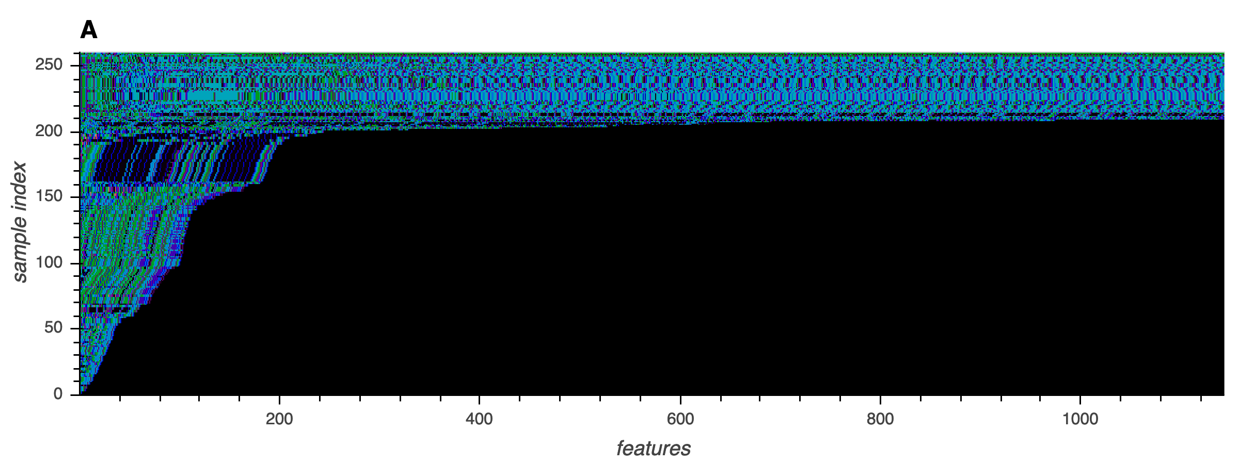
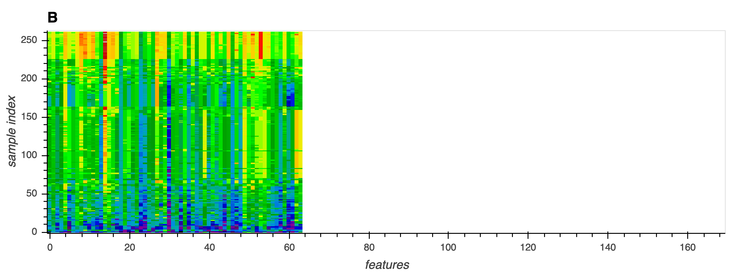

Slide 21
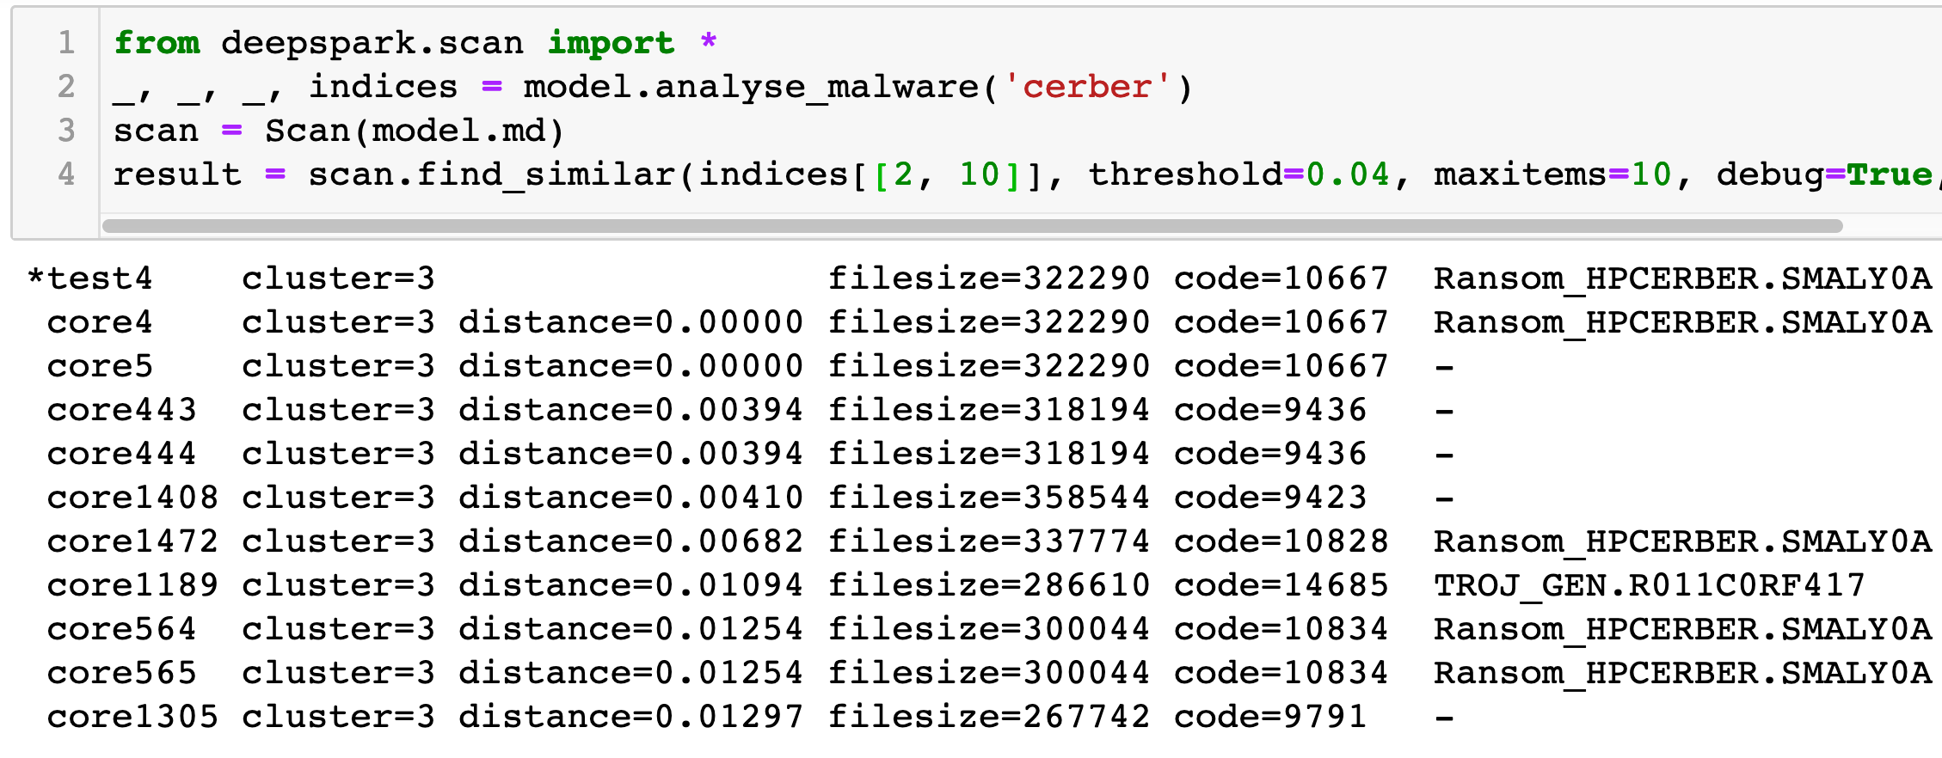

Slide 22
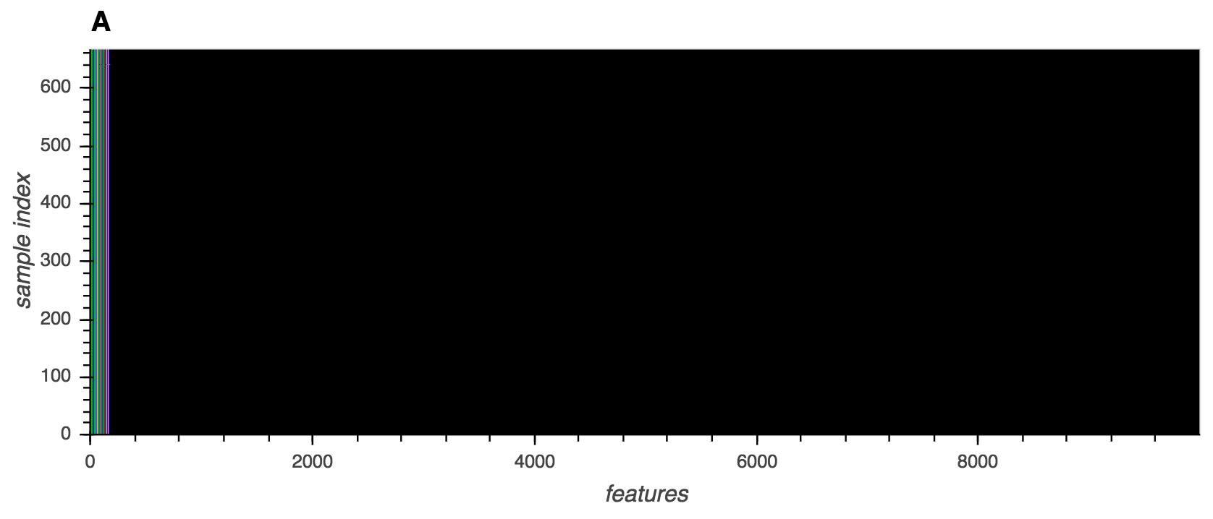
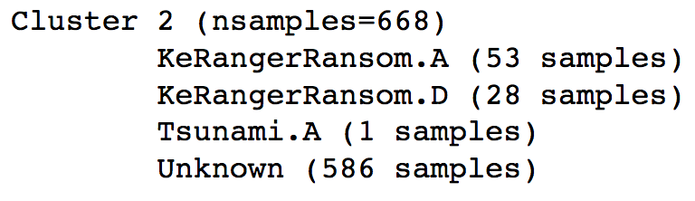
Power of Instruction Features

Slide 23
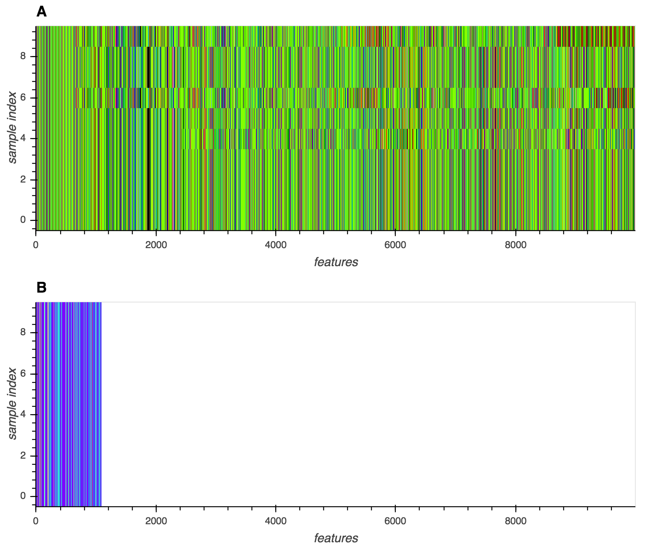
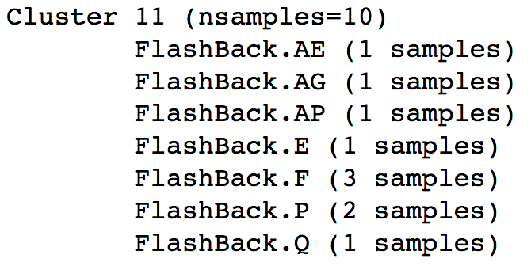
Power of Convolution

Slide 24
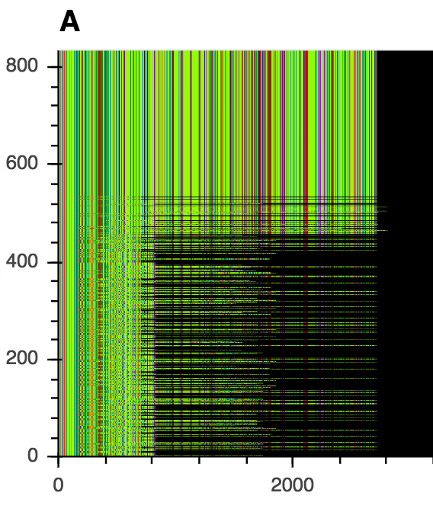
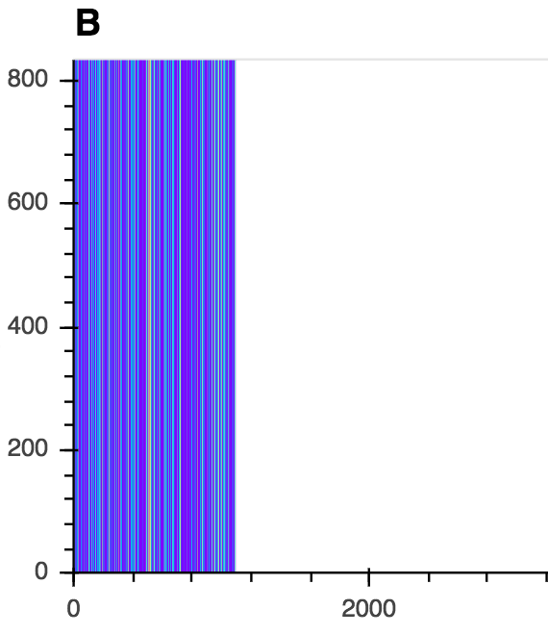
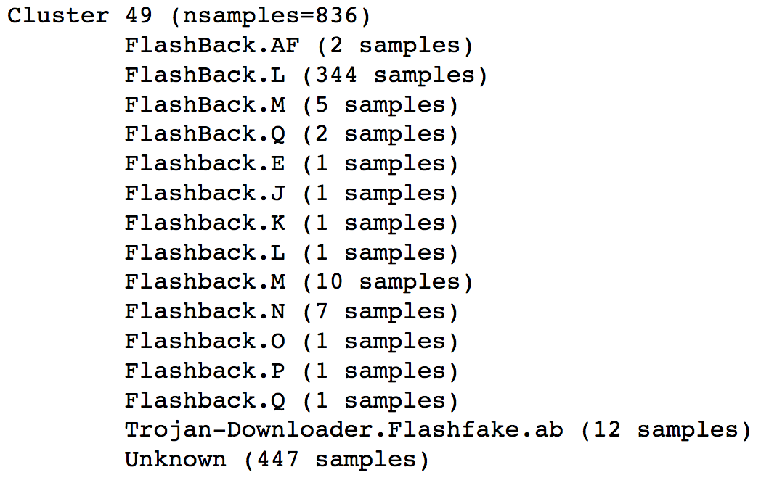
Unknown Sample Detection

Slide 25
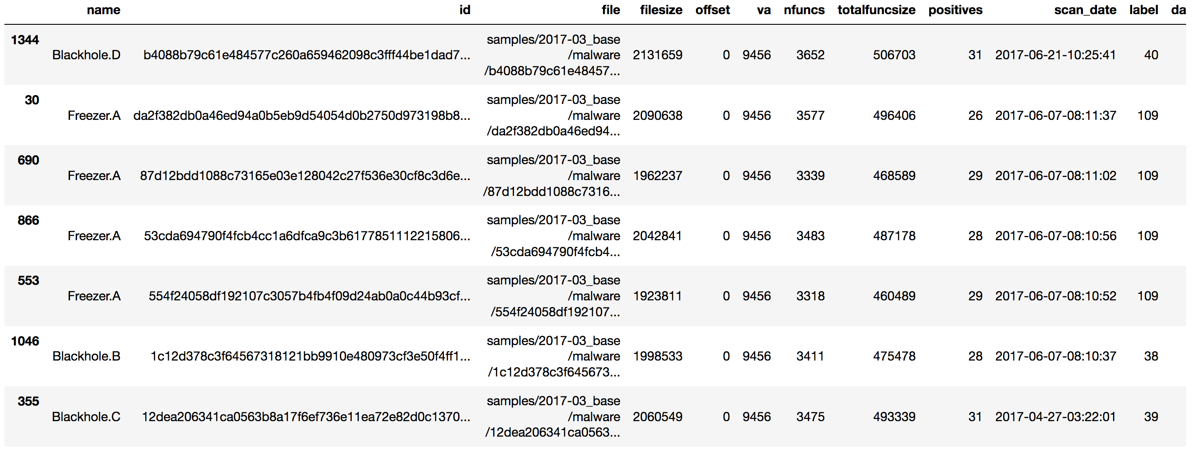
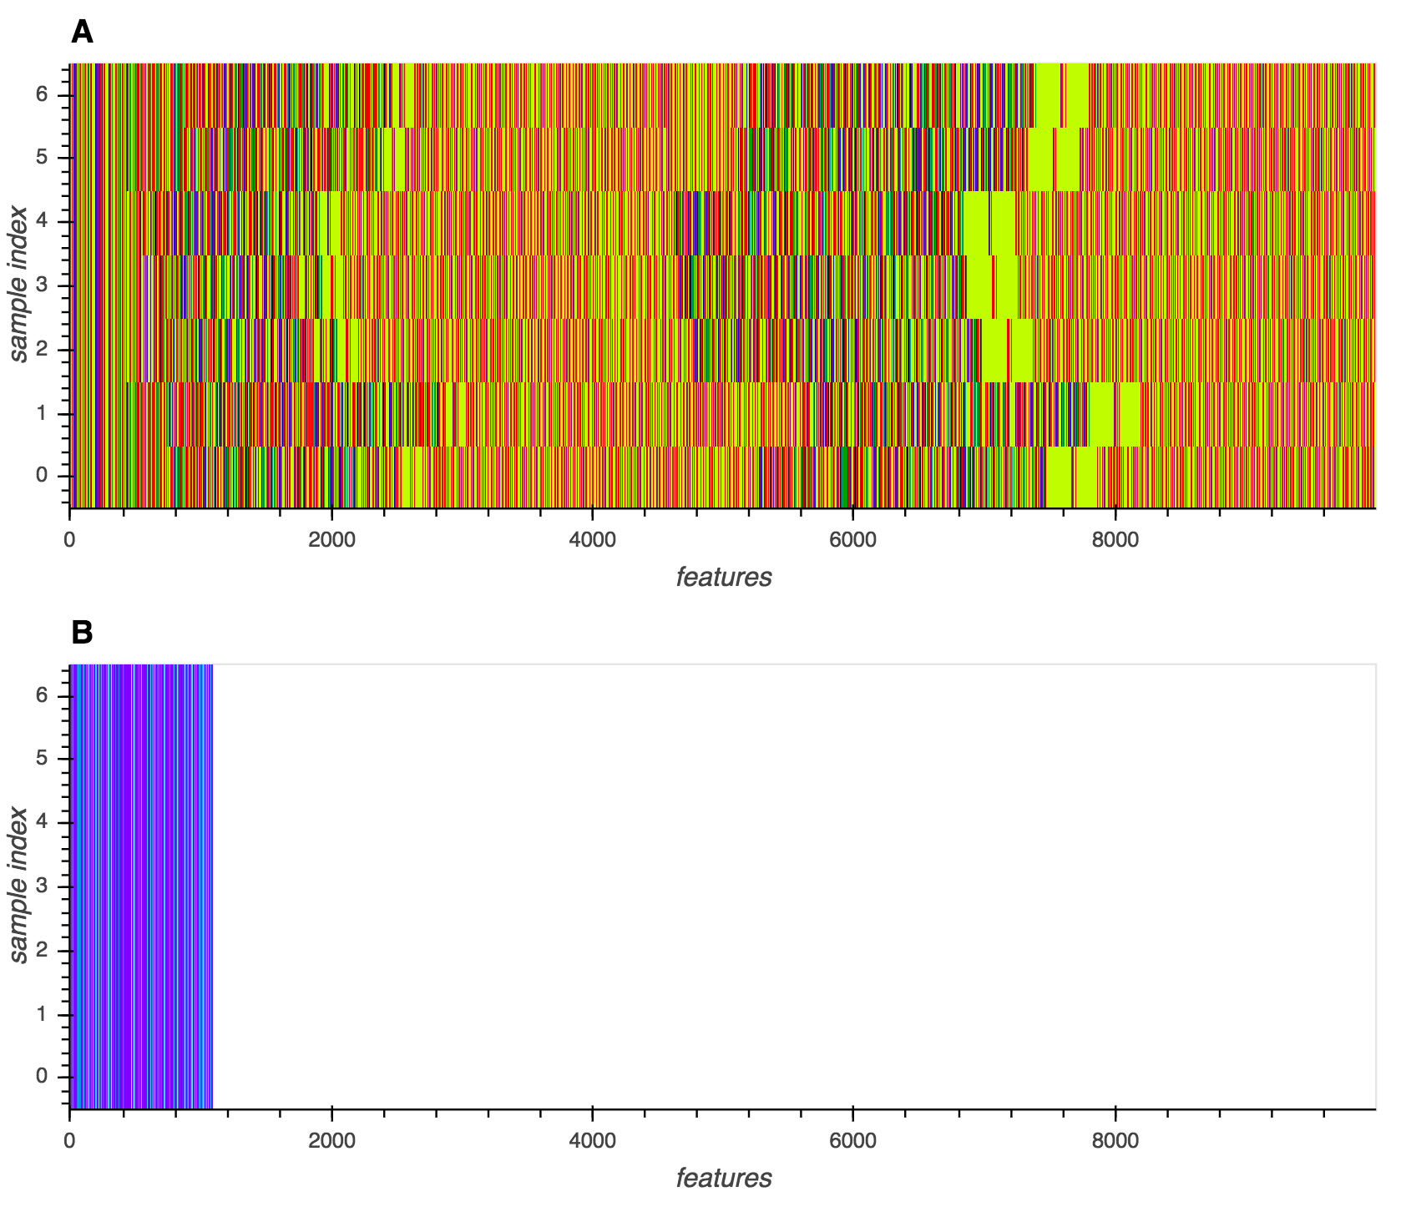
Early Detection

Slide 26
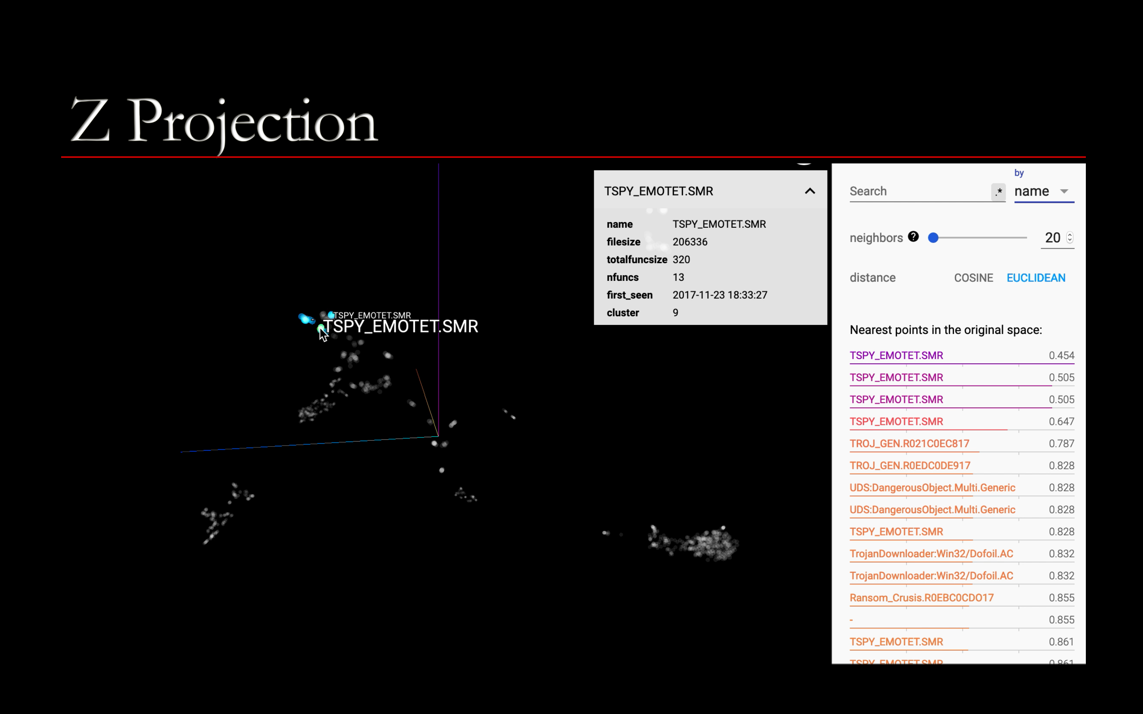

Slide 27
References
“Generative Malware Outbreak Detection,” IEEE ICIT, 2019.
"One-Shot Malware Outbreak Detection Using Spatio-Temporal Isomorphic Dynamic Features”, IEEE Trustcom, 2019
“Instruction Cognitive One-Shot Malware Outbreak Detection”, ICONIP, 2019

Slide 28


Rate today ’s session
Session page on conference website
O’Reilly Events App

