Slide 1
SPI: a minimalist financial sponsor
501(c)(3) non-profit http://www.spi-inc.org
Josh Berkus
Assistant Treasurer
Software in the Public Interest
OSCON 2013

Slide 2
Server Programming Interface?
Software in the Public Interest
  founded 1997
  “fork” of the Open Source Institute
    founded by Bruce Perens
  first OSS financial sponsor
501(c)3 charitable non-profit
fiscal sponsor of Debian Linux
  and 30+ other projects

Slide 3
What SPI provides
bank account
ability to receive charitable donations
ability to sign contracts
collective ownership of project assets
  servers
  trademarks, domain names
some light legal assistance
preference voting election assistance

Slide 4
What SPI doesn't provide
project infrastructure
startup funds
copyright assignment
liability protection
governance advice/direction
exclusive representation
annual conference

Slide 5
structure, assistance, requirements
Apache
SPI
Conservancy

Slide 6
Why Join SPI?
You just need a bank account
You want to run a fundraising campaign or a paid event
You want corporate ownership of your domain/trademark
You have an NGO in another country
You don't want to change your project

Slide 7
How to join SPI
Be a “substantial open source project”
  meeting the OSI or Debian definitions
  Don't be in the middle of a lawsuit
Find an SPI board member
Pick a Liaison
Have a few people join SPI as voting members
Submit a proposal
Attend a board meeting for vote

Slide 8
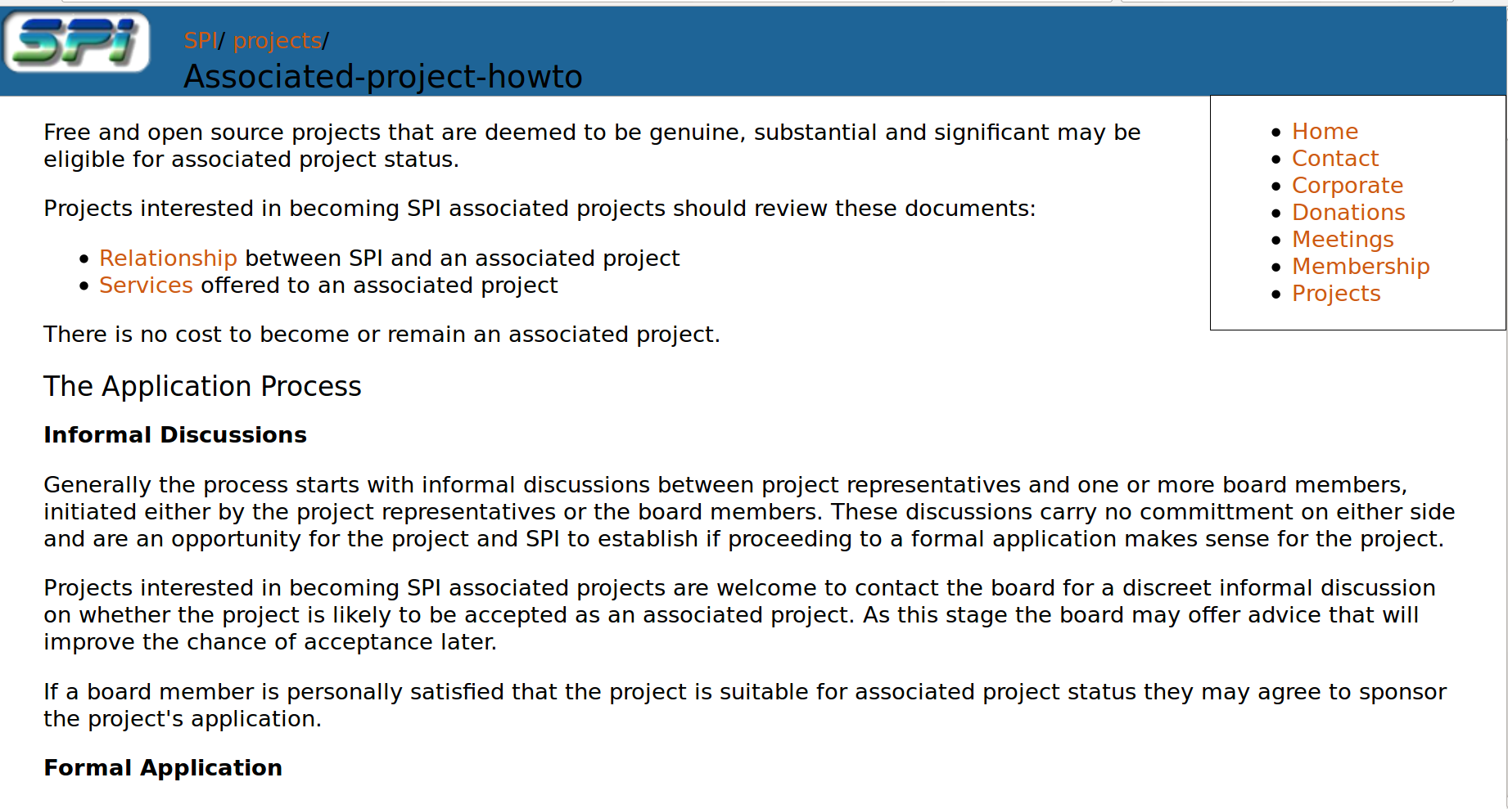

Slide 9
more details
Your members can run for SPI board
SPI deducts 5% of each donation
  plus transaction fees
  some exceptions
Payments can take a couple weeks
  generally reimbursements for expenses
  special requirements for contract work
  transaction fees for international payments

Slide 10
Join SPI Now!
… or not. we're good with that too. http://www.spi-inc.org treasurer@spi-inc.org

Slide 11
Software Freedom Conservancy
Bradley M. Kuhn
Executive, Director, Software Freedom Conservancy

Slide 12
Software Freedom Conservancy
A 501(c)(3) non-profit charity
Incorporated in New York under NYS charity law.
Founded on 2006-04-07.
“Direct Project” fiscal sponsor (Model A)

Slide 13
Why “Direct Project” Sponsor?
Projects actually become “part” of Conservancy
  Akin to being a wholly owned subsidiary
This gives some specific benefits:
  Liability protection for volunteer developers
  Conservancy can act officially in the name of project as a corporate entity.
  More oversight of spending & assets.

Slide 14
Primary Conservancy Services
Directed donations which the project leadership can spend as it sees fit (within 501(c)(3) charities rules).
Legal assistance
(CLAs, copyright policies, trademark registration & policies, license enforcement)
Conference Organizational Assistance
(venue contract negotiation & signing, all off-site logistics)
Asset Management
(hold copyrights, trademarks; own servers, equipment)
Fundraising assistance
Full list: sfconservancy.org/member/services

Slide 15
Application Requirements
All code, documentation, etc. must be under OSI-approved “Open Source license” and FSF-approved “free software license”.
Project must seek to make better software for the general public.
Project must be reasonably well established (new initiatives with “no code yet” aren't welcome)
Evaluation by Conservancy's Evaluation Committee, who are: http://sfconservancy.org/about/eval-committee/
Email <apply@sfconservancy.org> for full application materials.

Slide 16
Software Freedom Conservancy
If you want a full-service, hands-on public charity fiscal sponsor for your Open Source and Free Software project, Conservancy might be the home for your project.

Slide 17
Apache Software Foundation
501(c)(3) non-profit
Indemnity
Infrastructure
Independence

Slide 18
Apache Projects
Common
License
Infrastructure
Community model
Diverse
Focuses
Technologies
Development models

Slide 19
Being an Apache Project
Apache license
Collaborative, consensus-driven development
Diverse community

Slide 20
Becoming an Apache Project
Legal standards
Community standards

Slide 21


Slide 22
501(c)6 Trade Association
Committers and Organizations form our membership

Slide 23
Services to Foster Collaboration
Infrastructure
IP Management
Development Process
Community Development

Slide 24
Supported by:
20 professional staff
190+ member organizations
1000+ committers
Millions of software developers

Slide 25
Things you might not know about Eclipse:
Technology agnostic (more than Java)
Forge agnostic (embracing github)
Flexible licensing (more than EPL)

Slide 26
Success @ Eclipse
Lots of users
Lots of commercial and OSS adoption
Lots of Contributions
Successful Industry Platforms

Slide 27
Thank You
Ian.skerrett@eclipse.org

Slide 28

Outercurve Foundation
501(c)(6) non-profit
Overview
Paula Hunter, Executive Director
July 2013

Slide 29

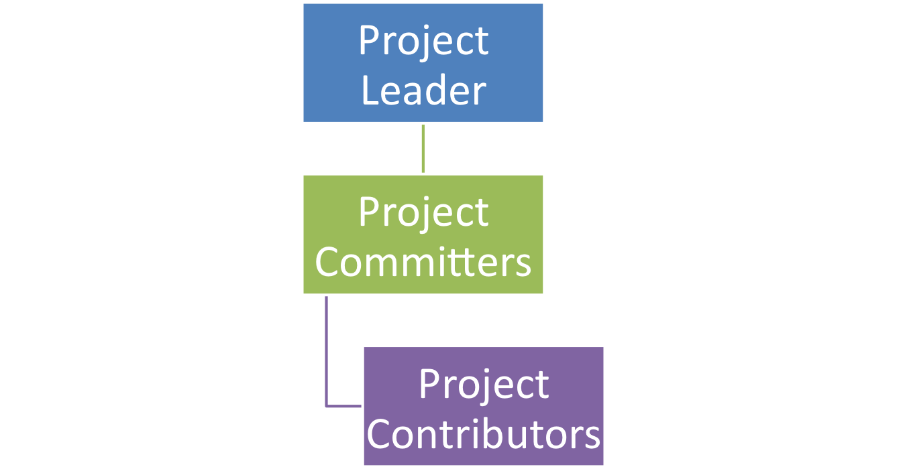
Typical OSS Project

Slide 30
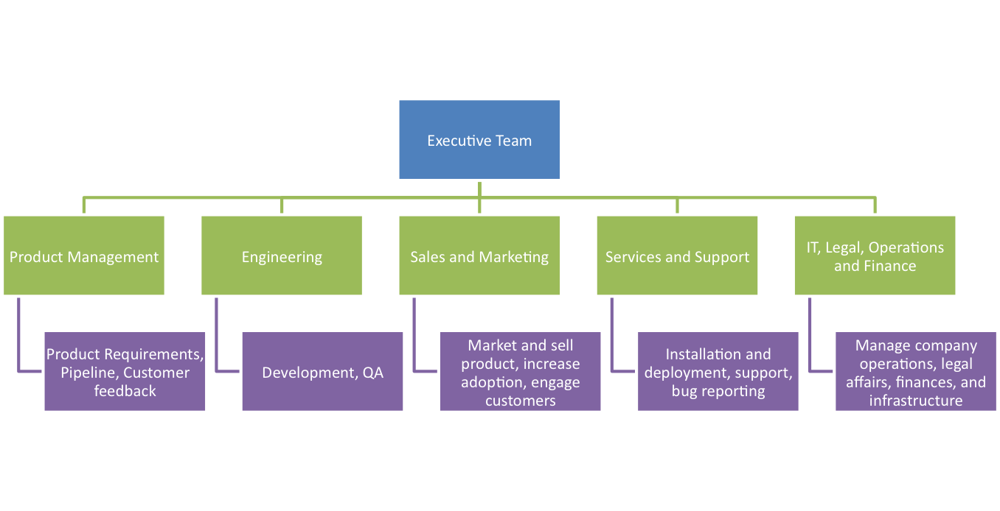
Typical Software Company

Slide 31
What is a Foundation’s Role?
Foundations are non-profits* that provide:
  Legal Structure
  Business Operations
  Technical Services
* But they are still businesses

Slide 32
The Role of Outercurve
Contributions are the life blood of any active FOSS project
Our goal is to increase the project contribution flow
We want to help projects gain users that become contributors that become committers

Slide 33
Outercurve Provides Staffing and Services Throughout the Project Lifecycle
Concept
Launch
Build Community
Sustain Support
Adoption
Counsel and content on best practices for licensing, code assignment, and contribution agreements
IP management and oversight
Electronic CLAs
Ensure each project has guidelines for getting started, how to get involved and contribution.
Acquire domains
Project Mentors.
Launch program tailored to the project audience(s), including integrated PR and Social Media campaigns
Code signing certificates
Project mailing lists and administrative resources
Project dashboard for all projects
Provide branding elements for project websites
Establish project management process
Forums and blogs
Support and fund developer events
Indemnify project committers
Establish a facility to collect and distribute project level donations and bounties
Facilitate surveys and contests
Gallery and project sponsors provide 3 year commitment
Education and promotion of IP management and development process
Project committers can serve on Technical Advisory Board
OCF Wiki for sharing of best practices across projects
Provide tools and templates to guide project leads to successful adoption of the project
Promote major milestones and releases

Slide 34
The Outercurve Foundation
While many Foundations provide a liability firewall and a demonstration of neutrality
  They are tied to a license, a particular technology base, or development process.
The Outercurve Foundation provides the benefits of neutrality, a liability firewall, IP and project governance, at a low cost
  Remaining agnostic on license, technology platform, and development process.

Slide 35

The Museum As A Metaphor
Sponsors create “Galleries” based on technology or industry themes
Gallery Managers and the Foundation encourage project assignments into Galleries
Individual Projects are complementary with the theme of the Gallery

Slide 36
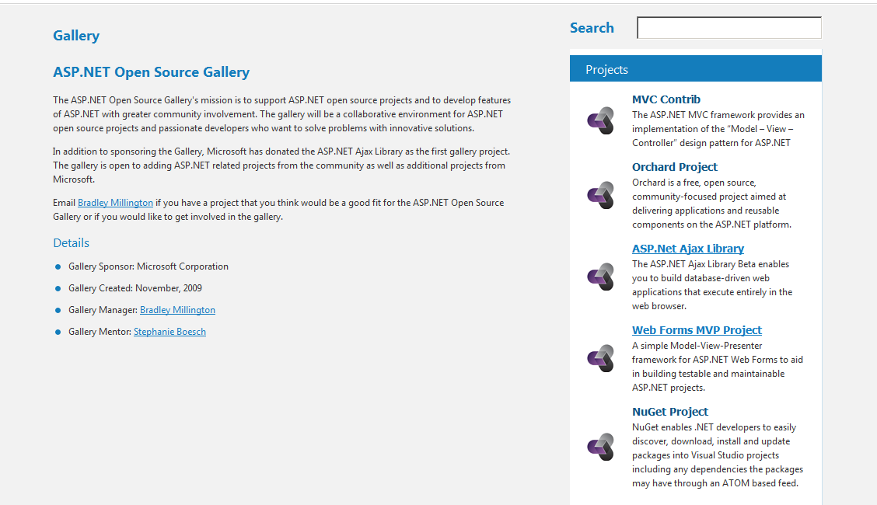
Technology Themed Gallery: ASP.NET
Gallery managed by Sponsor appointed manager, mentored by Outercurve board member.
Projects are a collection of sponsor and non-sponsor contributed projects.

Slide 37
Why does it matter?
Neutrality encourages contribution
Clean IP encourages adoption
Foundations act as community centre-of-gravity

Slide 38
Questions?
Paula Hunter, Executive Director
phunter@outercurve.org
Eric Schultz, Developer Advocate
eschultz@outercurve.org
http://www.outercurve.org
@outercurve

Slide 39

Linux Foundation
501(c)(6) non-profit
Jim Zemlin, Executive Director

