Slide 1

Worldwide Mobile Content And Commerce Usage And Trends - What You Need To Know To Thrive In A Global Economy
Presented by: Marjorie DeHey, JD/MBA – GM MEF

Slide 2


Marjorie DeHey, JD/MBA – GM MEF North America
General Manager for MEF where she drives the North American strategy for the global organization of over 200 members.
Has worked with top brands such as MGM, NBC/Universal, Turner Broadcasting, Coca-Cola, Sony, Sprint, AT&T, Verizon, Warner Brothers, MTV and Samsung.
Previously ran the media/entertainment division of the Irish government.
Named one of “The 25 Women to Watch in 2012” by Mobile Marketer Magazine and quoted as expert on digital media by MSNBC.

Slide 3
About MEF
MEF is the global community for mobile content and commerce. It is the leading trade organization for companies wishing to monetize their goods, services and digital products via the mobile connected device. MEF provides competitive advantage to its diverse membership, shapes industry growth, connects thought leaders and spearheads groundbreaking initiatives which explore and promote monetization opportunities.

Slide 4
Three cool things you may not know…

Slide 5

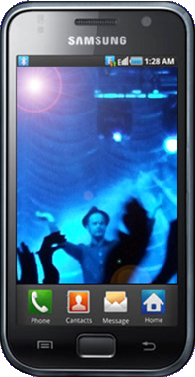
1. Faster than the computer that . .
2000x raw speed
{AGC (Apollo Guidance Computer) had 2kb memory, 32kb of read only memory (storage), CPU 1.024 MHz. Samsung Galaxy II S has 1 GB memory (1 048 576 kb), 32 GB storage (33 554 423 kb), CPU Dual-core 1.2 GHz (1200 MHz x 2)}

Slide 6
2. The “second screen is now the “first screen”
According to a study by InMobi:
TV usage: 141 minutes a day
Phone media usage: 144 minutes
Inmobi, 2012

Slide 7
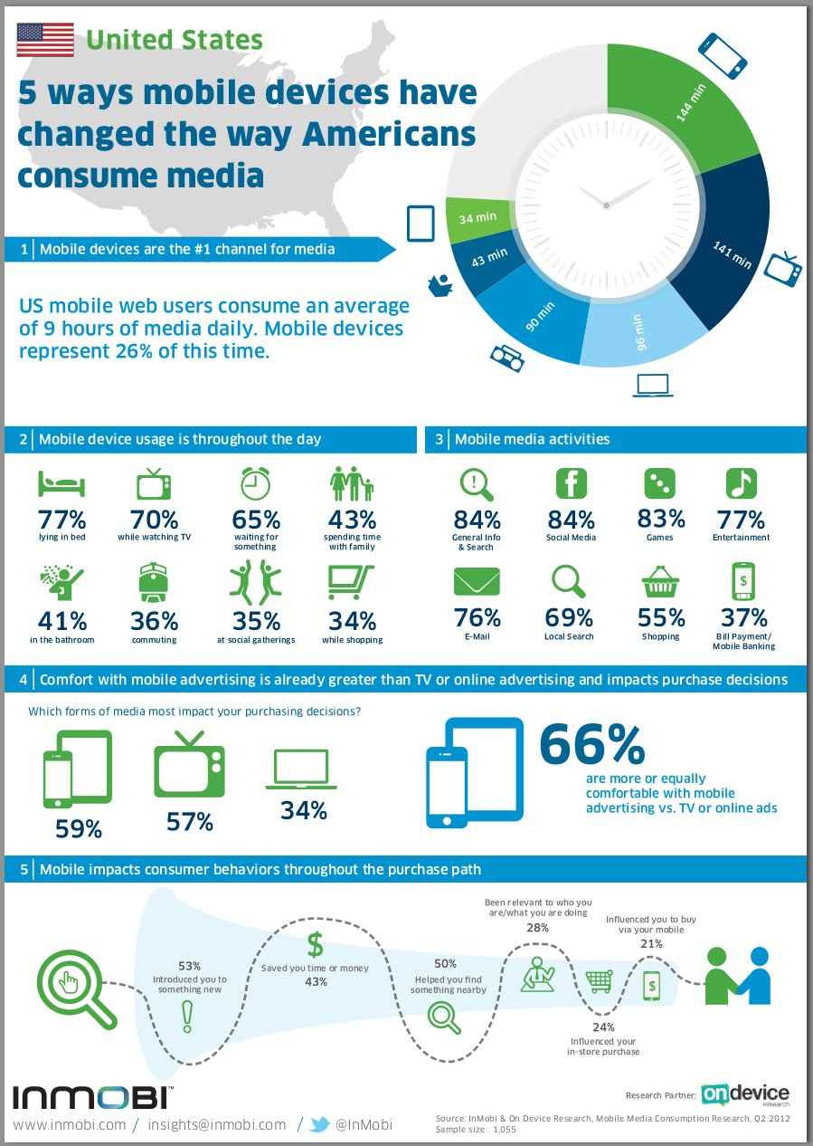
Notes:
I was going to use this as the 3rd interesting fact – 41% percent of people are using their mobile in the bathroom…

Slide 8
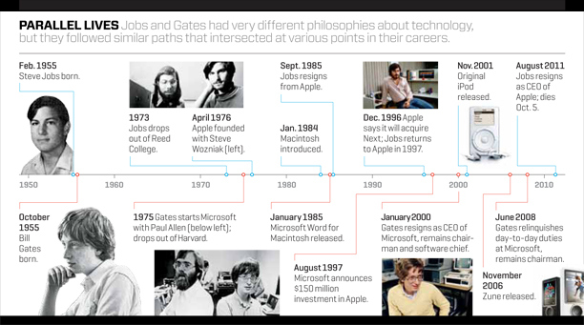
2.5) Both Bill Gates and Steven Jobs were college dropouts – tuition in 2030 is estimated to be $130,428 a year*
http://tech.fortune.cnn.com/2011/10/24/steve-jobs-walter-isaacson/; *CNBC, 2012
Notes:
The average net worth of billionaires who dropped out of college, $9.4 billion, is approximately triple that of billionaires with Ph.D.s, $3.2 billion
So is Mark Zuckerberg

Slide 9
3) Monetization is truly here
MEF, 2012; 9500 Global Consumers

Slide 10


GLOBAL CONSUMER SURVEY 2012:
Understanding Mobile Content and Commerce Usage & Trends Worldwide

Slide 11









MEF Global Consumer Survey 2012
UNDERSTANDING MOBILE CONTENT AND COMMERCE USAGE & TRENDS WORLDWIDE
MEF’s annual Global Consumer Survey surveys mobile media users worldwide to understand changing mobile content and commerce behaviors and trends.
Purchase – digital or physical goods
Research – using the phone to support product/purchase research
Banking – transaction or accessing bank accounts
9,500 mobile media users across ten countries were surveyed, namely: US, UK, China, India, Qatar, South Africa, Mexico, Brazil, Indonesia and Saudi Arabia.
Sponsors & Partners
Notes:
The 2012 study digs deep into consumer trends and attitudes, providing insight and analysis on their wider industry impact with mobile content and commerce broken down into three distinct activities:
It gives unprecedented data and intelligence into mobile engagement and purchasing habits.
The report delivers insight that can help both mobile specialists and those who are new to mobile to develop targeted mobile strategies and fully exploit the rich opportunities that mobile provides.

Slide 12
Device penetration for the Mobile Media Users differs greatly between markets
UNDERSTANDING MOBILE CONTENT AND COMMERCE USAGE & TRENDS WORLDWIDE
Date: Aug/Sep 2012 Base: Total respondents 9500
Notes:
Developed markets
(UK & US) are all about Smartphones namely
Android and iPhones
China is very much following this trend
Growth markets are still feature phone dominated,
but Android is coming

Slide 13
In 2012, globally 88% of Mobile Media Users have engaged in mobile content & commerce activity
UNDERSTANDING MOBILE CONTENT AND COMMERCE USAGE & TRENDS WORLDWIDE
Date: Aug/Sep 2012 Base: Total respondents 9500

Slide 14
Growth markets are a key driver behind the overall global increase in the number of mobile content and commerce users
UNDERSTANDING MOBILE CONTENT AND COMMERCE USAGE & TRENDS WORLDWIDE
Date: Aug/Sep 2012 Base: Total respondents 9500

Slide 15
Mobile as an engagement engine. Growth driven by Pre-Purchase Research and Banking
UNDERSTANDING MOBILE CONTENT AND COMMERCE USAGE & TRENDS WORLDWIDE
Date: Aug/Sep 2012 Base: Total respondents 9500

Slide 16
UNDERSTANDING MOBILE CONTENT AND COMMERCE USAGE & TRENDS WORLDWIDE
Purchase behavior is maturing & diversifying with a significant increase
in the purchase of physical & perishable goods since 2011
N/A
Date: Aug/Sep 2012 Base: Total respondents 9500
Notes:
Percentage of mobile media users purchasing digital content has not increased year-on-year (this does not measure consumption)
Significantly more people are purchasing physical and perishable goods, growing from 24% to 31% of all mobile media users.
Strong share also for Virtual Goods

Slide 17
Research leads to revenue
UNDERSTANDING MOBILE CONTENT AND COMMERCE USAGE & TRENDS WORLDWIDE
9
Date: Aug/Sep 2012 Base: Total respondents 9500

Slide 18
Global purchase behavior trends
UNDERSTANDING MOBILE CONTENT AND COMMERCE USAGE & TRENDS WORLDWIDE
BELOW AVERAGE
GLOBAL SCORE: 70%
ABOVE AVERAGE
Date: Aug/Sep 2012 Base: Total respondents 9500
Notes:
are the most likely to purchase via their mobile, while consumers in Mexico are the least likely
The Smartphone markets of China, US and UK show the highest penetration of purchasing via mobile
South Africa where 96% of consumers state that the mobile plays an important role in their life is however even higher

Slide 19
Growth Markets are showing above global average penetration for mobile purchases.
UNDERSTANDING MOBILE CONTENT AND COMMERCE USAGE & TRENDS WORLDWIDE
DIGITAL GOODS
BELOW AVERAGE
GLOBAL SCORE: 54%
ABOVE AVERAGE
Growth markets
DRIVING MOBILE
CONTENT uptake
PHYSICAL GOODS
BELOW AVERAGE
GLOBAL SCORE: 27%
ABOVE AVERAGE
Smartphone markets
DRIVING PURCHASE
of physical goods
Date: Aug/Sep 2012 Base: Total respondents 9500

Slide 20
Cards and operator payments are the major payments methods
UNDERSTANDING MOBILE CONTENT AND COMMERCE USAGE & TRENDS WORLDWIDE
Date: Aug/Sep 2012 Base: Total respondents 9500

Slide 21
Globally, 33% users now check their bank balance via their mobile, up from
22% in 2011
UNDERSTANDING MOBILE CONTENT AND COMMERCE USAGE & TRENDS WORLDWIDE
Date: Aug/Sep 2012 Base: Total respondents 9500

Slide 22
Globally - convenience and entertainment are the key reasons globally consumers purchase via their mobile
UNDERSTANDING MOBILE CONTENT AND COMMERCE USAGE & TRENDS WORLDWIDE
Date: Aug/Sep 2012 Base: Total respondents 9500
Notes:
Trend mimicked in the US

Slide 23
Consumer Trust and Lack of Need key barriers to further purchase via mobile devices
UNDERSTANDING MOBILE CONTENT AND COMMERCE USAGE & TRENDS WORLDWIDE
Date: Aug/Sep 2012 Base: Total respondents 9500
Notes:
26% of consumers state that they have no need to purchase via mobile – work still to be done on relevance and need
35% say consumer trust is the largest barrier to future adoption
Security as the biggest concern in terms of Consumer Trust

Slide 24

USA COUNTRY REPORT
GLOBAL CONSUMER SURVEY 2012
Mobile Content and Commerce Usage & Trends in the USA

Slide 25
Executive Summary
Notes:
Not so long ago, North America was considered to be behind the pace in mobile terms. All that changed with the advent of the iPhone and Android platforms – each of which was, of course, born in North America. The modern smartphone era catapulted the USA in particular to the forefront of the market for mobile content and commerce – as this report clearly demonstrates.
In the first instance the study reveals the degree to which US mobile media users have switched from feature phones to smart devices. A staggering 95 per cent of this group use a smartphone – with interestingly half of those surveyed choosing Android, while 31 per cent choose iPhone. The ability of the smartphone to connect seamlessly to the web, to run apps and to store payment card details is driving up activity in mobile content and commerce in virtually all areas.
For US mobile media users, using a handset to perform pre-purchase research is almost ubiquitous.
88 per cent did so in 2012 – up 17 per cent on 2011. In terms of precise activities, more than half of this group have looked for product info, checked prices, researched info for future services or checked to find a store location.
And it may be little surprise to know that, in a country with a strong tradition of collecting money-off coupons (shoppers saved $4.6 billion with coupons in 2011, according to the NCH Marketing Services), 32 per cent used a mobile coupon to redeem offers. The potential of the coupon market is certainly a key driver of big US mobile commerce projects such as Google Wallet and Project Isis.
Overall, 91 per cent of the US’s smartphone-using mobile media users had engaged with some form of mobile content and commerce in 2012, up eight per cent on 2011, and three per cent higher than the average across the ten countries in the study

Slide 26
US Consumers Prefer Payment Via Credit Cards
PAYMENT BY CARD
BELOW AVERAGE
GLOBAL SCORE: 27%
ABOVE AVERAGE
Notes:
Another truism about North Americans is their enthusiasm for credit cards. There are over 350m cards in use in the US and, according to FINRA American Financial Capability Insight, the average card user owns 3.7 cards.
The report clearly shows the extent to which Americans are also using the mobile as a channel for card payments. In all, 47 per cent of US mobile media users are employing ‘payment by card’ in their mobile commerce transactions. That’s the highest rate in the world.
Possibly this reflects the high number of iPhone and Android users in the US. All such consumers have to assign a credit or debit card to their app store accounts, which they can then use to make digital purchases. In 2012, 58 per cent bought digital goods by mobile. Within this group, two thirds are buying games.
But, more dramatic, purchases of physical and perishable goods virtually doubled in a year to 52 per cent.
Given the financial sophistication of the US mobile media user, it’s perhaps unsurprising that 69 per cent are now mobile banking in some form. Among this group, 41 per cent are checking balances and 42 per cent are paying bills.

Slide 27
95% of mobile media users in the USA use a smartphone to access the mobile web.
Half of smartphone owners in the USA use an Android device to access mobile media.
31% use an iPhone.
Mobile content and commerce activities have grown significantly since 2011.
91% now engage in some form of mobile commerce.

Slide 28
All aspects of mobile content and commerce are increasing in the US.
Purchases via mobile phones has grown to 74%
Mobile media users are also researching and banking via mobile significantly more than in 2011
The smartphone platform appears to encourage stronger levels of research, banking and purchase.
Smartphone owners offer a clear opportunity for brands and advertisers to engage with them, with their significantly higher usage of all forms of mobile content and commerce.

Slide 29
Mobile has a key role to play as a purchase tool.
50% mobile media users now use their mobile to locate shops, significantly more than in 2011.
Significantly more users now engage via mobile to research products and check pricing.
Use of mobile coupons and vouchers has also increased significantly in the US, indicating that mobile as a purchase tool is on the rise.

Slide 30
At 74%, the US places third in terms of goods purchased via mobile.
USA
purchase
average:
74%
BELOW AVERAGE
GLOBAL SCORE: 70%
ABOVE AVERAGE
Purchase of all types of goods has increased significantly.
51% mobile media users now purchase physical and perishable goods in the US
A clear opportunity to develop the market in terms of both type of goods offered, and new revenue streams

Slide 31
The is above average for both digital and physical goods purchase.
The US perhaps surprisingly places only in the top 4 for both digital and physical goods purchase.
DIGITAL PRODUCTS
BELOW AVERAGE
GLOBAL SCORE: 54%
ABOVE AVERAGE
PHYSICAL GOODS
BELOW AVERAGE
GLOBAL SCORE: 27%
ABOVE AVERAGE

Slide 32
66% of US mobile media users have purchased either a digital or virtual good.
With purchase digital goods stronger than that of virtual goods.
At 23%, the US has one of the strongest levels of purchasing both good types, level with the UK.
47% pay for purchases via their mobile phone using a card.
Notes:
With a significant increase in card payments, coupled with a significant decline in mobile phone payment methods, a shift in payment methods has appears to have occurred.

Slide 33
At 47% the US leads the world in card payments via mobile
Whereas global ranking in terms of airtime payments reflects market maturity levels.
PAYMENT BY CARD
BELOW AVERAGE
GLOBAL SCORE: 27%
ABOVE AVERAGE
PAYMENT BY AIRTIME
BELOW AVERAGE
GLOBAL SCORE: 14%
ABOVE AVERAGE

Slide 34
Significantly more mobile media users are now willing to spend high in relation to their income when purchasing goods on their mobile phone.
It would appear that consumers have migrated up the value chain, with more now willing to spend at higher levels.
This offers a clear opportunity to increase revenue within the market, especially given the US mobile media users appetite for physical goods and the overall increase in commerce activity.
Notes:
With such strong levels of purchase, creating a stronger offer/desire to purchase may help to increase consumers up the value chain.

Slide 35
Consumers are using their mobile phone to manage their daily finances significantly more.
41% now use their mobile to check their bank balance. 42% now use their phone to pay bills.
Applications for credit/loans has grown dramatically since 2011.
The maturity of the US consumer means that a clear opportunity for financial and utilities brands exists.

Slide 36
Despite the US market maturity, games are still by far the most favored app genre.
Music and social networking the next most favored genre of app
Same usage pattern evident across device types
News, navigation weather and sports apps are used more by feature phone owners.
Notes:
Engaging smartphone owners to increase the spread of their app usage to these more functional apps could help to increase revenues.

Slide 37
Different genres of applications are used by different profiles of users.
Catalogues, health and lifestyle apps are most appealing to women.
Business, navigation and utilities favored by males.

Slide 38
Convenience and Entertainment are key drivers of purchases via mobile phones.

Slide 39
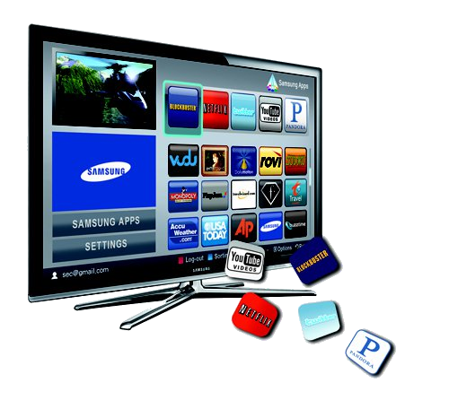
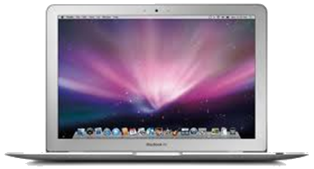
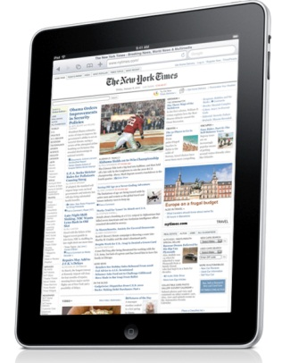
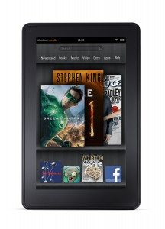
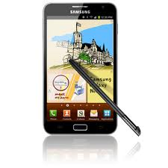
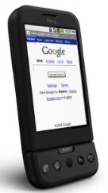
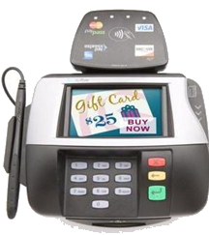
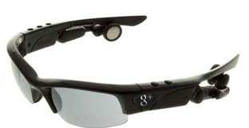
Multi-tasking over Multiscreens
Native digital folk
switch screens
27 times per hour
Notes:
People respond to text messages within 14 seconds

Slide 40
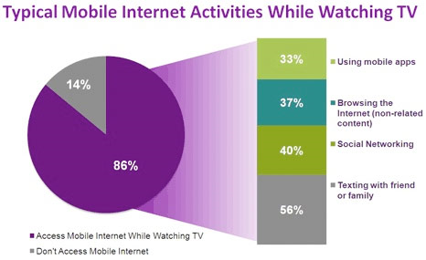
Second Screen: Distraction or Interaction?
Nielsen, 2011; 8,000 users between the ages of 13-64

Slide 41
Lack of need is a barrier to purchase, concerns about trust and safety of information.

Slide 42



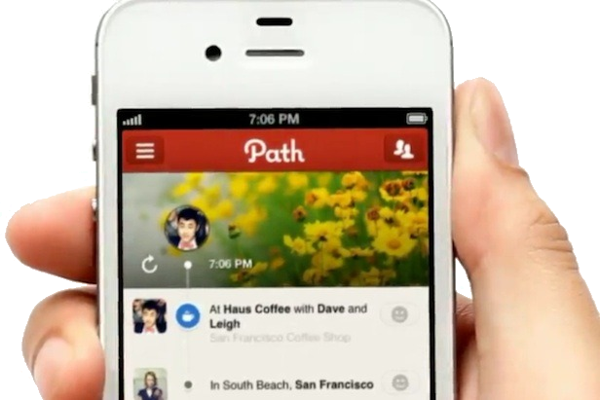

Slide 43
At 33%, trust is a key barrier to overcome to encourage greater purchase of goods via mobile.
TRUST Combined
(I don’t trust the security/I don't trust the service provider/Payment systems are not secure)
Notes:
Across all demographics and device types, concern of trust with the mobile platform is a key barrier to encourage greater purchase.
This suggests that a two pronged strategy that both drives desire to purchase and allays trust concerns offer a pathway to developing the market.

Slide 44
Why the concerns:
1) The phone is a data collector:
    - Personalization by design bundled with camera, microphone, gyroscope, compass, wallets and location features.
2) The phone is a data publisher:
    - Social by design makes sharing information seem natural and easy.
How valuable: People report a lost phone within 24 minutes, lost keys within 24 hours
Notes:
This data is collected and published on a small screen on the go in an impulse manner.
In a survey to be published later this year, Gartner found that 46 percent of people 18 to 24 would choose access to the Internet over access to their own car.

Slide 45
Summary of Findings
91% of mobile media users have conducted mobile content and commerce in the US significantly more than in 2011.
At 74%, the US has the 3rd strongest levels of purchase via mobile, half of consumers now purchase physical and perishable goods via their mobile.
Convenience is the key motivator behind purchasing via mobile, with entertainment and best deals also playing a role.
Lack of need and trust are the key barriers to overcome in order to encourage more purchase via the mobile platform
entertainment
banking
74% purchase
convenience
m-commerce
Notes:
In terms of mobile banking, mobile media users are using mobile to manage their finances by checking their bank balance and paying their bills, a sharp increase in applying for credit/loans has also occurred.
Pre-purchase research in the form of checking prices, information finding shops and using mobile coupons has increased.
Payment methods have swung in favor of cards.

Slide 46
Opportunities in Mobile Content & Commerce
Smartphone owners offer a clear opportunity to drive revenue, they conduct all forms of mobile content and commerce significantly more than feature phone owners.
Mobile has a clear role to play as a purchase tool - in both driving footfall to bricks and mortar, and as a stand alone purchase tool.
Mobile banking is a key growth opportunity for financial institutions and utilities brands.
The proportion of consumers who are willing to spend high in comparison to their income on mobile purchases has increased significantly.
Notes:
This coupled with the fact that more consumers in the US purchase physical and perishable goods on their mobile than they do digital goods offers a clear opportunity to increase revenue.
Leveraging the swing towards card payments could offer further growth.
A two-pronged strategy that both drives desire to purchase and allays concerns of trust offer a pathway to developing the market.

Slide 47
What are three cool things you should know:
BlackBerry 10 – merging work/play
By 2014, there will be more than 70 billion mobile app downloads from app stores every year.
Samsung F8000 – truly interactive TV

Slide 48
Questions
entertainment
growth markets
convenience
product research
banking
consumer trust

Slide 49
Thank You
Download the Executive Summary www.mefmobile.org
Marjorie DeHey – MEF GM, North America – marjorie@mefmobile.org
Thank you to Gary Schwartz, CEO of Impulse Mobile and Author of The Impulse Economy and Fast Shopper, Slow Store for his contribution
Follow Us on Twitter: @MEF
For more information on MEF please contact:

