Slide 1
kate pullinger
way beyond the book:
opportunities for writers in the digital age

Slide 2
www.thewritingplatform.com

Slide 3
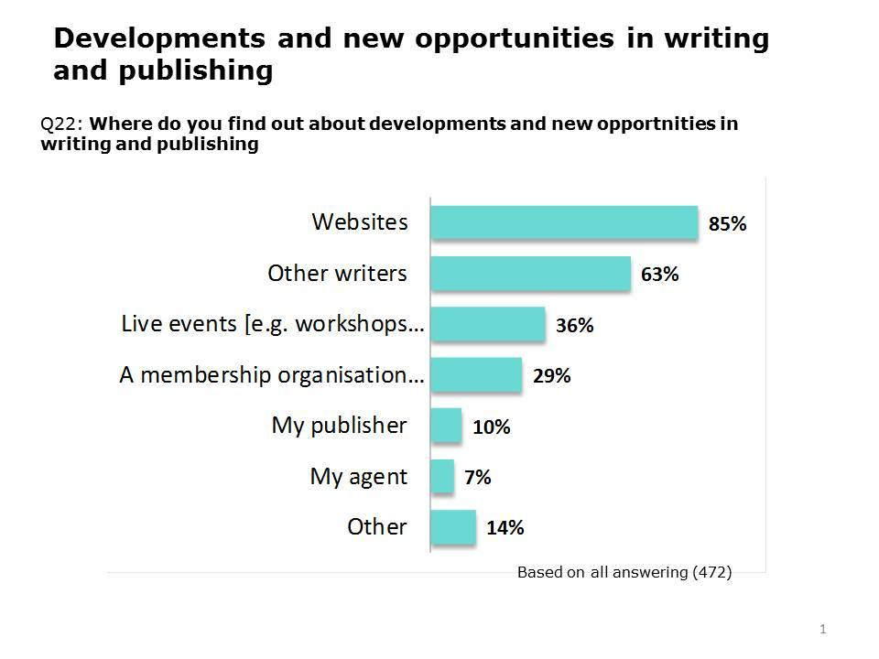
Notes:
We had over 500 respondents; 67% female, 33% male; 45% between the ages of 35 and 55; 35% are aspiring writers, 33% traditionally published writers, 15% both traditionally and self-published; and 9% self-published only. By far the greatest number of people agree with the statement ‘I want my work to be read by lots of people’ (39%), with only 20% agreeing that the statement that most accurately describes their aspirations as a writer is ‘I want to make money from my writing’.
- reflects the current disconnect between publishers and writers on the digital front; while publishers focus on digital workflows, ebooks, and digital marketing, they aren’t putting much thought into working with writers to develop what digital transformation might offer to writers and readers. Agents also need to be thinking hard about new opportunities for their writers, beyond the crucial, but seemingly endless, arguments about ebook rights and royalties.

Slide 4
books!
seven novels
three story collections

Slide 5
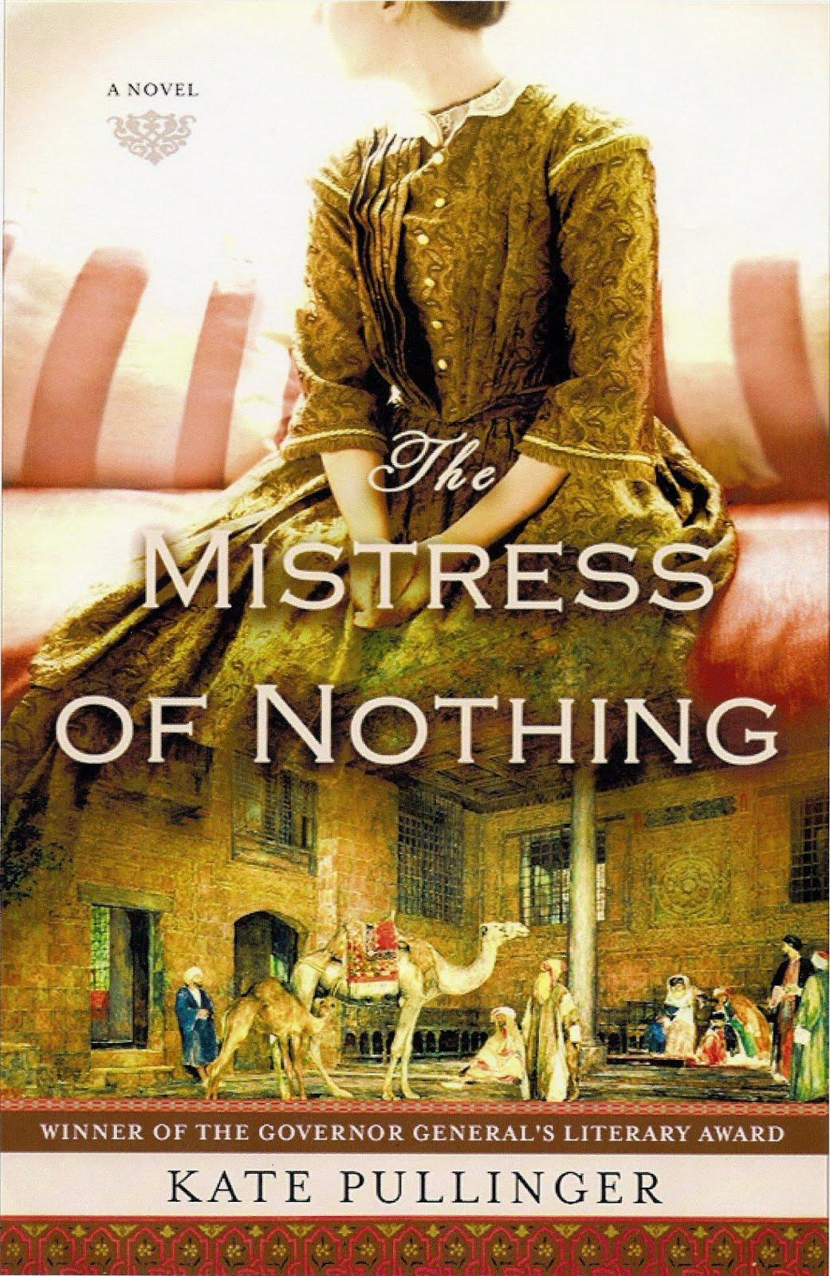
the mistress of nothing
Notes:
the most recent of which is 'The Mistress of Nothing' which, to my astonishment, was rather successful - published in numerous territories and languages, here in the US with S&S, and in Canada it won the GG in 2009.

Slide 6
digital fiction!
works that combine text with images, video, sound effects, music, animation, and games
existing in parallel to my work as a literary novelist and short story writer
Notes:
since 2002 - teaching online - year-long fellowship - must collaborate - new hybrid forms - collaborative - sometimes networked - lots of projects - show 3 now

Slide 7
A Million Penguins
can a community write a novel?
Notes:
2007 - 5 weeks - no rules - bananaman - answer to question: No. Not really. Yes.

Slide 8
Flight Paths: A Networked Novel
Notes:
man falling - started in a blog, commentpress widget - 100 contributors - 5 epis + 1

Slide 9
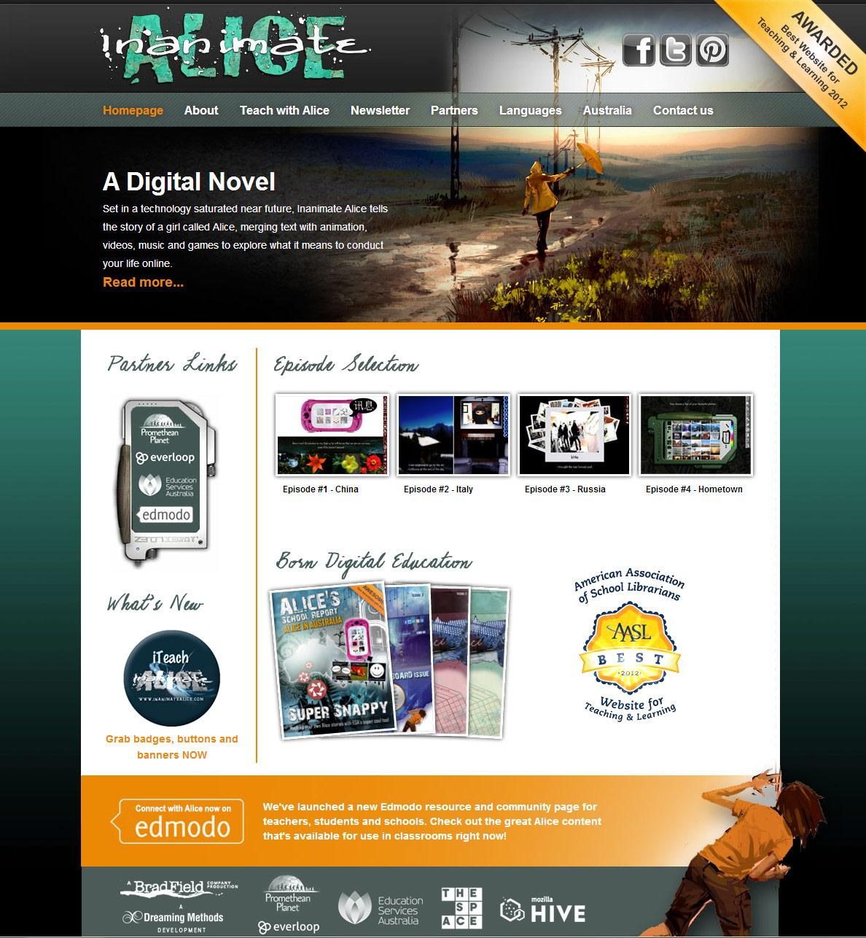
Inanimate Alice
Notes:
4 episodes - 5 languages - 2009 audience began to talk back - as a literary writer, this was a revelation; as a digital writer, it redefined my notion of interactivity - audience grows and grows - Australia - AASL best website - Mozilla Hackasaurus/Hive NYC - The Space

Slide 10
spreadable media
online works can have large, diverse audiences
an emerging market, colliding - or not - with an old market in extreme transition
as digitisation transforms our industry at the same time as transforming the art of storytelling itself, what new forms will emerge?
Notes:
Jenkins - one of the puzzling things about ebooks is that they are created using web technology while at the same time ignoring the spreadable qualities of web technology - how can we bust books out of their silos - how can I bust my books out of their silos? with MoN - 2009 - it's over
one of the puzzling things about ebooks is that they are created using web technology while at the same time ignoring the spreadable qualities of web technology - how can we bust books out of their silos - how can I bust my books out of their silos? with MoN - 2009 - it's over
new business models, new players - collaborations between technologists and artists - writers, visual artists, sound artists, game designers - there are countless examples of new forms of stories out there, that have nothing to do with publishing.

Slide 11
key questions:
will my book publisher ever be interested in my digital fiction?
will books ever become webby?
what new and exciting forms will emerge through collaboration?
Notes:
Hugh McGuire's article on TOC - http://toc.oreilly.com/2013/02/a-publishers-job-is-to-provide-a-good-api-for-books.html A Publisher's Jo is to provide a good API for books - books are data, what are the useful ways we can think about books as data - useful for readers - semantic map of my novel - a digital timeline of my novel

Slide 12
exhortations
grab a technologist and hug him or her
make your work spreadable
look at what's out there, and start thinking beyond the book
Notes:
my digital fiction projects success because they are spreadable - back in 2002 I had this strong feeling, a longing, waiting for the future to arrive - dreaming of the devices we might have - the future is here, it's now, and there are endless creative possibilities.

Slide 13
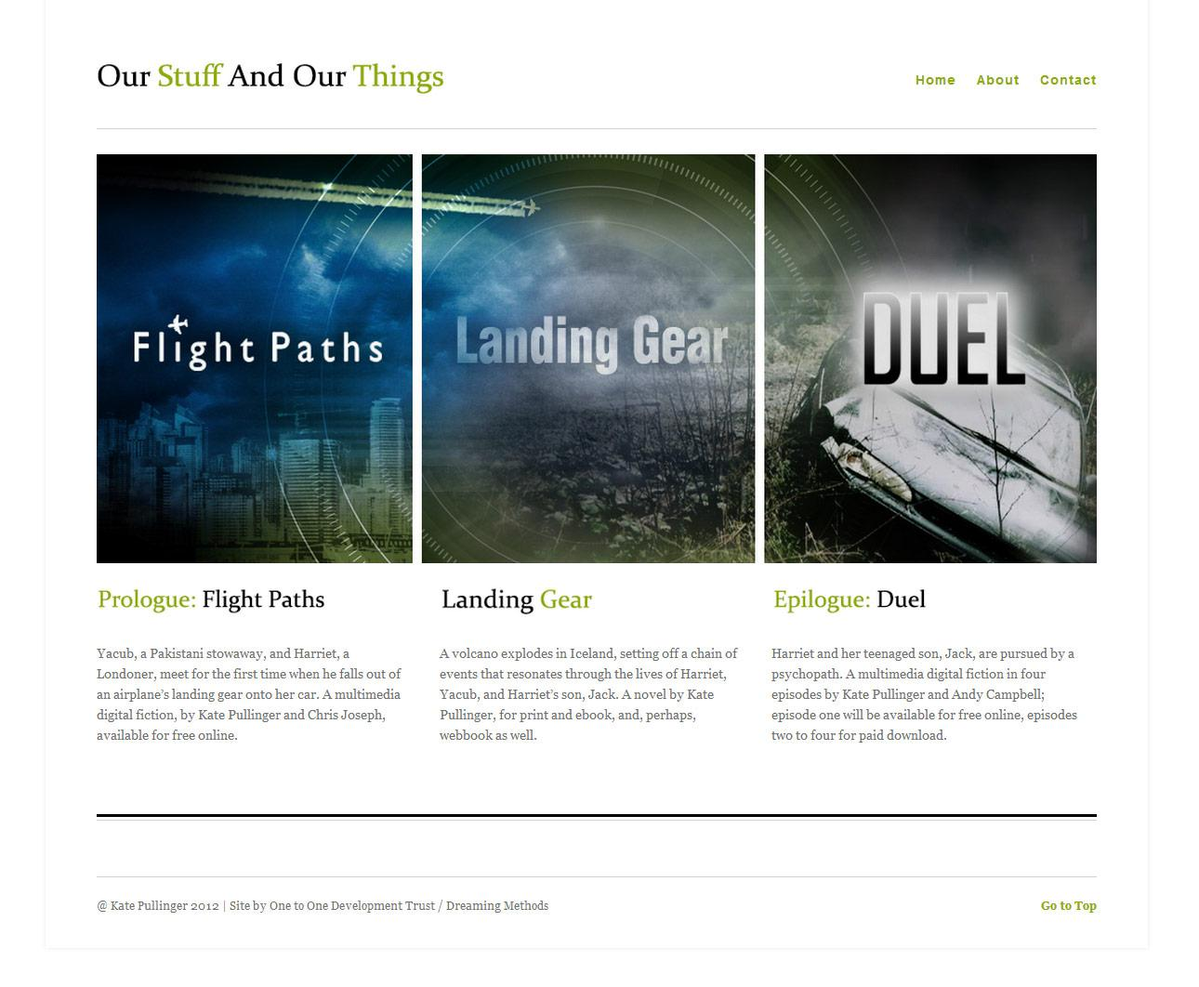
Our Stuff and Our Things

Slide 14
Duel
prototype
Notes:
works across all devices and platforms, from smartphones to tablets - desktop prototype

Slide 15
kate pullinger
http://www.katepullinger.com
thank you

