Slide 9
The Complete Reader Ecosystem
Discovery
Purchase
Digital Library
Reading Experience
Relationship

Slide 10
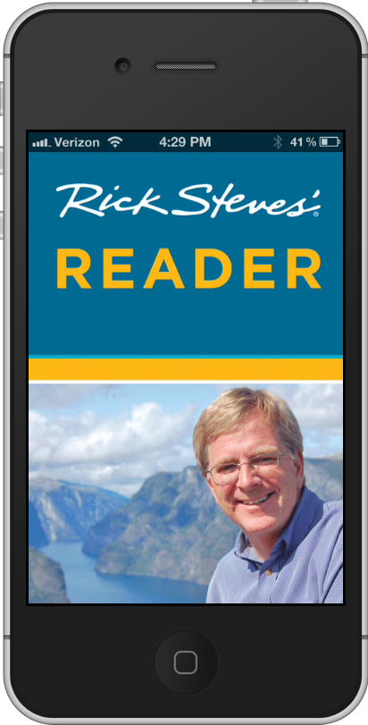
1. DISCOVERY: Branding and Community
RickStevesDigital.com

Slide 11
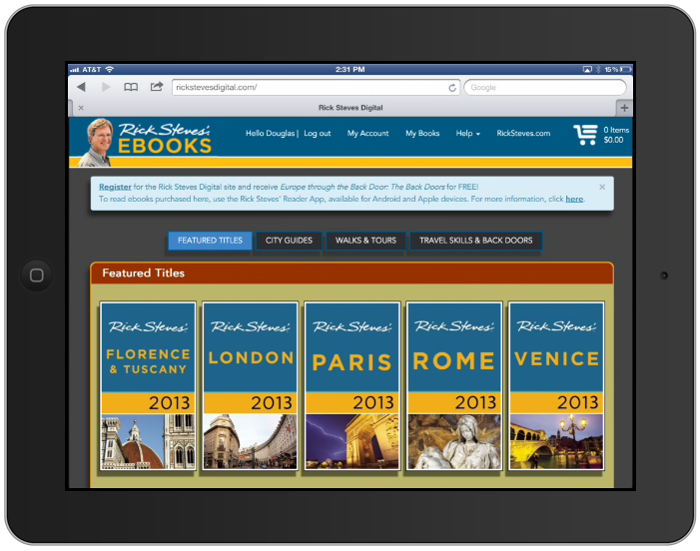
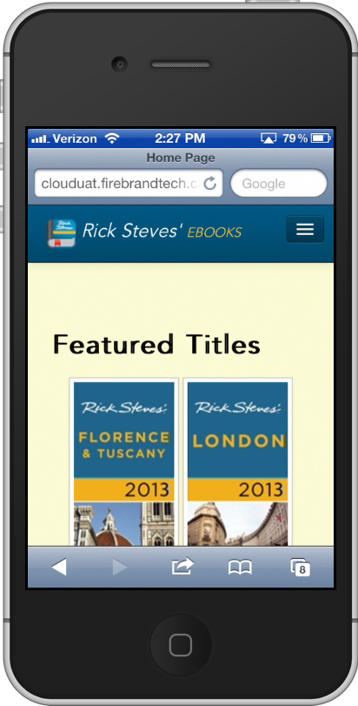
1. DISCOVERY: Mobile First Design

Slide 12
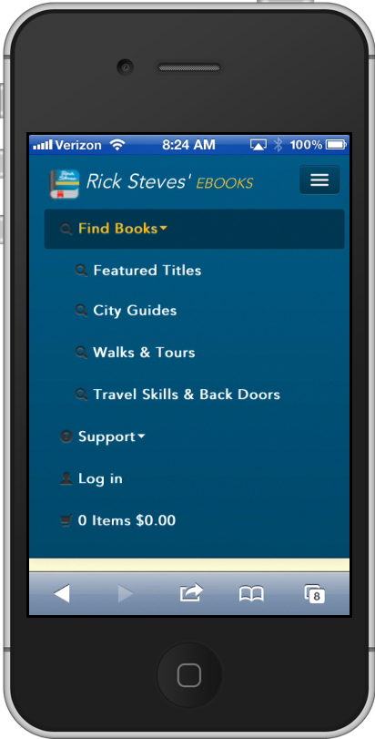
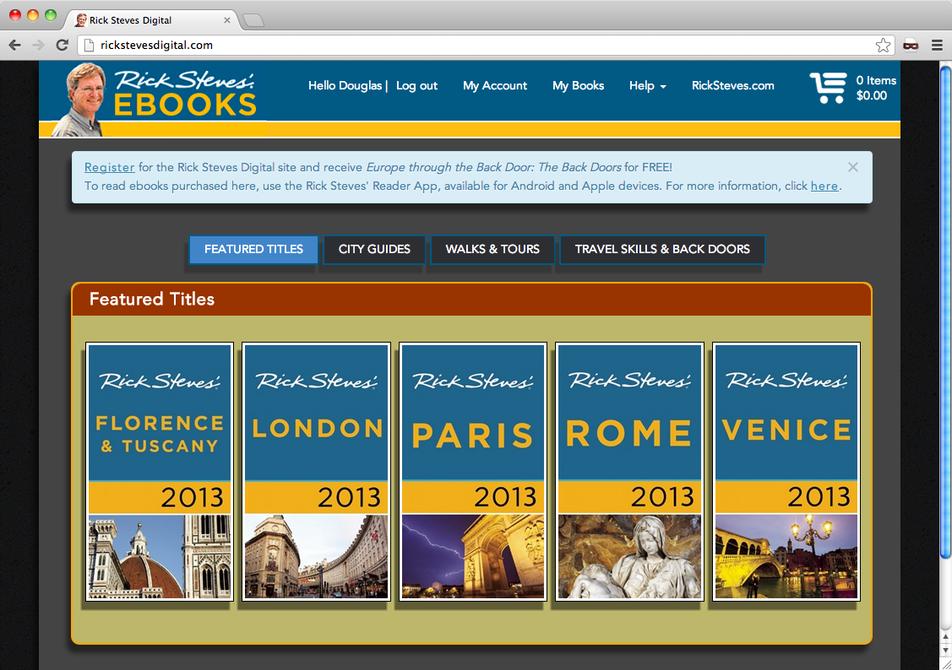
1. DISCOVERY: Mobile First Design
Mobile First Design by Luke Wroblewski
LukeW.Com

Slide 13
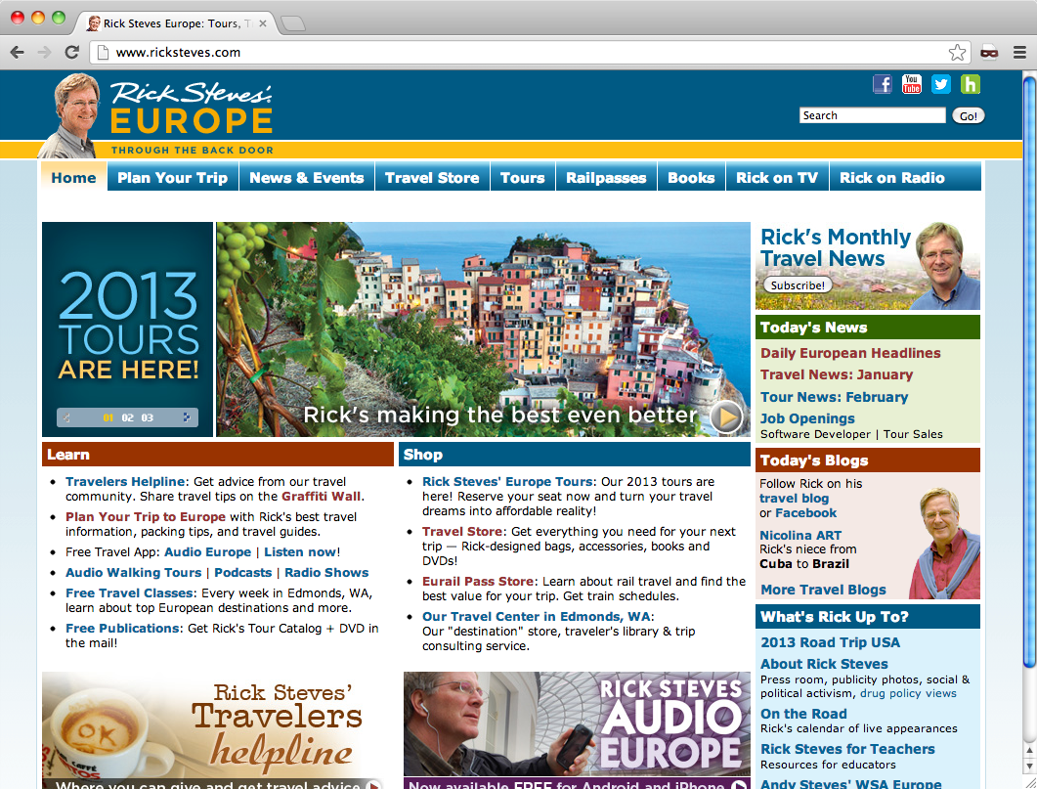
1. DISCOVERY: Integration

Slide 14
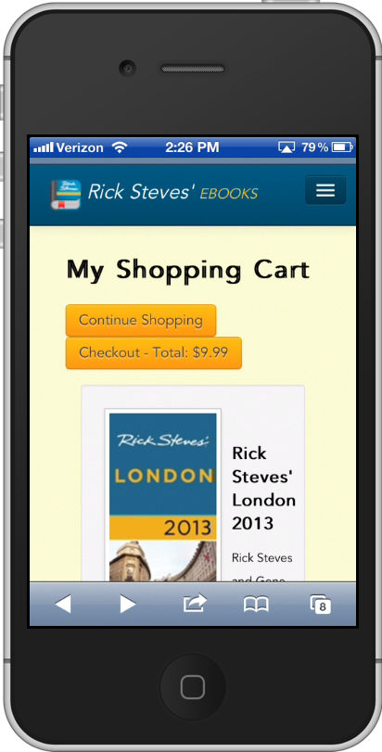
2. PURCHASE
• Registered Users
• Saved Credit Cards
• Minimum Clicks

Slide 15
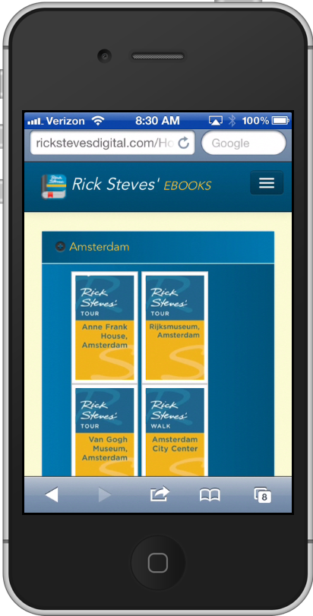
2. PURCHASE: Transaction Costs
• In-App Purchases
• DRM Transaction Costs
• Merchant Fees
• Unbundling Content

Slide 16
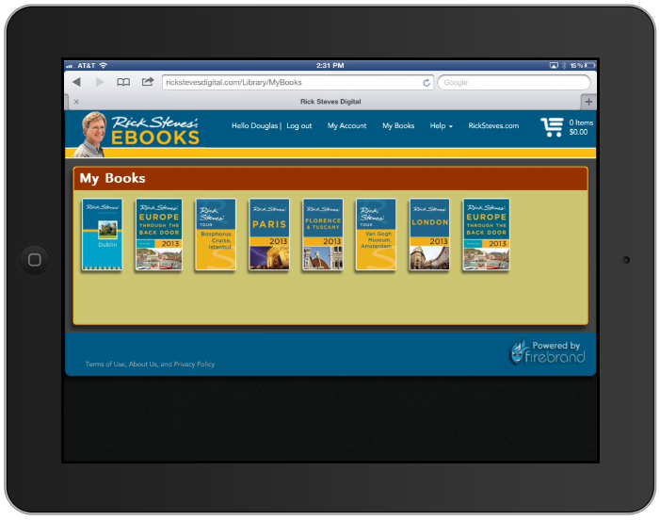
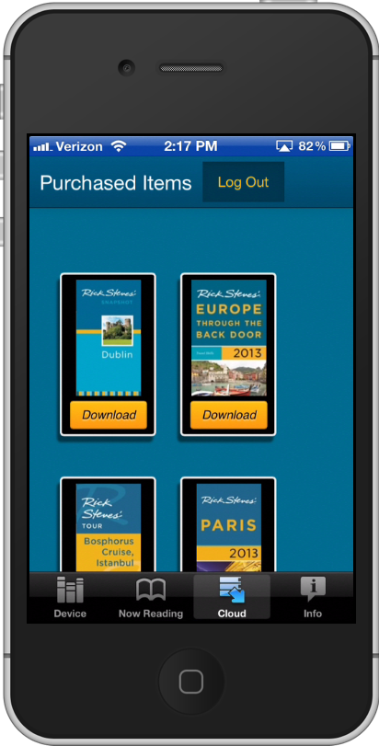
3. DIGITAL LIBRARY

Slide 17
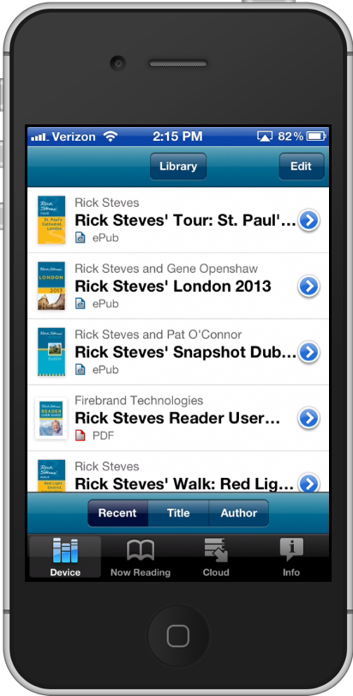
4. READING EXPERIENCE

Slide 18
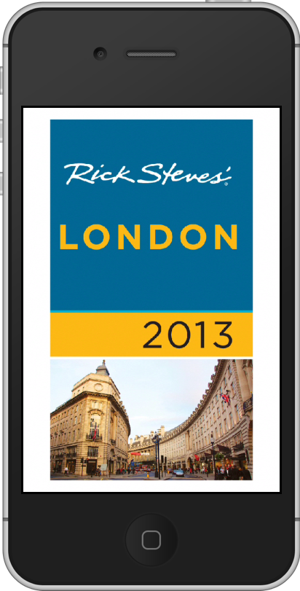
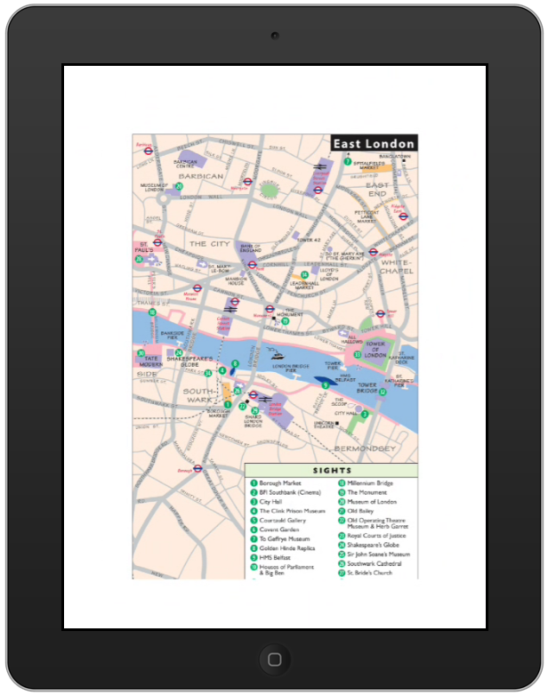
4. READING EXPERIENCE

Slide 19
5. RELATIONSHIP
• Reading Behavior
• Purchase Analytics
• Communication

