Slide 1
Open Standards in the Walled Garden
Tom McCluskey @TomMcCluskey
Amanda Gomm @agomm
Digital Bindery
www.digitalbindery.com

Slide 2
Open Standards in the Walled Garden
Metadata
Navigation
Semantics
Presentation

Slide 3
Metadata
I’m So Meta, Even This Acronym.
-xkcd

Slide 4
Data About Data (and Data and Data and Data)
Publication
Structure
Content
Container
Notes:
Four categories of metadata are included in the EPUB3 container. Information about the EPUB container itself (is it encrypted, who owns the rights, etc), information about the publication as a whole (Title, author, publisher, etc), information about the structure (which content documents go where and when, are they reflowable or fixed, etc.), and information about the content (does this content document have scripts, MathML, SVGs, etc.).

Slide 5
Data About Data (and Data and Data and Data)
Publication
Structure
Content
Container
Notes:
The container metadata, contained in the META-INF folder is fairly set as far as what we can and can’t manipulate. Reading systems may require additional information, like Apple’s display options addition, or provide or restrict encryption schemes, but we’re going to leave that alone because it’s just a bunch of reading specifications and checking off boxes. We will discuss the structure and content data later when we cover specific issues, so right now we’re going to briefly talk about how to wrangle publication metadata.

Slide 6
Required Elements
identifier
title
language
meta property=“dcterms:modified”

Slide 7
Optional Elements
Contributor
Coverage
Creator
Date
Description
Format
Publisher
Relation
Rights
Source
Subject
Type
Notes:
Date is used by iBooks to force cache release, very rarely are contributor, coverage, date, description, format, publisher, relation, rights, source, subject, or type displayed to the reader.

Slide 8
A little extra information never hurt anybody, right?
Title
title-type (main, subtitle, edition, short, etc.)
display-sequence
Creator
role (author, illustrator, editor, etc.)
display-sequence
Notes:
For the most part reading systems will gracefully ignore information it can’t use. They will generally display the author and title, less commonly the publisher or description, rarely it will use or provide the reader with information about rights and publication dates. As best practice, we encourage our publishers to include as much information as possible. There are two notable exceptions.

Slide 9
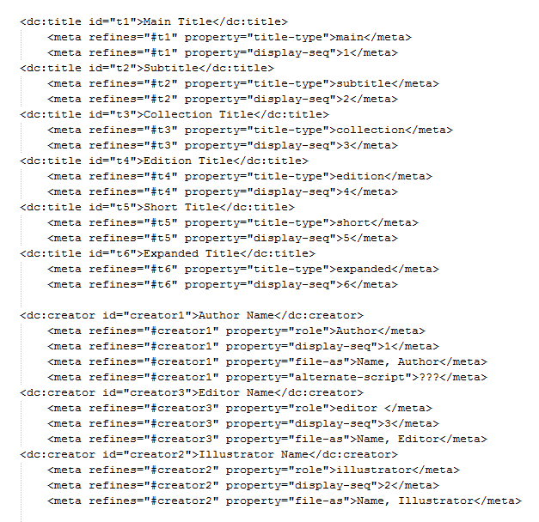
Notes:
For now we recommend not including additional title and creator information to avoid confusion. Additional information can be supplied within the content and the good news is that many retailers will allow you to re-introduce this information when you supply the file.

Slide 10
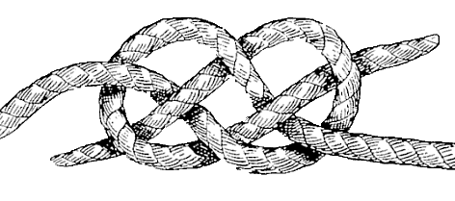
Navigation
Notes:
Navigation is one of the most important things to get right in an ebook. I’m sure I’m not alone in having bought an ebook only to find that the whole thing is one chapter. It’s incredibly frustrating, and that’s not the first impression you want to give your readers. Making books easy to get around inside of is very important, and if we can add in some extra bells and whistles like giving common page numbers between print and ebook versions, that’s even better. So, what are the aspects of Navigation that we’ll be looking at?

Slide 11
Navigation (highly scientific)

Slide 12
Table of Contents
(it’s kind of a big deal)
The main way for readers to get around your ebook
Lists all the main content documents
Basic functionality universally supported
Two different but compatible formats for epub 2.0.1 and epub 3
Great! No problems then, right? Well…

Slide 13
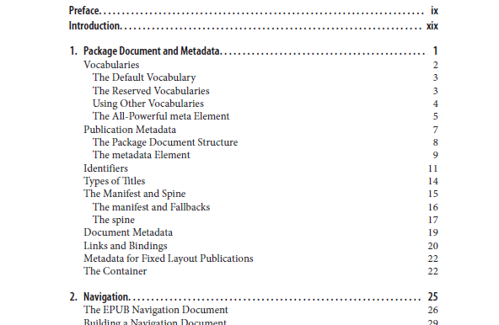
Nested TOCs
Nook won’t nest at all
Kobo Arc only goes 3 levels deep (sub-sub-items)

Slide 14
TOC Workarounds
Good navigation is critical!
Consider not nesting at all
If nesting is critical, try to ensure that the top level items are usefully granular
Include a toc.xhtml in your Table of Contents
Top level items can link to pages that break down the content in finer detail
If you’re not worried about nook eInk or Kobo Arc, nest away!

Slide 15
Nonlinear Content
Lets you hide content from readers! Wait, what? Why?
Books in which there is an adventure that you choose
Footnotes
Covers
Any ancillary content

Slide 16
Nonlinear Content
Adoption
Most reading systems will blissfully ignore your linear=“no”
Readium fully supports nonlinear <spine> content
iBooks does, but displays content on one long scrolling screen, like an image
potentially useful for big tables

Slide 17
Nonlinear Content
Workarounds
The sad truth is that linear=“no” is not well supported
Don’t count on it to work unless you’re designing specifically for iBooks (or Readium)
Keep nonlinear content together (perhaps nested under, eg, “Endnotes”)
For Gamebooks, accept that some people will just read through all the possible endings

Slide 18
Pagelists
Ebook, meet pbook!
Allows you to embed the location of print page breaks into your epub
Lets you keep all those references to “the table on page 27”
Makes life easier for people trying to compare notes between print and ebook

Slide 19
Pagelist
Adoption
Again, support is minimal:
Readium will make use of your <nav epub:type=“page-list”>
iBooks gives an option to display print page number
Nobody else will.
Dang.

Slide 20
Pagelist
Workarounds
You can always include the pagelist; it doesn’t hurt anything
You’ll still have to check your content for page references after all
Just as well, they should be hyperlinks anyway
Make sure to use display: none for the list
Hidden=“hidden” only works on iBooks, Readium, Kobo Arc, and Kobo for iOS

Slide 21
Pagelist
Example
<nav id=“pagelist” epub:type="page-list" hidden="">
<h2>Page List</h2>
<ol>
<li><a href="02-frontmatter.xhtml#page1">1</a></li>
<li><a href="03-chapter1.xhtml#page2">2</a></li>
</ol>
</nav>
nav#pagelist h2, nav#pagelist ol {
display:none;
}

Slide 22
Semantics
There are only two things in the world: nothing and semantics. ―Werner Erhard

Slide 23
Why Semantics?
Accessibility
Publisher Style Overrides Management
Sorting, searching, indexing, optimizing, background computer-y stuff (think SEO)
Super Killer Amazing Futuristic Functionality (SKAFF™)

Slide 24
HTML5 Semantics
Sections
Text Level
Grouping
body, article, section, nav, aside, h1-h6, hgroup, header, footer, address
p, hr, pre, blockquote, ol, ul, li, dl, dt, dd, figure, figcaption, div, main
a, em, strong, small, s, cite, q, dfn, abbr, time, code, var, samp, kbd, sub, sup, I, b, u, mark, ruby, rt, rp, bdi, bdo, span, br, wbr

Slide 25
HTML5 Semantics
Sections
body, article, section, nav, aside, h1-h6, hgroup, header, footer, address
Well, they don’t break it.

Slide 26
HTML5 Semantics
Grouping
p, hr, pre, blockquote, ol, ul, li, dl, dt, dd, figure, figcaption, div, main
Well, they don’t break it.
mostly
main

Slide 27
HTML5 Semantics
Text Level
a, em, strong, small, s, cite, q, dfn, abbr, time, code, var, samp, kbd, sub, sup, I, b, u, mark, ruby, rt, rp, bdi, bdo, span, br, wbr
Super Reliable:
a, b, strong, em, I, small, s, cite, var, u, sup, sub
Reliable within acceptable parameters:
code, samp, kbd
Meh:
mark, bdo, q, dfn
I’m sorry, did you say something?:
abbr, time

Slide 28
epub:type
It doesn’t appear to break things.
Some epub:types are required for EPUB3 validation/navigation
Eventual accessibility or SKAFF?
epub:type=“footnote” looks cool on the iPad…
It would be trivial to add most of them and there are always interns to add the rest (topic-sentence tagging for college credit?)
Notes:
If support is abysmal, do we dedicate resources to adding epub:type attribute? If it has potential accessibility uses (like for navigation or description, then absolutely. Otherwise, determine if there’s some potential use for it, and then figure out how to make that happen without relying on reading systems to do anything. We need to show how super killer it would be to have a list of all of the book’s topic sentences by creating that list and doing something killer with it or how totally ominous it would be if warnings flashed or played ominous music (it’d be like Geocities all over again).

Slide 29
Media Queries
Whoever controls the media, controls the mind.
― Jim Morrison

Slide 30
Why Media Queries Break Stuff
CSS3 in CSS2

Slide 31
Why this is ok
Target CSS2 and 3 devices separately when needed
Progressive Enhancement as reading systems adopt CSS3 functionality

Slide 32
How
In the XHTML:
<link href=“css2-stylesheet.css” rel=“stylesheet” type=“text/css” />
<link href=“css3-stylesheet.css” rel=“stylesheet” type=“text/css” />
In the CSS3:
@media only all {

Slide 33
Example (HTML):

Slide 34
Example (CSS):

Slide 35
Other Reliable Queries
Orientation (portrait, landscape)
Color (alone or min/max)
Width/Height (min/max, device)
Aspect Ratio (min/max, device—changes with orientation sometimes)
Unreliable queries
Resolution
Monochrome
Color-index

Slide 36
Alternate Stylesheets
Unsupported (but not broken)
CSS3 media queries for orientation are a viable option
Test books on devices with night-reading mode
Check images, transparency can be a good or bad thing
If you declare font color to be black, it will disappear in night vision on some readers
Notes:
Azardi allows the reader to change the background color so it’s easy to test dark background/night mode.

Slide 37
CSS & Visual Presentation

Slide 38
Hyphenation
Between CSS 2 & 3, there are lots of neat hyphenation options:
Turning off hyphenation completely (great for headers)
Manual hyphenation for non-standard words
Restriction of hyphenation to eliminate ladders
Use a new character as a hyphen (&, anybody?)
Require a certain number of letters before or after hyphens

Slide 39
Hyphenation
Adoption
No!
CSS 3 (hyphenate-before, -after, -line, -character)
Yes!
Hyphens: none, or –webkit, -moz, and adobe variants
Kinda!
Hyphens:manual(&#173;)
Soft hyphens on Nook and Kobo Arc aren’t formatted right. They (and Readium) will not auto hyphenate.
None of the new hyphenate- CSS is supported
by any reading systems.
Hyphens: none is supported by most
reading systems, and those that don’t will
support –webkit, -moz, or adobe.
Manual hyphens (&#173;)are supported by everyone, whether you like it or not. Mostly.
The Kobo Arc, Nook, and Readium will not hyphenate unless you insert soft hyphens
The Kobo Arc and the Nook behave strangely with soft hyphens

Slide 40
Hyphenation
Workarounds
There aren’t many options:
If you don’t want hyphens, use {hyphens: none;
-webkit-hyphens: none; -moz-hyphens:none; adobe-hyphenate: none;}
Avoid soft hyphens unless you’re targeting only devices that you know render them well
Sigh quietly and wish CSS 3 hyphenate- properties were supported

Slide 41
Text alignment
There’s some neat new CSS 3 stuff here as well:
Text-align: start and end instead of left and right
Text-align-last to control the final line of a paragraph
Text-align: match parent to ensure consistency and flexibility
The old standards: left, right, center, justify

Slide 42
Text alignment
Adoption
The good news is, the old standards work!
Left, right, center, and justify are supported just about everywhere
Start, end, and match parent are supported on iBooks, Kobo Arc, Kobo for iOS, and Readium
Nobody supports text-align-last

Slide 43
Text alignment
Workarounds
Things here are mostly OK:
The basics work everywhere, so if you stick with them you’ll be set across the board
The lack of consistent support for start and end means that if you’re doing multilingual texts, you’ll have to pay a little more attention
No support for text-align-last takes away a cool typographical option, but it’s not make-or-break
Once people realize that ebooks shouldn’t be justified, we’ll all be much happier

Slide 44
Page breaks and columns
Can be very important for organizing information
Keep the header with the following paragraph or caption with image
Keep boxed text from breaking
Emphasize content by giving it its own page

Slide 45
Page breaks
Adoption
After/Before: always;
Not supported on Kobo for iOS or Readium
After/Before: Left/Right;
Not supported on Kobo for iOS or Readium
Inside
Not supported on Kobo Arc, Kobo for iOS, Nook, or Readium
After/Before: avoid;
Not supported on iBooks, Kobo Arc, Kobo for iOS, or Readium
Doesn’t always work on list items
Kobo Arc will break in portrait mode, but not landscape.
Universally treated as always; no paging

Slide 46
Column
Adoption
Generally not well supported
iBooks and Readium support columns
Kobo Arc supports columns in landscape mode, but not portrait.
Kobo for iOS will display columns, but they are frequently cut off at the top and bottom of the screen

Slide 47
Page break and column
Workarounds
Remember that the goal is to be as readable as possible on as many devices as possible
Page-break-inside:avoid; is the least likely to work—iBooks, ADE, Kobo Mini, Nook, and Nook color support it
Forcing breaks can keep content together
Can lead to large black stretches
Good option for large images & captions
Avoid columns

Slide 48
Floating images
Floating an image to the right or left of text can be informative or decorative
Floating an illustrated drop cap
Keeping a small image next to relevant text

Slide 49
Floating images
Adoption
Not supported
Nook for iOS
Image positioning issues
Kobo Mini and Nook color will display images inside a <p> higher than those outside
Glitchiness
Nook: p {float:right;} before an image will sit behind that image
Kobo Mini: floated paragraphs will run off the edge of the screen
Nook for iOS is a hot mess. Full screen images, cut off text.

Slide 50
Floating images
Workarounds
Floating images is widely supported, but not glitch-free
Limit floating images where possible
For accessibility, try to use text for dropcaps rather than images
If you must use images, for best results put them outside the paragraph
<img class=“float-left” src=“” /><p>…</p>
Go fixed layout

Slide 51
Interactivity
Offers the potential for new ways of engaging with readers by reacting to their input
JavaScript: The core of online interactivity, increasingly supported by HTML 5
Triggers: Built in to epub 3.0. Limited to just a few types of tasks
Switch: not really interactive, but gives more display options for content

Slide 52
Interactivity
Adoption
The main way for readers to get around your ebook
Container-constrained and spine-level JS supported by iBooks, Kobo for iOS, and Readium
Trigger supported by iOS and Readium
Switch not supported by Kobo Mini

Slide 53
Interactivity
Workarounds
How do you work around lack of support for interactivity?
Design content so the interactive bits are not essential
Alternately, limit your market to just a few devices
Consider media queries; can have an interactive CSS 3 version and a non-interactive CSS 2 version

Slide 54
Centering
Center is a very tough position to play.
―Kareem Abdul-Jabbar

Slide 55
Images
Works all the time:*
<p style=“text-align:center”>Image</p> or
<div style=“text-align:center”>Image</p>
Image must be displayed inline
What should work but doesn’t
margin: 0 auto
box-pack: center
*styles only displayed inline for demonstration purposes. Feel free (and encouraged) to put them in the CSS.

Slide 56
Tables
Works all the time:
Table display:block, set to width less than 100%
Left/right margins set to (100%-table-width)/2
eg Table width: 80%; margin: 0 10%;
What should work but doesn’t
margin: 0 auto

Slide 57
Image Formats
As long as we are engaged in storytelling that moves the culture forward, it doesn't matter what format it is.
― LeVar Burton

Slide 58
Core Media Types
GIF
JPEG
PNG
SVG (with a few exceptions—filters, text on a path, rotated text)

Slide 59
Foreign Resources
Manifest Fallbacks
Required
Unsupported
Content Fallbacks
<object data="images/formats/tga-format.tga" >
<param name="image" value="images/formats/tga-format.tga" />
<img src="images/formats/tga-format.gif" alt="fallbackimage" />
</object>

Slide 60
Sizing Images
I am large, I contain multitudes.
―Walt Whitman, Leaves of Grass

Slide 61
Most Reliable Method
<div><img /></div>
Size the div appropriately
<div class=“fifty-percent”><img /></div>
.fifty-percent {
width:50%;
}
Size the image to fill the entire container
<div class=“fifty-percent”><img class=“full” /></div>
.fifty-percent {
width:50%;
}
.full {
width: 100%;
}

Slide 62
Responsive Sizing
Explicit Size with Relative Constraints:
width:100px;
max-width: 50%;
min-width: 25%;
Relative Size with Explicit Constraints:
width: 50%;
max-width: 400px;
min-width: 100px;
Relative Size with Relative Constraints:
width: 20em;
max-width: 50%;
min-width: 25%;

Slide 63
More Options
 |  |  | W=Image Width M/M=Min/Max-width
 | Units | em | W | W |  | M/M | M/M
 |  | % | M/M |  | W | W |  | M/M
 |  | px |  | M/M | M/M |  | W | W
Size controlled by |  |  | Font | Font | Viewport | Viewport | Explicit | Explicit
Size constrained by |  |  | Viewport | Explicit | Explicit | Font | Font | Viewport
.image {
width:30em;
max-width: 50%;
min-width: 25%;
}

Slide 64
Questions?
Amanda Gomm @agomm
Tom McCluskey @TomMcCluskey
Digital Bindery
www.digitalbinery.com

