Slide 1
How Libraries Use Publisher Metadata
Steve Shadle
Serials Access Librarian
University of Washington Libraries

Slide 2
Purpose
Provide an overview of how libraries provide access to publisher content using publisher-provided metadata
Library Catalog
OpenURL Link Resolver
Library Discovery System
Notes:
It’s not just about the catalog. Libraries provide access to resources through additional systems.

Slide 3

The University of Washington
Oldest public university on the West Coast (founded 1861)
Largest public university recipient of federal research funding (nearly $800 million)
Total enrollment: 48,022 students
16 colleges offering more than 1,800 undergraduate courses each quarter across 3 campuses
Ranked 16th among the world’s top 500 universities (ARWU)
54 programs ranked Top 10 in the U.S. (US News & World Report)
Notes:
LINE BY LINE ANIMATION. CLICK AT THE END TO KEEP THIS SLIDE ON. DON’T READ EACH BULLET...JUST THERE FOR BACKGROUND

Slide 4
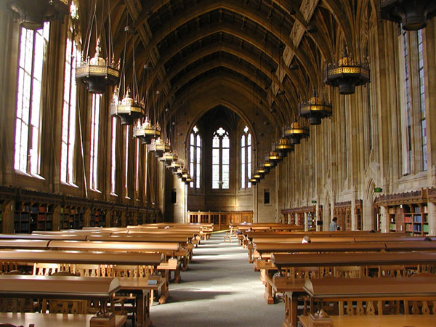
University of Washington Libraries
Digital Library
500,000 licensed electronic books and 100,000 online journals
600,000 locally digitized items in 300 collections
6 million licensed journal articles downloaded
9 million separate sessions on Libraries’ websites
Physical Library
16 libraries on three campuses with 5.2 million visits last year
7 million print volumes, 6 million microforms, 20K print serials
1.8 million check-outs
Reference Services
15,000 reference questions answered online
50,000 reference questions answered in person
Notes:
ANIMATION. CLICK FOR EACH SECTION. It’s not possible to provide this amount of service without the systems we’ll talk about today.

Slide 5
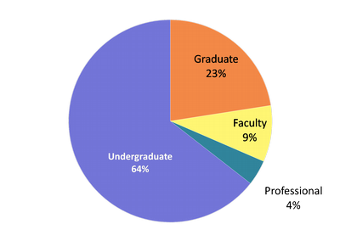
Who Are UW Library Users?
Brooke the Beginner
Richard the Researcher
Sharon the Scholar
Paul the Professional
April the Alumna
Notes:
In 2009, UW Libraries had a small group work on developing user ‘personas’ which serve as surrogate and help us with designing user services.
We’ll discuss two of these personas (Brooke and Richard) who account for nearly 90% of our users.

Slide 6
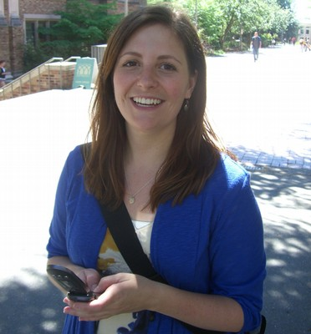




Meet Brooke
"I'd rather use an online article that ‘kinda works’ than go to the hassle of finding a book in the library.“
New to the research process and academia
Working on several assignments in different humanities disciplines, but not an expert in any of them
Will take the first thing that’s good enough
Brooke is a 19 year old undergraduate who hasn’t yet declared a major. Right now she’s taking classes in English, History and Biology. She hasn’t used the library website much yet, but will need to do research for many different class papers and projects over the next couple of years.
How Brooke Uses the Libraries Website
Finds class materials by looking up the class in MyUW and following the link to Course Reserves.
Checks the hours at Suzzallo Library to see how late they are open before she goes there to study
For class papers, if she can’t find enough articles using Google, she will visit the libraries’ website. She looks for basic academic articles across several different topic areas by entering key words in the main search box, then using filters to refine the results.
Notes:
Descriptions provide more detail than needed for this presentation but provide context for user behavior.
When Brooke first started at UW last year, she felt overwhelmed by all the activities and classes going on at once, and all the decisions she had to make. She’s learned to cope by tuning out most of the ‘extras’ and just focusing on what she needs to do immediately. She relies on MyUW to access all of her school information in one place, and keeps track of all her friends and social activities on Facebook.
Brooke comes to the library at least once a week to study and use the computer labs – she doesn’t like to carry her laptop around campus all day because it’s too heavy.
For class assignments, she mostly uses printed course materials and websites like Google and Wikipedia. She sometimes tries the Libraries website but she only uses the main search box on the home page because she’s not sure what the other links are.
What she needs to do
Get assigned readings for class
Find academic articles to cite in a paper
Pain points
Intimidated by all the different choices
Doesn’t understand terminology, like the difference between articles, journals, and databases

Slide 7
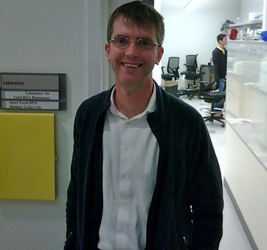



Meet Richard
“Accessing full-text articles online is my primary use of the library and is central to my research…but I still go to the library for some reference materials that aren’t online."
Dedicated full time student with significant knowledge in his area of study
Working on a long term, in-depth project
Will pursue all avenues to obtain materials related to his research
Richard is a 29 year old doctoral student in the College of Built Environments. He’s working on a dissertation about public transportation utilization and incentives, which he models with computer simulations. Richard has already completed a Master’s in Civil Engineering and has used academic libraries for research at both his undergraduate and masters’ institution. To earn his doctorate, Richard needs to do original research, which means reviewing everything published on transportation modeling.
How He Uses the Libraries Website
Searches the catalog for specific texts that he’s seen referenced in other works or heard about from colleagues
Uses Web of Science to find out which other researchers have cited articles important to his project
Searches for the full text of citations that he’s found through Google Scholar
Notes:
He focuses on journals because that’s where the important work in the area is published, and he uses EndNote to save a list of all the articles he comes across.
Richard’s faculty advisor refers him to specific authors and articles, and fellow students actively share advice about other resources to try (such as Web of Science, which lets him see who has cited a certain article). He also makes heavy use of internet sites like Google Scholar and public databases on government sites.
Richard usually works from his lab, where he has several different networked computers to run simulations. He also visits the Engineering and Business Libraries and Suzzallo Library to retrieve materials from different disciplines that relate to his project. Richard is very comfortable with technology. Generally if he has trouble online he will try figure it out for himself or search for online instructions rather than ask someone for help.
What he needs to do
Look up full text articles (already has citations)
Refer to facts in authoritative reference materials
Organize research materials
Pain points
Getting from a citation to full text
Only comfortable using his one ‘go-to’ database

Slide 8
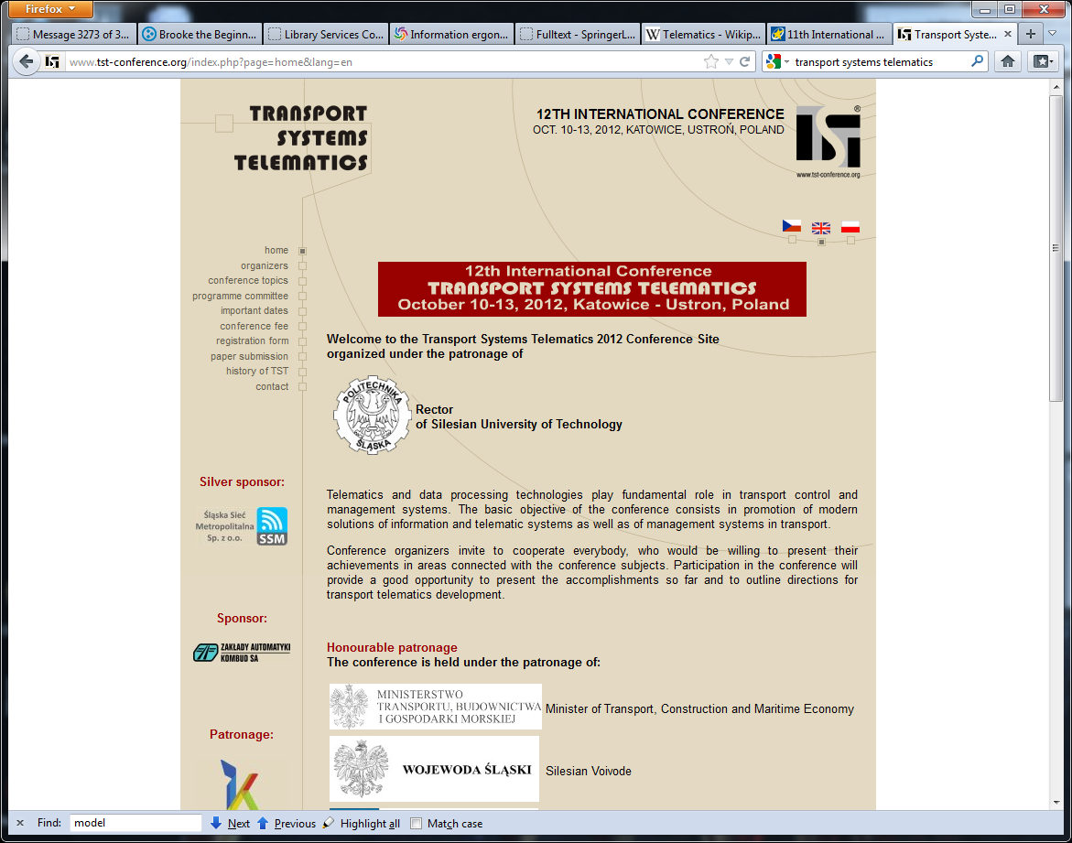
Richard Looks for Conference Proceedings
Notes:
Richard has been told by one of his advisors that he should review some of the recent proceedings from this conference to bring him up to date on the topic. His advisor provides him the conference website as a starting point.
The full-text is not available from the conference website. Richard is an experienced researcher that knows the library frequently has conference proceedings so Richard searches the library catalog to see if the library can provide him with any recent proceedings.

Slide 9
Library Catalog
Historically, the catalog was a record of what the library physically “held”
Beginning in the mid-90s, libraries started including online licensed resources in the library catalog
Does not include journal articles
Most library catalogs are still MARC-based

Slide 10
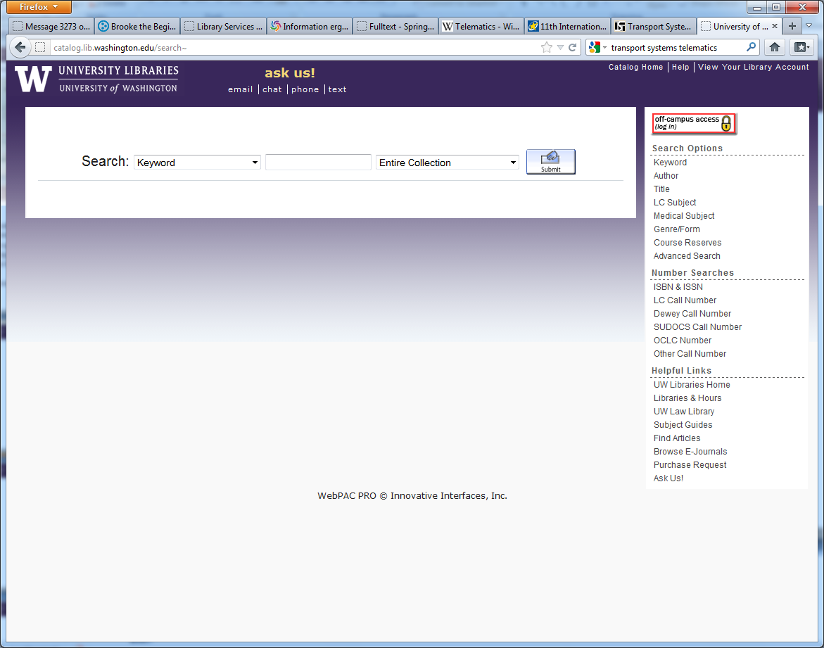
Catalog Search
Transport system telematics
Notes:
Richard enters the name of the conference in a Keyword search. Note that “Keyword” is the default but there are many other search options available.

Slide 11
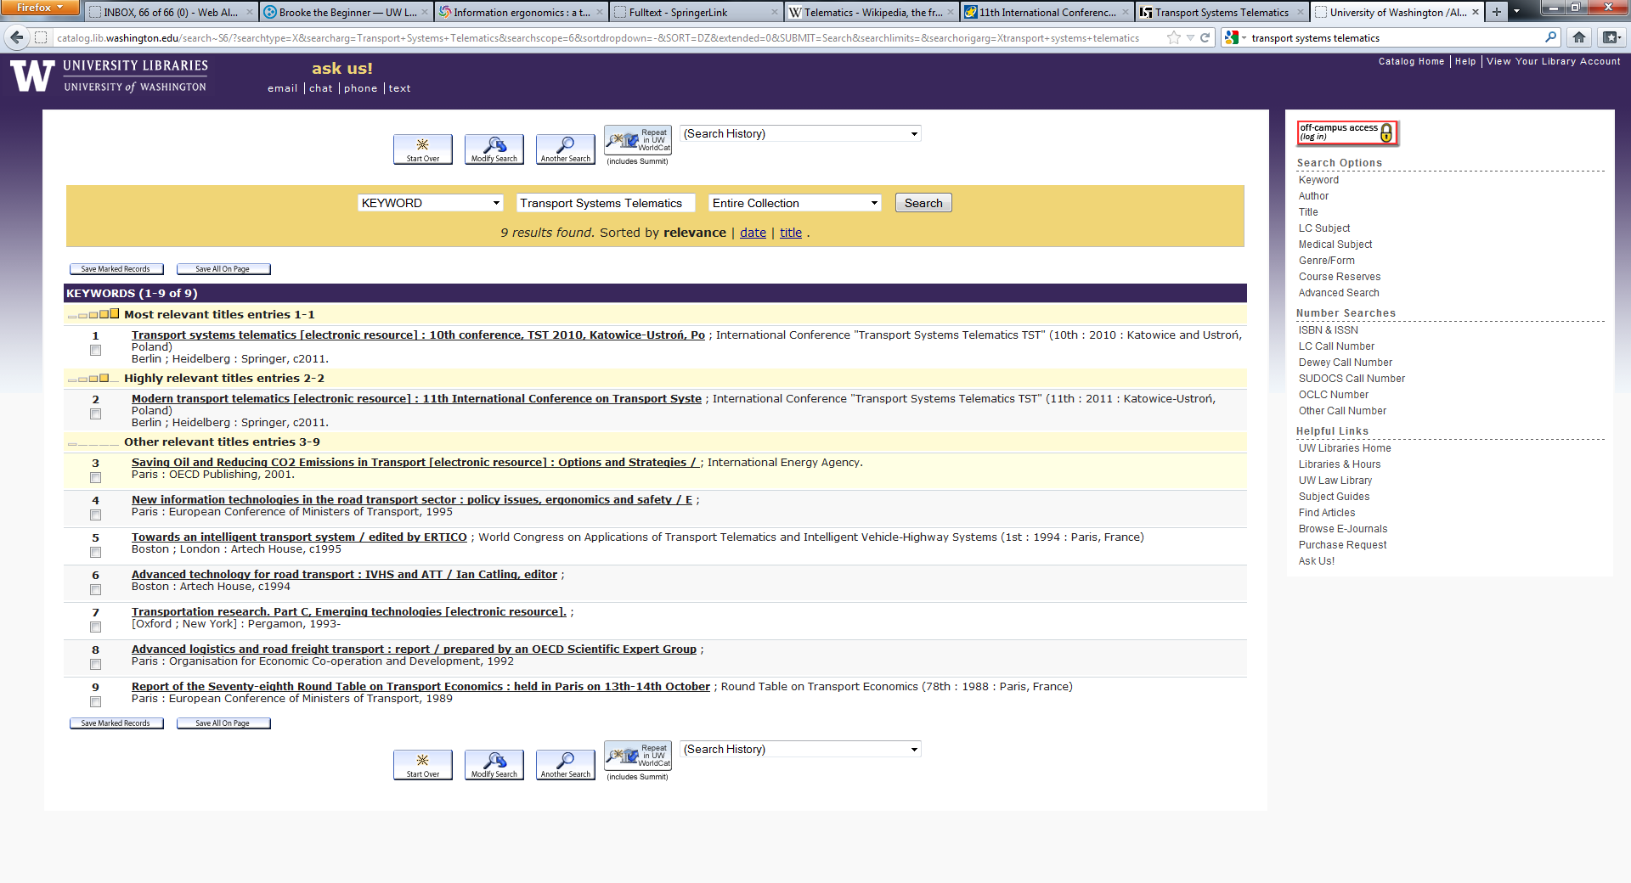
Search Results
Notes:
The first two results appears to be the conference proceedings from the 2010 and 2011 conference.
Perfect! Exactly what Richard was looking for. Recent proceedings so he can read about current research on the topic.
Richard clicks on the link for the second record (the 2011 proceedings).

Slide 12
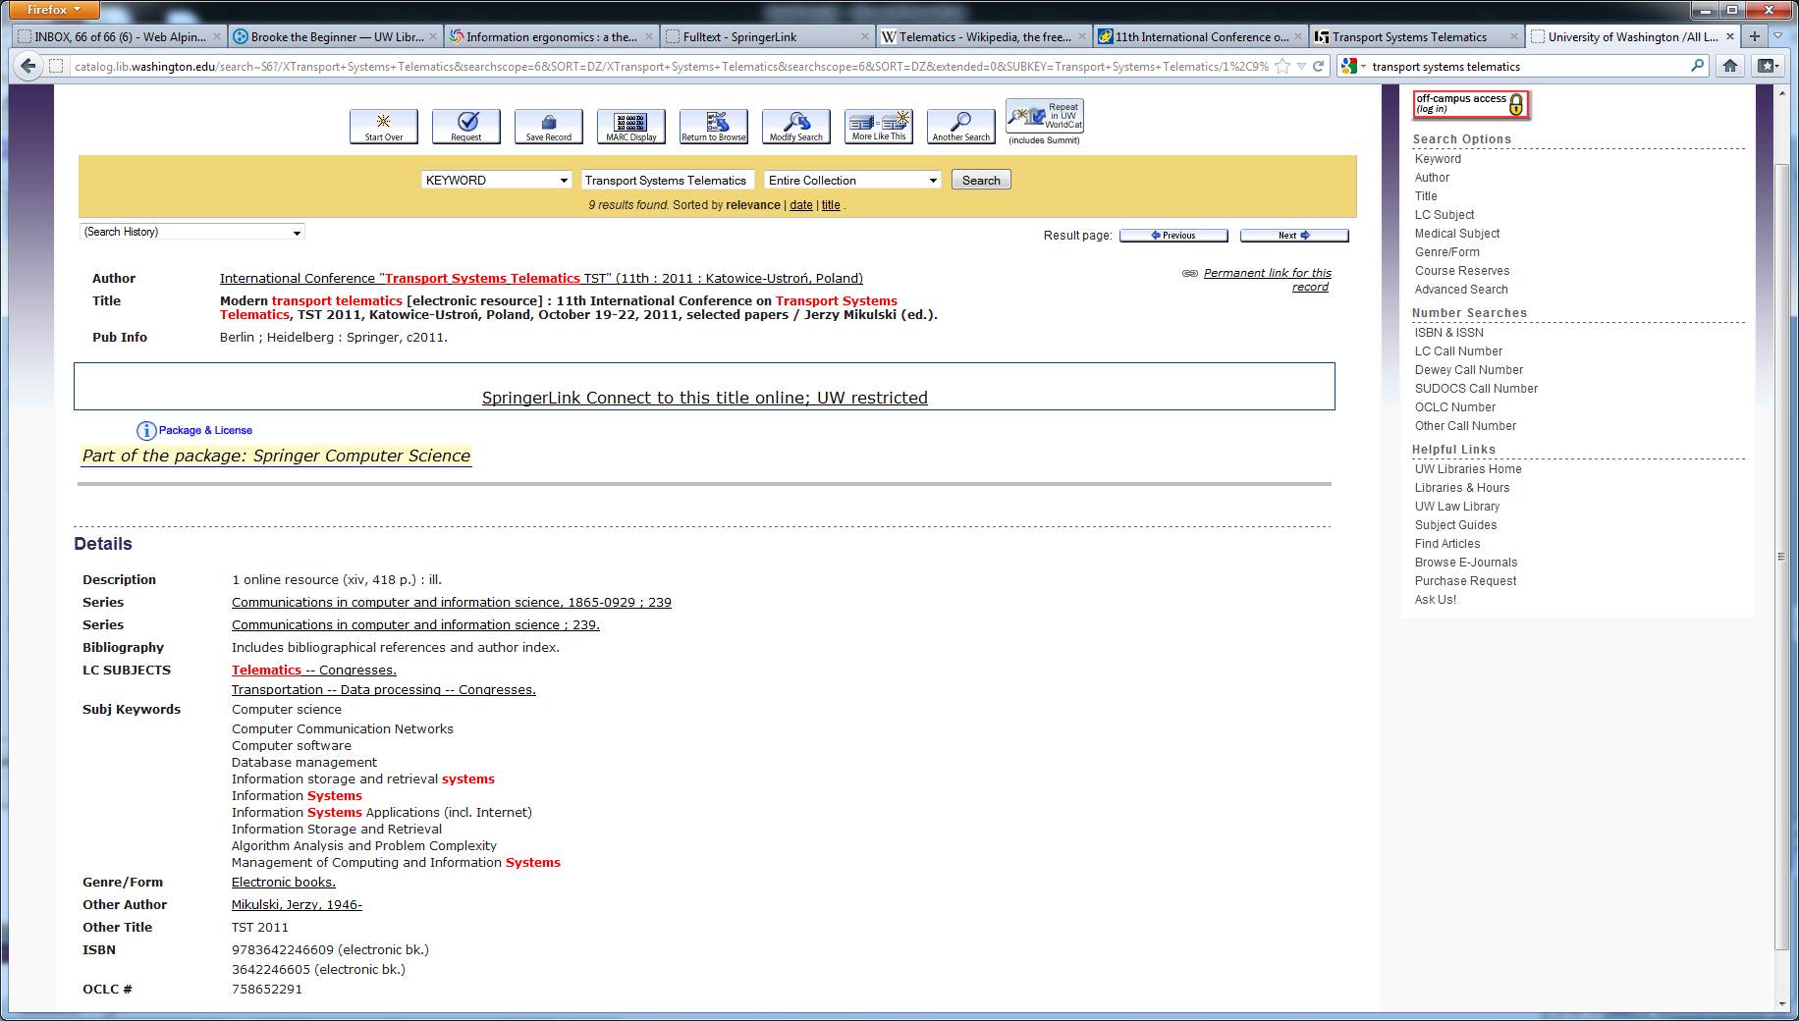
Catalog Record for 2011 Proceedings
Notes:
Richard is presented with the catalog record for the 2011 proceedings. The keywords from Richard’s search appear in red.
The record was retrieved because the name of the conference appeared as the “author” (and also appeared as part of the “title”).
This record provides a link to the full text, a note about the Springer package as well as information about the resource, including series, subjects, editor, ISBN and OCLC record #.

Slide 13
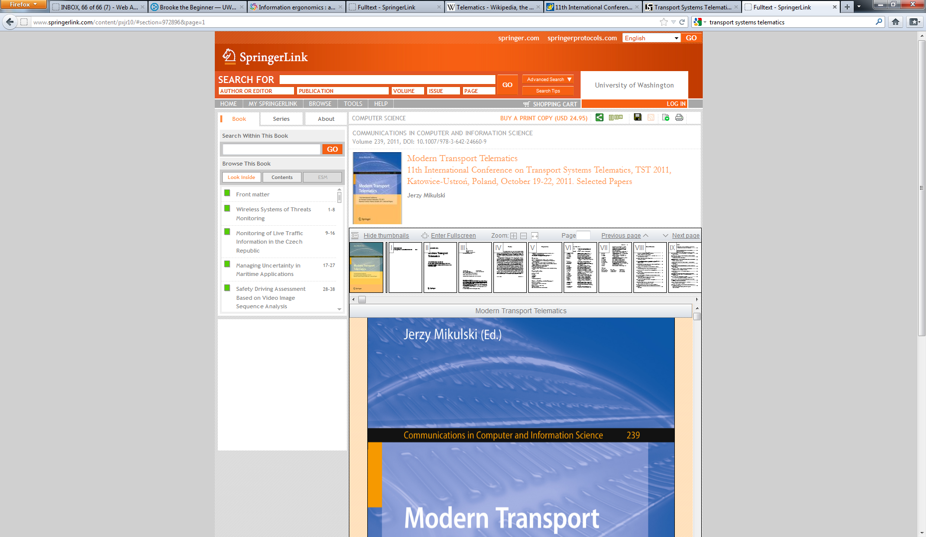
Full-Text Success
Notes:
Clicking on the “SpringerLink Connect to this title online” link gets Richard to the full-text of the proceedings on the Springer website. From here he can review the table of contents and read any individual papers he is interested in. He is also able to save a PDF of the proceedings that he can use later.

Slide 14
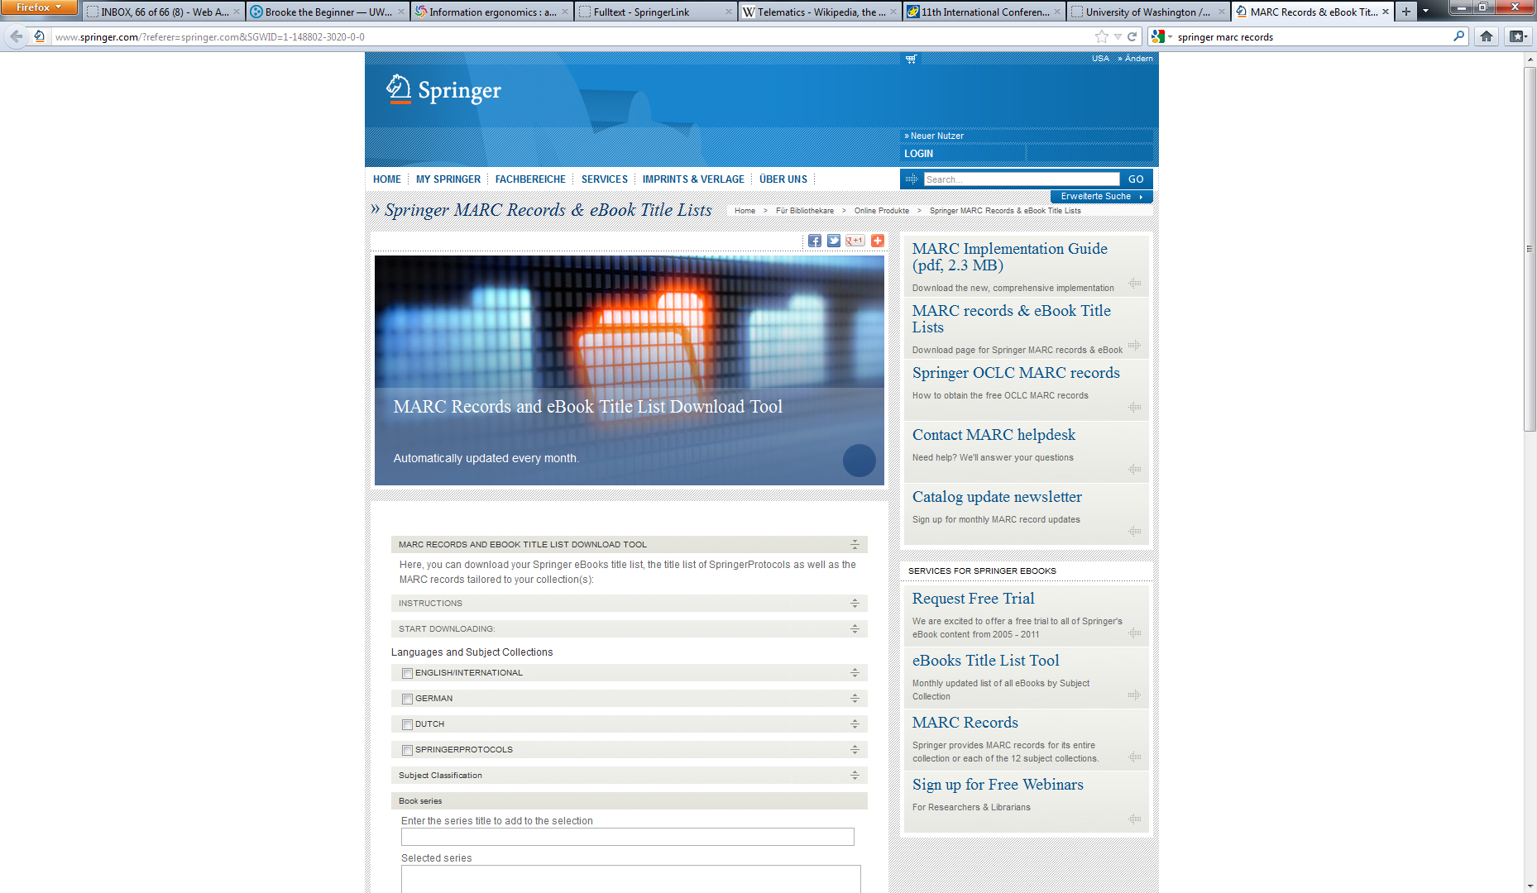
Catalog Record Source
Notes:
The library catalog was able to provide access to the conference proceedings because Springer made a catalog record available for the library to download and add to the catalog.
The library can directly download MARC records from this Springer website and load them into their local catalog.

Slide 15
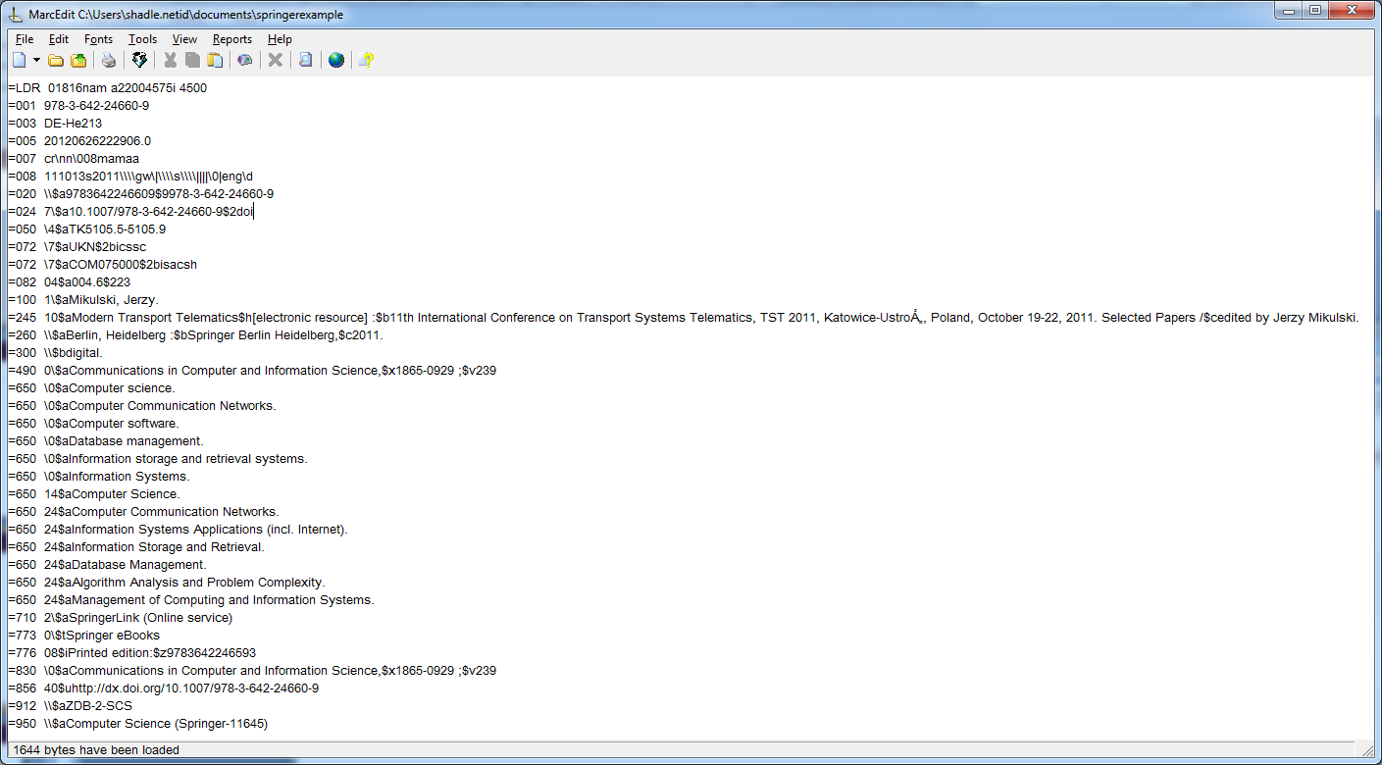
Springer MARC Catalog Record
Notes:
Here’s the MARC catalog record that Springer makes available for download. This is the record that was originally downloaded into our library catalog. Even though the use of numeric MARC field labels may be different, the elements in this record should be familiar to many of you.
Later changes were made to that record (ie, conference author, subject terms) to provide better, more specific access. A revised version of the record (which included these changes) was later downloaded from OCLC and overlaid the Springer record. The record currently in the catalog is a revised (better) version of the record than what was originally downloaded.

Slide 16
OpenURL Link Resolver
Service that takes a citation formatted as an OpenURL and provides the user with library services related to that citation. These services can include:
Accessing the online full-text
Placing an ILL (InterLibrary Loan) request
Searching a library catalog
Finding related resources
Notes:
The citation is often referred to as the “source” and the individual services or referred to as “targets”

Slide 17
OpenURL Knowledge Base
A database containing information about electronic resources such as electronic journals or eBooks and their availability and accessibility.
Using the knowledge base, an OpenURL link resolver can determine if an item (article, book, etc.) is available electronically and identify the appropriate copy for a user.
Notes:
Not to be confused with the computer science/expert system definition of a knowledge base.
A knowledgebase is typically presented in the form of a spreadsheet that lists information about all of the electronic resources a library licenses on behalf of their customers. Generally includes:
title (either journal or book)
book author
identifiers (ISBN, ISSN)
journal coverage
resource provider (ie, online publisher or content provider)
URL

Slide 18
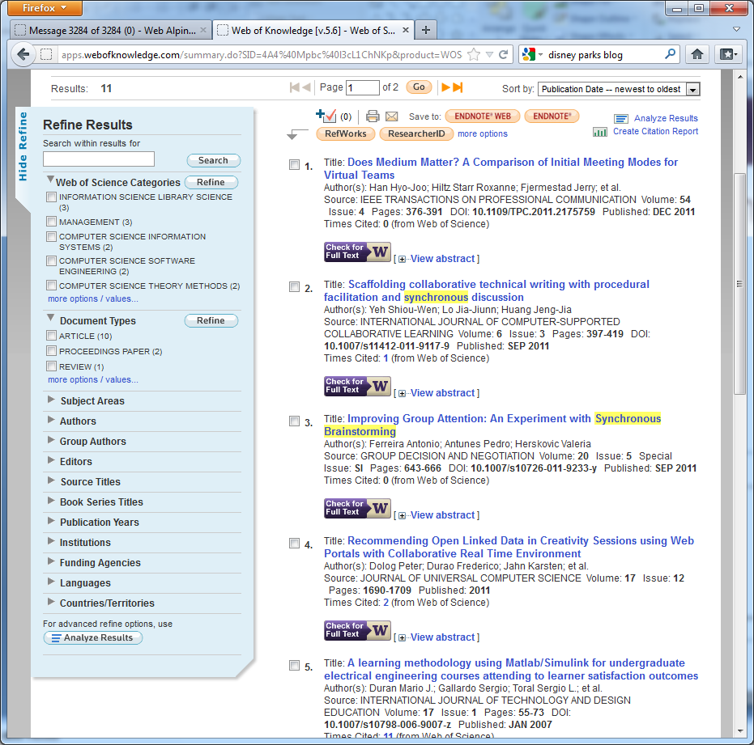
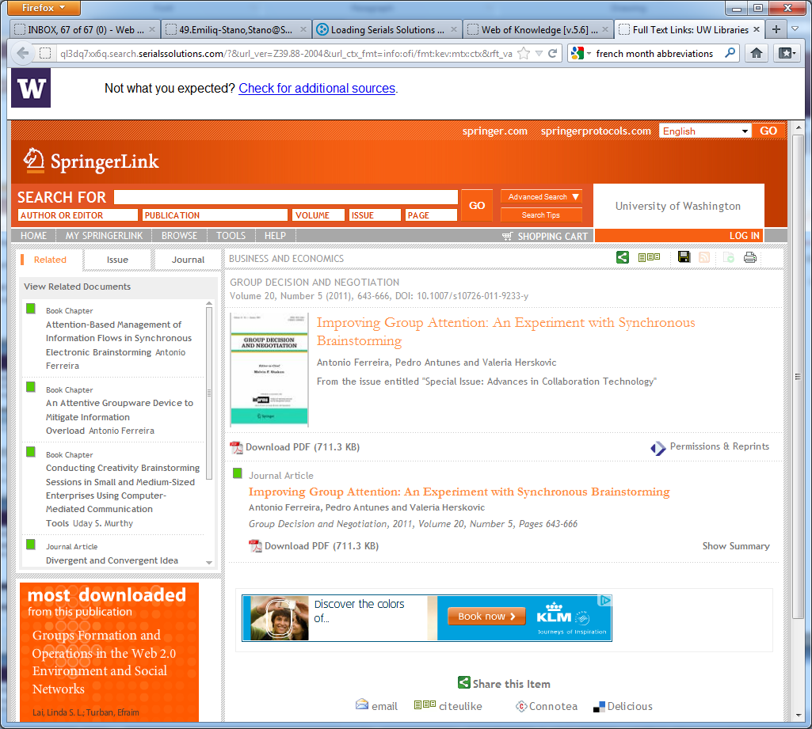
OpenURL Linking
Title | ISSN | eISSN | StartDate | EndDate | Resource | URL
Group decision and negotiation | 0926-2644 | 1572-9907 | 4/1/1992 | 12/31/1996 | SpringerLINK Archive - Humanities, Social Sciences and Law | http://www.springerlink.com/openurl.asp?genre=journal&issn=0926-2644
Group decision and negotiation | 0926-2644 | 1572-9907 | 1/1/1997 |  | SpringerLink Contemporary - Orbis Cascade Alliance | http://www.springerlink.com/openurl.asp?genre=journal&issn=0926-2644
Group decision and negotiation | 0926-2644 | 1572-9907 | 1/1/1997 | 12/31/2009 | SpringerLink Contemporary - Orbis Cascade Alliance (Perpetual Access) | http://www.springerlink.com/openurl.asp?genre=journal&issn=0926-2644
Group decision and negotiation | 0926-2644 | 1572-9907 | 11/1/2004 | 1 year ago | Business Source Complete | http://search.ebscohost.com/direct.asp?db=bth&jid=OFY&scope=site
360Link
http://www.springerlink.com/openurl.asp?genre=article&id=doi:10.1007/s10726-011-9233-y
http://resolver.lib.washington.edu/?&
rft.date=2011&rft.issn=0926-2644 &id=doi:10.1007/s10726-011-9233-y&…
Notes:
HEAVY ANIMATION
User starts in Web of Science, identifies an article they’re interested in. In this case, the user is in Web of Sciences and finds an article with the title “Improving Group Attention” which is published in the Sept 2011 issue of “Group Decision and Negotiation” (a Springer Journal)
User click on purple “Check for Full-Text” button. This sends an OpenURL from Web of Science to the link resolver (resolver.lib). This is part of the OpenURL that is sent by WoS. Notice the citation elements in the URL (including date, ISSN, article DOI). We will look at a complete OpenURL in a minute.
Resolver parses the citation elements, checks the ISSN and date against the KB and identifies the Springer version as having the full-text. The data about Springer journal titles are provided by Springer to Serials Solutions (actually Serials Solutions grabs the metadata (title/ISSN/dates/links) from the Springer download site on a monthly basis (see note below). UW Libraries staff then profile their specific subscriptions against the Serials Solutions KB.
Link resolver knows the rules to create a target URL and sends user session to the full-text of that article
NOTE FROM LEE DEITESFELD/SERSOL: For journals, we go to the SpringerLINK platform (http://www.springerlink.com/journals/all/a/?target=export), and download a CSV file. For ebooks/book series, we go to the Springer “downloader tool” (http://www.springer.com/?referer=springer.com&SGWID=1-148802-3020-0-0), and download an Excel file. And, in the rare case with SpringerOpen (http://www.springeropen.com/journals), we actually have software that scrapes the SpringerOpen website for title-level metadata.

Slide 19
Link Resolver
Parses the citation elements from the source OpenURL
Tests those elements against a library’s knowledge base
Identifies targets based on test results
Creates and offers links based on linking logic
Notes:
Overview of the link resolver steps we just walked through

Slide 20
OpenURL and Citation Data
Ferreira, Antonio, Pedro Antunes, and Valeria Herskovic. 2011. "Improving Group Attention: An Experiment with Synchronous Brainstorming". Group Decision and Negotiation. 20 (5): 643-666.
http://resolver.lib.washington.edu/?&rft_val_fmt=info:ofi/fmt:kev:mtx:journal
&rft.atitle=Improving%20Group%20Attention%3A%20An%20Experiment%20with%20Synchronous%20Brainstorming
&rft.aufirst=Antonio
&rft.aulast=Ferreira
&rft.date=2011
&rft.spage=643
&rft.epage=666
&rft.genre=article
&rft.issn=0926-2644
&rft.issue=5
&rft.jtitle=GROUP%20DECISION%20AND%20NEGOTIATION
&rft.pages=643-666
&rft.stitle=GROUP%20DECIS%20NEGOT
&rft.volume=20
&rfr_id=info:sid/www.isinet.com:WoK:UA
&rft.au=Antunes%2C%20Pedro
&rft.au=Herskovic%2C%20Valeria
&rft_id=info:doi/10.1007%2Fs10726-011-9233-y
http://resolver.lib.washington.edu/?&url_ver=Z39.88-2004&
url_ctx_fmt=info:ofi/fmt:kev:mtx:ctx&rft_val_fmt=info:ofi/fmt:kev:mtx:journal&rft.atitle=Improving%20Group%20Attention%3A%20An%20Experiment%20with%20Synchronous%20Brainstorming&rft.aufirst=Antonio&rft.aulast=Ferreira&rft.date=2011&rft.epage=666&rft.genre=article&rft.issn=0926-2644&rft.issue=5&
rft.jtitle=GROUP%20DECISION%20AND%20NEGOTIATION&rft.pages=643-666&rft.part=SI&rft.spage=643&rft.stitle=GROUP%20DECIS%20NEGOT&rft.volume=20&rfr_id=info:sid/www.isinet.com:WoK:UA&rft.au=Antunes%2C%20Pedro&rft.au=Herskovic%2C%20Valeria&rft_id=info:doi/10.1007%2Fs10726-011-9233-y
Notes:
ANIMATION. This is the openURL sent by Web of Science (note sid/www.isinet.com:WoK).
Looks like a lot of complication until you format it to see that the OpenURL essentially consists of two elements:
Link resolver address (in this case, ql3dq7xx6q.search.serialssolutions.com)
Citation elements
In order for link resolvers to function properly, citation metadata coming from a source must be accurate. In most cases, this data is originally coming from you, the publisher.

Slide 21
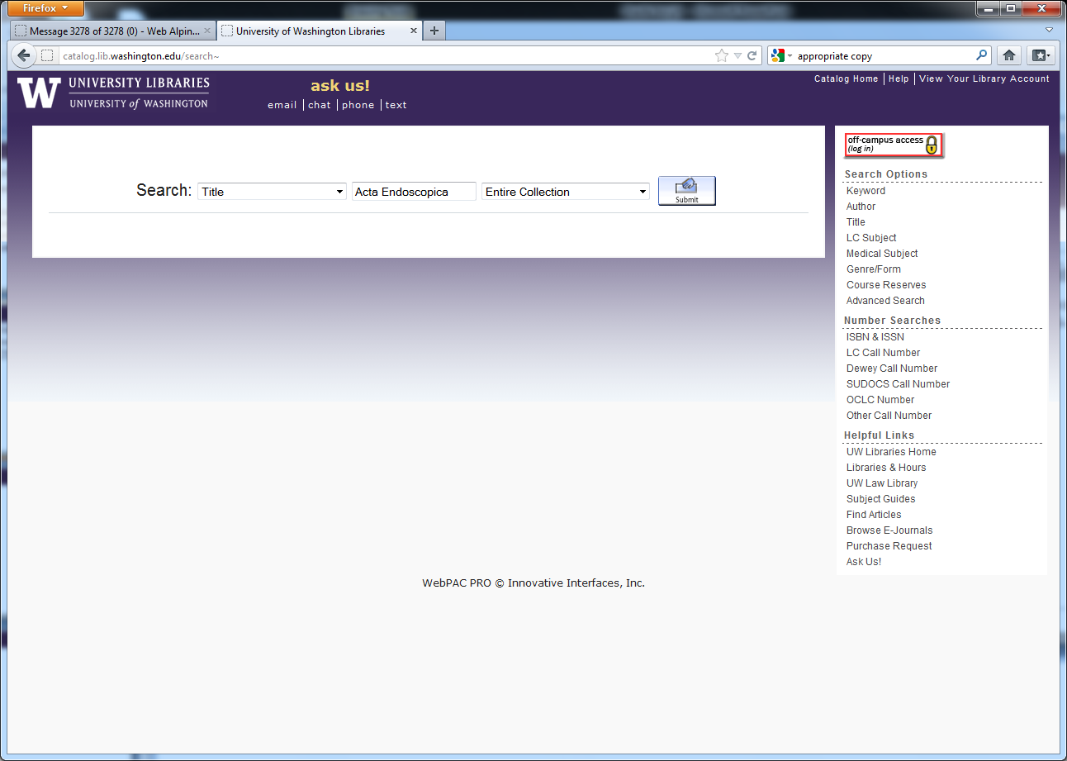
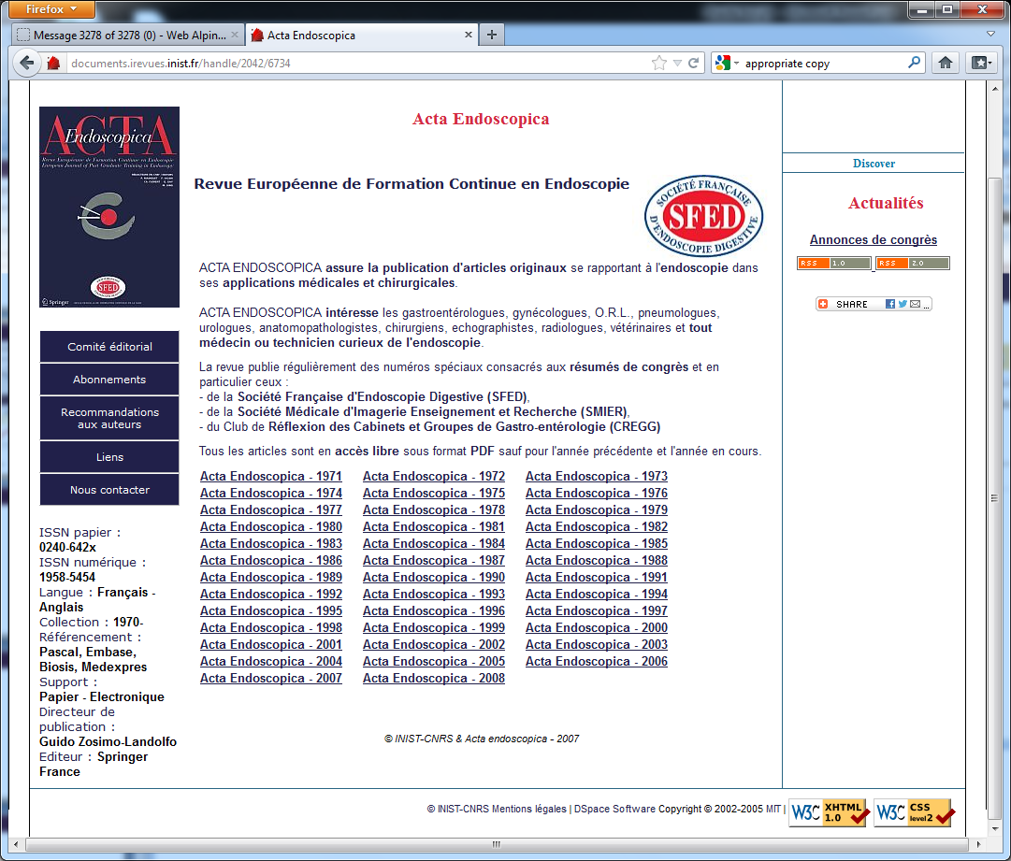
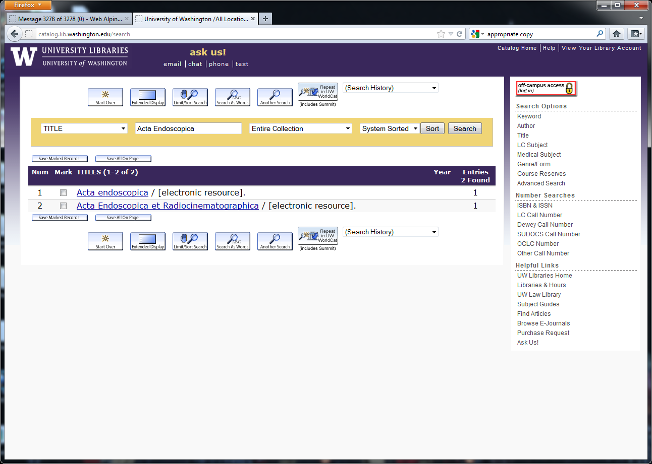
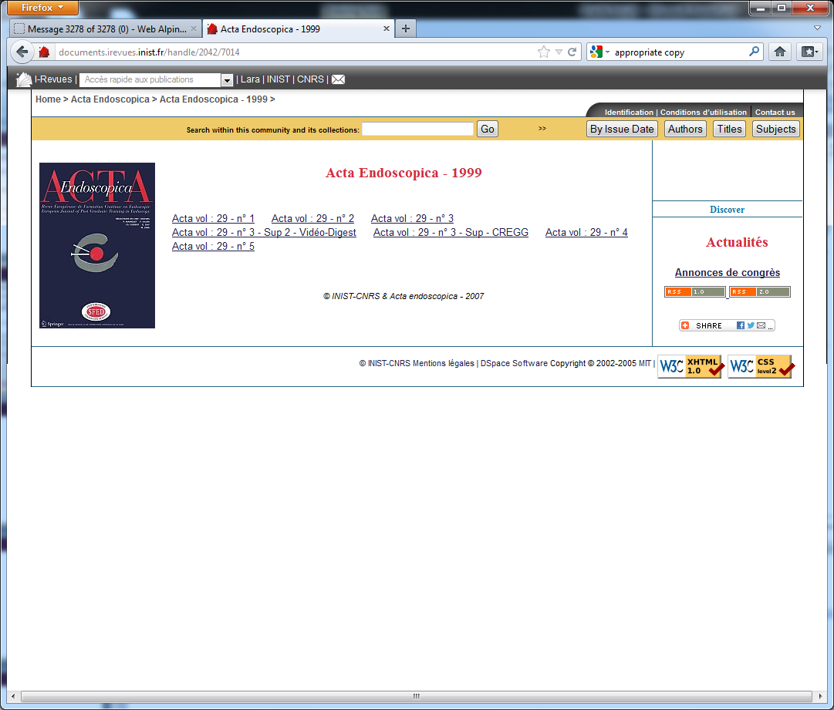
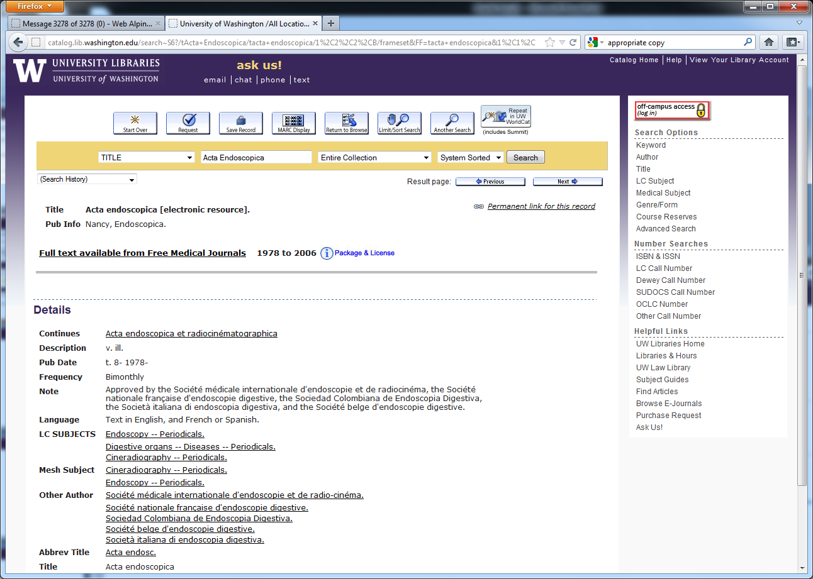
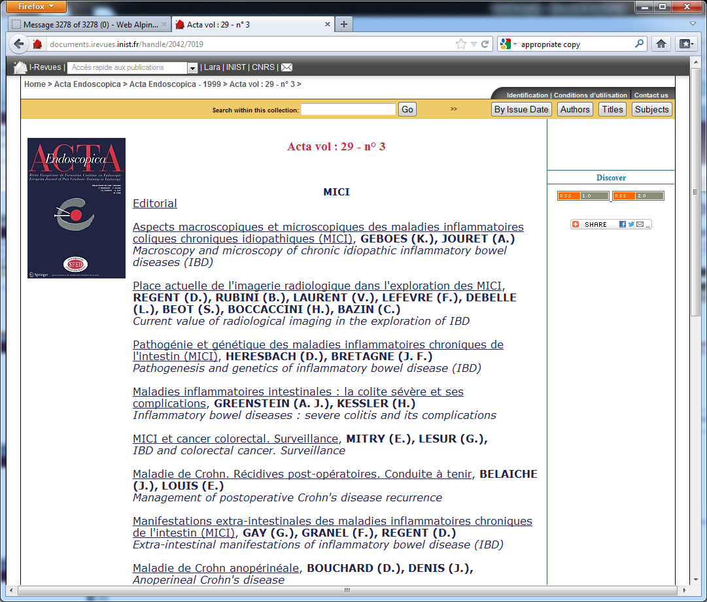
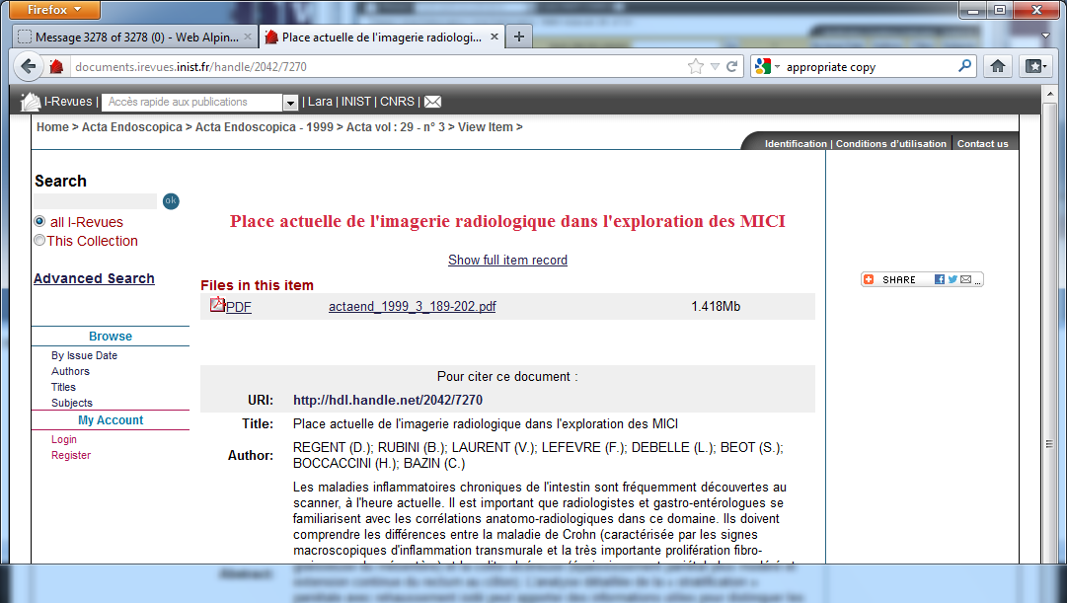
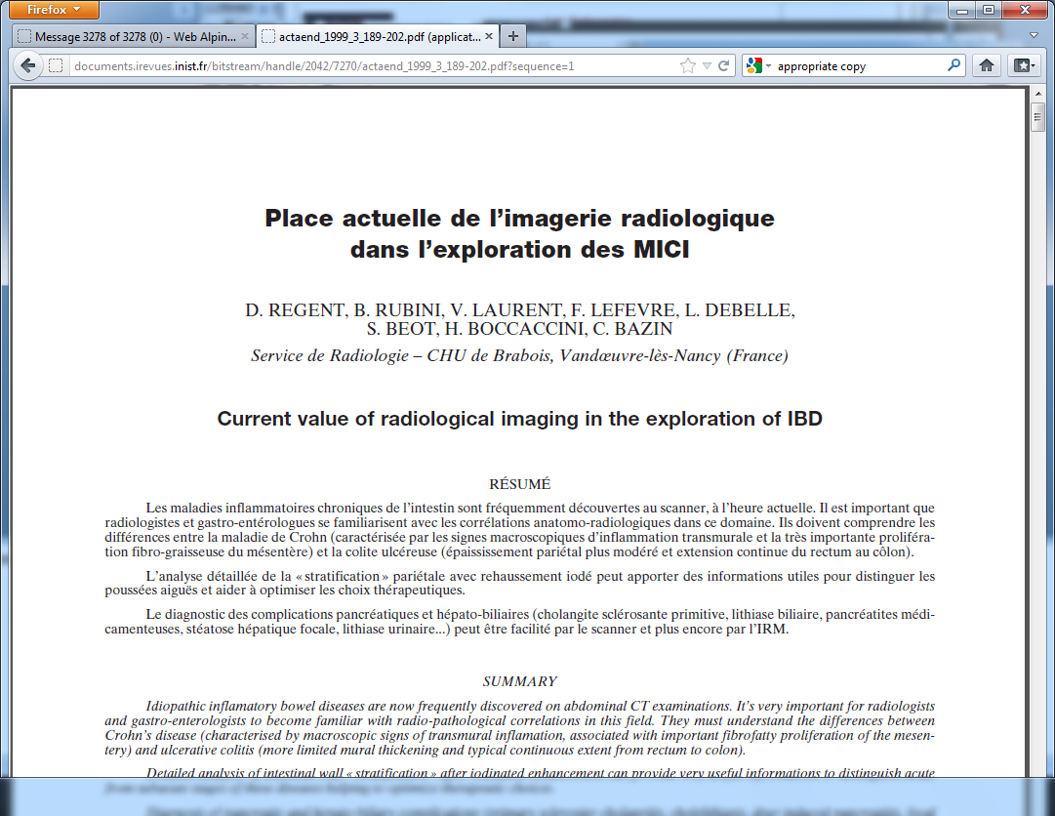
Why Use a Link Resolver?
Navigating library systems is time consuming
Regent, D., et al. 1999. "Place actuelle de l'imagerie radiologique dans l'exploration des MICI". Acta Endoscopica. 29 (3): 189-202.
Notes:
The next three slides are examples illustrating why libraries use link resolvers. In general they provide better or additional access to a resource than what the library is able to supply through the traditional library catalog or from it’s physical collection.
ANIMATION.
Without the link resolver, the user has drill down through the library catalog and then through the journal website to get to the article full-text.
Click through the drill-down process. SEVEN clicks to get to the full-text article through the library catalog.
On a side note, there are still some library staff who attempt to show users this method for getting to a full-text article. In cases where link resolution fails, this may be what the user has to do.

Slide 22
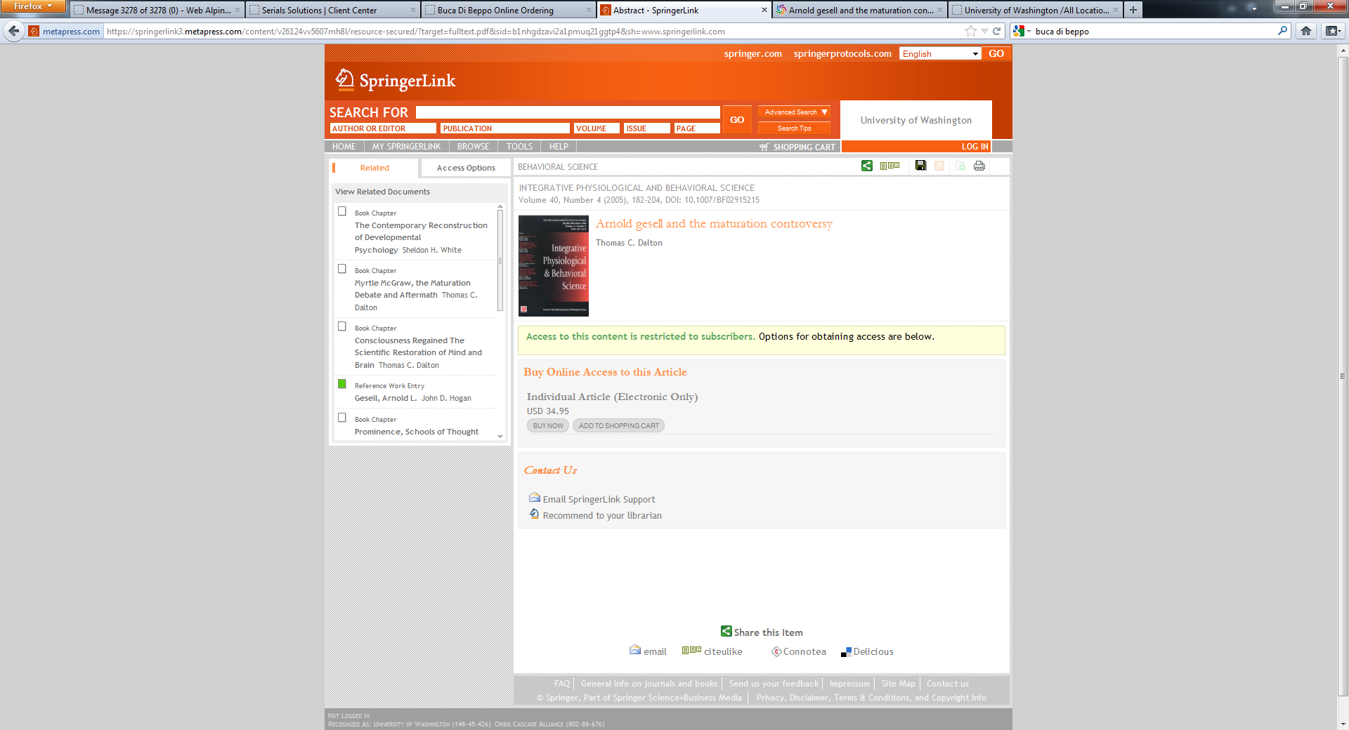
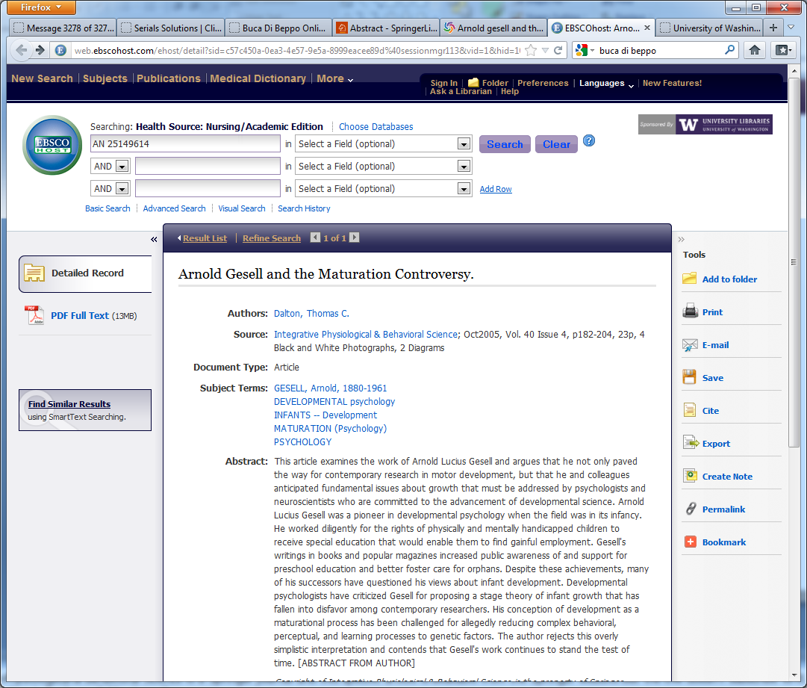
Why Use a Link Resolver?
Gets the User to the Appropriate Copy
Dalton, Thomas C. 2005. "Arnold gesell and the maturation controversy". Integrative Physiological & Behavioral Science. 40 (4): 182-204.
Notes:
ANIMATION.
The library may get access to electronic full-text through a source besides directly from the publisher. In this example, the user goes directly to the Springer website and can’t get to the article because the the library doesn’t subscribe to the content. Integrative Physiological & Behavioral Science is a Springer journal and this specific article is available from the Springer website but the UW doesn’t subscribe to it from Springer. Instead KB indicates that the issue in question is available from an EBSCOHost database. The Link Resolver works with the KB to identify which source is the most appropriate source for the full text.

Slide 23
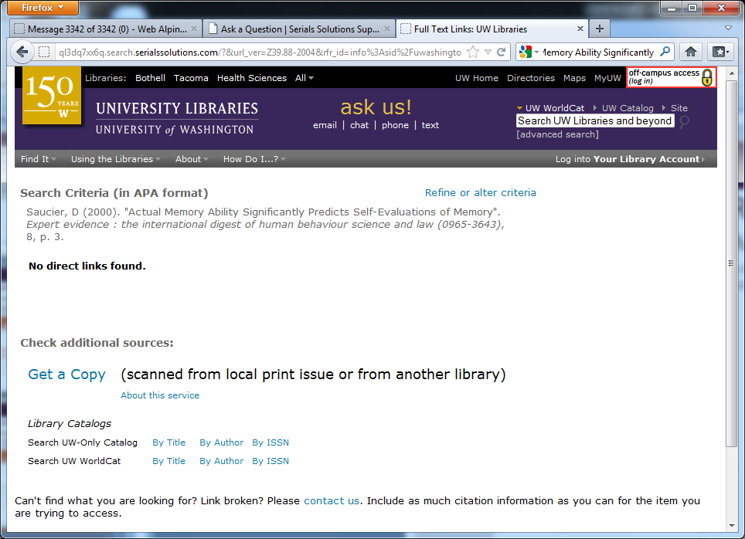
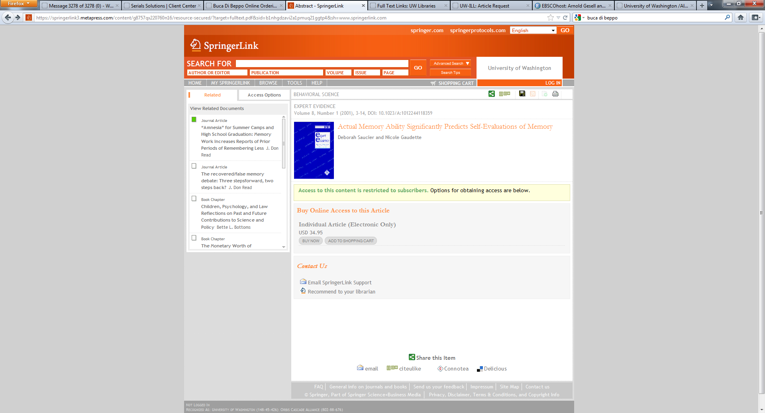
Why Use a Link Resolver?
Provides alternative services if full-text not licensed
Saucier, D., and N. Gaudette. 2000. "Actual Memory Ability Significantly Predicts Self-Evaluations of Memory". Expert Evidence. 8: 3-14.
Notes:
ANIMATION.
Get the user to a service that will get the content if the library doesn’t license it. Integrative Physiological & Behavioral Science is a Springer journal and this specific article is available from the Springer website but the UW doesn’t subscribe to it. However, the UW may have the journal in print or may have a reciprocal borrowing relationship with another library for print. So if the link resolver, can’t find an online version, the user is giving options to find another version (or to fill out a request to have it scanned). Every library customizes the services offered depending on it’s own borrowing arrangements, library catalog, etc. Some libraries provide links to related full-text databases (with the idea that if the library doesn’t subscribe to *this* article, there may be other articles in XYZ database which would serve the user’s purpose.

Slide 24
Library Discovery Service
A search interface to pre-indexed metadata and/or full text documents made available by a library.
  Simple Search
  Comprehensive (Good Starting Point)
  Fast Response Time
  Can Include Local Collections in Addition to Licensed Resources
  Supports “Get” as well as “Find”
Notes:
The final access method we will talk about is the library discovery service. From the user perspective, it is similar to the Google search experience. These are some of the reasons that libraries use a discovery service.
Discovery services differ from federated search applications in that discovery services don’t search live sources. By searching pre-indexed data discovery services return search results very quickly. Discovery services are touted as an evolution beyond federated search and in some ways they are. Some discovery services either provide integration with federated search or provide an API for others to do the integration

Slide 25
Library Discovery Service
13M eBooks
30M digital items
  Google Books
  Hathi Trust
  OAIster
681M article citations
OCLC WorldCat
225M books
Notes:
Each library discovery service has a different mix of content and can often be customized to include local content.
However, most library discovery services consist primarily of the content that has been historically available from libraries (books, journals, articles).
DON’T MENTION OTHER OCLC FUNCTIONALITIES/COMPONENTS. EUROPEANS GENERALLY DON’T USE AS CATALOGING SOURCE/RESOURCE SHARING/ETC.

Slide 26
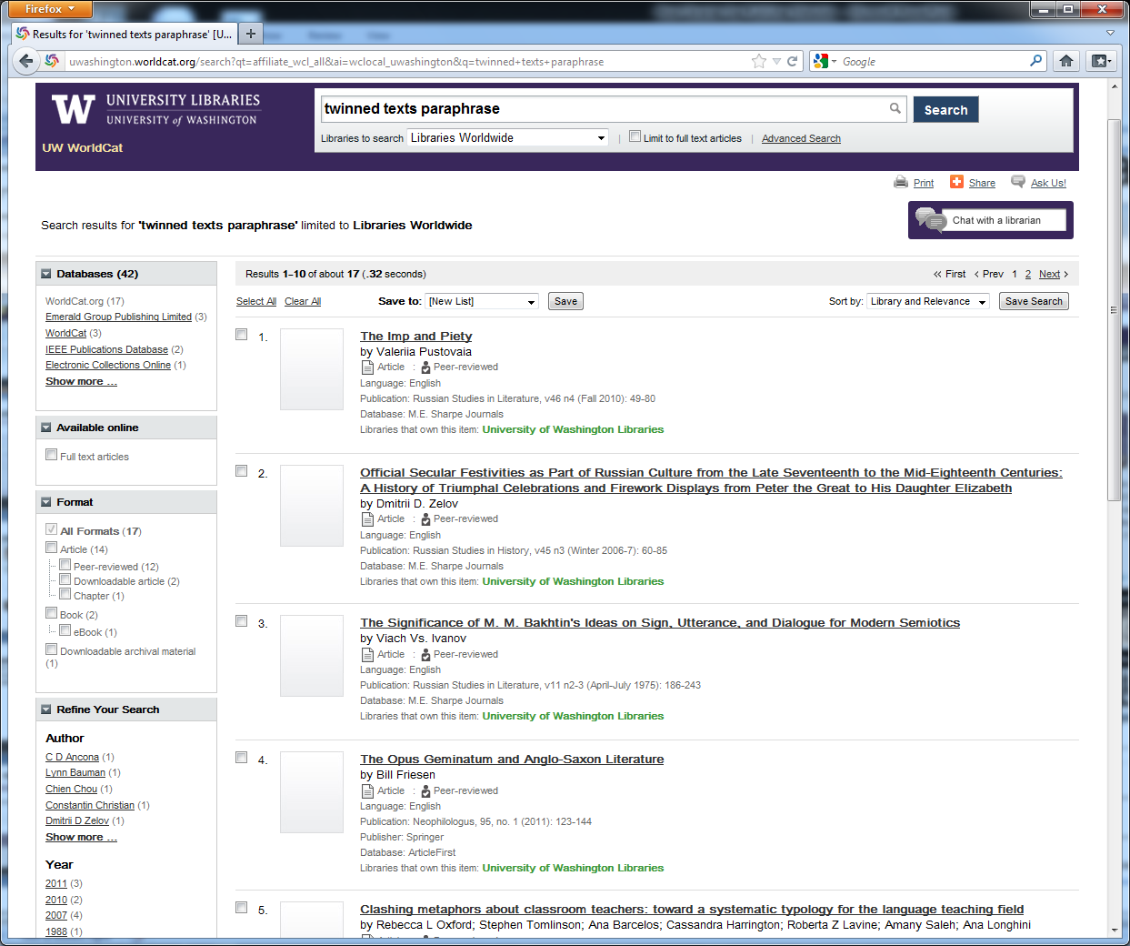
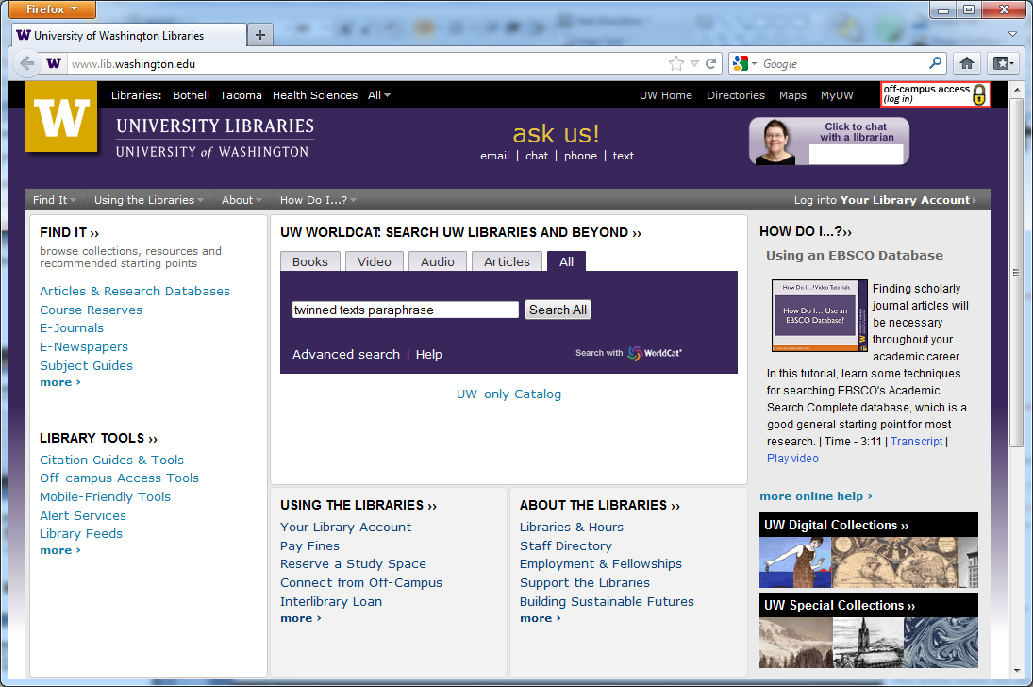
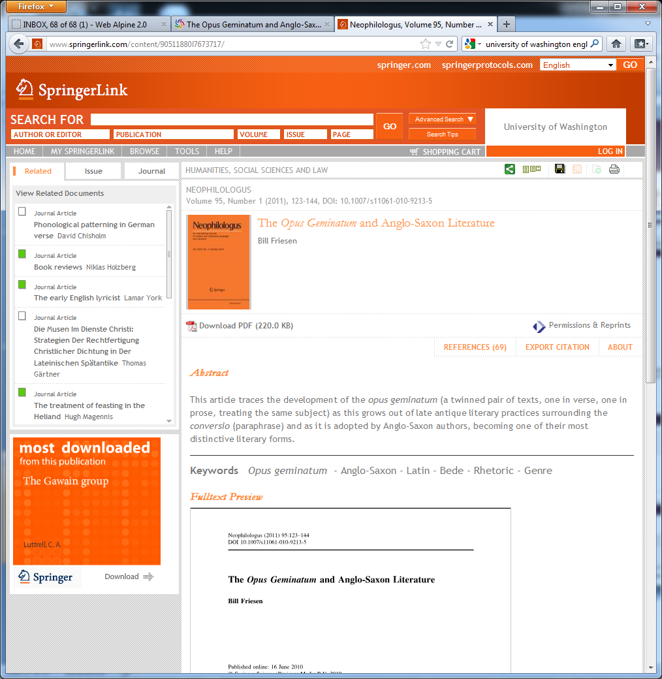
Brooke Starts Her Research
Notes:
HEAVY ANIMATION
In Brooke’s ENGL 210 (English Medieval and Early Modern Literature), she learns about the Anglo-Saxon literary practice of Opus geminatum (twinned work; a work consisting of a pair of texts, one in prose and one in verse). Her professor also mentions that paraphrase was often used as a literary device in this time period. Brooke is required to write a research paper on a topic of her choice and because of other commitments, she wants to get as much done as she can early on.
Brooke doesn’t take note of the latin phrase, but she does remember the concept so she inputs the words “paraphrase anglo saxon literature” into UW WorldCat (the UW Libraries’ discovery system). #3 includes the latin phrase in the article title (which she remembers as soon as she sees it). Because it has that phrase and because it’s held by the UW, she clicks on the link for that citation. Clicking the first “View full text” link gets Brooke to the article on the Springer website. Brooke gets from the discovery service to the full-text through link resolution (just like the Web of Science example we looked at earlier...the purple button). But unlike a traditional A&I database, a discovery service includes metadata from dozens of sources describing millions of resources (and not just journal articles).
Note that most of the information in the WorldCat entry is the same data that appears in the Springer website. Also note that the “Database” referenced in the WorldCat entry is “ArticleFirst.” The Springer indexer provides describes the citation for Springer’s system. That data is sent to OCLC (and to many other database providers, I assume) where it used as the basis for resource discovery in any number of systems. The metadata provided by Springer staff (and in some cases originally created by authors) is recycled into any number of database and systems that library use. So an error in the original metadata can be propagated across any number of systems and services.

Slide 27
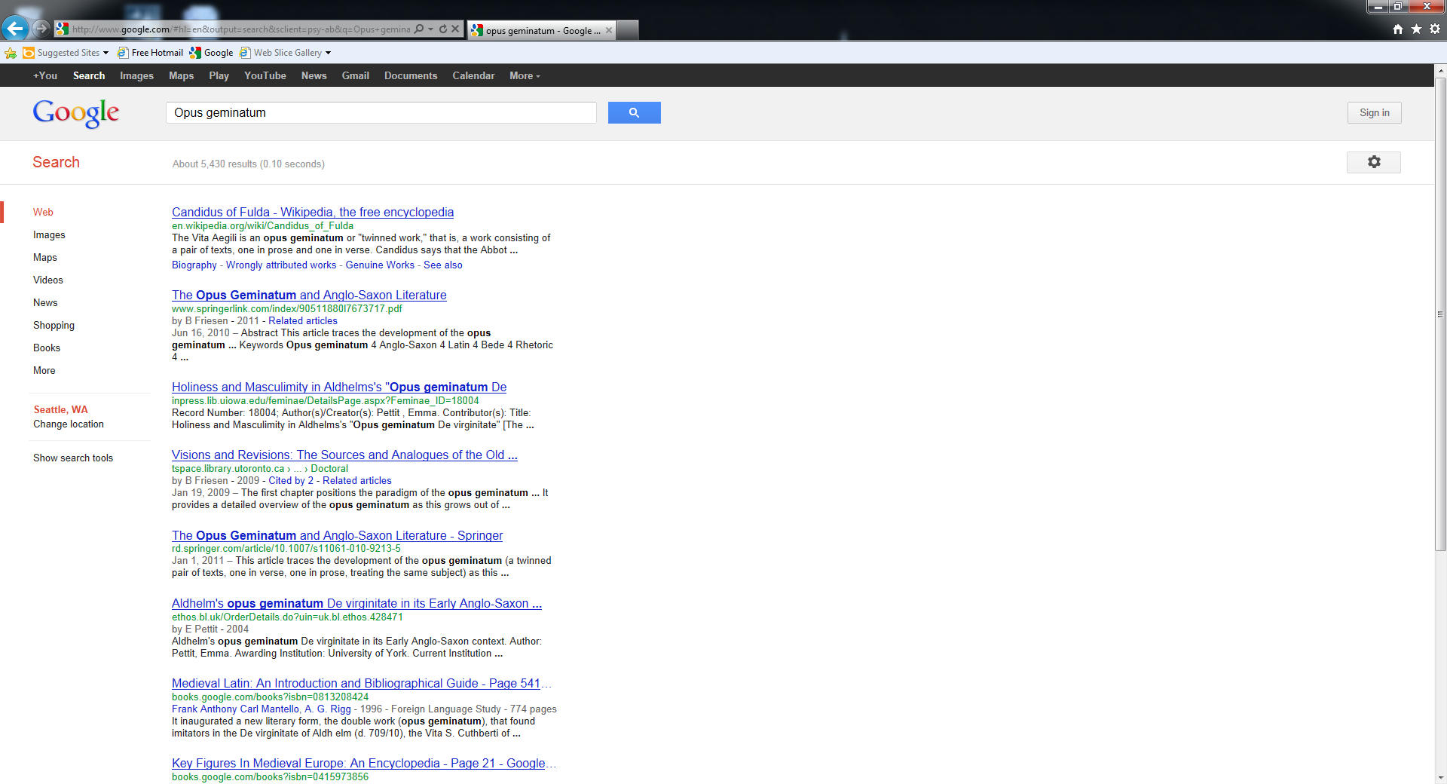
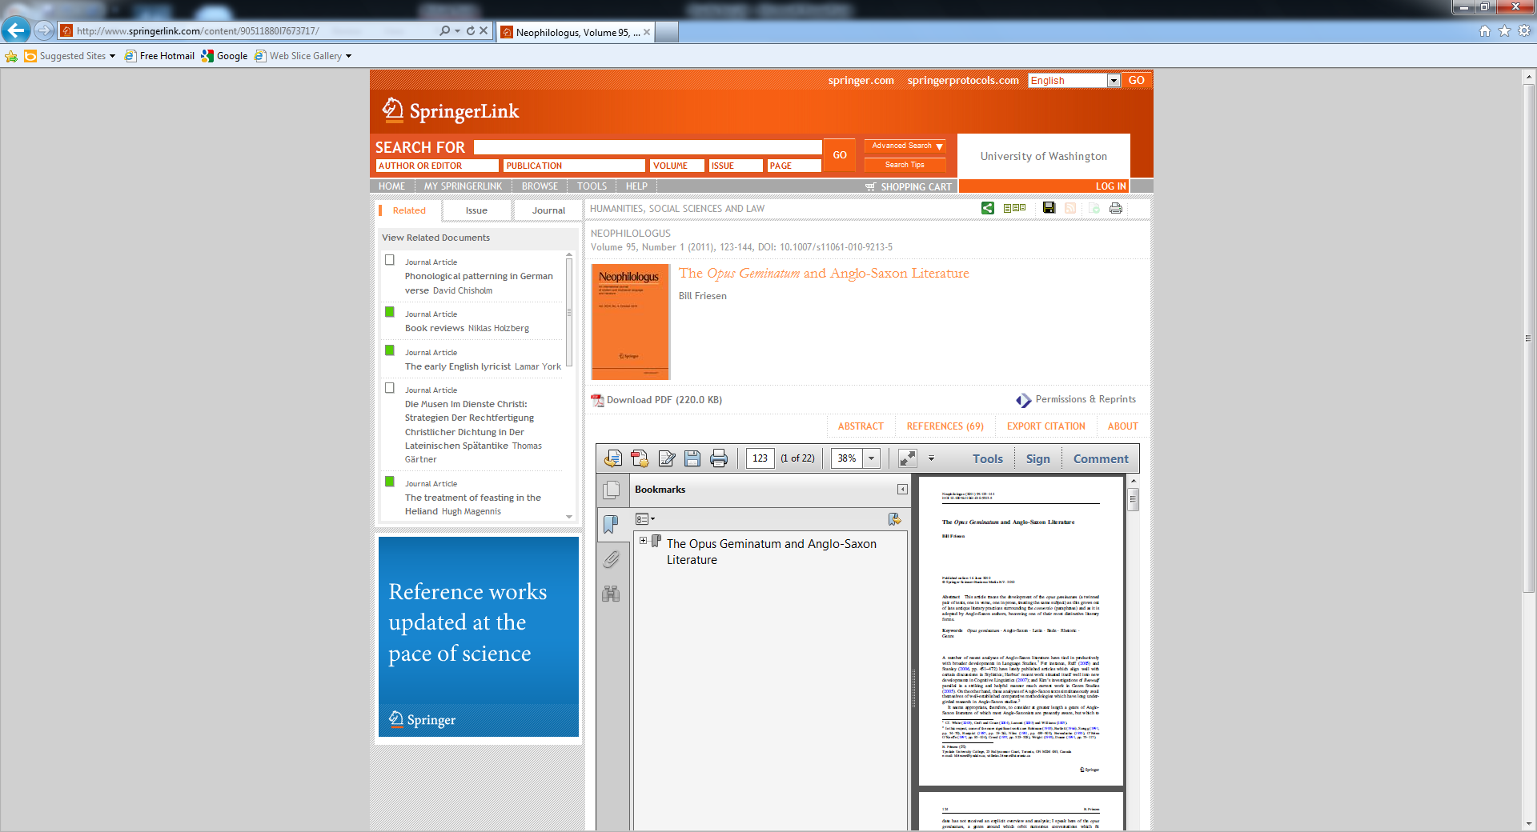
Brooke Continues Her Research in Google
Notes:
Now that Brooke remembers the phrase “Opus Geminatum” she searches in Google using that phrase.
The results are useful results including a Wikipedia entry for a specific instance of an opus geminaum “Candidus of Fulda” and it also uses the phrase “twinned work” to describe the literature style. There are other resource (mostly articles and books) that might be useful for additional research. But note the second entry is for the Springer-published article that she found earlier. Clicking on the Google link gets her to the full-text just as it does when she’s going from a citation database or the discovery service using link resolution.
This works because
the library has profiled it’s IP ranges with Google, so that Google can pass along IP information to the link target. As long as Brooke is on a campus workstation or has proxied her session, Google will recognize her as a University of Washington user
Google has the article metadata necessary to create the link to the full-text (likely an article DOI)
So if you create article or journal metadata, it will most likely appear in Google and be used to support Google Search

Slide 28
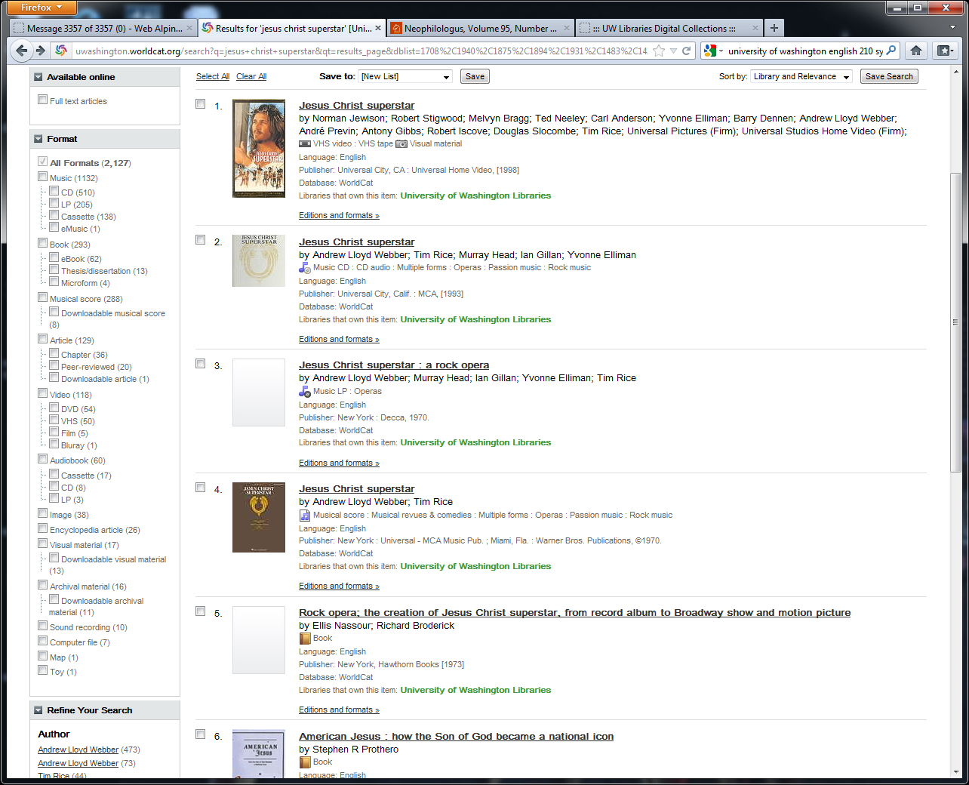
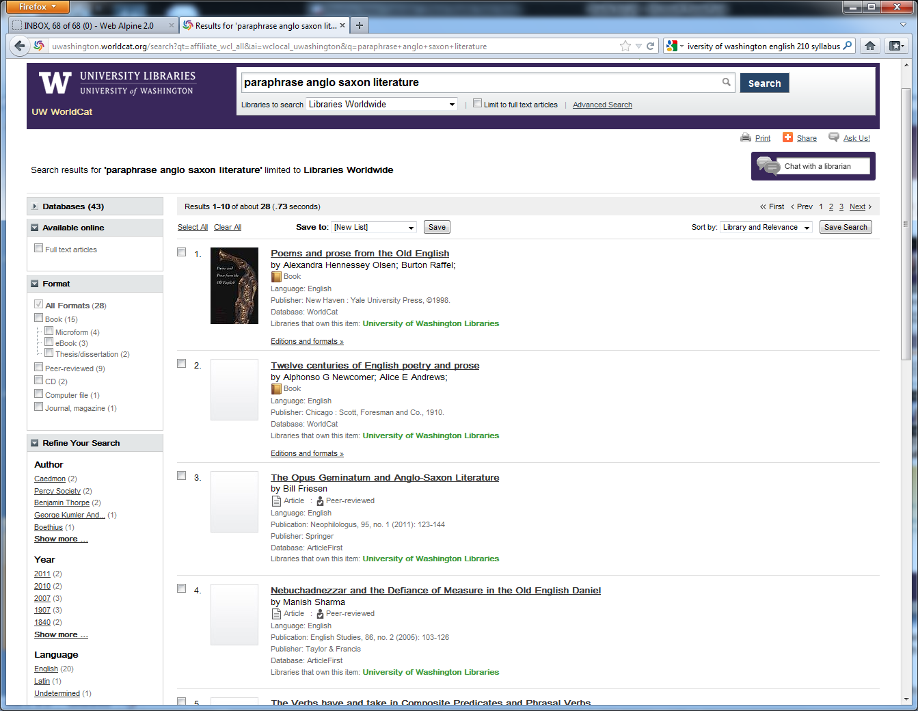
One-Stop Shop
Notes:
One of the benefits of a library discovery system is the integration of previously silo’d discovery systems/services. A good discovery system will be scoped to provide access to a majority of the resources that can be provided by the library. As our head of reference put it, WorldCat Local is a good place to start research and should provide for the needs of most undergraduates.
Brooke’s search for “paraphrase anglo saxon literature’ in WorldCat Local resulted in 28 resources. Of those, the eBooks, CDs and computer files may or may not have been in the traditional library catalog. The peer-reviewed articles definitely would not have been in the library catalog (so Brooke would need to search a separate database to find journal articles).
Here is a more illustrative case of the potential breadth of a discovery service. Looking down the format facet, one sees a search for Jesus Christ Superstar brings up video, soundtracks (cd/lp), musical score, books about the opera and on related topics, etc. Looking at the format facet, one sees the huge variety of resource types indexed in WorldCat (including 36 book chapters, 26 encyclopedia articles and even a toy!). The metadata for these resources is coming from various sources following encoding and content standards. it’s the job of the discovery service provider to manage, integrate and provide quality control over this wealth of metadata.

Slide 29
Library Discovery Metadata
Typically comes from many sources
Must be mapped to an underlying set of data elements in order to be indexed
Data element set must be rich enough to provide robust search
Data must be accurate!!
Notes:
WorldCat Local article citations come from dozens of sources, MARC records come from thousands of libraries. Because the discovery service indexes these all in one central index, there must be an underlying set of data elements that all the incoming data must be mapped to.
These data elements must be rich enough to provide for robust search (so more than just keywords, must be able to search by author, title as well as limit by format, etc.)
If incoming data is miscoded or (more likely) the mapping between the datasets is incorrect, bad results will occur. We’ll take a look at some of those in a minute.

Slide 30
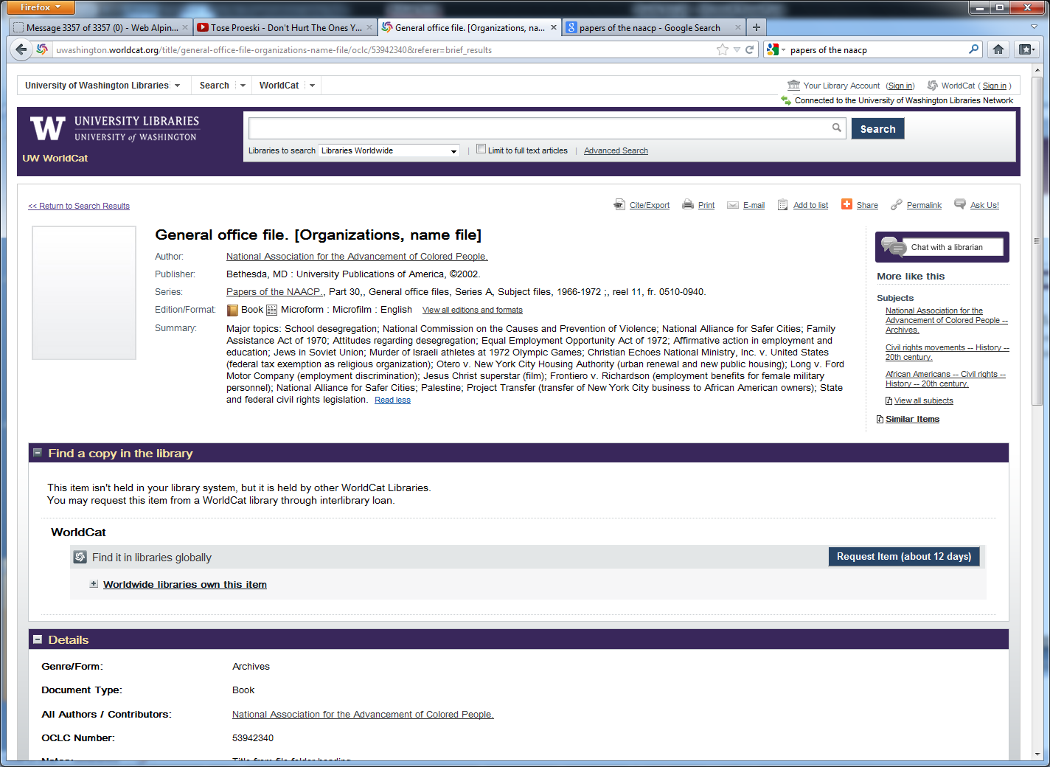
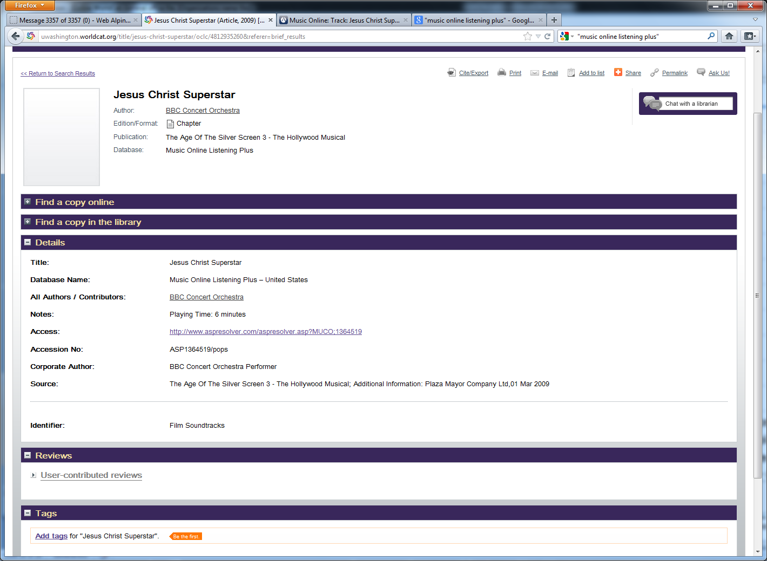
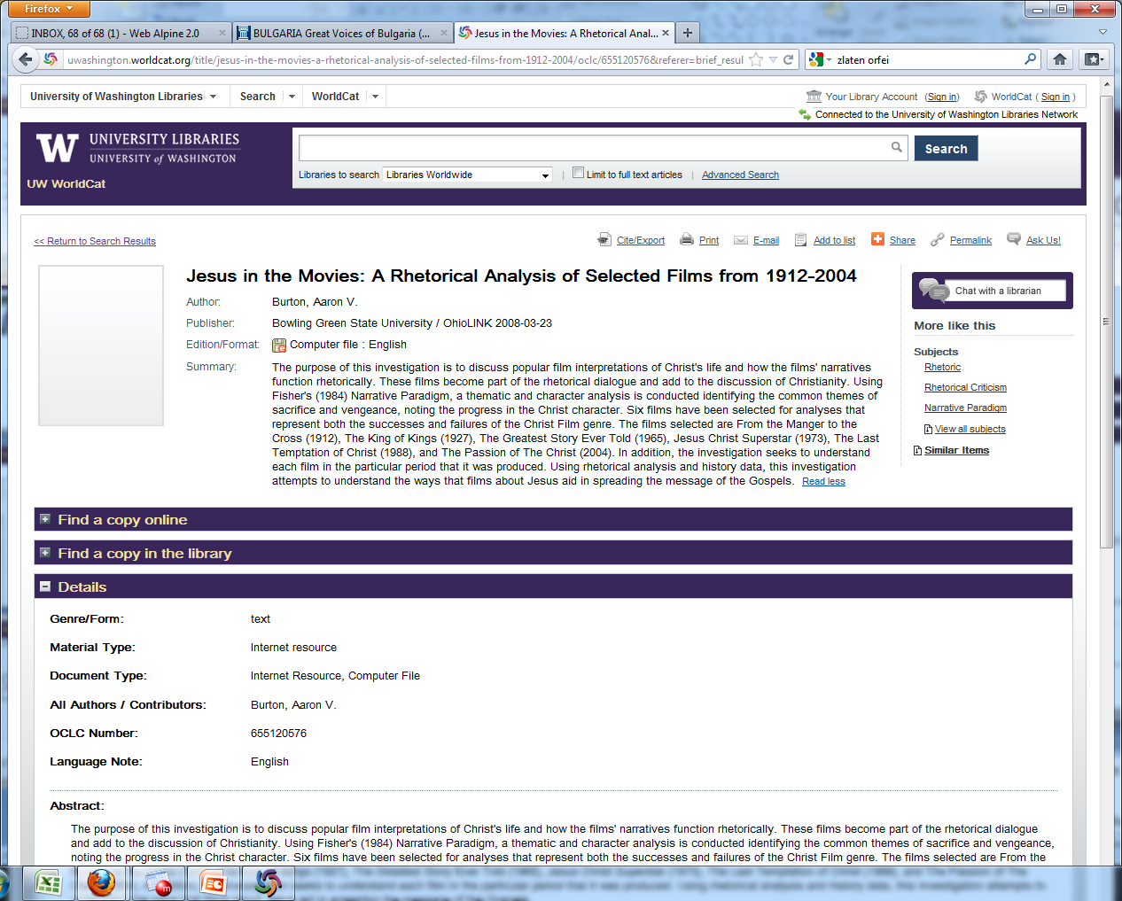
When Standards Collide
Notes:
ANIMATIONS (ONE FOR EACH EXAMPLE) - Here’s the list of formats from the format facet from the Jesus Christ Superstar search. Included are examples of where the metadata is miscoded (or mapped incorrectly) and the resource appears under the incorrect format facet.
Microform Book. This is a microfilm, but it is a set of office files from the NAACP office (and thus should appear under the “Archival Material” facet. University Publications of America generally does microfilm books and had their default coding set up provide book metadata elements.
Article Chapter. All 36 entries under this category are sound files provided by Alexander Street Press. These should be appearing under the eMusic facet, but somewhere along the way, a coding detail got lost and they were coded as “Article Chapters.”
Computer File. Technically it is, but this is actually a master’s thesis and should have appeared under the “Thesis/Dissertation” facet. In WorldCat, “Computer file” is reserved for resources inherently computer-like such as software. This record was created by OAI harvesting from Bowling Green State University’s electronic thesis and dissertation collection. The element that describes this as a thesis was not included in the template used to create these records and thus was not included in the records that were loaded into WorldCat.
In these examples, non-MARC metadata was used to create a record which then was converted into a MARC record which was loaded into WorldCat. Problems like the ones illustrated here can result from difference in encoding standards, content standards or in coding errors. In a discovery service, it is the responsibility of those contributing and managing metadata (and metadata crosswalks) to confirm that the metadata being contributed conforms to the discovery service standards.

Slide 31
Summary
Libraries use more than just MARC records in providing access to publisher content
Libraries use more than just the library catalog in providing access to publisher content
Metadata created by publishers is distributed to various systems, not just to libraries
Any source that supports OpenURL can potentially provide access to publisher content
Metadata accuracy is about more than correct transcription

Slide 32
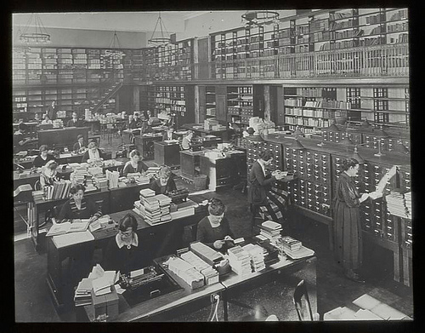
Final Word
Library catalogers can’t do it all!
Notes:
Working in cooperative systems, library catalogers could do it all when the only records we created were for books (not articles) physically held in the library. Those days are long gone.

Slide 33
Support for the Publisher
KBART (Knowledge Bases and Related Tools)
  UKSG & NISO joint initiative
  Recommends best practices for formatting and distributing title lists
  Phase 1 (2010) focused on eJournals
  Phase 2 (in process) includes eBooks and Conference Proceedings
  Phrase 2 also addressing other issues such as Open Access content and consortial access

Slide 34
Publisher Involvement
  Everything can be found at http://www.uksg.org/kbart/endorsement
  Review the requirements (data samples available)
  Format your title lists accordingly
  Self-check to ensure they conform to recommended practice
  Ensure that you have a process in place for regular data updates
  Register your organization on the KBART registry website: http://bit.ly.kbartregistry

Slide 35
Serials Solutions KnowledgeWorks
Includes a certification program for content providers
http://www.serialssolutions.com/en/services/knowledgeworks/
Project Transfer
UKSG Code of Practice http://www.uksg.org/transfer
Help publishers ensure that journal content remains easily accessible by librarians and readers when there is a transfer between parties, and to ensure that the transfer process occurs with minimum disruption.
Addresses responsibilities for both transferring and receiving publisher
Includes guidelines addressing title access, digital files, subscription lists, URL changes, communication and DOI ownership

Slide 36
MARC Metadata
MARC Record Guide for Monograph Aggregator Vendors
http://www.loc.gov/aba/pcc/sca/documents/FinalVendorGuide.pdf
Developed by the Program for Cooperative Cataloging
Provides detailed MARC data specifications for eBooks in packages and aggregations
MarcEdit
http://people.oregonstate.edu/~reeset/marcedit/html/index.php
An open source MARC editing utility developed by Terry Reese
Easy-to-use tool that can crosswalk data between MARC and other formats

Slide 37
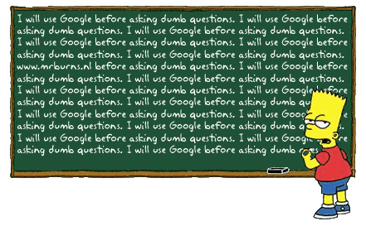
And finally....
Downloaded under a Creative Commons license

