Slide 1
Talking To the Aliens
Embracing the Metadata That Powers Your Book Sales

Slide 2
“We’ve Never Done It This Way Before”
Notes:
Tell Harold Grabau story.
Borders collapsed.
B&N is closing 20 stores a year.
Ebooks are still a new paradigm
No clear-cut standards for distributing digital – every vendor has different criteria.
Vendors are drinking from fire hose – no time to create feedback.
No tried-and-true practice such as that of the print world, which of course itself is in a massive state of flux right now.
Independent/self-publishing adds to the confusion – there are more and more indie enterprises every single year.

Slide 3
The New Big Six
Notes:
Notice that there are no publishers on this list.
These guys want content from whoever can supply it.

Slide 4
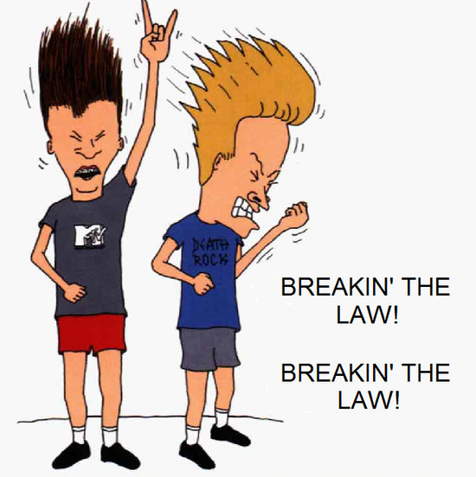
New guys don’t play by old rules
Notes:
Amazon – introduced customer reviews in 1999. Authors and publishers reeled.
Google – scanned books in libraries without regard for copyright. Authors and publishers reeled.
Sony and Apple are HARDWARE companies. They exist to sell devices. Books are not their core strength. And yet…

Slide 5
We can’t ignore them
Notes:
Whether you’re selling ebooks or print books or both, the fact is that the brick-and-mortar stores are shrinking. Even within the remaining stores, fewer shelves are devoted to books.
Increasingly, when people shop for books, they shop ONLINE. And the only way to get found ONLINE is via your book listing.

Slide 6
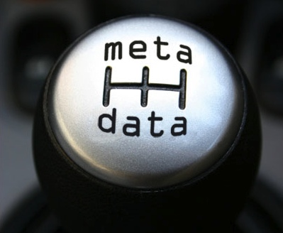
Amidst the Uncertainty
Notes:
So what is metadata? It’s the terms you use to describe your book. It’s what online shoppers see when they check Amazon, Goodreads, Google.

Slide 7
Required Metadata
ISBN
Title
Contributor/Author
Price
Format
Notes:
These are the five basic fields every vendor requires – they are the lowest common denominator.

Slide 8
Important-to-Have Metadata
Publisher name
Pub date
Availability
Page count (length)
Language
Dimensions (if any)
Notes:
These are sort-able, search-able fields. They help your vendor decide when your book will be put up for sale on their site, where it will reside in their warehouses, to whom they will market it.

Slide 9
…And There’s More
Territorial rights
Age range of audience
Series information
Edition description
Carton quantity
Replaces another product?
Notes:
Each of these is critical in its own way for decent book sales.

Slide 10
…And More
Description
Cover image
BISAC categories
Keywords
Reviews
Other formats the book is available in
Notes:
Finally, these are the marketing data items. Without these, your book might as well be invisible.

Slide 11
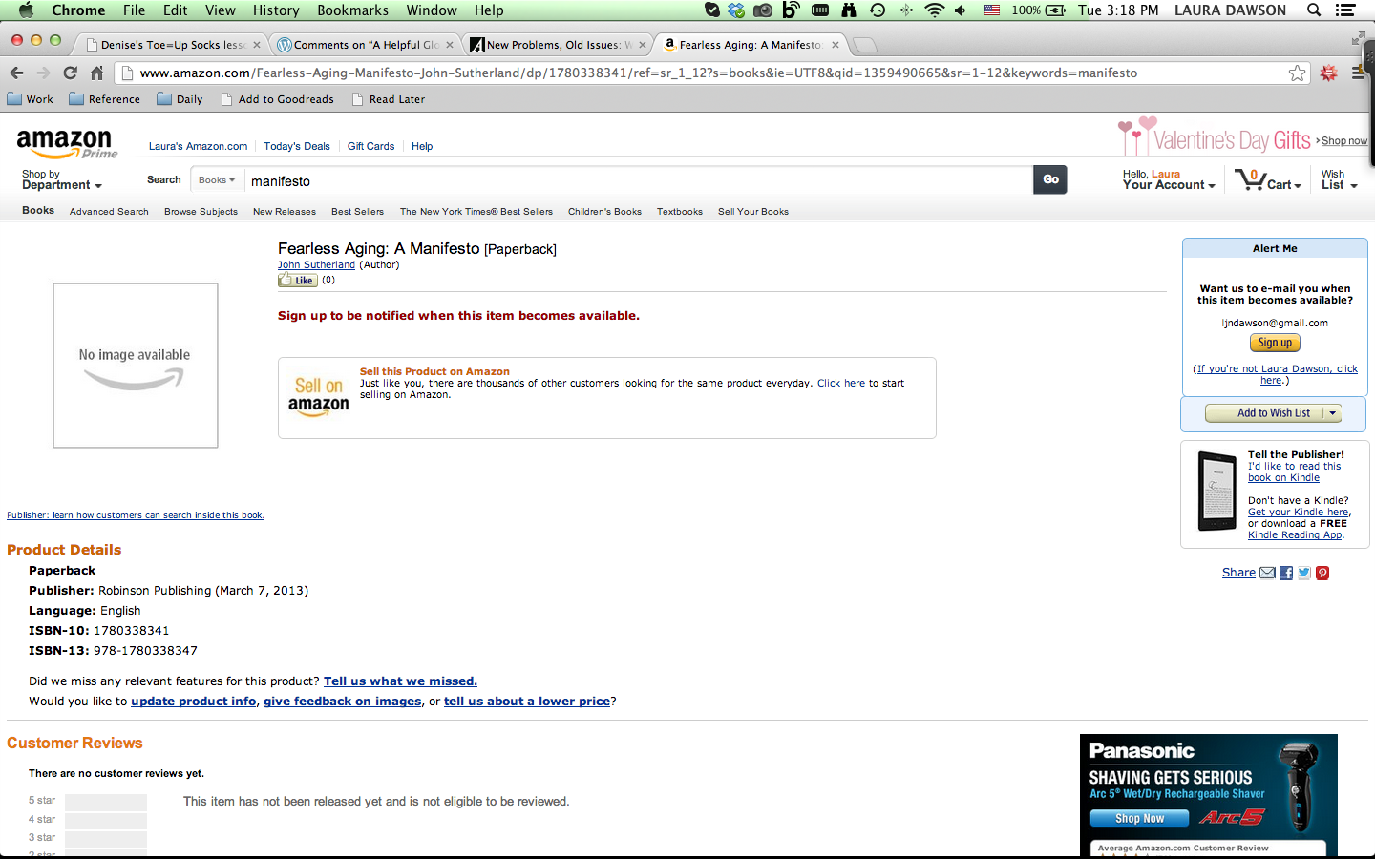
Book Listing with Required Metadata Only
Notes:
Not very inspiring. Does this make you want to buy the book? How can it, if you really don’t have a good sense as to what it’s about?

Slide 12
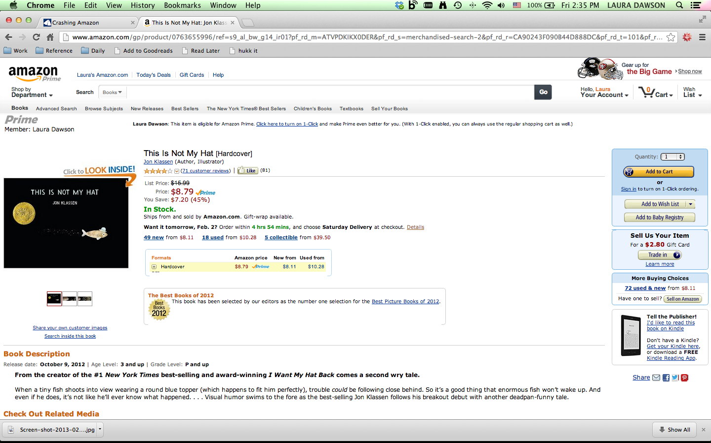
Book Listing With Rich Metadata
Notes:
This is much more fun to look at – it includes the “look inside” content, describes what the book is about. I’m not showing this hear, but when you scroll down to the bottom, you can see links to other books with the same categories.

Slide 13
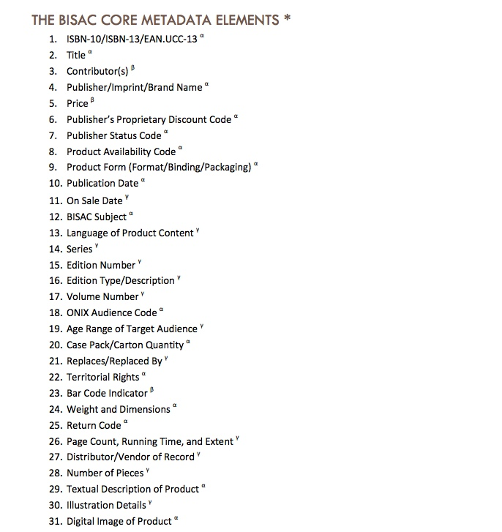
BISG Metadata Best Practices
Notes:
BISG has a list of core metadata elements for organizations sending out metadata to vendors and data aggregators. (I’ve included a link at the end of this presentation)

Slide 14
Nielsen Study - UK
Titles that meet the BIC Basic standard see average sales 98% higher than those that don’t meet the standard
The addition of an image has a strong impact on average sales, of 268% in comparison to titles without an image
Split into offline and online sales, offline sales see an increase of 35% for titles which have all enhanced metadata elements present, whereas online sales see a massive 178% increase
Notes:
The BIC Basic standard is the UK equivalent of the BISG best practices.
Cover images are vital for online sales.
As you can see, good metadata is much more powerful for online sales than offline. Indie publishers have to rely more and more on online sales for growth, so this is extremely important.

Slide 15
When Your Baby Leaves Home
Notes:
So that’s what you send. But once the data leaves the house, what happens to it?

Slide 16
The Word Spreads
Notes:
It gets ingested. By whoever you send it to, and whoever THEY send it to.
And as with any game of telephone, sometimes the message gets garbled over time.

Slide 17
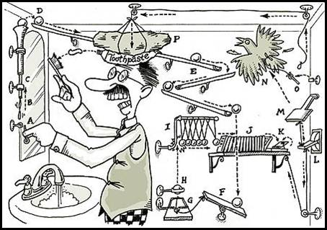
It’s Complicated
Notes:
Data from one source gets overwritten by another.
Data sources get ranked – there are business rules around whose data has the right to overwrite other data.
And it does get Rube-Goldbergian at times. At Barnes & Noble, for example, publishers had to earn the right to overwrite data from Ingram and Bowker. Why? Because experience had taught us that publisher data could not generally be relied upon. Distributor/aggregator data was more accurate.
That was when there were 900,000 books in print. There are now 32 million books in print. Vendors are, as I mentioned, drinking from the fire hose. However Rube-Goldbergian it was back then, it’s far, far more intricate now. There are many, many more data sources originating from many, many more organizations. And the algorithms at bookseller websites are phenomenally complicated.

Slide 18
Potential Hidden Data Sources
Distributors (Ingram, B&T, Bookazine, Perseus, etc.)
Data aggregators (Bowker, Ingram, B&T, OCLC)
Book-in-Hand programs (at vendor or distributor)
Vendor editorial/data entry team
Notes:
Tracing the places where your book metadata has gone wrong can be quite a wild goose chase.
Book in Hand programs are usually done at warehouses where staff literally checks the data against the physical book. This can cause problems when the book is designed in a way that doesn’t make it clear, for example, what the title is vs the subtitle, or who the main author is, or how many pages it has. For years there’s been a raging debate on the “page count” field (do you include front matter? Indexes, annotations, end-notes?).
And most bookselling websites have a team of editors who have manual override privileges on data fields, which cannot be overwritten by a data feed, so each further correction must be done manually as well.

Slide 19
Notes:
Any one of these fields could get overwritten due to a data feed with bad data in it.

Slide 20
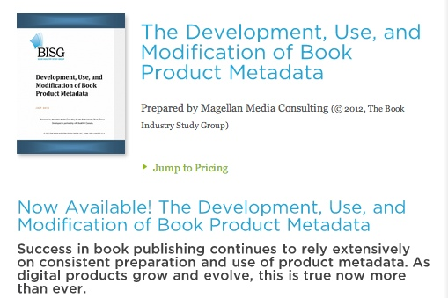
BISG Study on Metadata
Notes:
Researched and written by Brian O’Leary, this BISG study on metadata has wonder explanations of the potential pitfalls of all this book information zinging around the supply chain. Brian traces metadata feeds from publisher to aggregator to vendor very effectively and there are some surprising finds.
The report costs $50, but there’s an overview/summary available for free on the BISG website.

Slide 21
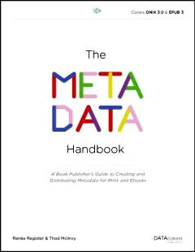
The Metadata Handbook
Notes:
Written by Renee Register and Thad McIlroy, The Metadata Handbook covers the entire metadata lifecycle from book acquisition at the publishing house to final sale to the consumer. It’s invaluable. It’s $99, but Renee just gave a presentation this morning and I’m sure TOC will have those slides up in short order so you can find out more about the book and see if it’s relevant to what you need.

Slide 22
Prescription
Notes:
Watch. Monitor your metadata. It’s that simple – you won’t know something’s wrong unless (a) you see it yourself or (b) someone tells you. But do you really want anybody telling you? It seems like a clumsy idea – and it is! – but because there are so many places that metadata can go wrong, it’s also essential. You have no control over how someone is going to use your book information. It’s not copyrightable, and vendors will of course list books however they feel their consumers want to see them listed. But you can prevent egregious errors by keeping an eye out on your book listings, and contacting the vendor when things go wrong.
Remember the hidden data sources! If you work with a distributor, and you see a bad listing for your book on Amazon, contact the distributor to find out what they’ve got for your book record.

Slide 23
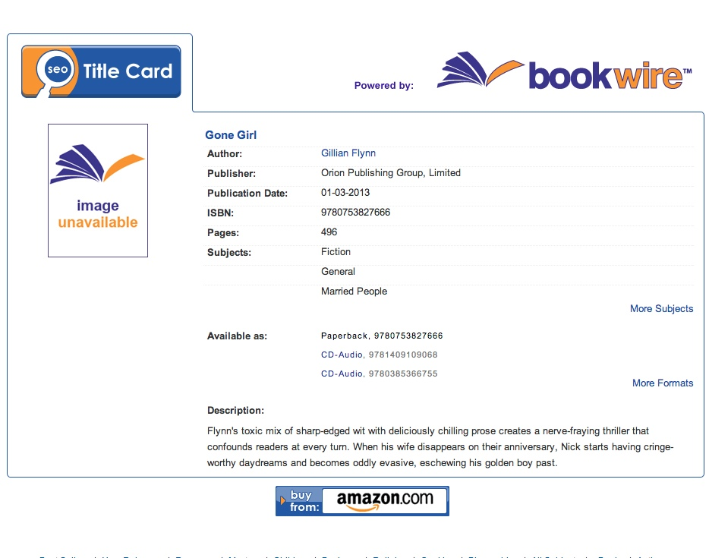
Bookwire
Notes:
If you’re listed in Books in Print, contact Bowker (you can check your listing online at www.bookwire.com). This is a good example because of course Gone Girl is a bestselling novel. But they never sent us the cover image. They sent it to Amazon, BN, other sites they deemed important – but it’s a good example of how data transmission is not always neat and orderly, and how one organization doesn’t always send out a consistent data feed to other organizations. Any website that is heavily reliant upon Bowker data is not going to get the cover image for this book unless they get it from a different source.

Slide 24
Useful Resources
http://www.bisg.org/docs/Best_Practices_Document.pdf
http://www.nielsenbookdata.co.uk/uploads/3971_Nielsen_Metadata_white_paper_A4(1).pdf
http://www.bisg.org/publications/product.php?p=27
http://themetadatahandbook.com/

