Slide 1
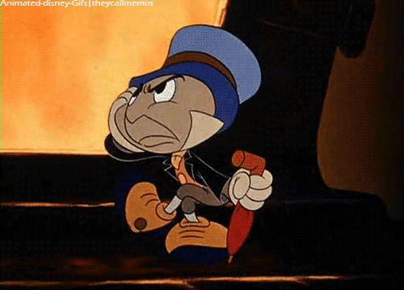
The Impatience Economy
Notes:
http://media.tumblr.com/tumblr_lxpw4y5Oxn1qm6oc3o1_500.gif

Slide 2
Notes:
Shows that the amount of time people are willing to wait has gone down from 10 days to 10 mins in 1 generation.
http://www.kana.com/sites/default/files/press-releases/kana-uk-impatience-index-survey.pdf

Slide 4
Impatience Index: 10 days → 10 minutes in 1 generation
http://www.kana.com/sites/default/files/press-releases/kana-uk-impatience-index-survey.pdf
Notes:
These Gen Y kids – 18-24 year olds check their devices every 9 mins 50 seconds
Compared to 55-64 year olds who check every 90 mints
They are wired differently
Getting in with Gen Y is a “do or die” initiative for digital service providers.
Gen Y.1 are 31 Million Consumers ages 18-24 years who are financially inexperienced and uncommitted to any one service provider.
Gen Y.2 are 42 Million Consumers who encompass ages 25-34 and are tech-savvy consumers, highly engaged in financial services, with a greater appetite for banking products.
Men are generally more impatient than women. Men will check a device for responses on average every 22 minutes, 30 seconds.
Women will check every 26 minutes, 15 seconds.
The 65+ age group checks devices more frequently than the 45-64 year old group, reflecting the time they have available and their newly developed digital capabilities. This suggests digitally enabled pensioners will become the prolific and demanding complainants within five years.
One-fifth of all social media users will check for a response at least once an hour, with one in 20 checking every 10 minutes or more
Those stats are interesting also relevant were the most frequently checked devices across all age groups. Here is a sample:
Email on smartphone – every 36 minutes
Checking Twitter for replies – every 39 minutes
Checking phones for texts – every 48 minutes
Checking Facebook for messages – every 57 minutes

Slide 5
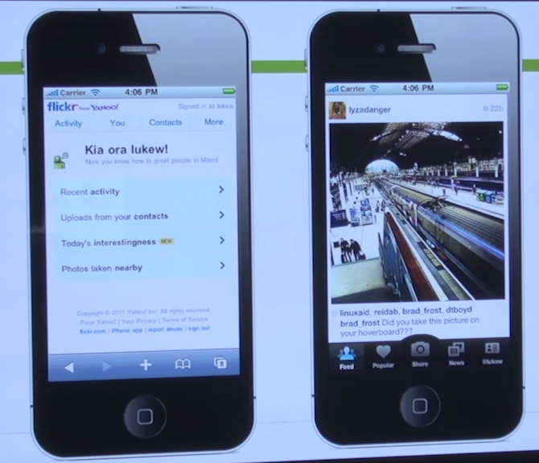
“People don’t like to wait while they are waiting”
Mike Krieger, co-founder of Instagram
https://www.youtube.com/watch?v=qlEJV_xUu6k
Notes:
And even when they have to wait, they are clicking and swiping – and they don’t like to wait while they are waiting..
Newly minted Googler & interface expert Luke Wroblewski here provides an interesting 5-minute tour of what works & what doesn’t in mobile interface design. In emphasizing the need to get people to the good stuff fast, he includes a great quote from Instagram co-founder Mike Krieger: mobile apps fill potholes of boredom, and “People don’t like to wait while they wait.” The whole thing is worth a watch:

Slide 6
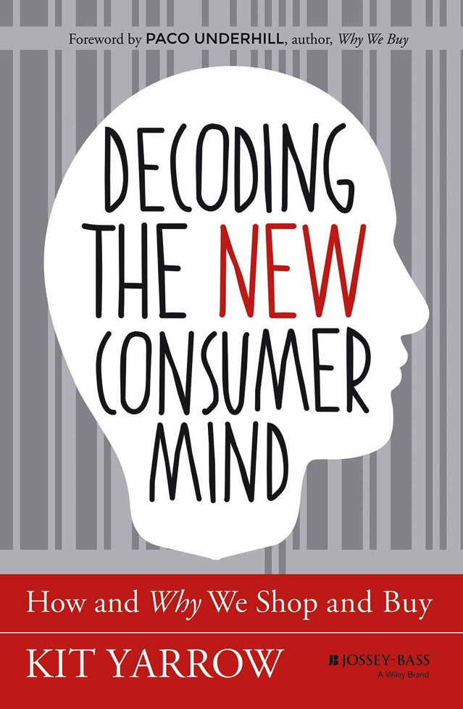
The Digital World… trains us to want everything faster
We’re more easily distracted… have less tolerance for … nearly everything that requires patience.”
Notes:
Kit Yarrow studies these kids and has just written a book about how this rewiring is affecting the New Consumer Mind.
March 2014
Kit Yarrow, Ph.D., is an award-winning consumer psychologist, a professor, author, consultant and speaker. Her home base is Golden Gate University, where she is a jointly appointed professor of both psychology and marketing. Kit's unique ability to apply clinical psychology to the field of behavioral economics has won her four endowed research professorships and recognition as the 2012 Outstanding Scholar of Golden Gate University. Kit's been a visiting professor at the Helsinki School of Economics and has taught consumer behavior at universities around the world - from Malaysia to Slovenia.
As part of her ongoing research on the psychology of consumers, Kit conducts interviews and ethnographies on a regular basis. She shares her findings and analysis in her books, Decoding the New Consumer Mind (Wiley, 2014) and Gen BuY (Wiley, 2009) and in her articles and blogs for Time and Psychology Today. Kit also regularly presents her findings and analysis in her popular keynote speeches. As a widely recognized authority on the psychology of consumers - and on Generation Y in particular - Kit is regularly quoted in a variety of media including The New York Times, The Wall Street Journal, NPR, and Good Morning America.
Please visit www.kityarrow.com

Slide 7
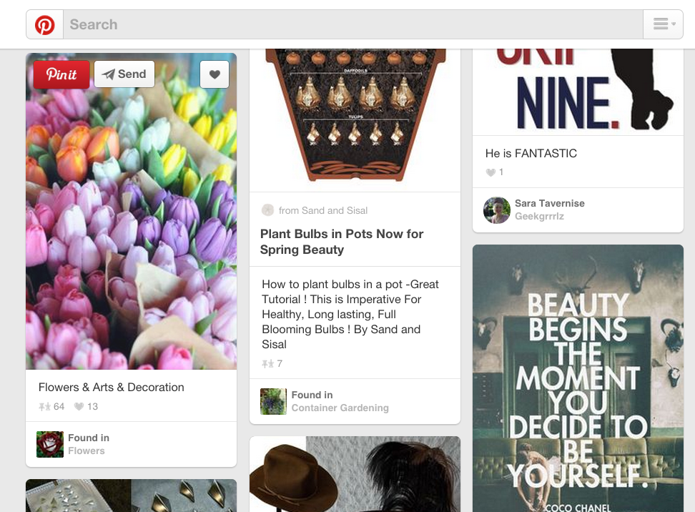
Colors, Likes, Pins

Slide 8
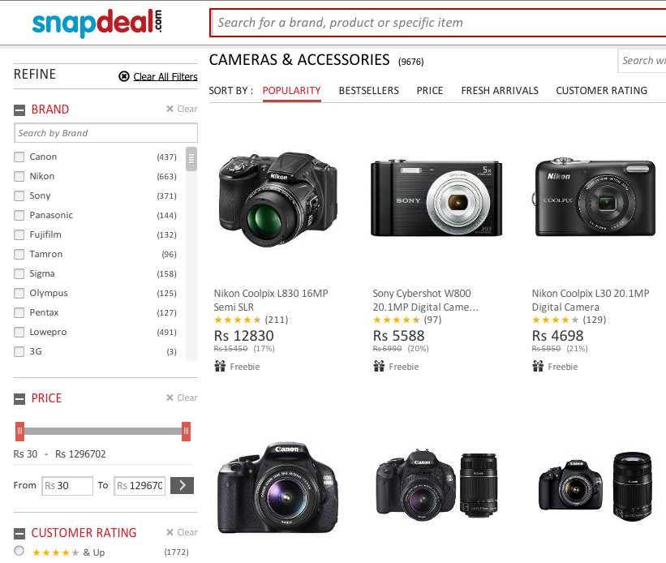
Search, Sort, Recommend… Personalize

Slide 9
1 second Faster leads to 2% better Conversions
http://blog.radware.com/wp-content/uploads/2014/10/Radware_SOTU_Fall_2014_Infographic_Final.gif

Slide 10
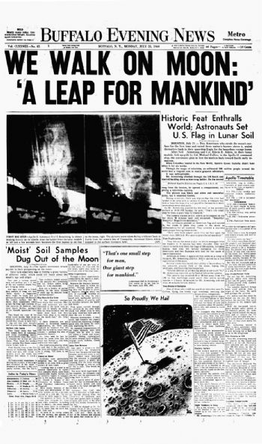
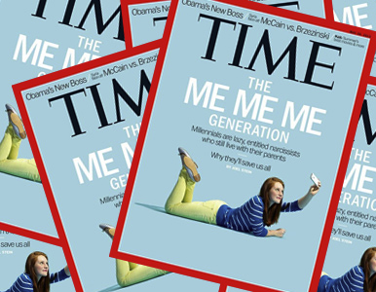
Advertising funds traditional media
Notes:
Growing 5.6%
http://www.emarketer.com/Article/Global-Ad-Spending-Growth-Double-This-Year/1010997
Global advertising market - $515B in 2014 – magna global - http://www.statista.com/chart/1188/global-advertising-forecast/
http://www.journalism.org/2014/03/26/revenue-sources-a-heavy-dependence-on-advertising/#fn-42398-2
2/3 of all news media revenue in US from advertising

Slide 11
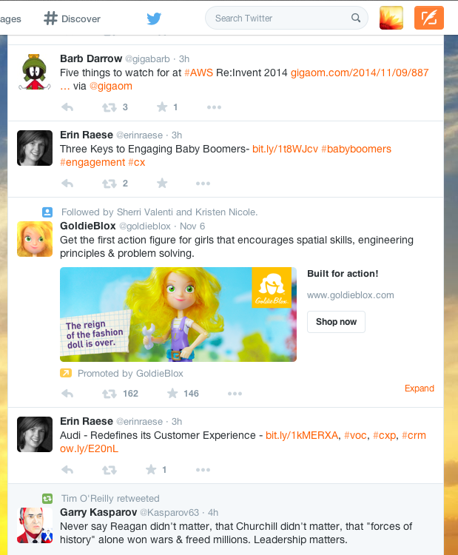
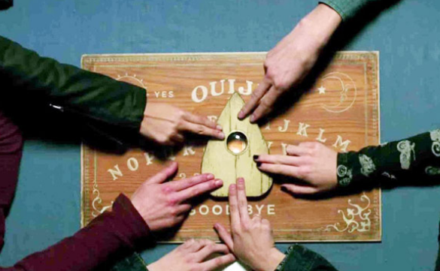
Advertising funds the Internet
Notes:
http://www.emarketer.com/Article/Global-Ad-Spending-Growth-Double-This-Year/1010997
25% of Ads are Digital Ads

Slide 12
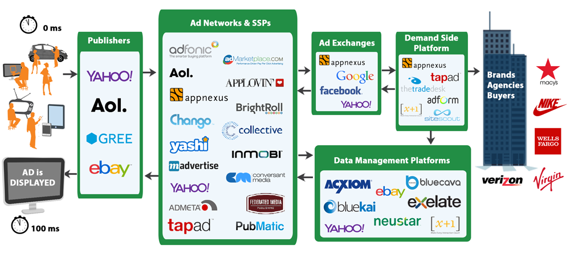
Real-Time Bidding (RTB) Personalizes the Internet
You Snooze You Lose… 5 Milliseconds to Decide…
Notes:
($10B in 2014) – 100 Milliseconds
Each party has just a few milliseconds to decide.
http://www.emarketer.com/Article/US-Programmatic-Ad-Spend-Tops-10-Billion-This-Year-Double-by-2016/1011312
$10B in 2014
Doubling by 2017

Slide 13
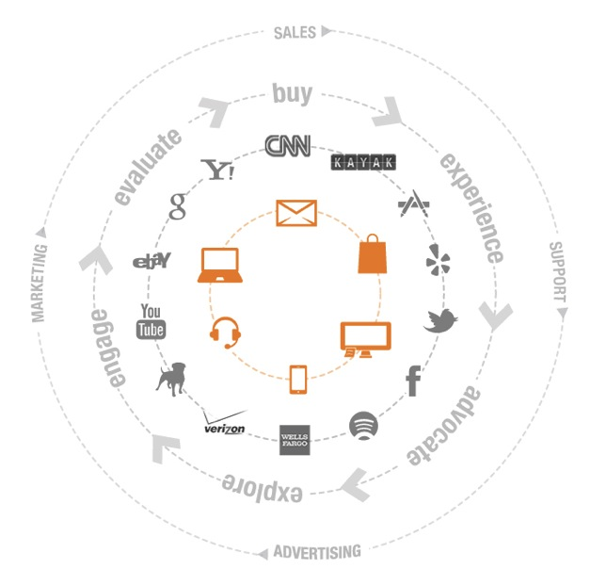
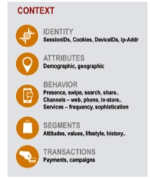
Personalizing Experiences across the Internet
Notes:
You need Velocity to handle this Volume
http://www.jeffbullas.com/2012/04/23/48-significant-social-media-facts-figures-and-statistics-plus-7-infographics/
1 Million Mobile Apps in both Google Play and iTunes
http://www.nielsen.com/us/en/insights/news/2014/smartphones-so-many-apps--so-much-time.html
ABI Research: The installed base of active wireless connected devices will exceed 16 billion in 2014, about 20% more than in 2013. The number of devices will more than double from the current level, with 40.9 billion forecasted for 2020. 75% of the growth between today and the end of the decade will come from non-hub devices: sensor nodes and accessories. The chart below is from ABI’s research on smart cars.

Slide 14
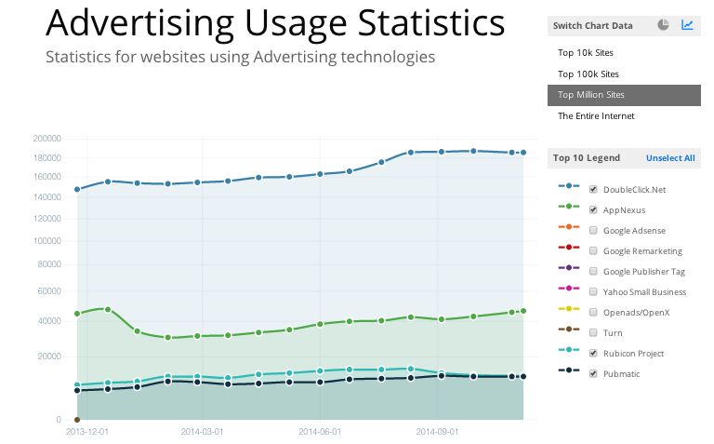
AppNexus - 30 Billion Impressions per Day
*Screen shot from BuiltWith.com /advertising
Notes:
Largest Independent Ad Exchange
Google doubleclick sees 185,588 sites
AppNexus sees 46527
30B is 700k Impressions per second
Founded 2007

Slide 15
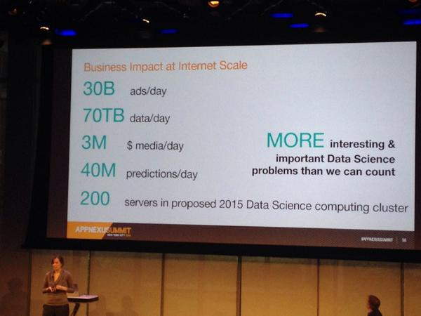
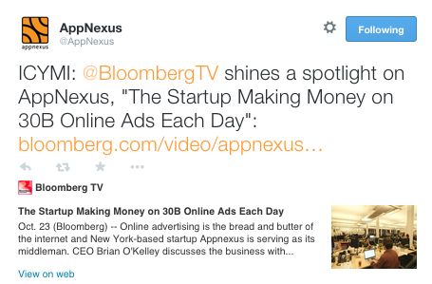
3M Reads per Second + 1.5M Writes per Second
Low Latency + High Throughput
Notes:
$2B in Ad Spend in 2014
Revenues net $100M

Slide 16
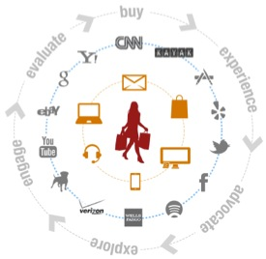
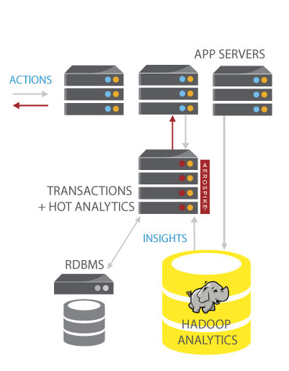
The New Stack – Hadoop Analytics + Hot Analytics
Velocity @ Volume → Personalization
Notes:
Personalization → Profits

Slide 17
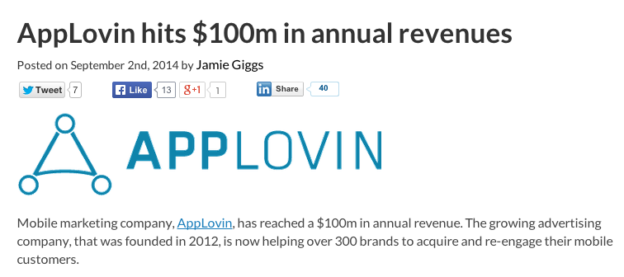
AppLovin –20 Billion Requests per Day - Every US Mobile User
Notes:
http://www.istockphoto.com/photo/dedicated-to-their-device-48728288?st=f373b68
http://blog.applovin.com/how-do-gender-and-platform-predict-mobile-advertising-and-mobile-commerce-behavior/
Founded 2012

Slide 18
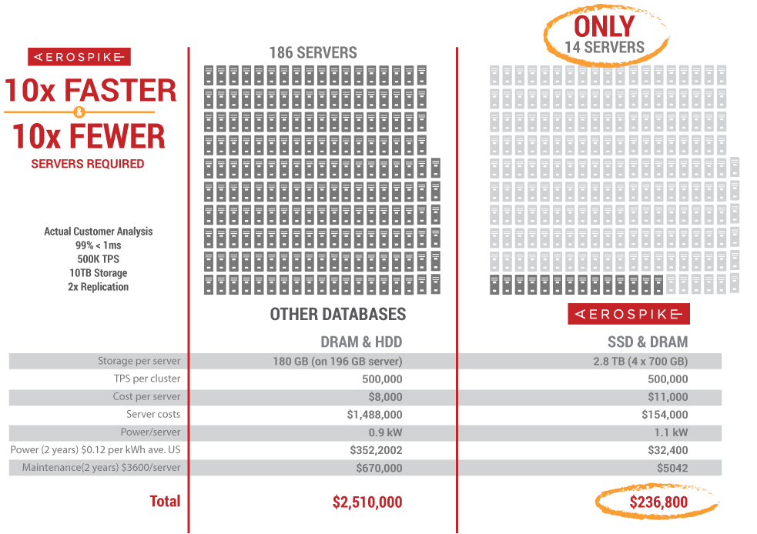
Velocity @ Volume + Economics of Flash
Notes:
Do More with Less

Slide 19
Velocity @ Volume + Economics of Flash → Profits

Slide 21
@raydiate monica@aerospike.com

